Slide 1
Fundamentals in Data Engineering
Thiago de Paiva
p7392@ulusofona.pt
https://github.com/tgvp

Slide 2
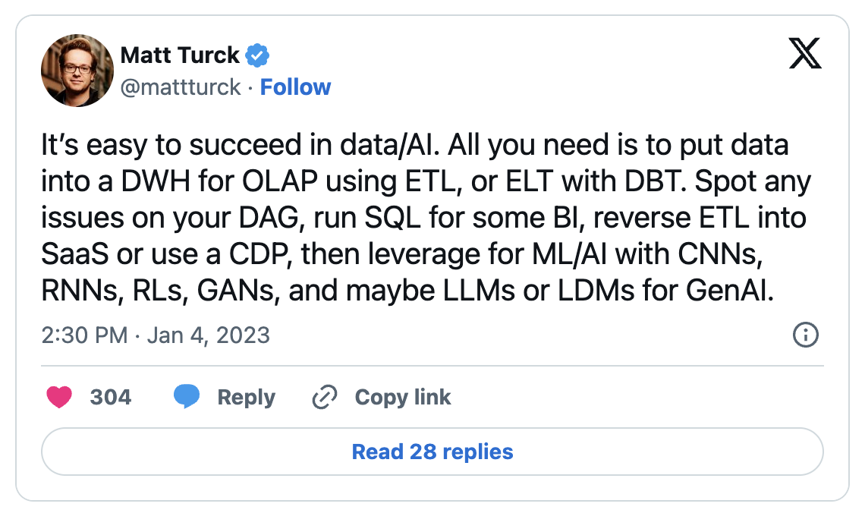

Slide 3





Data preparation example: reseach
Use-Case-Specific
Fit for purpose
Self-Service
Data Preparation
Raw Data
Transactions
Sensors
Log Files
Experiments
What you mostly learn at University
Notes:
“quem está procurando respostas para questões específicas. A ideia é que as pessoas que estão mais próximas dos dados, e então entendem melhor, devem ser as pessoas extraindo e analizando”

Slide 4


Data Integration from different sources must be centralized
Example: University data (contracts, student info, grants, etc…) – must be centrally managed
Raw Data
Transactions
Sensors
Log Files
Experiments
Data Integration
Source of Truth
Governed
Secure
Audited Managed
Alternative picture, but more traditional
Data must be integrated into the system, checked for correctness, verified, audited and managed
Notes:
“A key distinctive of ETL procedures and tools is that they are designed as elements of a formal workflow intended for use by IT professionals”

Slide 5
ETL
Extract: Collect raw data usually from multiple sources - Example: transactions, sensors, logs, user activity, databases, API streams, etc
01
Transform: Clean, validate, and convert data into standardized formats and schemas according to business rules.
02
Load: Store the processed data into target systems such as data warehouses, databases, or analytics platforms.
03

Slide 6
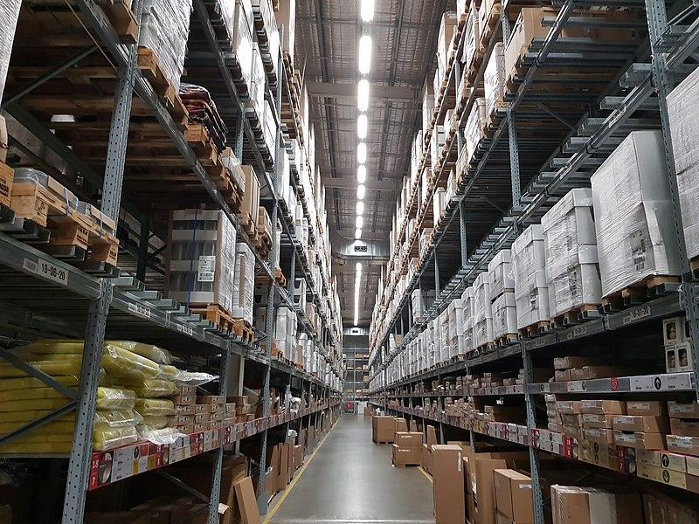

What kind of solutions?
Data Warehouse, (~1990s)
- “Single source of truth”: A centralized, structured repository for enterprise analytics
Schema is designed upfront (schema-on-write)
Data comes from trusted, curated sources
Data is transformed before loading to fit the warehouse schema
Optimized for reporting, BI, and structured queries
Data Lake, (~2010s)
“Landing zone”: Scalable storage for raw data in any format
Schema applied on demand (schema-on-read)Stores structured, semi-structured, and unstructured data
Extract → Load → Transform (ELT)
Transformations happen when data is needed for analysis
Data catalog evolves as datasets are reused

Slide 7
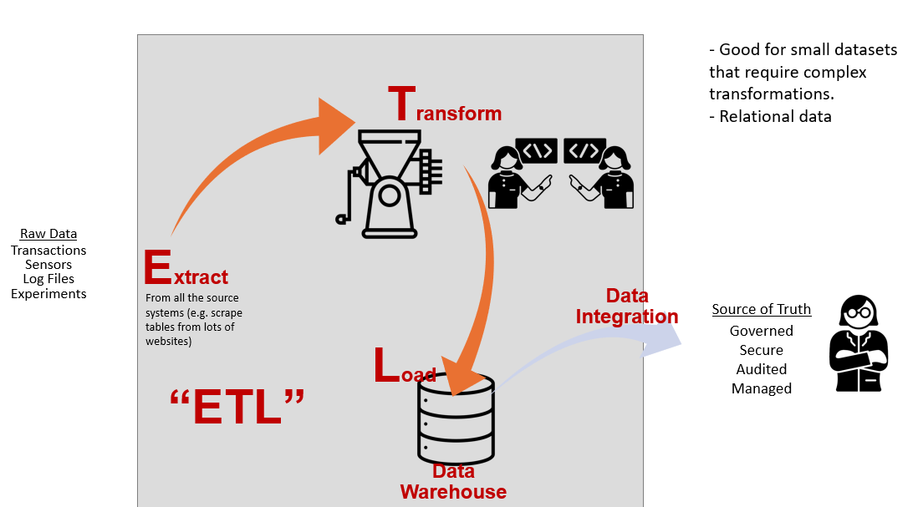
Data Pipeline Architectures

Slide 8
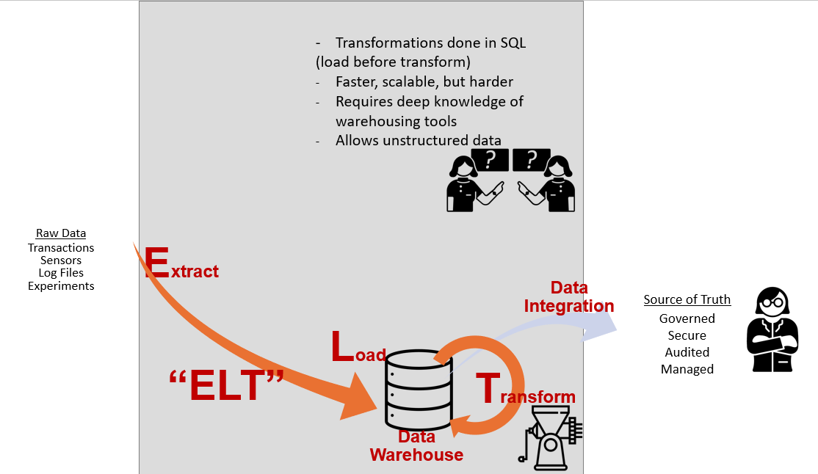
Data Pipeline Architectures

Slide 9
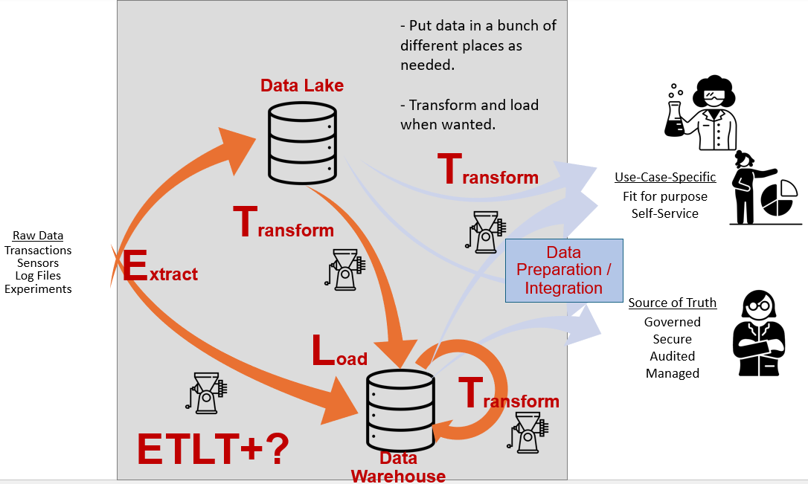
Data Pipeline Architectures

Slide 10
How Do We Understand Our Data?
Data Discovery & Data Assessment
Ad hoc exploration: End users retrieve, explore, and label data
Systematic discovery: Scanning and profiling datasets in the data lake
Content-focused analysis: Identifying data types and potential analytical value
Human expertise + AI-assisted analysis

Slide 11
How Do We Understand Our Data?
In a data lake, data often arrives without structure.
We need to profile it.
We need to classify it.
Sometimes this is manual.
Increasingly, AI helps with this process.
Discovery turns unknown data into usable assets.

Slide 12
How Do We Understand Our Data?
Data Quality & Integrity
Integrity checks (e.g., uniqueness, null constraints, referential integrity)
Business rules defined by humans, increasingly supported by AI
Data is dynamic and constantly evolving
Validation mechanisms can reject or quarantine invalid data
Example: No two products should share the same product ID
Data quality is not a one-time task — it is an ongoing process

Slide 13
Metadata
Application Metadata: describes what the data means
Entities (e.g., students, courses, employees)
Relationships between entities
Constraints and business rules
Behavioral Metadata: what happened to the data
Data lineage — Where did the data originate?
Audit trails — Who accessed or modified the data?
Job execution history
Change Metadata: how the system evolved
Versioning information
Schema evolution
Historical tracking of structural changes

Slide 14
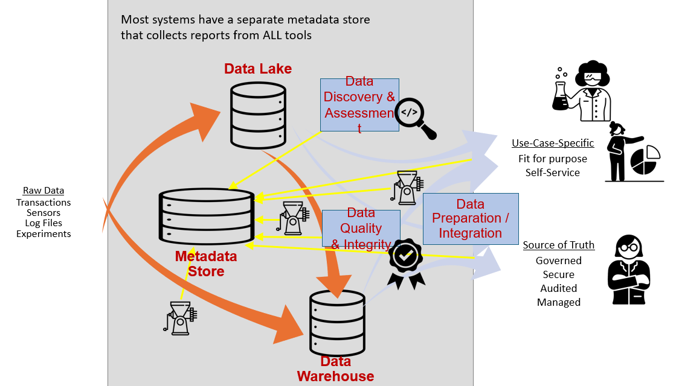
Data Pipeline Architectures

