Slide 1
Fundamentals in Data Engineering
Thiago de Paiva
p7392@ulusofona.pt
https://github.com/tgvp

Slide 2
Containers & Microservices
Foundations for Modern Data Systems with focus on containers and microservices

Slide 3
Historical Context: Early 2000s
Applications ran directly on physical servers
Hardware underutilization
Manual configuration
Dependency conflicts
Poor scalability and recovery

Slide 4
The Rise of Virtual Machines
Hardware → Hypervisor → Guest OS → Application
Hypervisor: A software layer that enables multiple virtual machines to share the same physical hardware by allocating and managing computing resources.
Guest OS: The operating system installed inside a virtual machine, running independently on top of the hypervisor as if it were on a physical machine.

Slide 5
The Rise of Virtual Machines
Hardware → Hypervisor → Guest Operating System → Application
Full operating system per VM Each VM includes its own kernel and system libraries.
Strong isolation VMs are isolated at the hardware level through the hypervisor.
High resource overhead Memory and storage are consumed by duplicated operating systems.
Slower provisioning Booting a VM requires starting a complete operating system instance.

Slide 6
Limitations of Virtual Machines
Large disk footprint
Redundant operating systems
Memory overhead
Slow startup times
Operational complexity

Slide 7
Containers A Paradigm Shift
Hardware → Host OS → Container Runtime → Containers

Slide 8
Containers: A Paradigm Shift
Virtualizes the application layer Containers isolate applications while sharing the host operating system kernel, avoiding the need for separate guest OS instances.
Uses Linux namespaces Namespaces provide process-level isolation by separating resources such as process IDs, networking, file systems, and users.
Uses control groups (cgroups) cgroups limit and manage CPU, memory, disk I/O, and network usage for each container.
Layered filesystem architecture Container images are built in immutable layers, enabling efficient storage, caching, and reproducibility.

Slide 9
VM vs Container Comparison
VM: Full OS, high overhead, slower startup
x
Container: Shared OS, lightweight, fast startup
Higher portability
Better scalability
Lower resource consumption

Slide 10
What Is Docker?
Containerization platform
Packages applications with dependencies
Automates deployment
Ensures reproducibility
Built originally in Go

Slide 11
Core Docker Components
Docker Engine
Docker Daemon
Docker CLI
Docker Images
Docker Containers
Docker Registry

Slide 12
Docker Images
Immutable templates
Built from Dockerfile
Layered architecture
Ensures reproducibility
Optimizes storage via layers

Slide 13
Containers in Data Engineering
Reproducible pipelines
Environment versioning
Isolation of dependencies
CI/CD integration
Cloud portability

Slide 14
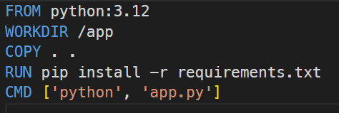
Dockerfile Example
What Each Instruction Does:
FROM → Defines the base image (Python 3.12 runtime)
WORKDIR → Sets the working directory inside the container
COPY → Copies application files into the container
RUN → Installs dependencies during image build
CMD → Defines the default command executed at container startup

Slide 15
Multi-Service Architectures
Application Service Handles business logic and API endpoints.
Database Service Stores structured or unstructured data.
Cache Service Improves performance by storing frequently accessed data.
Message Broker Enables asynchronous communication between services.
Monitoring & Logging Tools Provide observability and operational insight.

Slide 16
Docker Compose
Docker Compose is a tool used to define and manage multi-container applications.
Define multiple services Describe all application components in a single configuration file.
Automatic network management Creates an isolated virtual network for service communication.
Startup dependency control Ensures services start in the correct order.
Volume configuration Manages persistent storage outside container lifecycles.
Single YAML configuration file Infrastructure defined declaratively using docker-compose.yml.

Slide 17
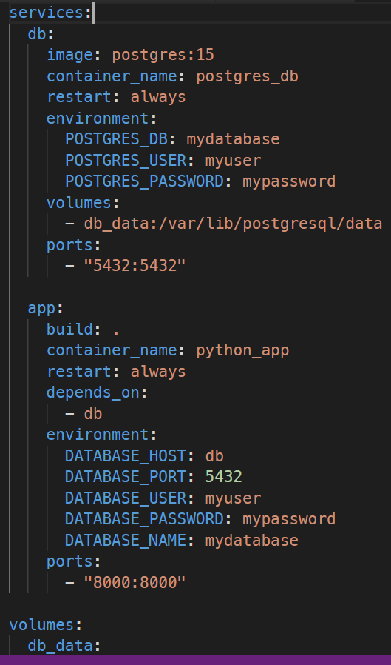
Docker Compose Example

Slide 18
Data Persistence
Containers are ephemeral When a container is removed, its internal filesystem is destroyed.
Volumes provide persistent storage Data is stored outside the container lifecycle on the host system.
Data survives container removal Containers can be recreated without losing database or application data.
Decouples storage from execution The application runtime becomes independent from the data layer.

Slide 19
Data Persistence
What Happens Internally?
The container writes data to a directory inside its filesystem.
Docker maps that directory to a volume stored on the host.
If the container is removed, the volume remains intact.
A new container can reattach to the same volume.

Slide 20
Data Persistence
Without Volume
Container deleted → Data lost.
With Volume
Container deleted → Data remains.

Slide 21
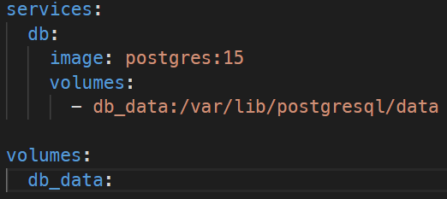
Data Persistence
/var/lib/postgresql/data → internal container path db_data → persistent storage on the host

Slide 22
Container Networking
Automatic internal DNS Docker automatically creates an internal DNS server for service discovery.
Service name communication Containers communicate using the service name defined in docker-compose.yml.
Isolated virtual network All services are connected through a private virtual bridge network.
Secure internal traffic Containers communicate internally without exposing ports externally.

Slide 23
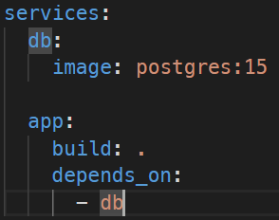

Container Networking
Inside the application:

Slide 24
Container Networking
Why Not Localhost?
Inside a container:
- localhost refers to the container itself.
- It does NOT refer to another container.
- It does NOT refer to the host machine.
- Each container has its own network namespace.

Slide 25
Databases in Containers
Why Run Databases in Containers?
Isolated testing environments Each project can have its own database instance without conflicts.
Fast setup and reset Databases can be created, destroyed, and recreated in seconds.
Reproducible development environments All team members use the exact same database version and configuration.
CI/CD ready Automated pipelines can spin up temporary database containers for testing.

Slide 26
Container Security
Minimize image size Use lightweight base images (e.g., slim or alpine variants) to reduce the attack surface.
Avoid running as root Configure containers to run as a non-privileged user to limit potential damage.
Scan for vulnerabilities Regularly scan images for known CVEs using security tools.
Avoid hardcoded secrets Never embed credentials directly in Dockerfiles or source code.
Use environment variables or secret managers Inject sensitive configuration securely at runtime.

Slide 27
Orchestration at Scale
As systems grow, a single host is no longer sufficient.
Multiple hosts Applications run across several machines in a cluster.
High availability If one node fails, services must continue running.
Load balancing Incoming traffic must be distributed across instances.
Auto-scaling The system should dynamically adjust to traffic demand.

Slide 28
Orchestration at Scale
Docker Swarm
Native to Docker
Simpler setup and configuration
Easier learning curve
Suitable for small to medium clusters
Limited ecosystem compared to Kubernetes

Slide 29
Kubernetes
Advanced orchestration platform
Automatic scaling (Horizontal Pod Autoscaling)
Self-healing (automatic container restarts)
Rolling updates and rollbacks
Large ecosystem and cloud integration
Industry standard for production systems

Slide 30
Docker and DevOps
Containers are foundational to modern DevOps practices.
Continuous Integration (CI) Automatically build and test applications inside reproducible container environments.
Continuous Deployment (CD) Deploy containerized applications consistently across environments.
Infrastructure as Code (IaC) Define infrastructure declaratively using configuration files (e.g., Docker Compose, Kubernetes YAML).
Microservices architecture Deploy independent, loosely coupled services in isolated containers.
Immutable infrastructure Replace containers instead of modifying running systems.

Slide 31
Docker in Modern Data Engineering
Containers are widely used across the modern data stack.
ETL jobs Batch data pipelines packaged as reproducible containerized tasks.
Stream processing Real-time processing services deployed as scalable containers.
ML model serving Machine learning models exposed as containerized APIs.
Distributed analytics Data processing frameworks deployed across clusters.
Cloud-native platforms Data services designed for scalable, container-based environments.

Slide 32
Installation (Windows)
Recommended: Docker Desktop + WSL 2 backend
Requirements: Windows 10/11 (64-bit), virtualization enabled in BIOS/UEFI
Install Docker Desktop and enable WSL 2 integration
After installation: verify using PowerShell commands
Docker: Accelerated Container Application Development
Install Docker Desktop

Slide 33
Installation (WSL)
If it fails, try this:
dism.exe /online /enable-feature /featurename:Microsoft-Windows-Subsystem-Linux /all /norestart
dism.exe /online /enable-feature /featurename:VirtualMachinePlatform /all /norestart
Install WSL with: wsl --install
Reboot then update it with: wsl --update
Set WSL2 as Default: wsl --set-default-version 2
Even if WSL is enabled, Docker will NOT work if virtualization is disabled.
Check: Task Manager → Performance → CPU You must see: Virtualization: Enabled

Slide 34
Installation (MacOS)
Recommended: Docker Desktop (Intel or Apple Silicon)
Install Docker Desktop and start the Docker daemon
Grant permissions when prompted (networking / file sharing)
After installation: verify using Terminal commands

Slide 35
Verify Installation
docker --version docker compose version docker run hello-world # list containers docker ps –a
# list images docker images

Slide 36
Practice 1 — Explore a Container (CLI Basics)
Goal: run a container, inspect it, and understand basic isolation
Use an official image and core Docker commands
Focus: containers are processes + isolated filesystem + isolated network namespace

Slide 37
Practice 1 — Commands
# 1) run an interactive shell docker run -it --name demo-ubuntu ubuntu:24.04 bash # inside the container: cat /etc/os-release uname -a ls -la exit # 2) inspect from the host: docker ps -a docker inspect demo-ubuntu # 3) remove when done: docker rm demo-ubuntu
Key idea: container ≠ VM • A container shares the host kernel

Slide 38
Practice 1 — What to Observe
Filesystem view differs from the host (root '/', /etc, /usr, ...)
Kernel is shared (uname shows the host kernel)
docker inspect reveals mounts, network settings, and container metadata

Slide 39
Practice 2 — Docker Compose (Two Services)
Goal: start a PostgreSQL database + a lightweight admin UI
Learn: services, ports, volumes, and internal networking
Outcome: confirm database persistence across container recreation

Slide 40
Practice 2 — docker-compose.yml
Download the docker-compose.yml file from the github repository (/etc) and put inside the Project directory.

Slide 41
Practice 2 — Run and Test
# start services docker compose up -d # confirm containers are running docker ps # open Adminer in your browser # http://localhost:8080 # Server: db | User: labuser | Password: labpass | Database: labdb # stop (keeps volume) docker compose down # start again (data should persist) docker compose up -d # remove everything INCLUDING volume (data deleted) docker compose down -v
Ports expose services to host • Volumes persist database state

Slide 42
Practice 2 — Run and Test
Starts PostgreSQL on port 5432
Starts Adminer (DB Web UI) on port 8080
Creates a named volume db_data
Ensures database data persists
Connects both services via internal Docker DNS

Slide 43
Practice 2 — Key Concepts Reinforced
Service discovery: 'db' resolves via Compose DNS
Port mapping exposes container ports on the host
Volumes persist state until you remove them explicitly (-v)
Compose is ideal for local development and small deployments

Slide 44
Practice 3 — Use the extra-docker-compose.yml
# remove everything INCLUDING volume (data deleted) docker compose down –v
# create a rsc directory on the project root
mkdir rsc
# download the init.sql file from the git repository (/etc)
# put inside the rsc directory that you have just created
# copy the contents of the extra-docker-compose.yml and paste inside your project’s compose file
# start services docker compose up -d # confirm containers are running docker ps # open Adminer in your browser # http://localhost:8080 # Server: db | User: labuser | Password: labpass | Database: labdb # stop (keeps volume) docker compose down # start again (data should persist) docker compose up -d
Ports expose services to host • Volumes persist database state

Slide 45
Spoiler: Second Assignment
Create Git repository – it can be the same one used in the First Assignment
Build Python container
Configure PostgreSQL container
Connect with Docker Compose
Persist data with volumes
More details will be available soon

Slide 46
Assignment 2 (Preview)
Goal: package a small Python service + database as a reproducible multi-service environment.
Create a Git repository (you may reuse the one from Assignment 1)
Build a Python container (Dockerfile)
Configure a PostgreSQL container
Connect both services with Docker Compose
Persist data using volumes
More details will be available soon.

