Slide 1
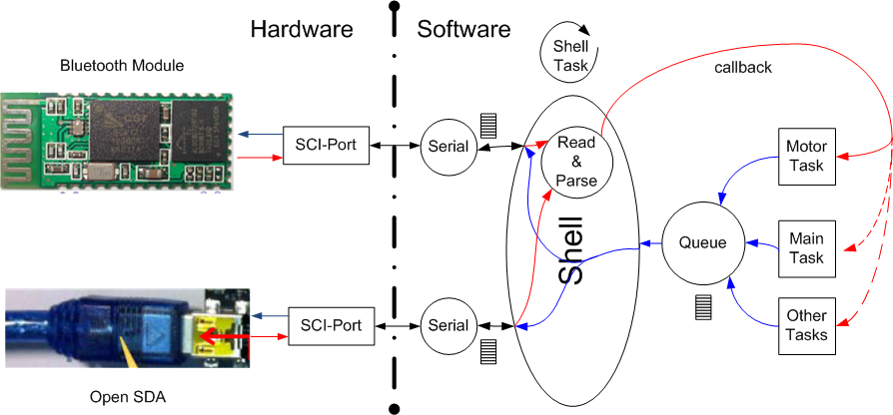

Slide 2
Shell Standard I/O
I/O structure with callbacks
Stdin: read char (Commands)
Stdout: write char (Answers)
Stderr: write char (Error)

Slide 3
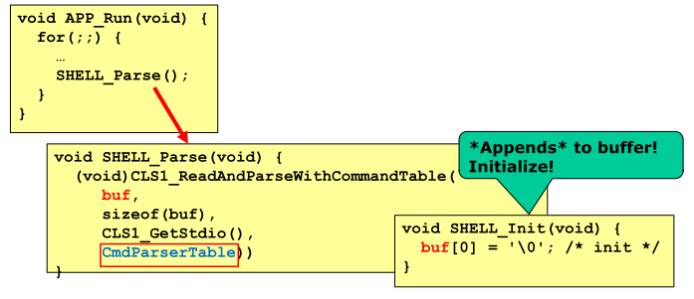
Shell Parser

Slide 5
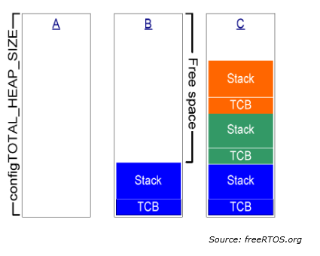
Memory Scheme 1

Slide 6
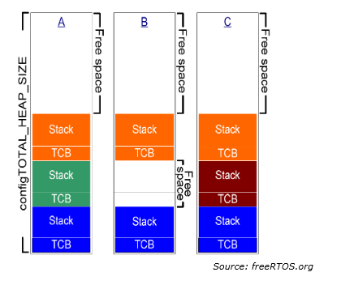
Memory Scheme 2

Slide 7
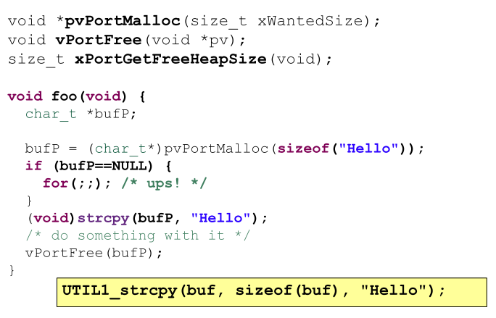
Malloc(), Free() Example

