Slide 1
Shell, USB and UART, Memory and Queue
Andreas Walker,
Ruedi Herger,
Reto Müller

Slide 2
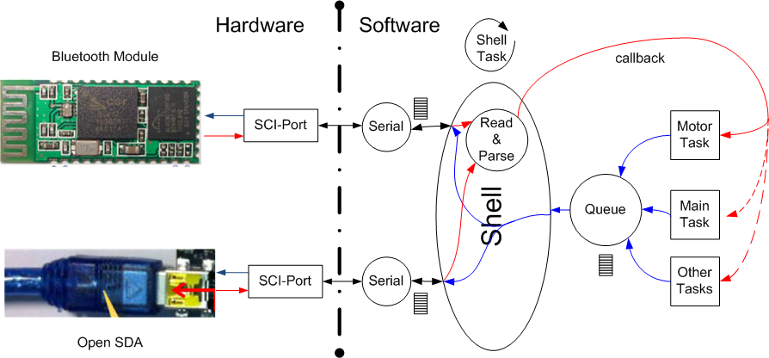

Slide 3
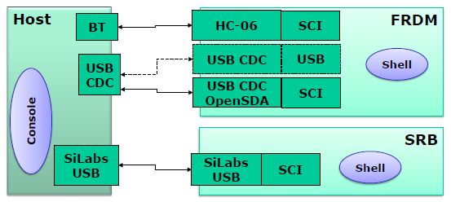
Ways to communicate
Bluetooth to a SCI port of the MCU
USB bridge to a SCI port of the MCU
( USB directly to a USB port of the MCU )

Slide 4
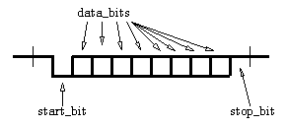
SCI Serial COM Interface (UART)
Wires:
Rx, receive line
Tx, send line
Additionally: flow control lines (not at the FRDM)
Protocol properties:
Asynchron, serial (no clock)
Fixed baudrate
Processor expert component: AsynchroSerial
-> Used by the Shell and Bluetooth component

Slide 5
USB
Wires:
2 power supply lines
2 data lines (differential signal, noise resistant)
Device types:
Host, device, OTG (On-The-Go)
Device classes:
CDC (Communication Device Class), HID, MSD, …
Protocol properties
Not bound to a fixed baudrate
Asynchron, serial, and asymmetrical (host requests to send data)

Slide 6
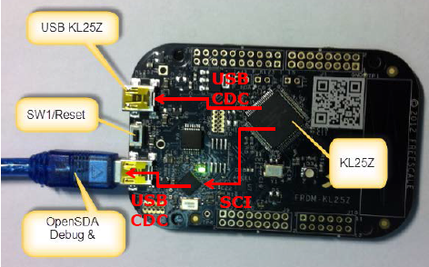
OpenSDA and USB CDC
K20 adapts USB CDC protocol to the KL25Z SCI (UART) protocol
Virtual COM port at the PC (USB CDC)
Handable like a UART protocol

Slide 8
Shell Standard I/O
I/O structure with callbacks
Stdin: read char (Commands)
Stdout: write char (Answers)
Stderr: write char (Error)

Slide 9
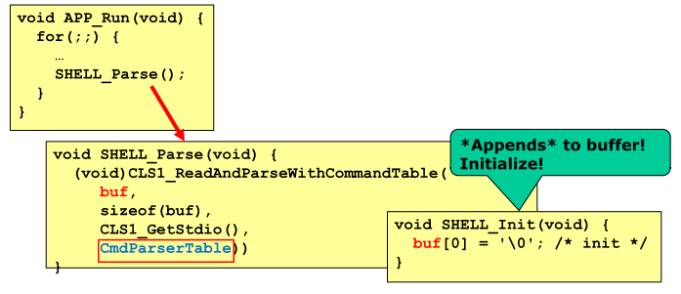
Shell Parser

Slide 11
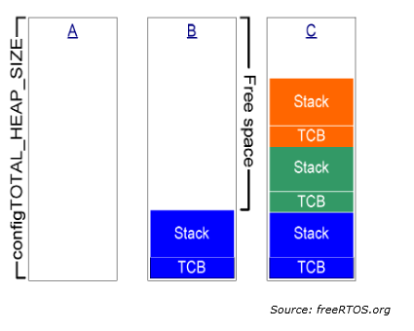
Memory Scheme 1

Slide 12
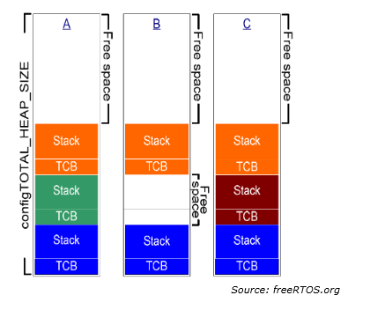
Memory Scheme 2

Slide 13
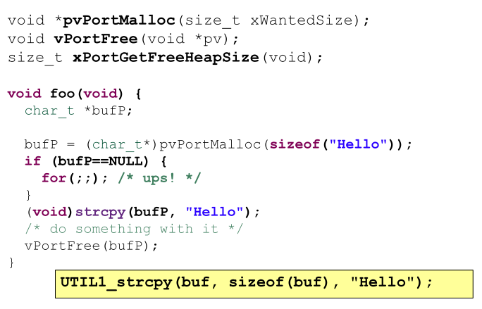
Malloc(), Free() Example

Slide 15
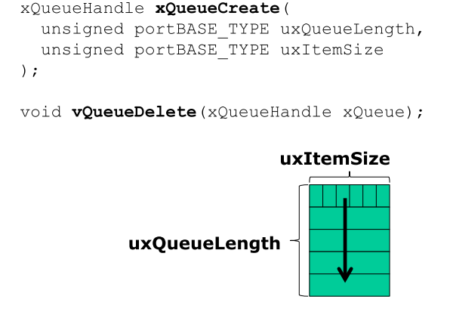
Queue Create & Delete

Slide 16
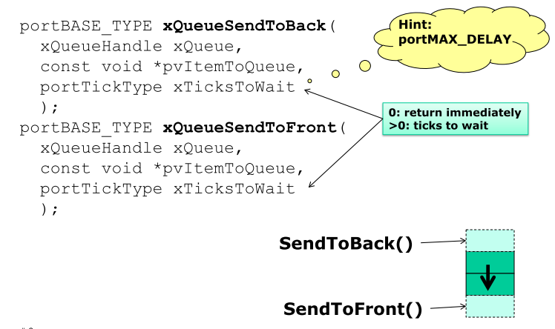
Queue Send

Slide 17
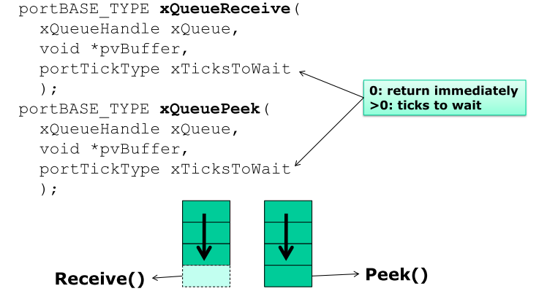
Queue Receive & Peek

