Slide 1
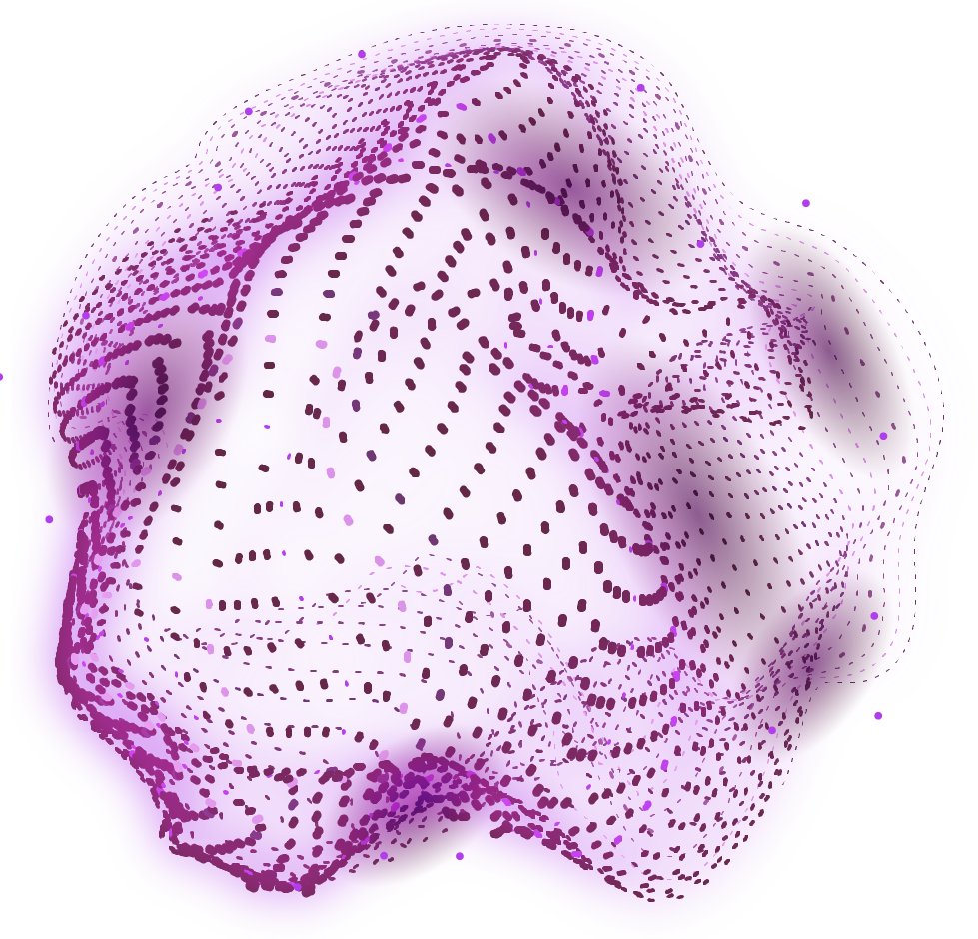


SNAKE GAME (AI)
Mini PROJECT
Here is a glimpse of of the game
Oussama Itou
Abdlemajid Amdjar

Slide 2
Groupe | Dev WFS 202
Nom Projet | Snake Game
Chef équipe | Oussama Itou
Membres | Abdelwahid Amdjar
Description Projet | It’s a game of a snake the more you point you earn(eat) the bigger the snake gets And if the snake runs into himself it’s a game over for the player And there’s a score of the player and another one for highest score
Orientation technologique | PHP for the back-end Javascript & HTML & CSS for the front-end

