Slide 1
Bachelorseminar
Thema: SPICENet Integration in the Neuromorphic Intermediate Representation Framework
Vortragender: Lutz Mitländer
Betreuer: Prof. Dr. Cristian Axenie

Slide 2

Agenda
Introduction
Goal
Theory
SPICENet
Neuromorphic Intermediate Representation
Spiking Neural Networks
Methodology & Results
Original Plan
SOM SNN Training
NIR Integration Architecture
Conclusion
Problems
Future Steps

Slide 3
Original Goal
Integrating SPICEnet into NIR
Increase usage fields (platforms) of SPICEnet
Integration into NIR
Simplifying transfer of SPICEnet between Neuromorphic Platforms
Evaluating SPICEnet on Neuromorphic Platforms
Releasing an open code repository

Slide 4
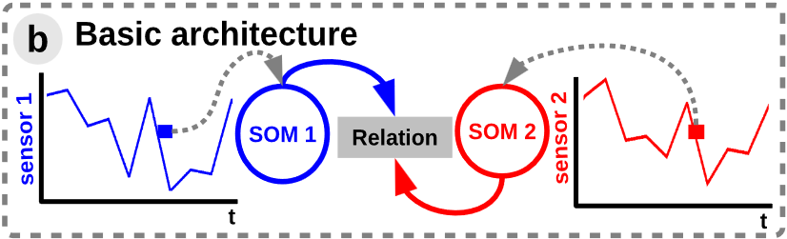
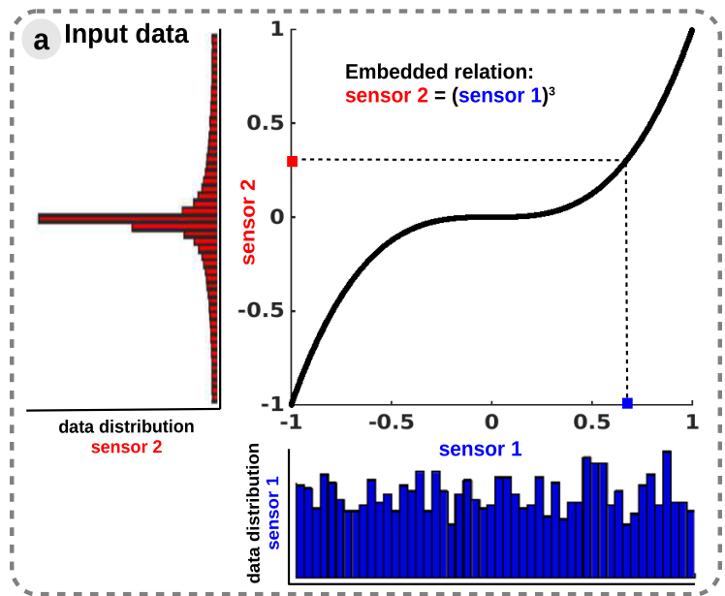
SPICEnet - General
Finds mathematical relation of two time series by:
Utilizing tweaked Self-Organizing Maps (competition)
Hebbian learning based on the SOM results (cooperation)
And adapting weights based on results
Existing python package
Existing SNN version
Uses in: Relation Finding, Control, Value Interpolation, etc.

Slide 5
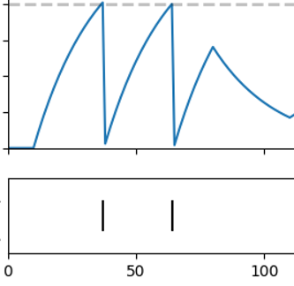
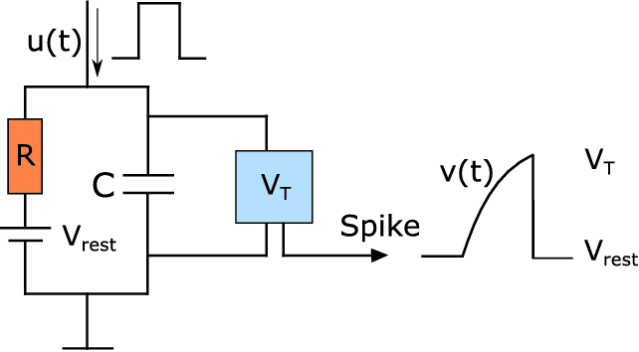
Spiking Neural Networks
Biologically Inspired Neural Networks
Biology works on electricity, not 0 and 1
Electrical Signals increase or decrease a charge (Membrane Potential)
On reaching a charge threshold an Event (Spike/Action Potential) is created
Sparse events = Energy Savings
Efficient hardware implementation possible

Slide 6
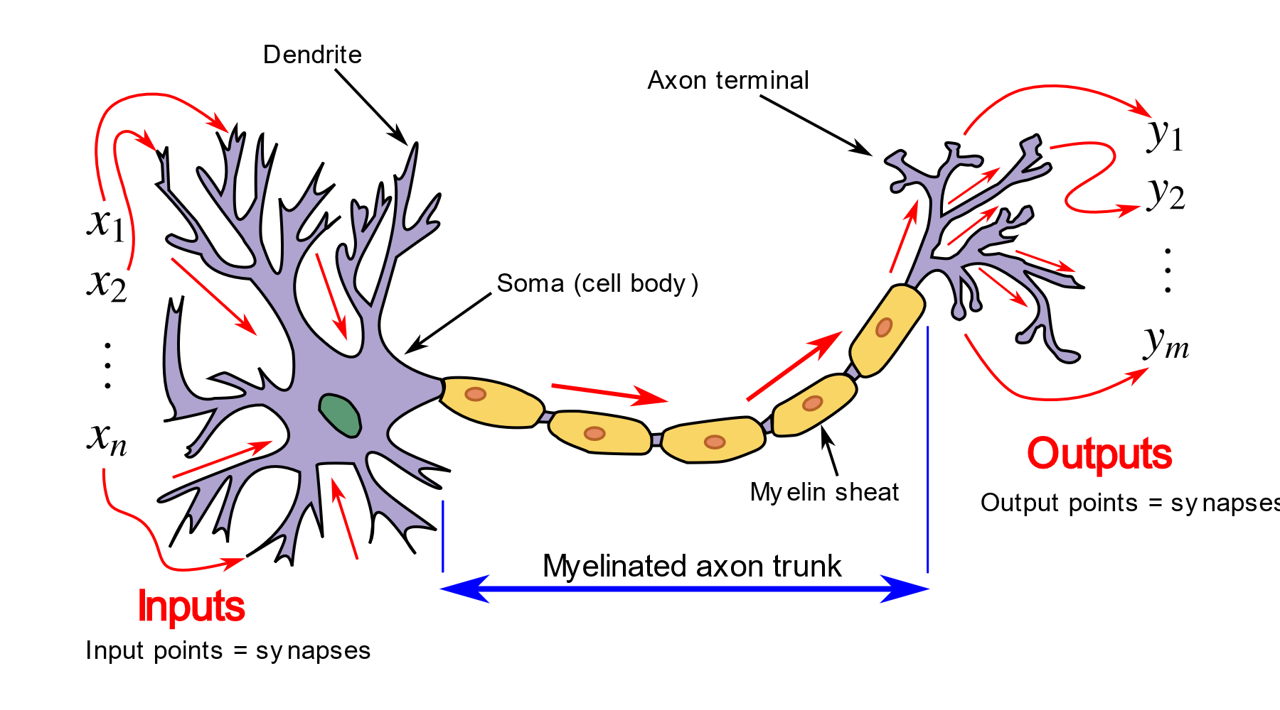
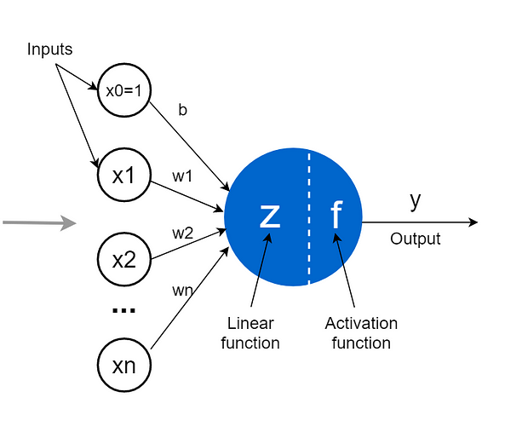
SNN – Biological Neural Comparision

Slide 7
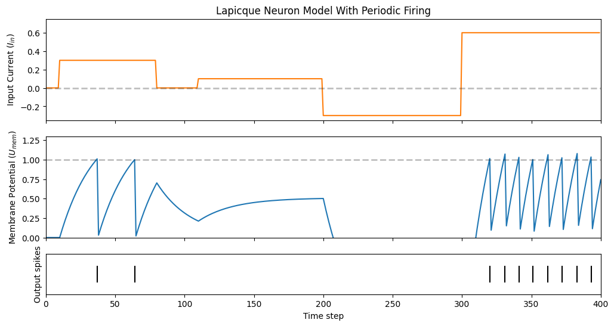
SNN – LIF Current Example

Slide 8
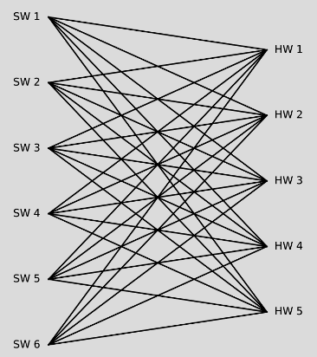
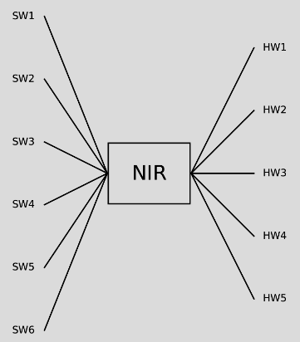
NIR
Neuromorphic Intermediate Representation
Exchange Format for Spiking Neural Networks
Based on standardized „Primitives“
And non-weighted Edges
Support for 8 Neuromorphic SNN Frameworks
Hardware and Software Simulation Platforms
Decouples Network Architecture from Framework

Slide 9
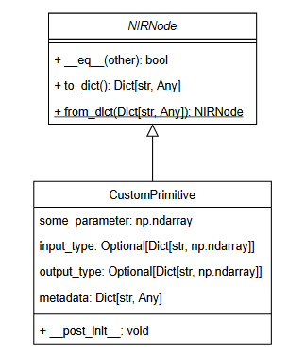
Primitives
General Architecture
Hybrid Continuous-time dynamical system
Discrete-time dynamics
Continous-time dynamics
Subclass NIRNode
All Primitives children of NIRNode
One input specifier (shape, type)
One output specifier
Parameters

Slide 10
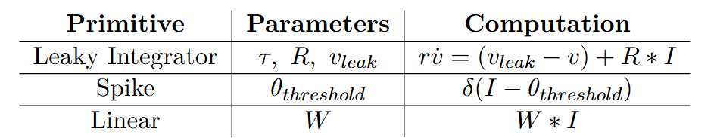
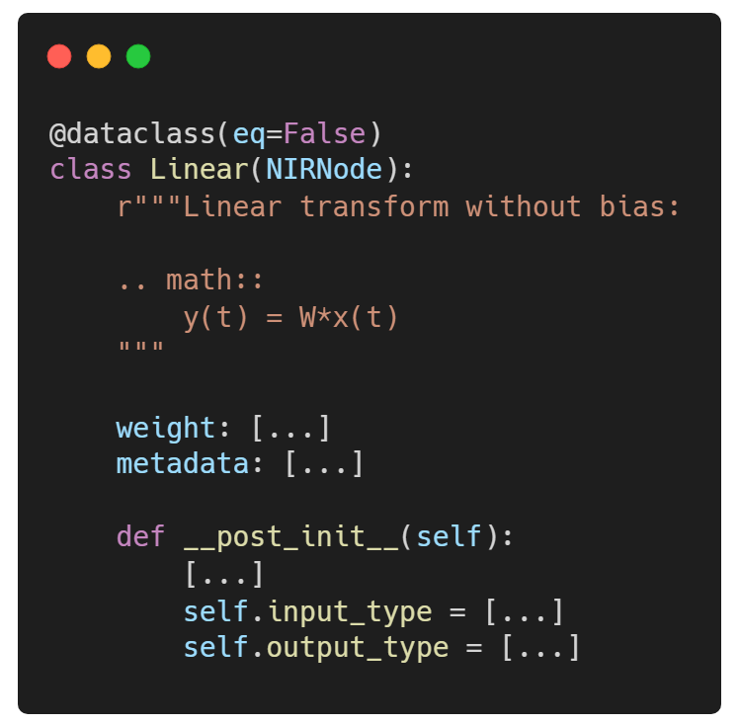
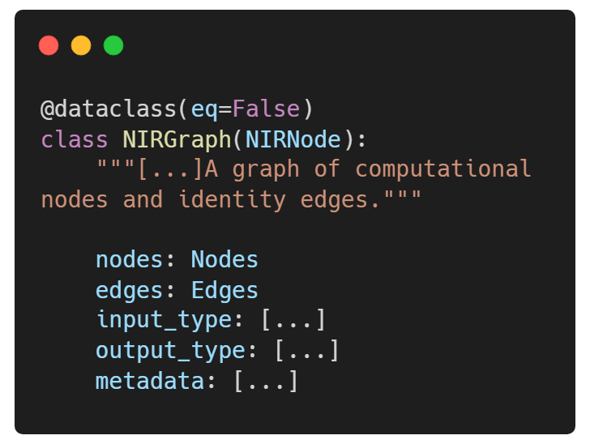
Primitives
Example Primitive

Slide 11
Methodology & Results

Slide 12
Original Plan
Analyse existing SNN SPICEnet implementation
Split into parts
Analyse parameters
Implement primitive architecture
Integrate into NIR Python Framework
Setup reproducible SPICENet Evaluation Architecture
Evaluate on different SNN Platforms

Slide 13
Original Plan
..but not anymore
Analyse existing SNN SPICEnet implementation
Tricks using mostly non-spiking computations
Can‘t depend on existing implementation
Alternative: Implement small component (SOM Forward) as part of the Bachelors
Rest of the process the same

Slide 14
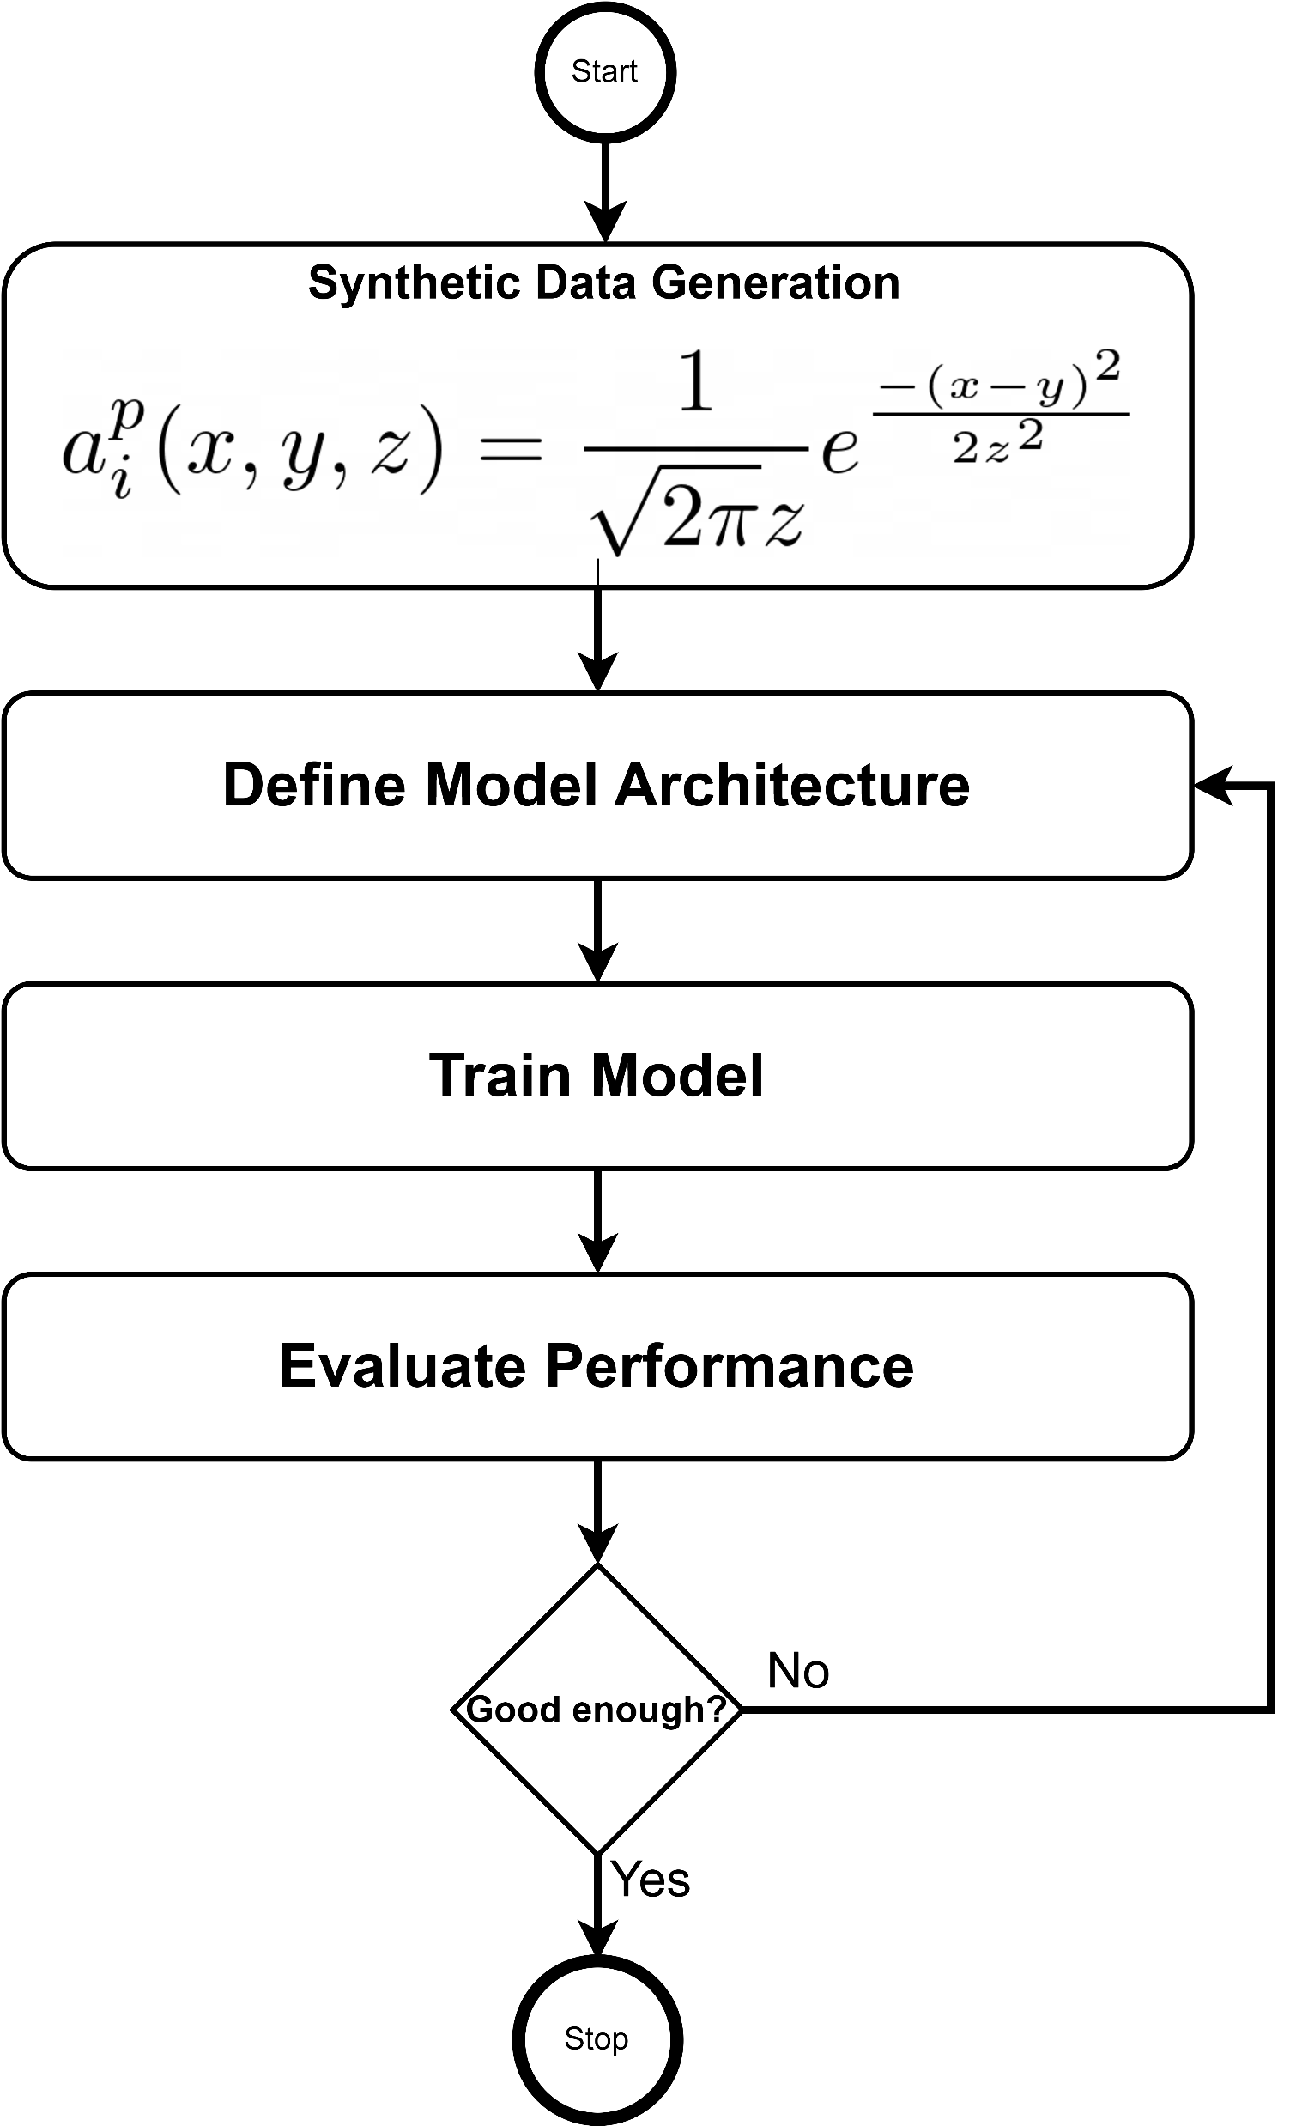
SOM Implementation
Training SOM SNN Forward Function
unsupervised -> supervised
Generating synthetic data
Choosing architecture
Training model
Evaluating performance

Slide 15
SNN Trainingsansätze
Maybe?
SNN First
ANN First
Decide on Encoding Strategy
Encode input values
Decide on SNN Architecture
Train SNN directly
Evaluate decoded SNN outputs directly
No „tricks“ necessary
Train Artifical Neural Network
Optimize it
Evaluate it
Transform ANN to SNN
Evaluate SNN Performance
SNN Architecture not optimal

Slide 16
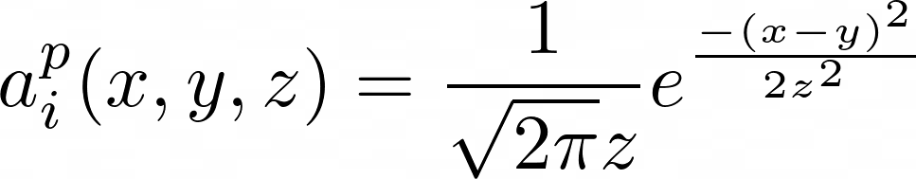
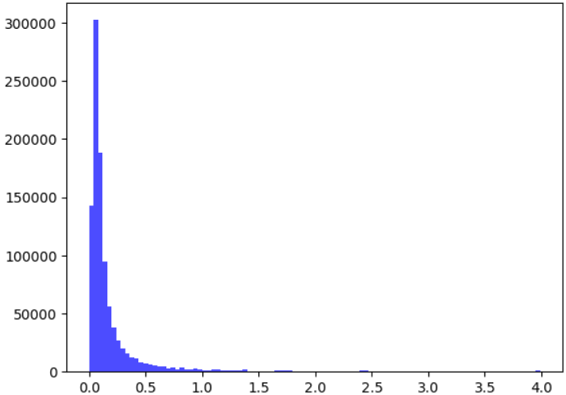
SOM Implementation
Synthetic Data Generation
Standard deviation (σ, z) from 0.1 to 2*PI
Mean / Expectation (y) from –PI to +PI
Input values (x) between -3σ to +3σ
Current Problems:
Lower STD results in huge density values
Limited ranges
Right Tailed data distribution

Slide 17
SOM Implementation
ANN Training
Multiple Architecture Attempts:
All Smallish Input – Hidden * (1 to 3) – Output
Adam or SGD Optimizer
Sometimes Dropout Regularization
Mean Squared Error Loss – maybe not the best
SNN Transformation is a simple function call

Slide 18
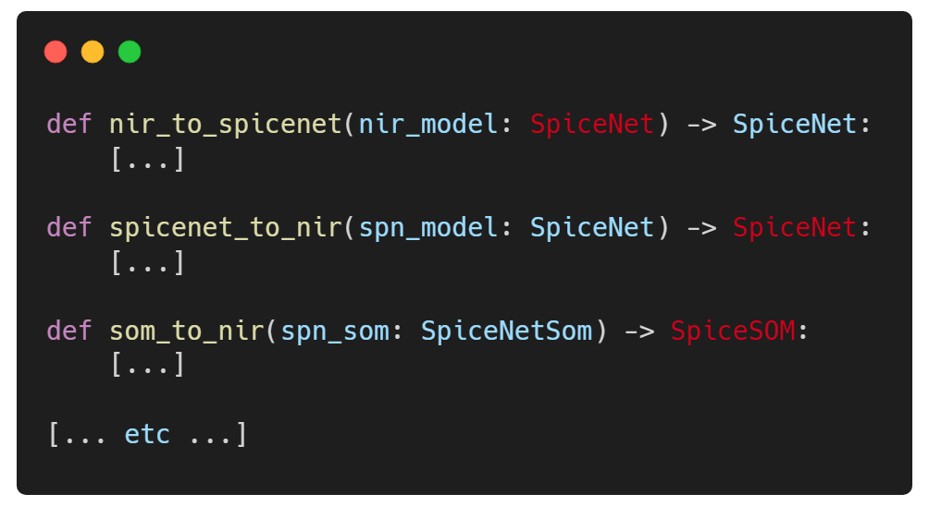
NIR Integration
Connecting SPICEnet package and NIR
NIR is just an exchange format
SPICEnet can be instantiated from or exported to NIR
Analyse SPICEnet Parameters
Define NIR Architecture
Expand SPICEnet Package with utility functions
Training can be done in normal SPICEnet

Slide 19
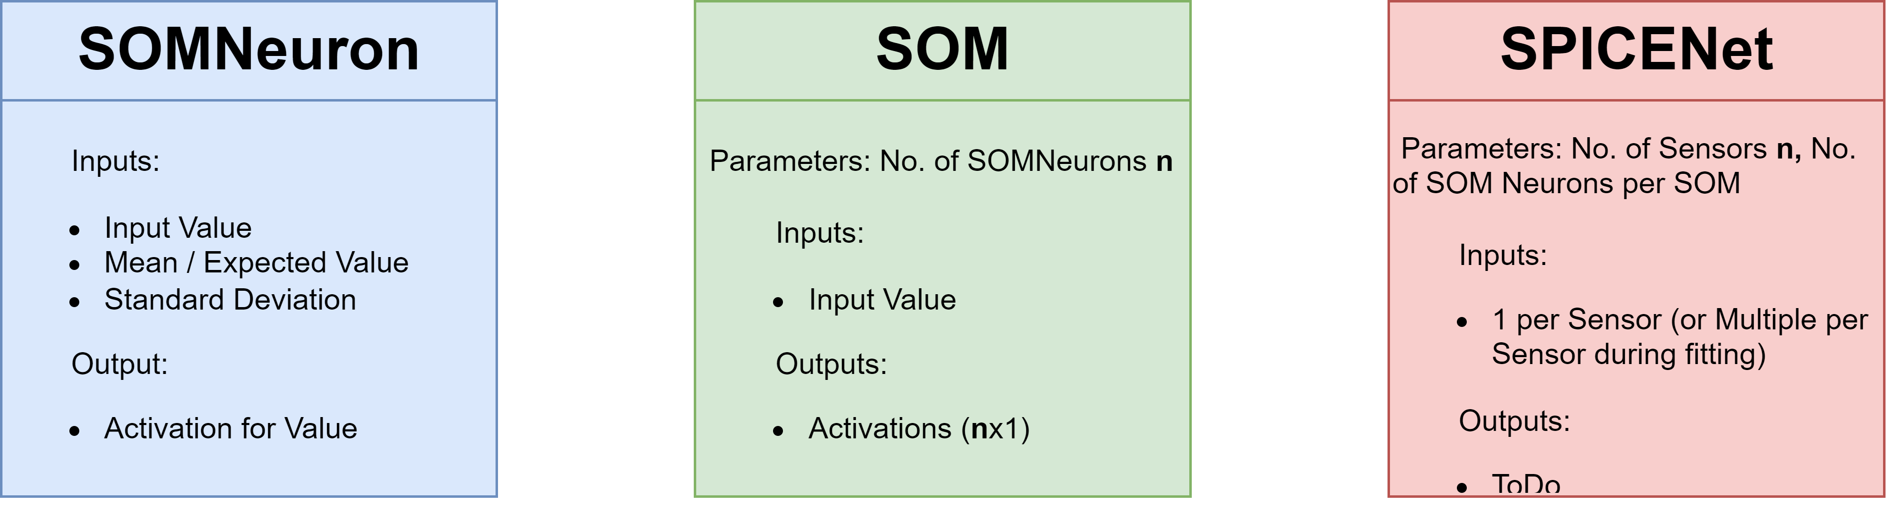
NIR Integration – Architecture
Higher Levels automatically instantiate lower levels OR take a given list and infer parameters

Slide 20
NIR Integration
Integrating Architecture into NIR package
NIR is a python package like any other
Doesn‘t handle export and imports itself
Just offers a serialized format
Classes do not have functionality
Logic (like learning or functionality) does not get exchanged
SOM and Correlation Matrix Learning is not part of the integration

Slide 21
NIR Integration
Export to other platforms
Every platform has ist own limitations
Implementation of a exchange class SpiceSom is different on every platform
Optimally: Efficient hardware implementation on hardware platforms
Our trained SOM is a generic implementation
Usable on many SNN Platforms through own NIR transfer..
.. But unoptimized

Slide 22
Conclusion

Slide 23
Problems
Theoretical Problems
Practical Problems
Theory of SNNs
No experience at the start
Especially training still hard
Very interdisciplinary field
Existing SNN SPICEnet
Unexpected
Change of Methodology necessary
Can‘t evaluate what‘s not there

Slide 24

Future Steps
Transformation ANN to SNN
NIR Architecture Implementation
Tests and Evaluation of:
SPICEnet to NIR
NIR to SPICEnet
SNN SOM

Slide 25

THANK YOU
For Your Attention
Any Questions? Fragen?

