Slide 1


Layout 04 - Netflix
Mão na Massa

Slide 2
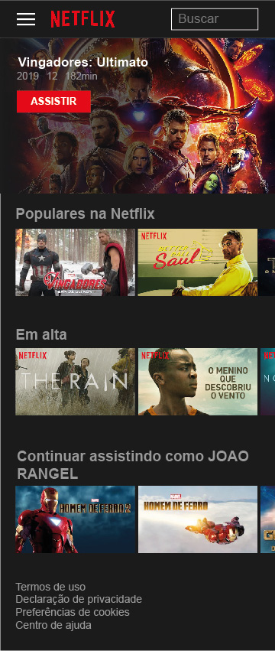
XS

Slide 3
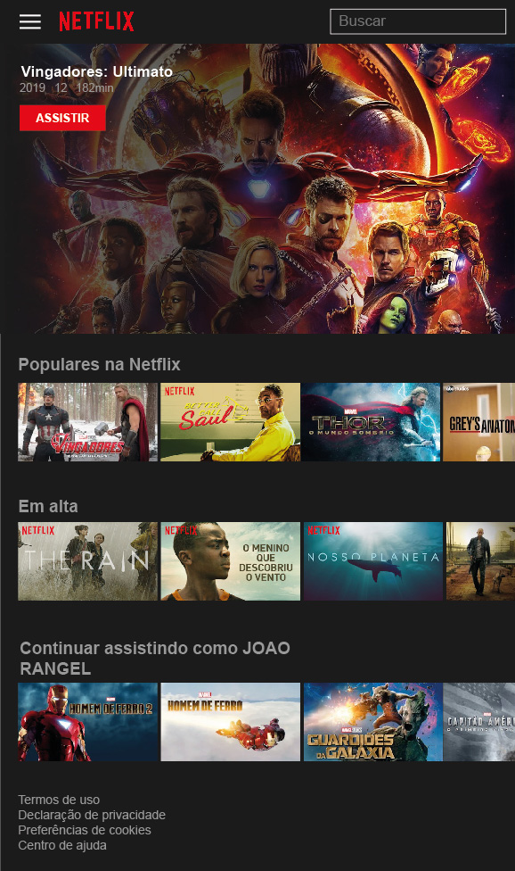
SM

Slide 4
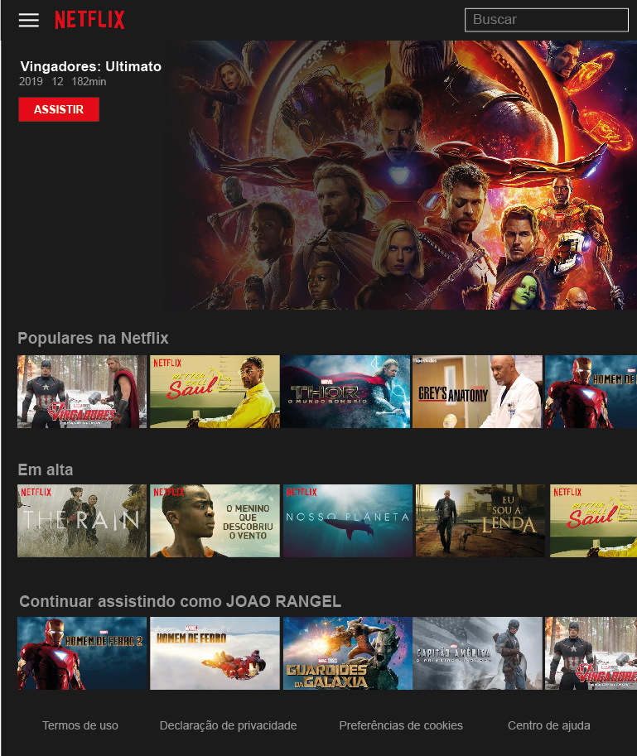
MD

Slide 5
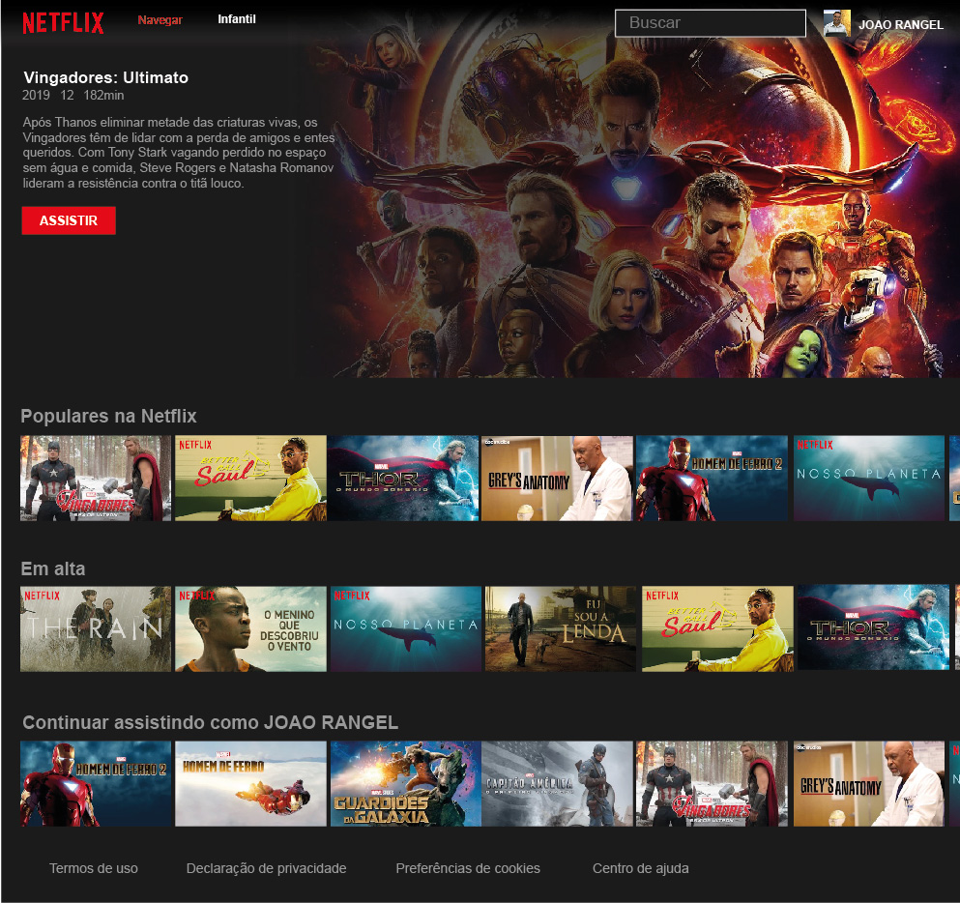
LG

Slide 6
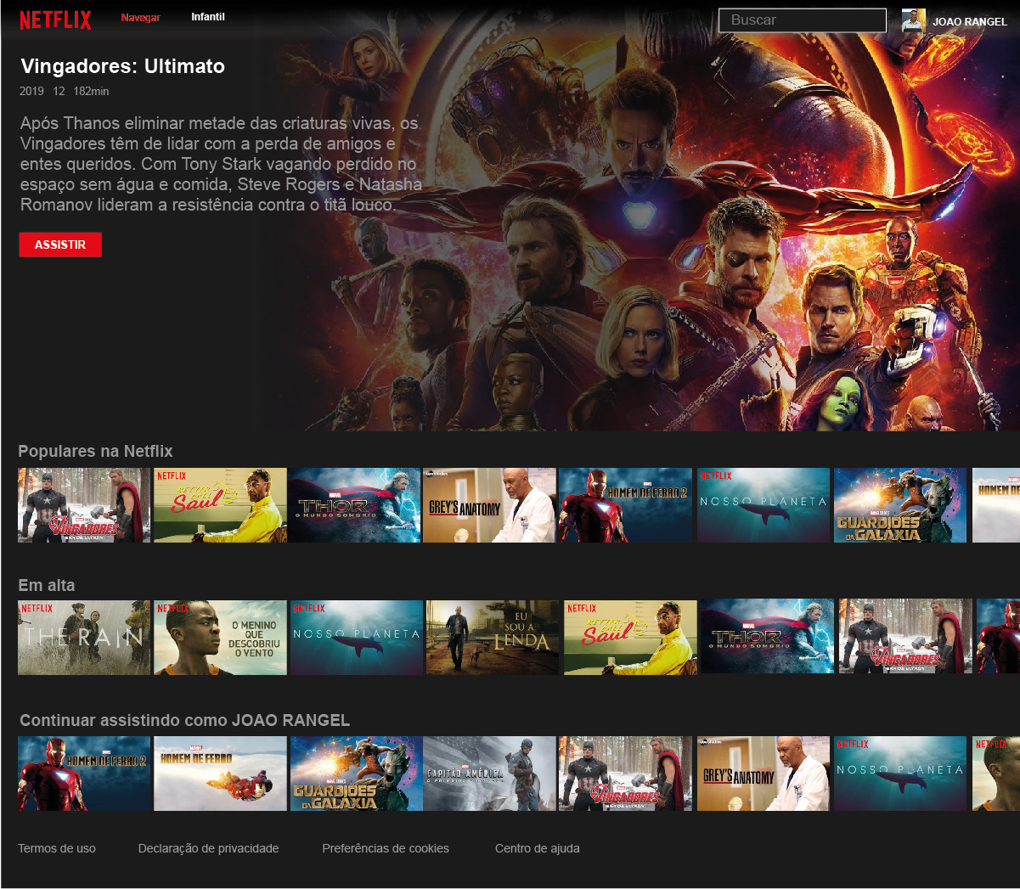
XL

Slide 7
Cores
#1B1B1B
#E30F19
#999898
#4d4d4d
#FFFFFF

