Slide 1
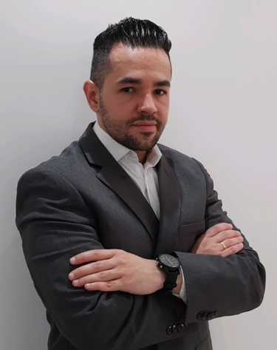
THIAGO GONÇALVES CUSTÓDIO
th14g0cust0d10@gmail.com
Guarulhos, São Paulo - Brasil
thiago-custodio
https://th14g0cust0d10.github.io
55 11 98664-4215
PROFILE
Multidisciplinary professional with a hands-on profile, always in learning mode with extensive experience in managing customer relationship channels and business planning, using data science and analytics to solve business problems. Solid knowledge of the most used programming languages and frameworks like R , Python, Microsoft Azure Machine Learning and Apache Spark MLlib for use in data science and predictive modeling, having experimented with various machine learning algorithms. Advanced knowledge in Relational Database Management Systems (DBMS), NoSQL and Data Stores, ETL, ELT, Data Munging and Wrangling routines. Experience in creating Dashboards to support business strategy using Power BI, QlikView or Sense, Tableau, D3.js and R-Shiny applications. Performance focused on MLOps and DataOps concepts.
Portfolio Data Science and Business Analytics: https://th14g0cust0d10.github.io
EDUCATION
UNIP – University Paulista
MBA – Marketing - Concluded
2012-2013 São Paulo - Brasil
UNIBAN – University Bandeirante São Paulo
HR - Human Resource Management - Concluded
2007-2009 São Paulo - Brasil
TECHNICAL COURSE
DATA SCIENCE ACADEMY
Data Scientist Training - Concluded
2021 E-learning
PROFESSIONAL EXPERIENCE
DATA SCIENCE & BA CONSULTANCY
Consultant
September/2020 – Currently São Paulo - Brasil
Supervised and unsupervised Predictive Modeling applied to business problems;
Machine Learning Algorithms;
Data-Driven Personalization;
Data Quality Report;
A/B hypothesis test;
Big Data Queries and Interpretation;
Creation of KPI Dashboards to support business strategy and management;
Storytelling;
Application of descriptive, diagnostic and prescriptive analysis techniques to support decision making;
LANGUAGES
Native: Português;
Advanced: English – Spanish;
SKILLS - TOOLKIT
DBMS (Rel. NoSQL) Data Stores ETL / ELT | Machine Learning Frameworks | Data Visualization
Microsoft SQL Server | R | Power BI
Postgre SQL | Python | QlikView/Sense
MySQL | Microsoft Azure Machine Learning | Tableau
MongoDB | Apache Spark MLlib | D3.js
Oracle |  | R - Shiny
Apache Hadoop Apache Hbase Apache Hive
Microsoft SQL Server Integration Services (SSIS)
Apache Sqoop
CHUBB INSURANCE 8 years 3 months
Sales Channels and Commercial Planning Manager
October/2019 – March/2020 São Paulo - Brazil
Management and contracting of sales channels and direct marketing - Commercial Affinity Board;
Management of analysis and visualization of performance data;
Management of commercial planning;
Management and performance of database strategies for insurance sales;
Management of projects to implement new businesses and technological solutions;

Slide 2
PROFESSIONAL EXPERIENCE
CHUBB INSURANCE 8 years 3 months
Regional Business Controller – LatAm
March/2018 – September/2019 São Paulo - Brasil
Project management and business control processes - LatAm regional direct marketing department;
Implementation and dissemination of omnichannel solution for direct marketing actions, establishing CX and CS precepts along customer relationship channels;
Hiring technology providers, defining commercial conditions and contractual SLAs;
Management risk analysis, projections, budget control and sales monitoring of direct marketing campaigns;
Performance analysis of portfolio products and profit;
Management, data analysis, creation of business management KPIs and creation of Dashboards on platforms such as QlikView/Sense and Power Bi;
Commercial Planning Specialist
September/2015 – February/2018 São Paulo - Brasil
Commercial Planning Analyst
February/2014 – August/2015 São Paulo - Brasil
Call Center Executive
January/2012 – January/2014 São Paulo – Brasil
LEADERSHIP COURSES
Arete Consultoria RH
Leader training (MBTI – Myers-Briggs Type Indicator)
2010 São Paulo – Brasil
LIQ Contax TNL
People management and development
2010 São Paulo – Brasil
LIQ Contax TNL
Coaching & Feedback
2009 São Paulo – Brasil
Chubb Seguradora
Negotiation and communication strategies
2017 São Paulo – Brasil
AWARDS
ClienteSA
3º Telesales Award 2011
Outsourcing Innovation Category
September/2011 São Paulo – Brasil
Grupo Padrão / Consumidor Moderno
Multichannel Relationship Quality Standard Award
Category Best B2B Sales Operation
August/2011 São Paulo – Brasil
ABEMD
XVII Award ABEMD 2011
Category Best B2B Sales Operation
May/2011 São Paulo – Brasil
LIQ Contax TNL 6 years
Operations coordinator
December/2009– January/2012 São Paulo – Brasil
Operations Specialist Supervisor
December/2007 – December/2009 São Paulo – Brasil
Operations Supervisor
October/2006 – December/2007 São Paulo – Brasil
TLMK Operator
February/2006 – September/2006 São Paulo – Brasil

