Slide 1
SIGNALS AND SYSTEMS USING MATLAB
Chapter 0 — From the Ground Up!
L. F. Chaparro and A. Akan

Slide 2
Digital signal processing
1948 – birth of digital technologies
Transistor (Bell Labs)
Stored–program computer (Manchester University, UK)
Publications
Shannon’s digital communications
Hamming’s error correcting codes
Wiener’s Cybernetics
Moore’s Law, DSPs and FPGs
1965 — Moore (Intel): number of transistors in a chip would double every 2 years
Digital Signal Processors (DSPs): optimized microprocessors for real–time processing
Field Programmable Gate Array (FPGA): device with programmable blocks and interconnects

Slide 3
Compact disc (CD) and compact disc player
Speaker
Laser
DAC
Sensor
Audio Amplifier
When playing a CD, the CD player follows tracks in the disc, focus laser beam on them, as CD is spun. Light is reflected by pits and bumps on the surface of disc (corresponding to the coded digital signal from acoustic signal). Sensor detects reflected light and converts it into a digital signal and converted into an analog signal by DAC. Amplified and fed to speakers signal sounds like original recorded acoustic signal.

Slide 4

Software–defined radio (SDR)
TRANSMITTER
Antenna
Microphone
ADC
Modulator
DAC
Antenna
RECEIVER
Speaker
Super heterodyne
ADC
Demodulator
DAC
Voice SDR mobile two-way radio
Transmitter: voice signal inputted using microphone, amplified by an audio amplifier, converted into a digital signal by ADC,modulated using software, converted by DAC into analog signal which is amplified and radiated by antenna
Receiver: analog signal received by antenna is processed by a superheterodyne, converted by ADC,demodulated using software, converted by DAC, amplified and fed to speaker

Slide 5
Computer–control system
w(t)
r(t) ₊
y(t)
ADC
Digital Computer
DAC
Plant
-
Clock
 | Sensor
v(t)
Computer control system for an analog plant (e.g., cruise control for a car) Reference signal r (t) (e.g., desired speed) and output y (t) (e.g., car speed)
Signals v (t) and w(t): disturbances or noise in plant and sensor (e.g., electronic noise in the sensor and undesirable vibration in the car)

Slide 6
Continuous and discrete representations
Sampling continuous–time signal x (t) into discrete–time signal sequence x [n]:
x [n] = x (nTs ) = x (t)|t=nTs
Ts :sampling perioddepends on frequency content of x (t)
2
x (0.1n)
0
−2
1
0
1
2
3
4
5
6
7
8
9
10
2
0
−2
x (n)
2
0
1
2
3
4
5
t (sec)
6
7
8
9
10
Sampling x (t) = 2 cos(2πt), 0 ≤ t ≤ 10, with Ts1 = 0.1 (top) and Ts2 = 1 (bottom) giving x1(0.1n) = x1[n] and x2(n) = x2[n]
Notice similarity between x1[n] and x (t) and loss of information when Ts2 = 1

Slide 7
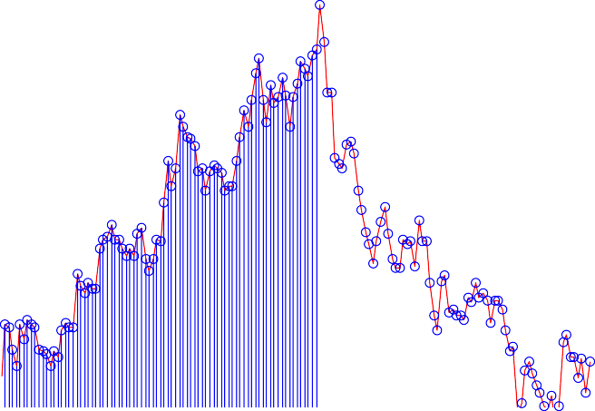
Inherent discrete–time signal
260
240
220
200
180
160
140
120
100
ACM Closings, Jan. 2006− Dec. 2009
Dollars
20 40 60 80 100 120 140
Week
Weekly closings of ACM stock for 160 weeks in 2006 to 2009. ACM is the trading name of the stock of the imaginary company ACME Inc. makers of everything you can imagine.

Slide 8
Implementation of DSP Algorithms
Continuous-time signals Electrical and electronic circuits
Digital signals Addition, multiplication, and delay
DSP system’s output Arithmetic operations on input
Possible real-time implementations;
General-purpose microprocessors (Ps) and micro-controllers (Cs)
General-purpose digital signal processors (DSPs)
Field programmable gate arrays (FPGAs)

Slide 9
Infinitesimal and finite calculus
Derivative and forward– difference
Integral and summation

Slide 10

Approximation of integral
10
8
6
4
2
0
 |  |  |  | t
t, n
0
2
4
t
6
8
10

Slide 11


Differential and difference equations
Solve d.e. from series RC circuit with a constant voltage source vi (t) as input and R = 1 Ω, C = 1 F (huge plates!)
dv (t)
c
vi (t) = vc (t) +
with initial voltage vc (0) across capacitor
Use integrators
t ≥ 0
dt
v_{c}(0)
v_{i}(t)
v_{c}(t)
v_{i}(t)
+
dv_{c}(t)
dt
v_{c}(t)
+
(.)dt
dv_{c}(t)
d(.)
dt
dt
Block diagram for d.e. using differentiators (left) and integrators (right). Differentiators increase noise, integrators smooth out noise

Slide 12

t t₀ t₁
∆t
Trapezoidal approximation of area
Difference equation
T
2 + T
2 − T
2 + T
v (nT ) =
[v_{i} (nT ) + v_{i} ((n − 1)T )] +
v ((n − 1)T ),
v (0) = 0, n ≥ 1
c
c
c
can be solved iteratively

Slide 13
Complex or real?
Damping and frequencyof signals represented by complex variable
Complex numbers and functions
(x, y)
z + v
y
|z|
θ
v
z
(a)
(b)
x
(x, y)
|z|
θ
θ
v
|z|
θ
z
|v|
φ
θ + φ
|z|
(c)
(d)
|z||v|
(x, −y)
(a) z = x + jy as vector ; (b) addition of complex numbers; (c) multiplication of complex numbers; (d) complex conjugation of z.

Slide 14

Complex numbers
Representations
z = x + jy
rectangular polar
j ∠z
= |z |e
Operations
Rectangular to polar conversion
Im[z]
1
3
Re[z]
3
Re[z]
z = 3 + j4 = 5e^{j0.93}
u = −3+ j = √10 e^{j2.82}
4
Im[z]
Im[z]
1
Re[z]
1
Re[z]
3
j3.79
w = −4 − 3j = 5 e
v = 1 − j = √2 e^{−jπ/4}

Slide 15
Euler’s identity
e^{j θ} = cos(θ) + j sin(θ)
_{e}j θ _{+ e}−j θ
j θ
cos(θ) = Re[e ] =
sin(θ) = Im[e ] =
2
_{e}j θ _{− e}−j θ
j θ
.
2j
Polar to rectangular conversion

Slide 16
Roots and powers of j
z ³ + 1 = 0 ⇒
3
j (2k+1)π
z = −1 = e
, k = 0, 1, 2
k
z_{k} = e^{j (2k+1)π/3}, k = 0, 1, 2
_{z0 = e}j π/3,
z₁ = e^{j π} = −1,
_{z2 = e}j (6−1)π/3 _{= e}j 2π_{e}−j π/3 _{= e}−j π/3
120
90
1
60
120
90
1
60
150
0.5
30
150
0.5
30
180
0
180
210
330
210
33
240
270
300
240
270
300
Left: roots of z³ + 1 = 0. Right: integer powers of j , periodic of period 4, with period of {1, j ,− 1, − j }

Slide 17
Trigonometric identities

Slide 18
Phasors
Sinusoids and phasors
x (t) = A cos(Ω₀t + ψ) − ∞ < t < ∞
A amplitude, Ω₀ = 2πf₀ frequency (rad/sec),
Phasor : X = Ae^{j ψ}, x (t) = Re[Xe^{j Ω0t} ]
ψ phase (rad)
Ω₀
sin
cos
sin
Generation of sinusoids from phasors of a frequency Ω₀ shown at initial position

Slide 19






90
30
120
90 30
60
120
60
20
10
150
30
20
180
0
150
30
10
210
330
240
270
300
180
0
40
20
210
330
0
240
300
−20
270
−40
Phasor 1 + Phasor 2
0
0.02
0.04
0.06
0.08
0.1
0.12
0.14
0.16
0.18
0.2
Sum of phasors I₁ = 10 e^{j 0} and I₂ = 20 e^{j π/4} with the result in the top left and the corresponding sinusoid (right bottom).

Slide 20
Phasors and systems
Eigenfunction property of LTI systems
Input: x (t) = Re[Xe^{j Ω0t} ], input phasor X = Ae^{j θ}
j Ω₀t
Output: y (t) = Re[Ye ], output phasor Y = XH(j Ω₀)
Steady–state response
Input
Linear time-invariant system
Output
x(t) = A cos(Ω₀t + θ)
y_{ss}(t) = A|H(jΩ₀)| cos(Ω₀t + θ + ∠H(jΩ₀))
Frequency response of system

