Slide 1
SIGNALS AND SYSTEMS USING MATLAB
Chapter 1 — Continuous–time Signals
L. F. Chaparro and A. Akan

Slide 2
Classification of time–dependent signals
Predictability: random or deterministic
Variation of time and amplitude: continuous-time, discrete–time, or digital
Energy/power: finite or infinite energy/power
Repetitive behavior: periodic or aperiodic
Symmetry with respect to time origin: even or odd
Support: Finite or infinite support (outside support signal is always zero)

Slide 3
Analog to digital and digital to analog conversion
Analog to digital converter (ADC or A/D converter): converts analog signals into digital signals
Digital to analog converter (DAC or D/A converter): converts digital to analog signals
level
x(t)
∆
∆/2
2T_{s}
3T_{s}
t
−∆/2
∆
T_{s}
4T_{s}
x(nT_{s})
Discretization in time and in amplitude of analog signal using sampling period Ts and
quantization level ∆. In time, samples are taken at uniform times {nTs }, and in amplitude the range of amplitudes is divided into a finite number of levels so that each sample value is approximated by one of them

Slide 4
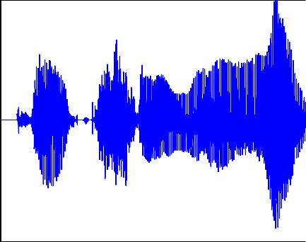
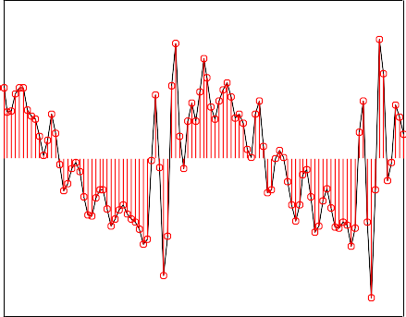
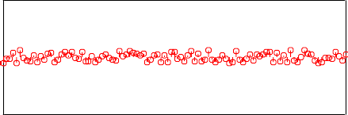
1
0.8
0.6
0.4
0.2
0
−0.2
−0.4
−0.6
−0.8
v(t)
−1
0
2
4
6
t (sec)
8
10
0.5
0.4
0.3
0.2
0.1
0
−0.1
−0.2
−0.3
−0.4
−0.5
v(nT_{s}), v_{q}(nT_{s})
0.5
0
v(t), v(nT_{s})
−0.5
1.45
1.5
1.55
0.5
e(nT_{s})
0
−0.5
1.45
1.5 1.55 1.45
t, nT
1.5 1.55
nT_{s}
s
Segment of voice signal on top is sampled and quantized. Bottom left: voice segment (continuous line) and the sampled signal (vertical samples) using a sampling period Ts = 0.001 sec. Bottom-right: sampled and quantized signal at the top, and quantization error, difference between the sampled and the quantized signals, at the bottom.

Slide 5
Continuous-time signals

Slide 6
Basic signal operations
Given signals x (t), y (t), constants α and τ , and function w(t):
Signal addition/subtraction: x(t) + y (t), x (t) − y (t)
Constant multiplication: αx (t)
Time shifting
x (t − τ ) is x (t) delayed by τ
x (t + τ ) is x (t) advanced by τ
Time scaling x(αt)
α = −1, x (−t) reversed in time or reflected
α > 1, x (αt) is x (t) compressed
α < 1, x (αt) is x (t) expanded
Time windowing x(t)w(t), w(t) window
Integration

Slide 7
x(t)
z(t) = x(t) + y(t)
x(t)
α x(t)
x(t)
x(t − τ )
α
Delay
τ
+
+
y(t)
(a)
(b)
(c)
y(0)
x(t)
x(t) w(t)
x(t)
w(t)
(d)
(e)
Basic signal operations: (a) adder, (b) constant multiplier, (c) delay, (d) time-windowing,
(e) integrator

Slide 8
Delayed, advanced and reflected signals
(a)
x(t)
(b)
x(t − τ)
t
t
τ
(c)
x(t + τ)
(d)
x(−t)
t
t
τ
Continuous-time signal (a), and its delayed (b), advanced (c), and reflected (d) versions.

Slide 10
Even and odd signals
even: odd :
x (t) = x (−t)
x (t) = −x (−t)
x(t)
Even and odd decomposition: For any signal y (t)
y (t) = ye (t) + yo (t)
ye (t) = 0.5 [y (t) + y (−t)]
yo (t) = 0.5 [y (t) − y (−t)]
even component odd component
Example: x (t) = cos(2πt + θ), − ∞ < t < ∞
even x (t) = x (−t) → cos(2πt + θ) = cos(−2πt + θ) = cos(2πt − θ) θ = −θ, or θ = 0, π
odd x (t) = −x (−t) → cos(2πt + θ) = − cos(−2πt + θ) = cos(−2πt + θ ± π)
= cos(2πt − θ ∓ π)
θ = −θ ∓ π, or θ = ∓π/2

Slide 11
Example:
2 cos(4t) t > 0
0 otherwise
x (t) =
not even or odd, its even and odd components are
2
1
0
−1
−2
x(t)
−1
−0.5
0
0.5
1
1
0.5
0
−0.5
−1
1
0.5
0
−0.5
−1
x (t)
e
x (t)
o
−1
−0.5
0
t
0.5
1
−1
−0.5
0
t
0.5
1
If signal is 2 at t = 0
2 cos(4t) t ≥ 0
0 otherwise
x (t) =
1
the odd component is same as before, and the even component is 2 at t = 0 and same as before otherwise

Slide 12
Periodic and aperiodic signals

Slide 13
Finite–energy and finite-power signals
x (t) is finite–energy, or square integrable, if Ex < ∞
x (t) is finite–power if Px < ∞

Slide 14
Power of periodic signal
x (t) period of fundamental period T₀ is

Slide 15
Basic signals
Complex exponential
x (t) = Ae^{at} = |A|e^{j θ}e^{(r +j Ω0)t}
rt
= |A|e [cos(Ω₀t + θ) + j sin(Ω₀t + θ)]
− ∞ < t < ∞
4
3
2
1
4
3
2
1
_{e}−0.5 t
_{e}0.5 t
−2
0
t
2
−2
0
t
2
4
4
e^{−0.5 t} cos(2π t)
2
e^{0.5 t} cos(2π t)
2
0
0
−2
−2
−4
−2
0
t
2
−4
−2
0
t
2
Analog exponentials: decaying exponential (top left), growing exponential (top right), modulated exponential decaying and growing (bottom left and right).

Slide 16
Sinusoid
A cos(Ω0t + θ) = A sin(Ω0t + θ + π/2)
− ∞ < t < ∞
Modulation systems
A(t) cos(Ω(t)t + θ(t))
Amplitude modulation or AM: A(t) changes according to the message, frequency and phase constant,
Frequency modulation or FM: Ω(t) changes according to the message, amplitude and phase constant,
Phase modulation or PM: θ(t) changes according to the message, amplitude and frequency constant

Slide 17
Unit-impulse signal
p∆(t)
u∆(t)
1/∆
1
0.5
−∆/2 ∆/2
δ(t)
t
−∆/2 ∆/2
u(t)
1
t
(1)
t
t
Unit-impulse δ(t) and unit–step u(t) as ∆ → 0 in pulse p∆(t) and its integral u∆(t).

Slide 19
Λ(t)
dΛ(t)
dt
1
1
0
1
2
t
0
1
2
t
1

Slide 20
ρ(t)
dρ(t)
dt
1
(1)
(2)
1
3
0
1
2
3
t
0
2
t
(−2)
(−2)
1
The number in () is area of the corresponding delta signal and it indicates the jump at the particular discontinuity, positive when increasing and negative when decreasing

Slide 21
Generic representation of signals
δ(t − t₀)
f(t)
f(t₀)δ(t − t₀)
(f(t₀))
Generic representation
t
t₀ t
t₀
t
x(t)
x∆(t)
x(∆)
x(0)
+
+
t
∆
t
∆ 2∆
t
∆

