Slide 1
SIGNALS AND SYSTEMS USING MATLAB
Chapter 8 — Sampling Theory
L. F. Chaparro and A. Akan

Slide 2

Uniform sampling
x(t)
t
x_{s}(t)
0
t
0
T_{s} 2T_{s}
δ_{Ts}(t)
t
−T_{s} 0 T_{s}
2T_{s}

Slide 4
X(Ω)
1
(a)
−Ωmax
X_{s}(Ω)
Ωmax
Ω
1/T_{s}
(b)
Ω_{s} ≥ 2 Ω_{max}
no aliasing
Ωmax
Ω_{s}
Ω
X_{s}(Ω)
Ωs − Ωmax
1/T_{s}
(c)
Ω_{s} < 2 Ω_{max}
aliasing
Ωs = Ωmax
Ω
(a) Spectrum of band–limited signal, (b) spectrum of sampled signal when satisfying the Nyquist sampling rate condition, (c) spectrum of sampled signal with aliasing (superposition of spectra, shown in dashed lines, gives a constant shown by continuous line)

Slide 5
Band–limited signals and Nyquist condition

Slide 6
(a)
(b)
2
2
x(t), x(0.2n)
1
x(t), x(0.4n)
1
0
0
−1
−1
−2
−2
0
1
2
3
0
1
2
3
(c)
(d)
2
2
x(t), x(0.5n)
1
x(t), x(n)
1
0
0
−1
−1
−2
−2
0 1 2 3 0 1 2 3
t t
Sampling of x (t) = 2 cos(2πt + π/4): (a) T_{s} = 0.2, (b) T_{s} = 0.4, (c) T_{s} = 0.5 and (d) T_{s} = 1 sec/sample

Slide 8
Nyquist–Shannon sampling theorem

Slide 9
Antialiasing filtering
For signals that do not satisfy the band–limitedness condition
X(Ω)
X_{a}(Ω)
Ω
−Ω_{c}
Ω_{c} Ω
H(s)
1
H(jΩ)
−Ω_{c}
Ω_{c}
Ω
Anti–aliasing filtering of non band–limited signal

Slide 10
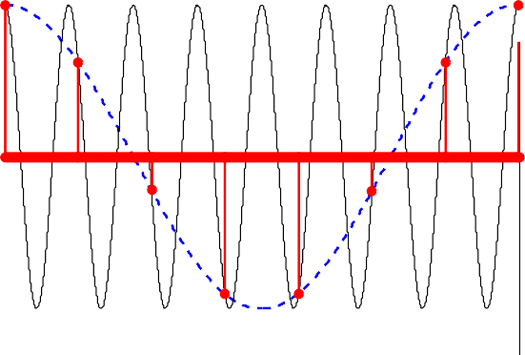
x₁(t)
x₂(t)
1
x (nT )
1 s
x₁(t),x₂(t),x₁(nT_{s})
0.5
0
−0.5
−1
0
1
2
3
t
4
5
6
Sampling sinusoids of frequencies Ω₀ = 1 and Ω₀ + Ω₁ = 8 with T_{s} = 2π/Ω₁. The higher frequency signal is under–sampled, causing aliasing and making the two sampled signals coincide

Slide 11
Practical aspects of sampling — Sample–and–hold sampling

Slide 12
Practical aspects of sampling — Quantization and coding

Slide 13
Application to digital communications
PCM transmitter
Sample and hold
m(t)
LPF
Quantizer and coder
1011100
Channel
1011100
1011100
Repeater
Repeater
Repeater
PCM receiver
Decoder
mˆ (t)
1011100
LPF
PCM system: transmitter, channel and receiver.

Slide 14


m₁(t)
mˆ ₁(t)
m₂(t)
Quantizer & encoder
Channel
Decoder
mˆ ₂(t)
m₃(t)
mˆ ₃(t)
Decommutator
Commutator
Time Division Multiplexin (TDM) system: transmitter, channel and receiver

