Slide 1
Top-Down Network Design
Chương 5
Thiết kế mô hình mạng
Copyright 2010 Cisco Press & Priscilla Oppenheimer

Slide 2

Mô hình - Topology
Là một thuật ngữ trong lĩnh vực Mạng máy tính để mô tả cấu trúc của mạng.
Notes:
Did you know that according to topologists, a coffee cup and donut are the same shape? If they were made of clay, for example, consider how easy it would be to mold the one to look like the other, while retaining the most significant characteristics (such as the roundedness and the hole).
Just like with coffee and donuts made of clay, in the networking field, during the logical design phase, we are more concerned with the overall architecture, shape, size, and interconnectedness of a network, than with the physical details.
For more information regarding topology, coffee, and donuts, see:
http://en.wikipedia.org/wiki/Topology

Slide 3
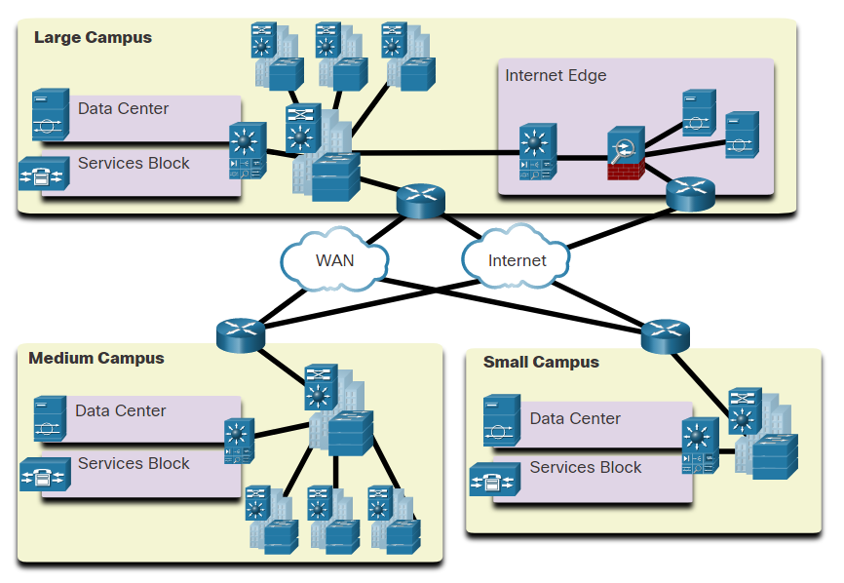
Borderless Switched Networks
The Cisco Borderless Network is a network architecture that can connect anyone, anywhere, anytime, on any device; securely, reliably, and seamlessly.
It provides the framework to unify wired and wireless access, built on a hierarchical infrastructure of hardware that is scalable and resilient.
Borderless switched networks are hierarchical, modular, resilient, and flexible.
Notes:
11 – Network Design
11.1 – Hierarchical Networks
11.1.3 – Borderless Switched Networks

Slide 4
Network Topologies
Phân cấp - Hierarchy
Dự phòng - Redundancy
Khối - Modularity
Xác định đầu vào và đầu ra - Well-defined entries and exits
Khu vực cần bảo vệ - Protected perimeters

Slide 5
1. Hierarchical Networks
Access, Distribution, and Core Layer Functions
Access Layer
The access layer provide network access to the user.
Access layer switches connect to distribution layer switches.
Distribution Layer
The distribution layer implements routing, quality of service, and security.
It aggregates large-scale wiring closet networks and limits Layer 2 broadcast domains.
Distribution layer switches connect to access layer and core layer switches.
Core Layer
The core layer is the network backbone and connects several layers of the network.
The core layer provides fault isolation and high-speed backbone connectivity.
Notes:
11 – Network Design
11.1 – Hierarchical Networks
11.1.5 – Access, Distribution, and Core Layer Functions

Slide 6
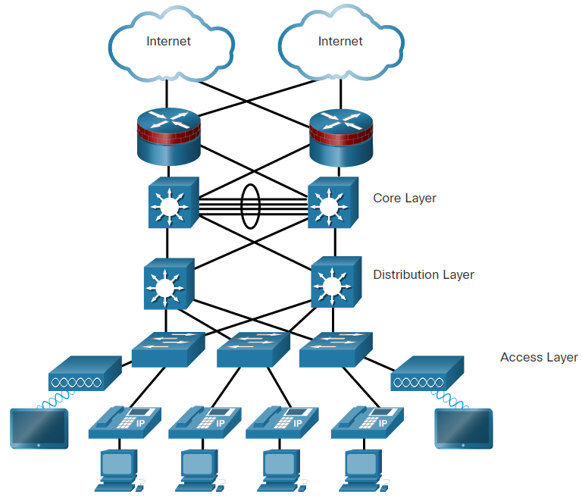
1. Hierarchical Networks
Access, Distribution, and Core Layer Functions
Access Layer
High Availability
Authentication
Broadcast control
QoS
STP
PoE
Voice Vlan
Notes:
11 – Network Design
11.1 – Hierarchical Networks
11.1.5 – Access, Distribution, and Core Layer Functions

Slide 7
1. Hierarchical Networks
Access, Distribution, and Core Layer Functions
Distribution Layer
Access control to core devices
Redundancy to access devices
Redistribution
Filtering
Route summarization
Policy routing
Security
Separate multicast and broadcast domains
Routing between Vlans
Media traslationg and boundaries (FastEthernet to GigabitEthernet)
Notes:
11 – Network Design
11.1 – Hierarchical Networks
11.1.5 – Access, Distribution, and Core Layer Functions

Slide 8
1. Hierarchical Networks
Access, Distribution, and Core Layer Functions
Core Layer
High speed
Reliability and availability
Redundancy
Fault tolerance
Load balancing
Manageability and scalability
Limited, consistent diameter
QoS
Notes:
11 – Network Design
11.1 – Hierarchical Networks
11.1.5 – Access, Distribution, and Core Layer Functions

Slide 9
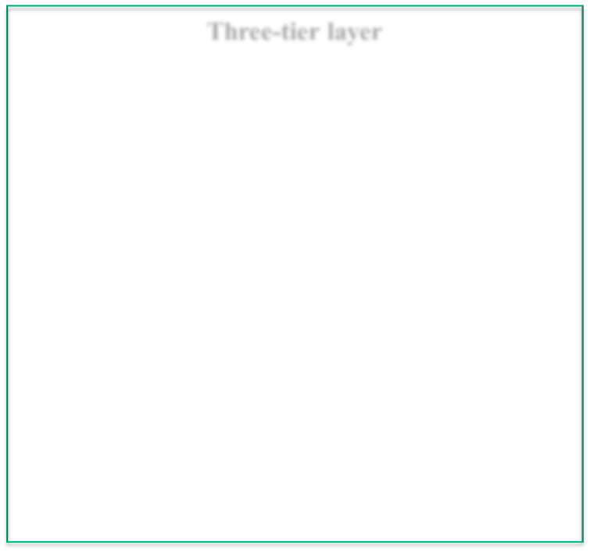
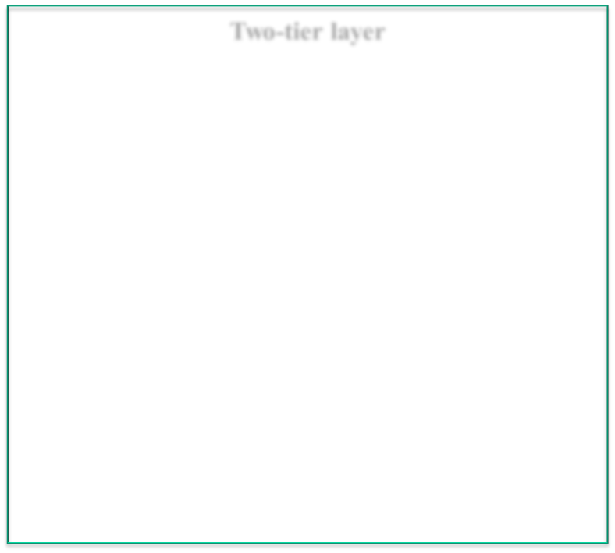
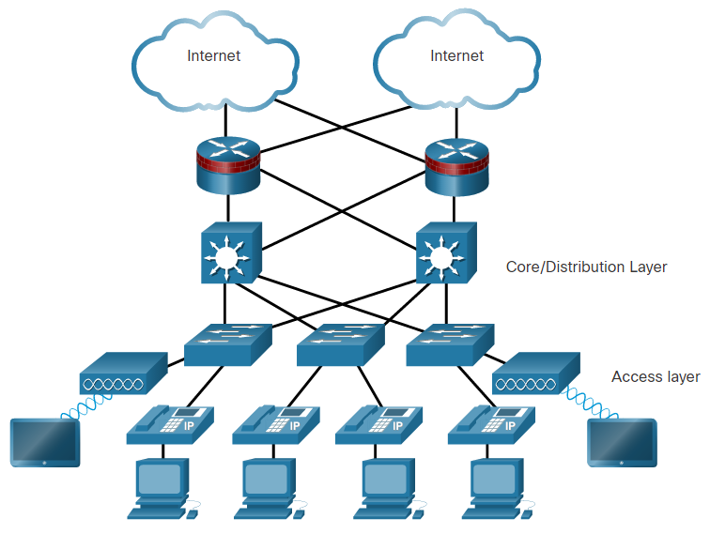
1. Hierarchical Networks
Access, Distribution, and Core Layer Functions
  Hierarchical networks use a tiered design of access, distribution, and core layers with each layer performing a well-defined role in the campus network.
  There are two time-tested and proven hierarchical design frameworks for campus networks.
Three-tier layer
Two-tier layer
Notes:
11 – Network Design
11.1 – Hierarchical Networks
11.1.4 – Hierarchy in the Borderless Switched Network

Slide 10

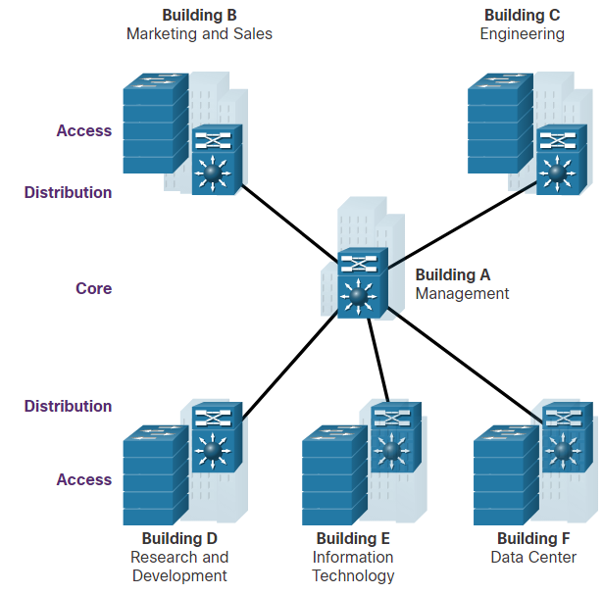

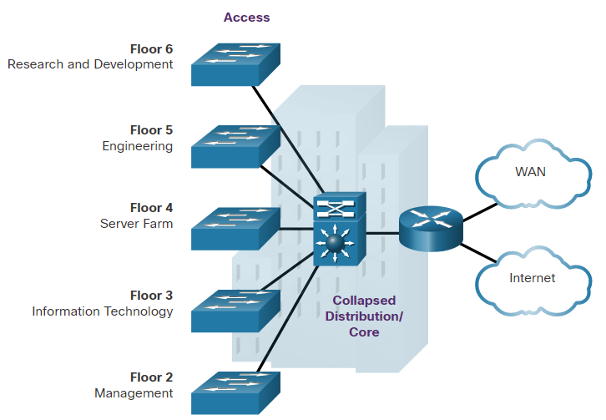
1. Hierarchical Networks
Access, Distribution, and Core Layer Functions
Three-tier Campus Network
Used by organizations requiring access, distribution, and core layers.
The recommendation is to build an extended-star physical network topology from a centralized building location to all other buildings on the same campus.
Two-tier Campus Network
Used when separate distribution and core layers is not required.
Useful for smaller campus locations, or in campus sites consisting of a single building.
Also known as the collapsed core network design.
Notes:
11 – Network Design
11.1 – Hierarchical Networks
11.1.6 – Three-Tier and Two-Tier Examples

Slide 11
Advantages of Hierarchical Model
Ease of Understanding
Flexibility
Cost savings
Modularity
Easily modified
Allows for Network growth
Notes:
11 – Network Design
11.1 – Hierarchical Networks
11.1.3 – Borderless Switched Networks

Slide 12
Khi nào ta có một mô hình tốt?
Khi ta biết làm thế nào để thêm một tòa nhà, một tầng, một chi nhánh, một dịch vụ
Khi một thành phần được thêm vào, nó chỉ ảnh hưởng cục bộ, ảnh hưởng đến thiết bị kết nối trực tiếp
Khi mạng tăng gấp 2, 3 lần nhưng không ảnh hưởng lớn đến thiết kế
Quá trình troubleshooting dễ dàng vì không có các giao thức phức tạp.
Notes:
Said by Dr. Peter Welcher, consultant and author of many networking articles in magazines, etc.

Slide 13

Flat Versus Hierarchy
Headquarters in Medford
Headquarters in Medford
Grants Pass Branch Office
Klamath Falls Branch Office
Ashland Branch Office
Grants Pass Branch Office
Klamath Falls Branch Office
Ashland Branch Office
White City Branch Office
Flat Loop Topology
Hierarchical Redundant Topology
Notes:
The flat loop topology shown at the top of Figure 5-2 meets goals for low cost and reasonably good availability. The hierarchical redundant topology shown at the bottom of Figure 5-2 meets goals for scalability, high availability, and low delay

Slide 14

Mesh
Designs
Partial-Mesh Topology
Full-Mesh Topology
Notes:
Although mesh networks feature good reliability, they have many disadvantages if they are
not designed carefully. Mesh networks can be expensive to deploy and maintain. (A fullmesh network is expensive.) Mesh networks can also be hard to optimize, troubleshoot,
and upgrade, unless they are designed using a simple, hierarchical model. In a nonhierarchical mesh topology, internetworking devices are not optimized for specific functions.
Containing network problems is difficult because of the lack of modularity. Network
upgrades are problematic because it is difficult to upgrade just one part of a network.

Slide 15
A Partial-Mesh Hierarchical Design
Headquarters (Core Layer)
Regional Offices (Distribution Layer)
Branch Offices (Access Layer)

Slide 16
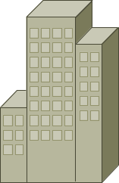
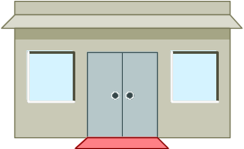

A Hub-and-Spoke Hierarchical Topology
Corporate Headquarters
Branch Office
Home Office
Branch Office

Slide 17

Tránh Chains và Backdoors
Core Layer
Distribution Layer
Access Layer
Backdoor
Chain
Notes:
The core layer of a three-layer hierarchical topology is the high-speed backbone of the
internetwork. Because the core layer is critical for interconnectivity, you should design
the core layer with redundant components. The core layer should be highly reliable and
should adapt to changes quickly.
The distribution layer of the network is the demarcation point between the access and
core layers of the network. The distribution layer has many roles, including controlling
access to resources for security reasons and controlling network traffic that traverses the
128 Top-Down Network Design
core for performance reasons. The distribution layer is often the layer that delineates
broadcast domains. (Although this can be done at the access layer as well.) In network
designs that include virtual LANs (VLAN), the distribution layer can be configured to
route between VLANs.
The access layer provides users on local segments with access to the internetwork. The
access layer can include routers, switches, bridges, shared-media hubs, and wireless
access points. As mentioned, switches are often implemented at the access layer in campus networks to divide up bandwidth domains to meet the demands of applications that
need a lot of bandwidth or cannot withstand the variable delay characterized by shared
bandwidth

Slide 18
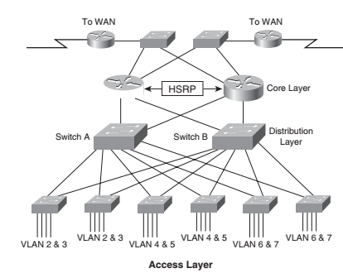
2. Redundant Network Design Topologies
Redundancy can prevent disruption of network services by minimizing the possibility of a single point of failure by:
Installing duplicate equipment
Providing failover services for critical devices
Redundant paths offer alternate physical paths for data to traverse the network supporting high availability.
However, redundant paths in an Ethernet network may cause logical Layer 2 loops.
Therefore, Spanning Tree Protocol (STP) is required.

Slide 19
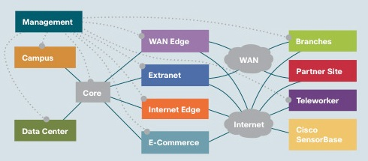
3. Modular Network Design
Cisco’s SAFE Security Reference Architecture
Core: connecting together all the other modules.
Data center: hosting servers, applications, and storage devices for use by internal users.
Campus: providing network access to end users and devices located in a single geographical location
Management: providing monitoring, analysis, authentication, and logging services.
WAN edge: providing WAN links that connect geographically distant branch offices to a central site
Internet edge: providing connectivity to the Internet and that acts as a gateway for the enterprise to the rest of the world
Branches: providing connectivity to users and devices at remote locations.
Extranet: An extranet allows selected business partners, customers, and suppliers to access a portion of the network via secure protocols.
Partner site: Being networks owned by business partners customers, and suppliers.

Slide 20
Thiết kế Mô hình mạng Campus
Sử dụng hướng tiếp cận là phân cấp, mô hình khối
Giới hạn bandwidth
Giới hạn miền broadcast
Cung cấp dự phòng cho:
  Các server
  Các phương pháp để user có thể đến được router
Notes:
A campus network can consist of access, distribution, and core layers:
■ Campus access layer: This module contains end-user workstations and IP phones
connected to switches or wireless access points. Higher-end switches provide uplinks
to the distribution layer. Services offered by this module include network access,
broadcast control, protocol filtering, and the marking of packets for quality of service
(QoS) features.
■ Campus distribution layer: The job of this module is to aggregate wiring closets
within a building and provide connectivity to the campus core via routers (or switches with routing modules). This module provides routing, QoS, and access control
methods for meeting security and performance requirements. Redundancy and load
sharing are recommended for this module. For example, each building should have
two equal-cost paths to the campus core.
■ Campus core layer: The campus core interconnects the access and distribution modules with the data center, network management, and edge modules. The campus core
provides redundant and fast-converging connectivity. It routes and switches traffic as
quickly as possible from one module to another. This module usually uses high-speed
routers (or switches with routing capability) and provides QoS and security features.

Slide 21


A Simple Campus Redundant Design
Host A
LAN X
Switch 1
Switch 2
LAN Y
Host B

Slide 22
Bridges and Switches use Spanning-Tree Protocol (STP) to Avoid Loops
Host A
LAN X
X
Switch 1
Switch 2
LAN Y
Host B

Slide 23
Các switch sử dụngSTP
Các switch bầu chọn một Root Bridge.
Tính khoảng cách ngắn nhất đến Root Bridge và chọn một Root Port có đường đi ngắn nhất đến Root Bridge.
Với mỗi LAN, bầu chọn một Designated Bridge và môt Designated Port trên switch đó. The Designated Port là một port trên LAN gần với Root Bridge. (Tất cả port Root Bridge là Designated Ports.)
Chọn tất cả các port có trong STP: the Root Ports and Designated Ports, những port này có thể truyền/nhận dữ liệu. Các ports khác sẽ block traffic.
Notes:
If all ports have equal distance to the Root Bridge, then the Designated Port is chosen by lowest sender Bridge ID. If the IDs are the same, then the port is chosen by lowest Port ID.
In general, STP checks for the best information by using these four criteria in the following order:
Lowest Root Bridge ID
Lowest path cost to the Root Bridge
Lowest sender Bridge ID
Lowest Port ID
See Top-Down Network Design for more details.

Slide 24
Mở rộng về STP
Giữ một STP network nhỏ
  Không quá 7 switches
Sử IEEE 802.1w
  Cung cấp việc tái cấu hình STP nhanh chóng (Rapid STP – RSTP)

Slide 25
Virtual LANs (VLANs)
Là một tập hợp các thiết bị cùng một nhóm quản lý
VLAN được sử dụng để giới hạn miền broadcast

Slide 26
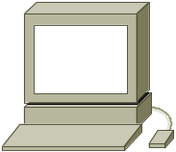
VLANs versus Real LANs
Switch A
Switch B
Station A1
Station A2
Station A3
Station B1
Station B2
Station B3
Network A
Network B
Notes:
To understand VLANs, it helps to think about real (non-virtual) LANs first. Imagine two switches that are not connected to each other in any way. Switch A connects stations in Network A and Switch B connects stations in Network B,
When Station A1 sends a broadcast, Station A2 and Station A3 receive the broadcast, but none of the stations in Network B receive the broadcast, because the two switches are not connected. This same configuration can be implemented through configuration options in a single switch, with the result looking like the next slide.

Slide 27
A Switch with VLANs
VLAN A
Station A1
Station A2
Station A3
Station B1
Station B2
Station B3
VLAN B
Notes:
Through the configuration of the switch there are now two virtual LANs implemented in a single switch, instead of two separate physical LANs. This is the beauty of VLANs. The broadcast, multicast, and unknown-destination traffic originating with any member of VLAN A is forwarded to all other members of VLAN A, and not to a member of VLAN B. VLAN A has the same properties as a physically separate LAN bounded by routers. The protocol behavior in this slide is exactly the same as the protocol behavior in the previous slide.

Slide 28
VLANs Span Switches
VLAN A
VLAN A
Station A1
Station A2
Station A3
Station A4
Station A5
Station A6
Switch A
Switch B
Station B1
Station B2
Station B3
Station B4
Station B5
Station B6
VLAN B
VLAN B
Notes:
VLANs can span multiple switches. In this slide, both switches contain stations that are members of VLAN A and VLAN B. This design introduces a new problem, the solution to which is specified in the IEEE 802.1Q standard and the Cisco proprietary Inter-Switch Link (ISL) protocol. The problem has to do with the forwarding of broadcast, multicast, or unknown-destination frames from a member of a VLAN on one switch to the members of the same VLAN on the other switch.
In this slide, all frames going from Switch A to Switch B take the same interconnection path. The 802.1Q standard and Cisco's ISL protocol define a method for Switch B to recognize whether an incoming frame belongs to VLAN A or to VLAN B. As a frame leaves Switch A, a special header is added to the frame, called the VLAN tag. The VLAN tag contains a VLAN identifier (ID) that specifies to which VLAN the frame belongs.
Because both switches have been configured to recognize VLAN A and VLAN B, they can exchange frames across the interconnection link, and the recipient switch can determine the VLAN into which those frames should be sent by examining the VLAN tag. The link between the two switches is sometimes called a trunk link or simply a trunk.
Trunk links allow the network designer to stitch together VLANs that span multiple switches. A major design consideration is determining the scope of each VLAN and how many switches it should span. Most designers try to keep the scope small. Each VLAN is a broadcast domain. In general, a single broadcast domain should be limited to a few hundred workstations (or other devices, such as IP phones).

Slide 29
WLANs and VLANs
A wireless LAN (WLAN) là một dạng triển khai của VLAN
Hỗ trợ tính di động/di chuyển
Dễ dàng áp dụng ACL để bảo vệ mạng có dây khỏi người dùng wireless

Slide 30
Truyền thông giữa Workstationvà Route
Sử dụng Hot Standby Router Protocol (HSRP) để dự phòng

Slide 31

HSRP
Active Router
Enterprise Internetwork
Virtual Router
Workstation
Standby Router

Slide 32
Thiết kế Mô hình Enterprise Edge
Dự phòng kết nối Internet
ISP 1
ISP 1
Enterprise
Paris
Enterprise
NY
Option A
Option C
ISP 1
ISP 2
ISP 1
ISP 2
Enterprise
Paris
Enterprise
NY
Option B
Option D

Slide 33

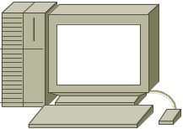
4. Secure Network Design Topologies
DMZ
Enterprise
Network
Internet
Web, File, DNS, Mail Servers

Slide 34

4. Secure Network Design Topologies
Internet
Firewall
DMZ
Enterprise Network
Web, File, DNS, Mail Servers

Slide 35
Review Questions
Why are hierarchy and modularity important for network designs?
What are the three layers of Cisco’s hierarchical network design?
What are the major components of Cisco’s enterprise composite network model?
What are the advantages and disadvantages of the various options for multihoming an Internet connection?

Slide 36
Summary
Use a systematic, top-down approach
Plan the logical design before the physical design
Topology design should feature hierarchy, redundancy, modularity, and security

