Slide 1
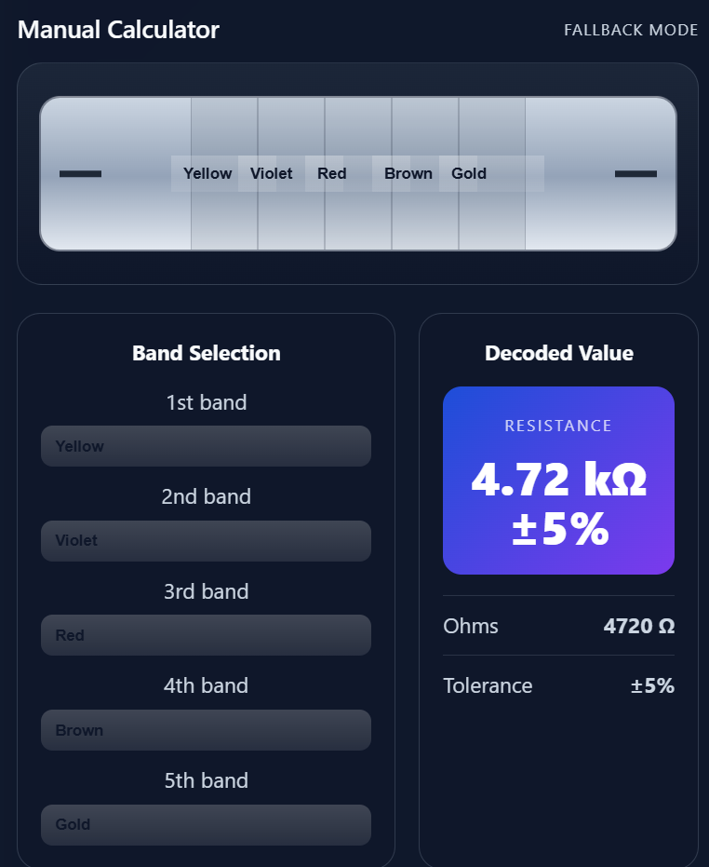
Resistor Value
Identifier
Choose the bands. Read the value.
A hands-on tool for selecting resistor bands and reading the resulting resistance.
4-band
5-band
Live value + tolerance
THE MANUAL CALCULATOR

Slide 2
RESISTOR VALUE IDENTIFICATION / 01 / 07
Introduction
AI Resistor Value Identification is a project designed to identify the resistance value of a resistor using its color bands. Resistors commonly use color bands to represent their resistance and tolerance, but reading these bands manually can sometimes be difficult or time-consuming. This project provides a digital solution where users can select resistor bands and instantly obtain the resistance value and tolerance. It also includes an optional AI-based image recognition feature for identifying resistor values from photographs.

Slide 3
02 / MAIN FEATURE
3 / 7
Manual calculator: from bands to a value
1
Choose band count
Select a 4-band or 5-band resistor.
2
Set each color
Use the labeled selectors; the resistor preview updates.
3
Read the result
Resistance in ohms and tolerance recalculate immediately.
4-band: 2 significant digits • 5-band: 3 significant digits

Slide 4
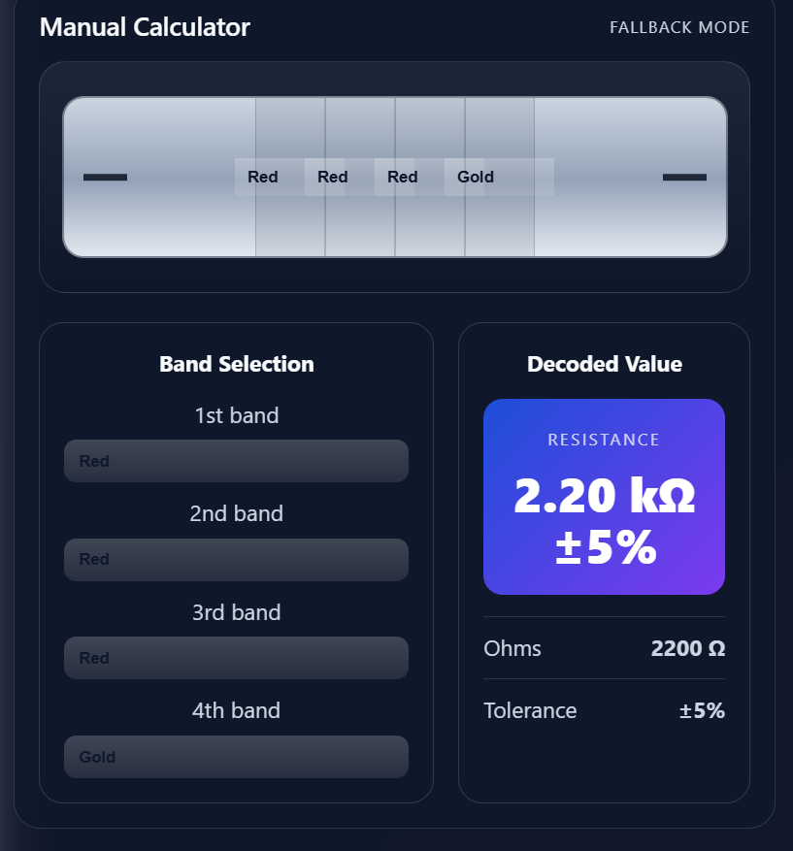
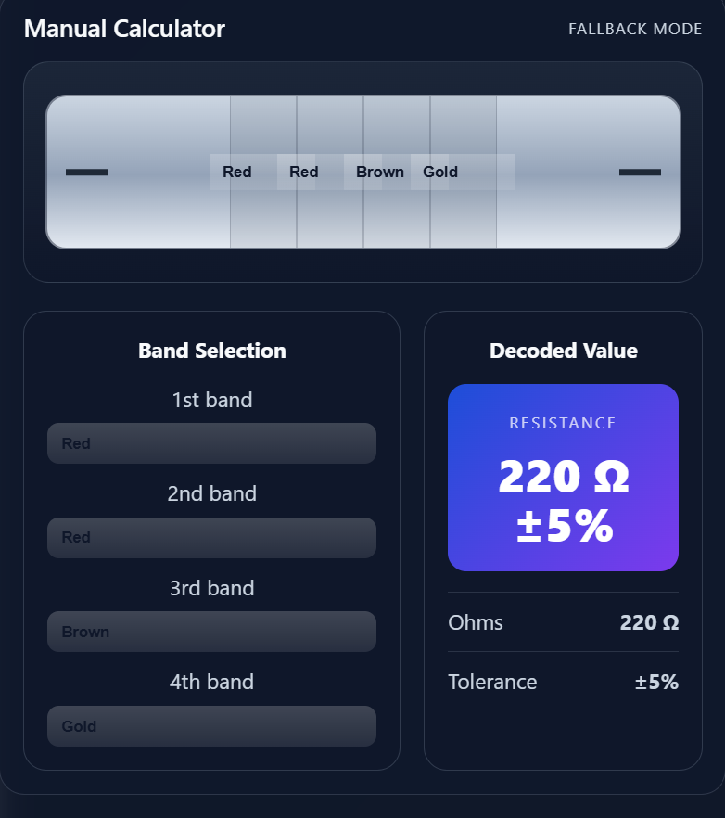
03 / CALCULATOR EXAMPLES
4 / 7
Change the bands; the decoded value follows
RED • RED • BROWN • GOLD
YELLOW • VIOLET • RED • GOLD

Slide 5
04 / HOW THE CALCULATOR WORKS
5 / 7
Digits, multiplier, tolerance
4-BAND RESISTOR
5-BAND RESISTOR
RED
2
RED
2
BROWN
×10
GOLD
±5%
YELLOW
4
VIOLET
7
RED
0
BROWN
×10
GOLD
±5%
(22) × 10 = 220 Ω
(470) × 10 = 4.7 kΩ
Why tolerance matters
Gold indicates ±5%; silver indicates ±10%. Metallic colors are not valid significant digits.
4-band formula: (10 × first digit + second digit) × multiplier

Slide 6
05 / PROJECT RESULTS
6 / 7
A practical resistor calculator with an AI extension
WORKING FEATURES
AI MODEL SUPPORT
MANUAL
CALCULATOR
• Select four or five bands
• See a resistor preview
• Decode resistance and tolerance
• Upload-photo AI mode is optional
• 37 resistor classes
• 91% top-1 test accuracy
• 99.7% top-5 on 289 held-out photos
• Model/band conflicts are flagged
4-BAND / 5-BAND
220 Ω
4.7 kΩ
Decoded values with tolerance, updated from color selections.
TAKEAWAY
The manual calculator is the core; image recognition adds a second way to identify a resistor.

Slide 7
RESISTOR VALUE IDENTIFICATION / 07 / 07
Conclusion
The AI Resistor Value Identification project provides a practical and user-friendly way to determine resistor values. The manual calculator successfully supports both 4-band and 5-band resistors, displaying resistance and tolerance based on the selected colors. The project also includes an AI extension for image-based identification, providing an additional way to recognize resistor values. Overall, the system combines traditional resistor color-code calculation with AI-based recognition to make resistor identification faster and easier.

