Slide 1
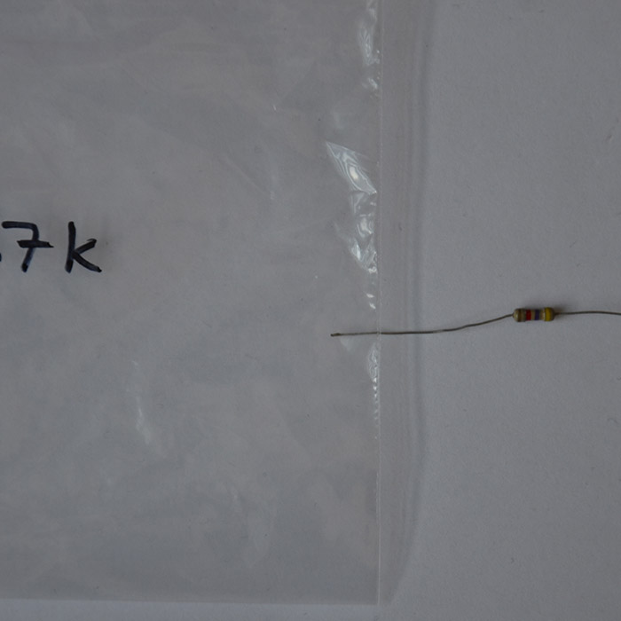
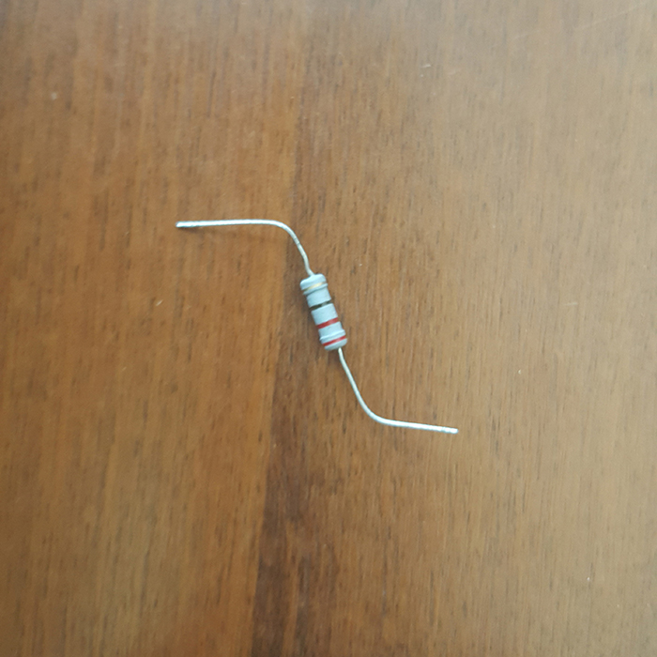
ECE PROJECT / COMPUTER VISION
Resistor Value
Identifier
From a photo to an ohmic value
Color-band decoding cross-checked with a trained image classifier
EXAMPLE / 4.7 kΩ CLASS
37 classes
2,881 photos
91% top-1 test accuracy
EXAMPLE / 220 Ω CLASS
Resistor Value Identifier • Class presentation

Slide 2
RESISTOR VALUE IDENTIFICATION / 01 / 07
Introduction
AI Resistor Value Identification is a project designed to identify the resistance value of a resistor using its color bands. Resistors commonly use color bands to represent their resistance and tolerance, but reading these bands manually can sometimes be difficult or time-consuming. This project provides a digital solution where users can select resistor bands and instantly obtain the resistance value and tolerance. It also includes an optional AI-based image recognition feature for identifying resistor values from photographs.

Slide 3
02 / SYSTEM DESIGN
3 / 7
One photo, two independent checks
01
02
03
04
Upload
›
Find bands
›
Classify
›
Report value
React UI loads the selected photo.
Pixel analysis locates the resistor body and stripe colors.
YOLO11n predicts one of 37 labeled resistor classes.
Band-code result is compared with model output.
IMPLEMENTATION
React + TypeScript
Electron IPC bridge
Python + Ultralytics
Image stays local
If estimates disagree, the app flags the result instead of hiding the mismatch.
Architecture: image-level classification plus color-band decoding

Slide 4
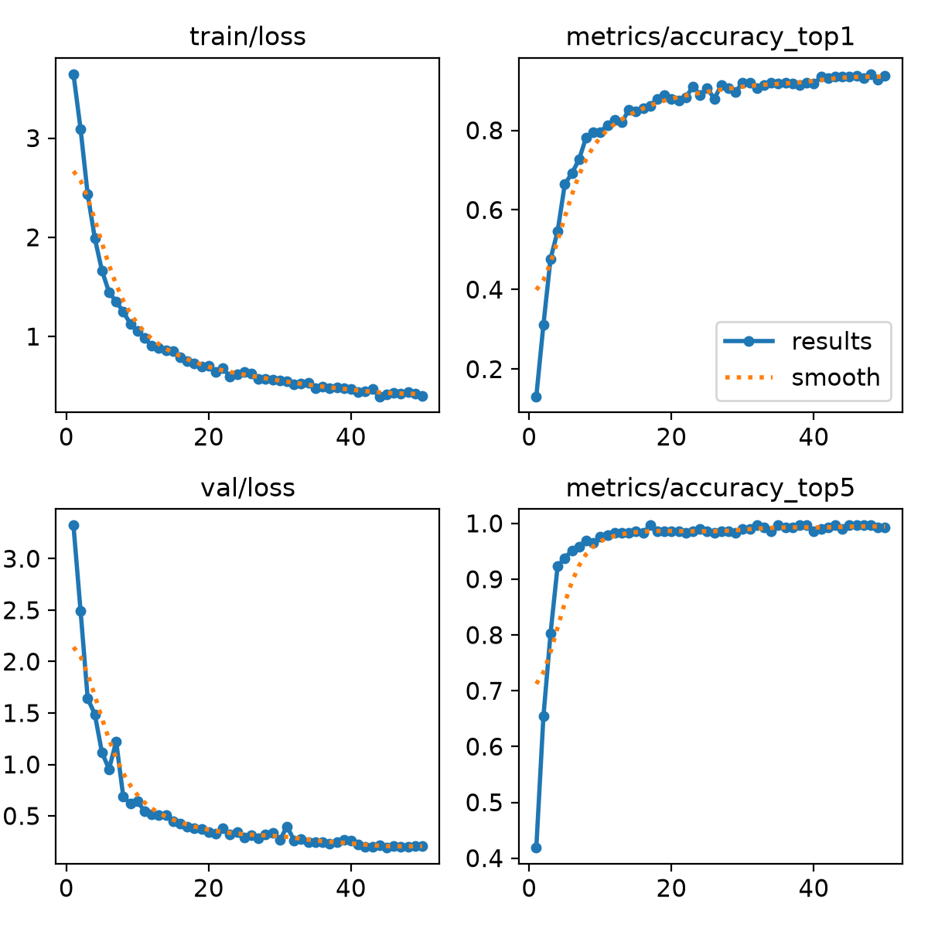
03 / DATA AND TRAINING
4 / 7
Learning resistor classes from labeled photos
TRAINING METRICS BY EPOCH
2,881
37
50
images
classes
epochs
81 / 10 / 10 SPLIT
2,303 train • 289 validation • 289 test
PRETRAINED MODEL
YOLO11n-cls / 224 px input / CPU training
The best checkpoint is saved as
models/resistor_classifier.pt.
Dataset labels come from class names; the app uses the classifier confidence as a second opinion.

Slide 5
04 / VALUE DECODING
5 / 7
A resistor value is encoded in its bands
RED • RED • BROWN • GOLD
YELLOW • VIOLET • RED • GOLD
22 × 10¹ = 220 Ω
47 × 10² = 4.7 kΩ
±5% tolerance
±5% tolerance
4-band rule: (first digit × 10 + second digit) × multiplier
Gold/silver are multiplier or tolerance bands, never significant digits.
Band sequence is tested in both orientations; invalid metallic digit readings are rejected.

Slide 6
05 / RESULTS AND NEXT STEPS
6 / 7
What works, and what still needs testing
CURRENT STRENGTHS
NEXT IMPROVEMENTS
91%
• Trained 37-class image classifier
• Independent color-band value check
• Flags classifier/band disagreements
• 9 automated tests pass
• Test more cameras, lighting, and backgrounds
• Add varied real photos per class
• Improve resistor/body localization
• Track per-class errors and confidence
TOP-1 TEST ACCURACY
99.7% top-5
289 held-out images
91% exact class match; top-5 includes the correct class among the five highest scores.
TAKEAWAY
The model proposes a class; the color code provides a physical cross-check.
Questions?
Measured project result; broader real-world accuracy still requires additional evaluation.

Slide 7
RESISTOR VALUE IDENTIFICATION / 07 / 07
Conclusion
The AI Resistor Value Identification project provides a practical and user-friendly way to determine resistor values. The manual calculator successfully supports both 4-band and 5-band resistors, displaying resistance and tolerance based on the selected colors. The project also includes an AI extension for image-based identification, providing an additional way to recognize resistor values. Overall, the system combines traditional resistor color-code calculation with AI-based recognition to make resistor identification faster and easier.

