Slide 1
Enhancing Human-Machine Collaboration in Industrial Workflows using Generative AI Models
Dissertation (Abstract Viva)
in partial fulfilment of the requirements for the degree: M.Tech. in Artificial Intelligence & Machine Learning

Slide 2

Rounaq Choudhuri
I am driven by a passion for converting data into practical business intelligence.
My expertise includes a robust background in computer vision, where I have conceptualized and built video-based analytical solutions.
Currently, at LTIMindtree, I am focused on creating real-time intelligent surveillance systems for applications such as Environmental, Health, and Safety (EHS) and quality inspection.
My enthusiasm lies in crafting cutting-edge data solutions and utilizing the power of AI/ML and Generative AI to tackle intricate business problems.

Slide 3
Dissertation Overview

Slide 4
Overview
This dissertation addresses the critical industrial challenge of limited anomaly and failure data, which hinders robust AI system operation and comprehensive human operator preparedness.
The work proposes to leverage non-Transformer based Generative AI models, specifically Variational Autoencoders (VAEs) for robust anomaly detection from normal data, and Generative Adversarial Networks (GANs) for synthesizing diverse, realistic industrial data.
The ultimate goal is to overcome data scarcity, enable more reliable AI systems, enhance human situational awareness and decision-making, and thus significantly improve human-machine collaboration for industrial efficiency and safety.

Slide 5
Motivation & Benefits
What is the motivation?
Industrial workflows are often very complex pertaining to the wide variety of intrinsic and extraneous factors.
Very difficult to model these complex distributions, therefore, AI systems often fail to provide robust solutions.
What is the benefit of this work?
A comprehensive and comparative study in AI systems for industrial workflow.
It will create a premise for addressing the issues in modelling these complex data.
What are the expected outcome?
Robust AI systems which can correctly assess unforeseen circumstances.
Harnessing the power of SOTA Generative AI Models to create realistic and diverse synthetic industrial data.
How it can eventually enhance human-machine collaboration?
Meeting increasing demands to have closed loop systems in the era of Industry 4.0.
Foster trust among industrial machinery operators, business personnels and AI systems.

Slide 6
Scope of Work
In-Scope
Out-of-Scope*
Generative Models: Implementation and experimentation with VAEs and GANs on industrial datasets.
Anomaly Detection: Implementation of anomaly detection models and their evaluation.
Data Generation: Use generative AI models to generate synthetic faulty data and its evaluation.
Model Generalization: Anomaly detection model generalization using synthetically generated data.
Transformer based Models: Implementation and application of Transformer based architectures for human-machine interaction or synthetic data generation.
Advance HMIs: Designing and constructing full-scale, highly interactive Human-Machine Interfaces or complete control systems based on model outputs.
*The out-of-scope of this dissertation is subject to change depending on the project timeline and new discoveries.

Slide 7
Datasets
Industrial Equipment Monitoring Dataset (Kaggle) This dataset provides simulated real-time monitoring data for various industrial equipment, including turbines, compressors, and pumps. It captures key parameters like temperature, pressure, vibration, and humidity, along with a binary indicator for 'faulty' equipment, making it suitable for anomaly detection tasks where faulty instances are typically a minority class.
Download Link
Skoltech Anomaly Benchmark (SKAB) SKAB is a benchmark designed for evaluating anomaly detection algorithms using time-series data. It contains datasets with collective and point anomalies, which are often rare events in real-world industrial processes. The dataset is multivariate, collected from sensors installed on a testbed.
Download Link
*Datasets are not limited to the two mentioned here. Other datasets are also being explored.
Notes:
Industrial Equipment Monitoring Dataset (Kaggle)
=====================================================
The SKAB v0.9 corpus contains 35 individual data files (experiments). Each dataset represents a single experiment and contains a single anomaly. The datasets represent a multivariate time series collected from the sensors installed on the testbed. Columns in each data file are following:
datetime - Represents dates and times of the moment when the value is written to the database (YYYY-MM-DD hh:mm:ss)
Accelerometer1RMS - Shows a vibration acceleration (Amount of g units)
Accelerometer2RMS - Shows a vibration acceleration (Amount of g units)
Current - Shows the amperage on the electric motor (Ampere)
Pressure - Represents the pressure in the loop after the water pump (Bar)
Temperature - Shows the temperature of the engine body (The degree Celsius)
Thermocouple - Represents the temperature of the fluid in the circulation loop (The degree Celsius)
Voltage - Shows the voltage on the electric motor (Volt)
RateRMS - Represents the circulation flow rate of the fluid inside the loop (Liter per minute)
anomaly - Shows if the point is anomalous (0 or 1)
changepoint - Shows if the point is a changepoint for collective anomalies (0 or 1)

Slide 8
Concepts At Work

Slide 9
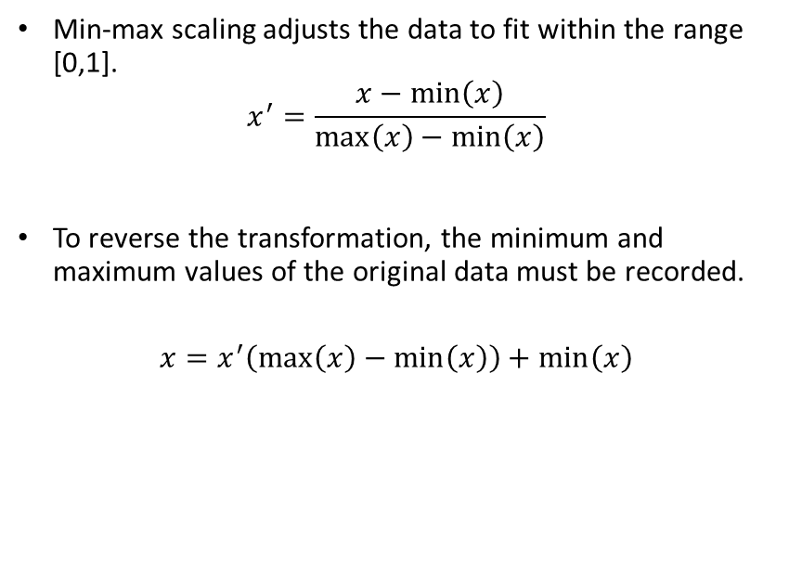
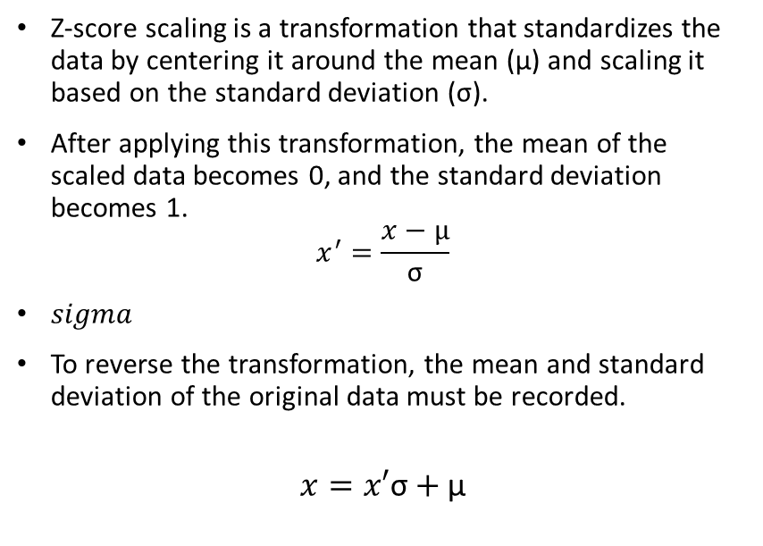
Feature Scaling
Min-Max Scaling
Z-Score Scaling
Min-max scaling adjusts the data to fit within the range [0,1].
$$x^{′}=\frac{x−\min\left(x\right)}{\max\left(x\right)−\min\left(x\right)}$$
To reverse the transformation, the minimum and maximum values of the original data must be recorded.
$$x=x^{′}\left(\max\left(x\right)−\min\left(x\right)\right)+\min\left(x\right)$$
Z-score scaling is a transformation that standardizes the data by centering it around the mean (µ) and scaling it based on the standard deviation (σ).
After applying this transformation, the mean of the scaled data becomes 0, and the standard deviation becomes 1.
$$x^{′}=\frac{x−µ}{\text{σ}}$$
$sigma$
To reverse the transformation, the mean and standard deviation of the original data must be recorded.
$$x=x′\text{σ}+\text{µ}$$
Notes:
Z-Score Scaling also know as standard scaling

Slide 10
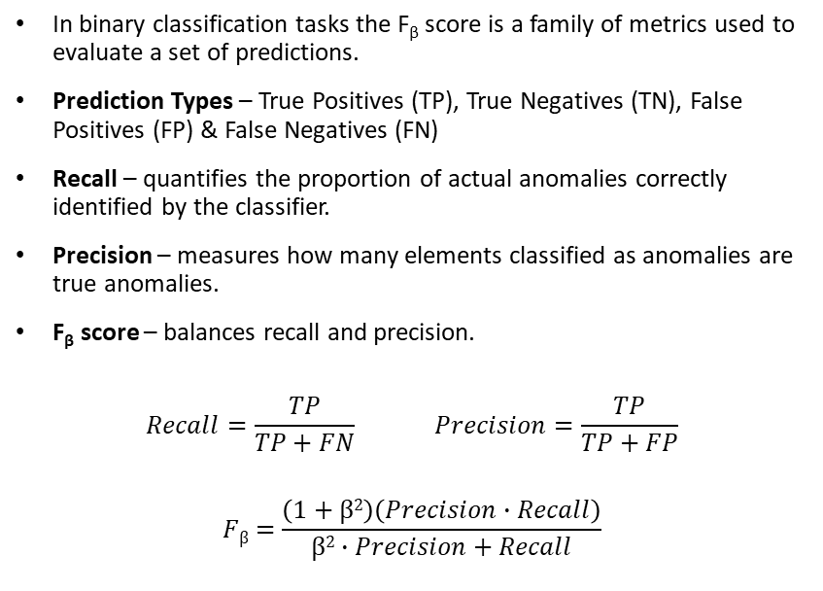
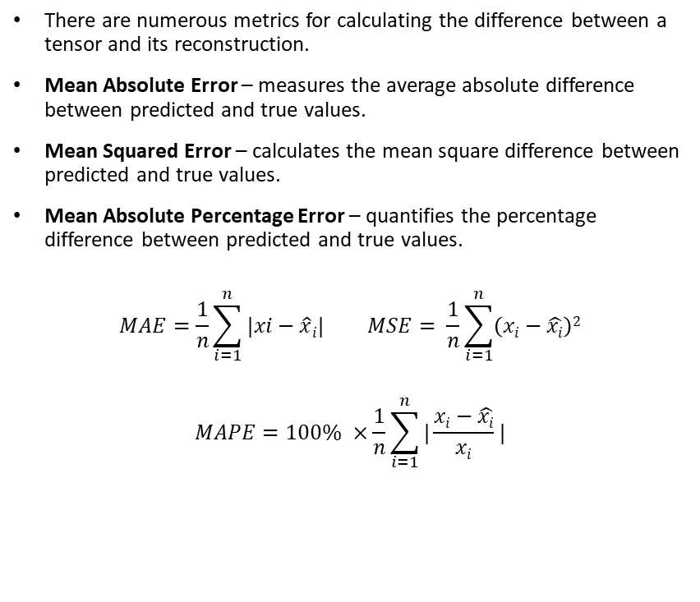
Performance Metrices
F_{β} Score
Reconstruction Metrics
In binary classification tasks the F_{β} score is a family of metrics used to evaluate a set of predictions.
Prediction Types – True Positives (TP), True Negatives (TN), False Positives (FP) & False Negatives (FN)
Recall – quantifies the proportion of actual anomalies correctly identified by the classifier.
Precision – measures how many elements classified as anomalies are true anomalies.
F_{β} score – balances recall and precision.
$$Recall=\frac{TP}{TP+FN} Precision=\frac{TP}{TP+FP}$$
$$Fβ=\frac{\left(1+β2\right)\left(Precision∙Recall\right)}{β2∙Precision+Recall}$$
There are numerous metrics for calculating the difference between a tensor and its reconstruction.
Mean Absolute Error – measures the average absolute difference between predicted and true values.
Mean Squared Error – calculates the mean square difference between predicted and true values.
Mean Absolute Percentage Error – quantifies the percentage difference between predicted and true values.
$$MAE=\frac{1}{n}\sum_{i=1}^{n}{|xi−\hat{x}i|} MSE= \frac{1}{n}\sum_{i=1}^{n}{\left(xi−\hat{xi}\right)2}$$
$$MAPE=100\% ×\frac{1}{n}\sum_{i=1}^{n}{|\frac{xi−\hat{xi}}{xi}|}$$
Notes:
In anomaly detection, TP represents correctly predicted anomalies, while TN refers to non-anomalies accurately identified as non-anomalies. FP occurs when a non-anomaly is mistakenly predicted as an anomaly, and FN occurs when an anomaly is wrongly predicted as a non-anomaly.
Here, β is a constant that allows the metric to apply preferential weight to either Precision or Recall, depending on whether false negatives or false positives have more severe consequences. In this thesis, this metric will be used for the specific case β =1,whichassigns equal importance to both precision and recall.

Slide 11
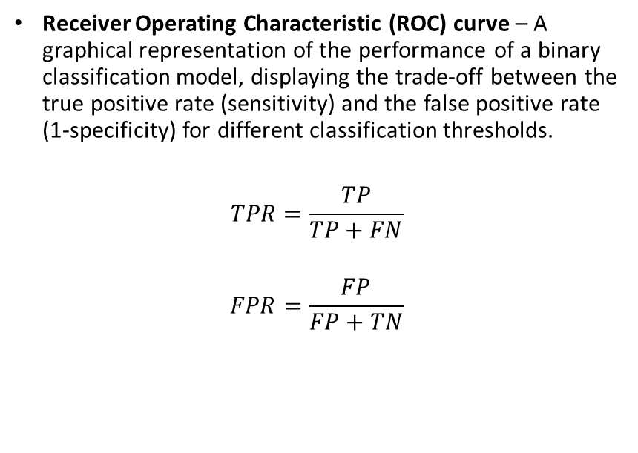
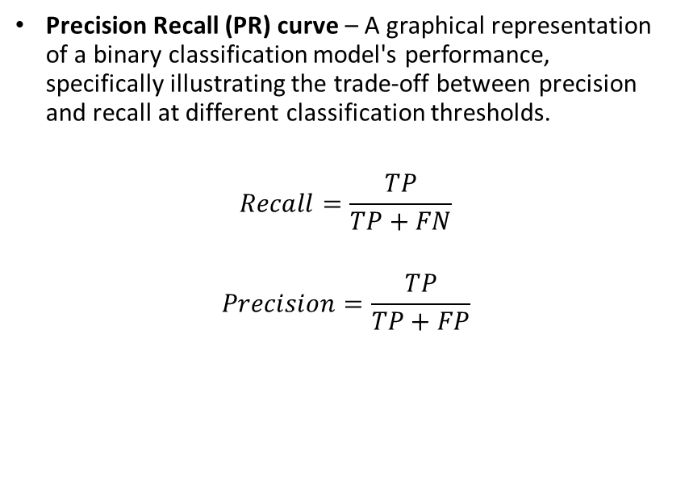
Performance Metrices (contd.)
ROC-AUC
PR-AUC
Receiver Operating Characteristic (ROC) curve – A graphical representation of the performance of a binary classification model, displaying the trade-off between the true positive rate (sensitivity) and the false positive rate (1-specificity) for different classification thresholds.
$$TPR=\frac{TP}{TP+FN}$$
$$FPR=\frac{FP}{FP+TN}$$
Precision Recall (PR) curve – A graphical representation of a binary classification model's performance, specifically illustrating the trade-off between precision and recall at different classification thresholds.
$$Recall=\frac{TP}{TP+FN}$$
$$Precision=\frac{TP}{TP+FP}$$
Notes:
The ROC curve is obtained by varying the classification threshold and plotting the TPR against the FPR. A perfect classifier would have a curve that passes through the top-left corner of the graph, indicating a TPR of 1 and an FPR of 0. A random classifier, on the other hand, would have a diagonal line from the bottom-left corner to the top-right corner, representing a random guess.
A PR curve that is closer to the upper-left corner of the plot indicates better precision and recall across thresholds.
Area Under the Curve (AUC), known as the AUC, is a single scalar value that summarizes the overall performance of the classification model across all possible thresholds. The AUC ranges from 0 to 1, where a value of 1 represents a perfect classifier, and a value of 0.5 corresponds to a random classifier.
The AUC has several desirable properties that make it a popular choice for evaluating classification models:
Invariance to class distribution: The AUC is not affected by the proportion of positive and negative instances in the dataset, making it suitable for imbalanced datasets.
Invariance to classification threshold: The AUC considers the classifier’s performance across all possible thresholds, comprehensively evaluating the model’s performance.
When to Use Each ::
ROC-AUC is suitable when the dataset is relatively balanced, and false positives and false negatives are of similar importance. It provides a comprehensive view of the model's overall discrimination ability across all thresholds.
PR-AUC is more appropriate and informative when the dataset is heavily imbalanced, and the accurate identification of the minority (anomaly) class is paramount, especially when the costs associated with false negatives are high. It offers a more focused evaluation on the model's ability to correctly predict positive cases at various levels of recall.

Slide 12
Learning Paradigms
Supervised Learning
Unsupervised Learning
Supervised learning is a type of machine learning where the algorithm learns from labelled examples.
Supervised models performs regression or classification tasks on new, unseen data.
In the context of deep neural networks, it involves training a model using input-output pairs, where the inputs are the features or attributes of the data, and the outputs are the corresponding labels or target values.
The goal is to teach a function f(x) that maps the input features to the correct output labels.
Unsupervised learning is a type of machine learning where the algorithm learns patterns or structures in the input data without explicit labels or target values.
Unlike supervised learning, it does not rely on explicit labels or target values. Instead, it focuses on finding patterns or organizing the data to capture meaningful information without specific guidance.
In the context of deep neural networks, it is often used for clustering, dimensionality reduction, or generative modelling tasks.
The goal is to discover inherent structures, relationships, or representations within the data.

Slide 13
Solution Plan

Slide 14





Dissertation Workflow
Supervised Model Training
Statistical Reports
Data Source
Unsupervised Model Training
VAE Model Training
Anomaly Score
Function
*The technology to be used to represent the reports in the presentation layer are yet to be decided.
Wrangling
Feature Scaling
GAN Model Training
Synthetic Data Generation
Model Evaluation
Data Preprocessing Pipeline
Presentation Layer*
Modelling Pipeline

Slide 15
Planner
 | Sl No. | Deliverables |  |  |  |  | Weeks |  |  |  |  |  |  |  |  |  |  |  |  |  |  |  | Status
 |  |  |  |  |  |  | 1 | 2 | 3 | 4 | 5 | 6 | 7 | 8 | 9 | 10 | 11 | 12 | 13 | 14 | 15 | 16
 | 1 | Proposal Approval |  |  |  |  |  |  |  |  |  |  |  |  |  |  |  |  |  |  |  |  | Completed
 | 2 | Literature Review |  |  |  |  |  |  |  |  |  |  |  |  |  |  |  |  |  |  |  |  | Completed
 | 3 | Dataset Finalization |  |  |  |  |  |  |  |  |  |  |  |  |  |  |  |  |  |  |  |  | Ongoing
 | 4 | Data Wrangling |  |  |  |  |  |  |  |  |  |  |  |  |  |  |  |  |  |  |  |  | Ongoing
 | 5 | Data Statistics Reporting |  |  |  |  |  |  |  |  |  |  |  |  |  |  |  |  |  |  |  |  | Pending
 | 6 | VAE Model Implementations |  |  |  |  |  |  |  |  |  |  |  |  |  |  |  |  |  |  |  |  | Pending
 | 7 | Implementation of Anomaly Scoring Function |  |  |  |  |  |  |  |  |  |  |  |  |  |  |  |  |  |  |  |  | Pending
 | 8 | Model Evalution |  |  |  |  |  |  |  |  |  |  |  |  |  |  |  |  |  |  |  |  | Pending
 | 9 | VAE Anomaly Detection Performance Report |  |  |  |  |  |  |  |  |  |  |  |  |  |  |  |  |  |  |  |  | Pending
 | 10 | Implementation of GAN Model |  |  |  |  |  |  |  |  |  |  |  |  |  |  |  |  |  |  |  |  | Pending
 | 11 | Model Evalution |  |  |  |  |  |  |  |  |  |  |  |  |  |  |  |  |  |  |  |  | Pending
 | 12 | GAN Performance Report |  |  |  |  |  |  |  |  |  |  |  |  |  |  |  |  |  |  |  |  | Pending
 | 13 | Synthetic Data Generation |  |  |  |  |  |  |  |  |  |  |  |  |  |  |  |  |  |  |  |  | Pending
 | 14 | ML Model Performance Report |  |  |  |  |  |  |  |  |  |  |  |  |  |  |  |  |  |  |  |  | Pending
 | 15 | Comprehensice Evaluation Report |  |  |  |  |  |  |  |  |  |  |  |  |  |  |  |  |  |  |  |  | Pending
 | 16 | Dissertation Finalization |  |  |  |  |  |  |  |  |  |  |  |  |  |  |  |  |  |  |  |  | Pending
 | 17 | Submission |  |  |  |  |  |  |  |  |  |  |  |  |  |  |  |  |  |  |  |  | Pending
*The dissertation planner is subject to change depending on the project timeline and new discoveries.

Slide 16
Thank You

Slide 17
QA

