Slide 1
Enhancing Human-Machine Collaboration in Industrial Workflows using Generative AI Models
Dissertation (Abstract Viva)
in partial fulfilment of the requirements for the degree: M.Tech. in Artificial Intelligence & Machine Learning

Slide 2

Rounaq Choudhuri
I am driven by a passion for converting data into practical business intelligence.
My expertise includes a robust background in computer vision, where I have conceptualized and built video-based analytical solutions.
Currently, at LTIMindtree, I am focused on creating real-time intelligent surveillance systems for applications such as Environmental, Health, and Safety (EHS) and quality inspection.
My enthusiasm lies in crafting cutting-edge data solutions and utilizing the power of AI/ML and Generative AI to tackle intricate business problems.

Slide 3
Dissertation Overview

Slide 4
Overview
This dissertation addresses the critical industrial challenge of limited anomaly and failure data, which hinders robust AI system operation and comprehensive human operator preparedness.
The work proposes to leverage non-Transformer based Generative AI models, specifically Variational Autoencoders (VAEs) for robust anomaly detection from normal data, and Generative Adversarial Networks (GANs) for synthesizing diverse, realistic industrial data.
The ultimate goal is to overcome data scarcity, enable more reliable AI systems, enhance human situational awareness and decision-making, and thus significantly improve human-machine collaboration for industrial efficiency and safety.

Slide 5
Motivation & Benefits
What is the motivation?
Industrial workflows are often very complex pertaining to the wide variety of intrinsic and extraneous factors.
Very difficult to model these complex distributions, therefore, AI systems often fail to provide robust solutions.
What is the benefit of this work?
A comprehensive and comparative study in AI systems for industrial workflow.
It will create a premise for addressing the issues in modelling these complex data.
What are the expected outcome?
Robust AI systems which can correctly assess unforeseen circumstances.
Harnessing the power of SOTA Generative AI Models to create realistic and diverse synthetic industrial data.
How it can eventually enhance human-machine collaboration?
Meeting increasing demands to have closed loop systems in the era of Industry 4.0.
Foster trust among industrial machinery operators, business personnels and AI systems.

Slide 6
Scope of Work
In-Scope
Out-of-Scope*
Generative Models: Implementation and experimentation with VAEs and GANs on industrial datasets.
Anomaly Detection: Implementation of anomaly detection models and their evaluation.
Data Generation: Use generative AI models to generate synthetic faulty data and its evaluation.
Model Generalization: Anomaly detection model generalization using synthetically generated data.
Transformer based Models: Implementation and application of Transformer based architectures for human-machine interaction or synthetic data generation.
Advance HMIs: Designing and constructing full-scale, highly interactive Human-Machine Interfaces or complete control systems based on model outputs.
*The out-of-scope of this dissertation is subject to change depending on the project timeline and new discoveries.

Slide 7
Concepts At Work

Slide 8
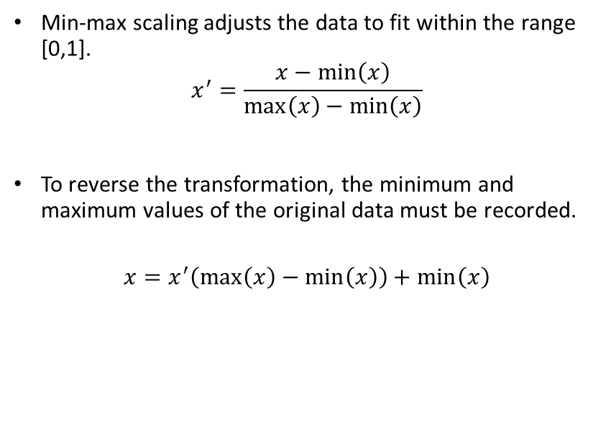
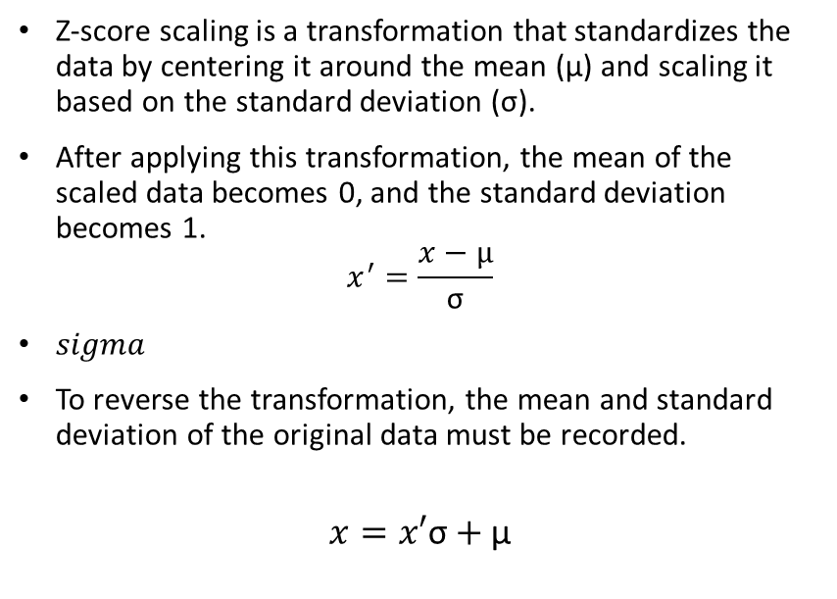
Feature Scaling
Min-Max Scaling
Z-Score Scaling
Min-max scaling adjusts the data to fit within the range [0,1].
$$x^{′}=\frac{x−\min\left(x\right)}{\max\left(x\right)−\min\left(x\right)}$$
To reverse the transformation, the minimum and maximum values of the original data must be recorded.
$$x=x^{′}\left(\max\left(x\right)−\min\left(x\right)\right)+\min\left(x\right)$$
Z-score scaling is a transformation that standardizes the data by centering it around the mean (µ) and scaling it based on the standard deviation (σ).
After applying this transformation, the mean of the scaled data becomes 0, and the standard deviation becomes 1.
$$x^{′}=\frac{x−µ}{\text{σ}}$$
$sigma$
To reverse the transformation, the mean and standard deviation of the original data must be recorded.
$$x=x′\text{σ}+\text{µ}$$
Notes:
Z-Score Scaling also know as standard scaling

Slide 9
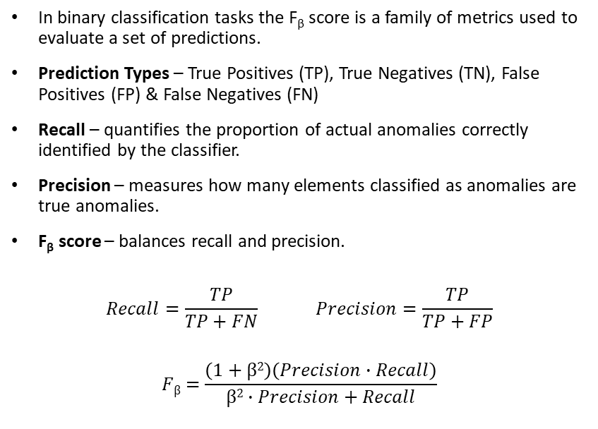
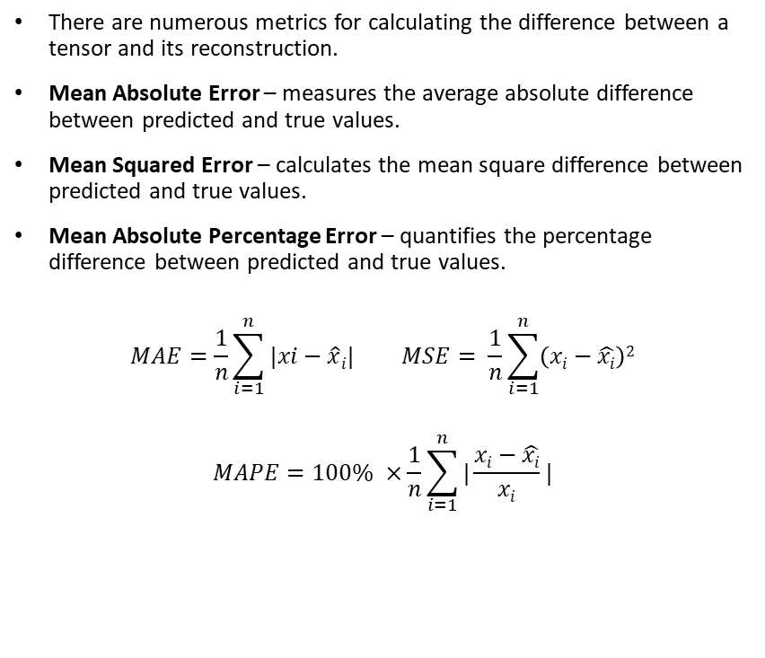
Performance Metrices
F_{β} Score
Reconstruction Metrics
In binary classification tasks the F_{β} score is a family of metrics used to evaluate a set of predictions.
Prediction Types – True Positives (TP), True Negatives (TN), False Positives (FP) & False Negatives (FN)
Recall – quantifies the proportion of actual anomalies correctly identified by the classifier.
Precision – measures how many elements classified as anomalies are true anomalies.
F_{β} score – balances recall and precision.
$$Recall=\frac{TP}{TP+FN} Precision=\frac{TP}{TP+FP}$$
$$Fβ=\frac{\left(1+β2\right)\left(Precision∙Recall\right)}{β2∙Precision+Recall}$$
There are numerous metrics for calculating the difference between a tensor and its reconstruction.
Mean Absolute Error – measures the average absolute difference between predicted and true values.
Mean Squared Error – calculates the mean square difference between predicted and true values.
Mean Absolute Percentage Error – quantifies the percentage difference between predicted and true values.
$$MAE=\frac{1}{n}\sum_{i=1}^{n}{|xi−\hat{x}i|} MSE= \frac{1}{n}\sum_{i=1}^{n}{\left(xi−\hat{xi}\right)2}$$
$$MAPE=100\% ×\frac{1}{n}\sum_{i=1}^{n}{|\frac{xi−\hat{xi}}{xi}|}$$
Notes:
In anomaly detection, TP represents correctly predicted anomalies, while TN refers to non-anomalies accurately identified as non-anomalies. FP occurs when a non-anomaly is mistakenly predicted as an anomaly, and FN occurs when an anomaly is wrongly predicted as a non-anomaly.
Here, β is a constant that allows the metric to apply preferential weight to either Precision or Recall, depending on whether false negatives or false positives have more severe consequences. In this thesis, this metric will be used for the specific case β =1,whichassigns equal importance to both precision and recall.

Slide 10
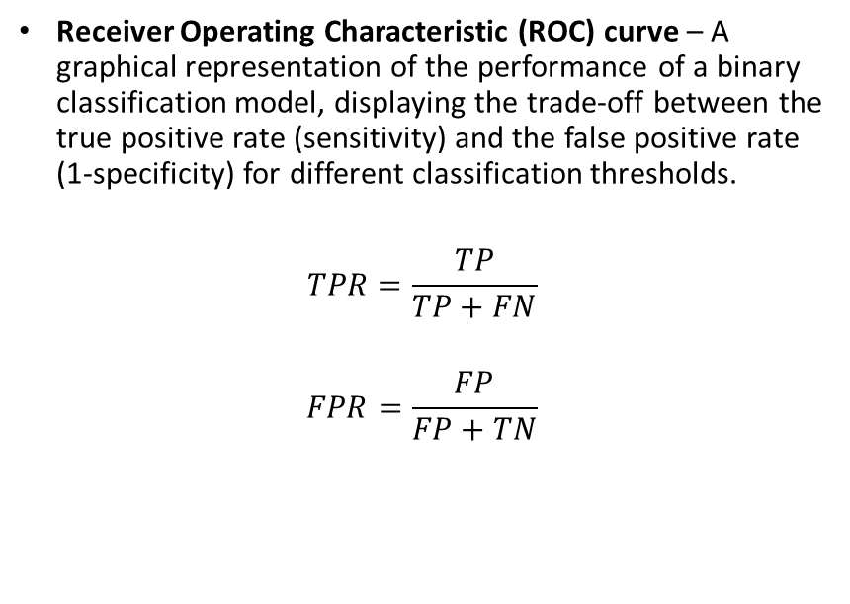
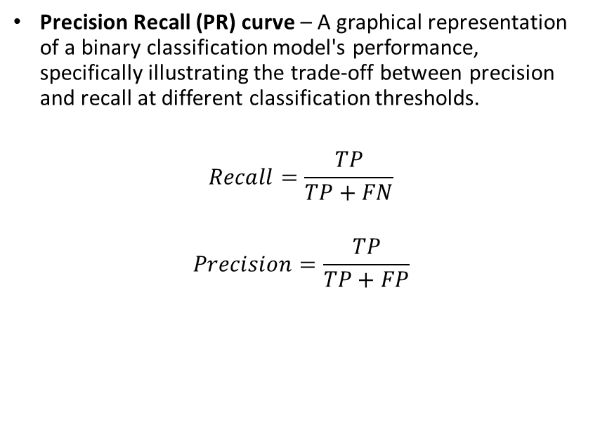
Performance Metrices (contd.)
ROC-AUC
PR-AUC
Receiver Operating Characteristic (ROC) curve – A graphical representation of the performance of a binary classification model, displaying the trade-off between the true positive rate (sensitivity) and the false positive rate (1-specificity) for different classification thresholds.
$$TPR=\frac{TP}{TP+FN}$$
$$FPR=\frac{FP}{FP+TN}$$
Precision Recall (PR) curve – A graphical representation of a binary classification model's performance, specifically illustrating the trade-off between precision and recall at different classification thresholds.
$$Recall=\frac{TP}{TP+FN}$$
$$Precision=\frac{TP}{TP+FP}$$
Notes:
The ROC curve is obtained by varying the classification threshold and plotting the TPR against the FPR. A perfect classifier would have a curve that passes through the top-left corner of the graph, indicating a TPR of 1 and an FPR of 0. A random classifier, on the other hand, would have a diagonal line from the bottom-left corner to the top-right corner, representing a random guess.
A PR curve that is closer to the upper-left corner of the plot indicates better precision and recall across thresholds.
Area Under the Curve (AUC), known as the AUC, is a single scalar value that summarizes the overall performance of the classification model across all possible thresholds. The AUC ranges from 0 to 1, where a value of 1 represents a perfect classifier, and a value of 0.5 corresponds to a random classifier.
The AUC has several desirable properties that make it a popular choice for evaluating classification models:
Invariance to class distribution: The AUC is not affected by the proportion of positive and negative instances in the dataset, making it suitable for imbalanced datasets.
Invariance to classification threshold: The AUC considers the classifier’s performance across all possible thresholds, comprehensively evaluating the model’s performance.
When to Use Each ::
ROC-AUC is suitable when the dataset is relatively balanced, and false positives and false negatives are of similar importance. It provides a comprehensive view of the model's overall discrimination ability across all thresholds.
PR-AUC is more appropriate and informative when the dataset is heavily imbalanced, and the accurate identification of the minority (anomaly) class is paramount, especially when the costs associated with false negatives are high. It offers a more focused evaluation on the model's ability to correctly predict positive cases at various levels of recall.

Slide 11
Learning Paradigms
Supervised Learning
Unsupervised Learning
Supervised learning is a type of machine learning where the algorithm learns from labelled examples.
Supervised models performs regression or classification tasks on new, unseen data.
In the context of deep neural networks, it involves training a model using input-output pairs, where the inputs are the features or attributes of the data, and the outputs are the corresponding labels or target values.
The goal is to teach a function f(x) that maps the input features to the correct output labels.
Unsupervised learning is a type of machine learning where the algorithm learns patterns or structures in the input data without explicit labels or target values.
Unlike supervised learning, it does not rely on explicit labels or target values. Instead, it focuses on finding patterns or organizing the data to capture meaningful information without specific guidance.
In the context of deep neural networks, it is often used for clustering, dimensionality reduction, or generative modelling tasks.
The goal is to discover inherent structures, relationships, or representations within the data.

Slide 12
Dataset

Slide 13
Dataset
Skoltech Anomaly Benchmark (SKAB) SKAB is a benchmark designed for evaluating anomaly detection algorithms using time-series data. It contains datasets with collective and point anomalies, which are often rare events in real-world industrial processes. The dataset is multivariate, collected from sensors installed on a testbed.
Download Link
Column Description
• datetime : Dates and times of data points (YYYY-MM-DD hh:mm:ss).
• Accelerometer1RMS : Vibration acceleration along the x-axis.
• Accelerometer2RMS : Vibration acceleration along the y-axis.
• Current : Current strength on electric motors (Amperes).
• Pressure : Pressure in the circuit after the water pump (Bar).
• Temperature : Temperature of the engine housing (◦C).
• Thermocouple : Temperature of the liquid in the circulation circuit (◦C).
• Voltage : Voltage on electric motors (Volts).
• Volume Flow RateRMS : The circulation flow rate of the fluid inside the loop (Liter per minute).
• anomaly : Shows whether the point is anomalous (0 or 1).
• changepoint : Shows whether the point is the point of change of state (0 or 1).
Notes:
Skoltech Anomaly Benchmark (SKAB) dataset is designed to evaluate the anomaly detection
score. The SKAB dataset contains 35 data files in “.csv” format. Each file represents one
experiment and contains one anomaly (the exception is the anomaly-free file, which does not
contain any anomalies). The set of data represents a multidimensional time series collected
from sensors installed on the test bench. This experiment was recorded 13 different types of
anomalies across 3 days.
Since the scope of this work is limited to anomaly detection, the changepoint column will
be dropped. All the 35 data files will be merged into a single “.csv” file for the ease of
processing and performing downstream tasks like Exploratory Data Analysis (EDA), Model
Training and Evaluation, etc.

Slide 14
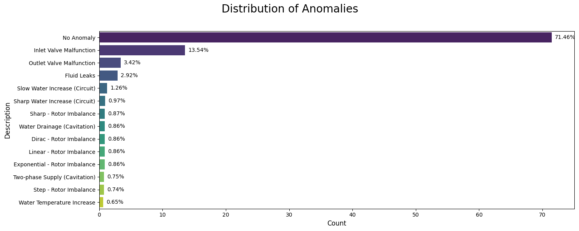
Data Proportion
A severe class imbalance within the dataset.
“No Anomaly” instances constitute a dominant 71.46%.
Anomalous data points are less than 30%.

Slide 15
Data Preprocessing

Slide 16
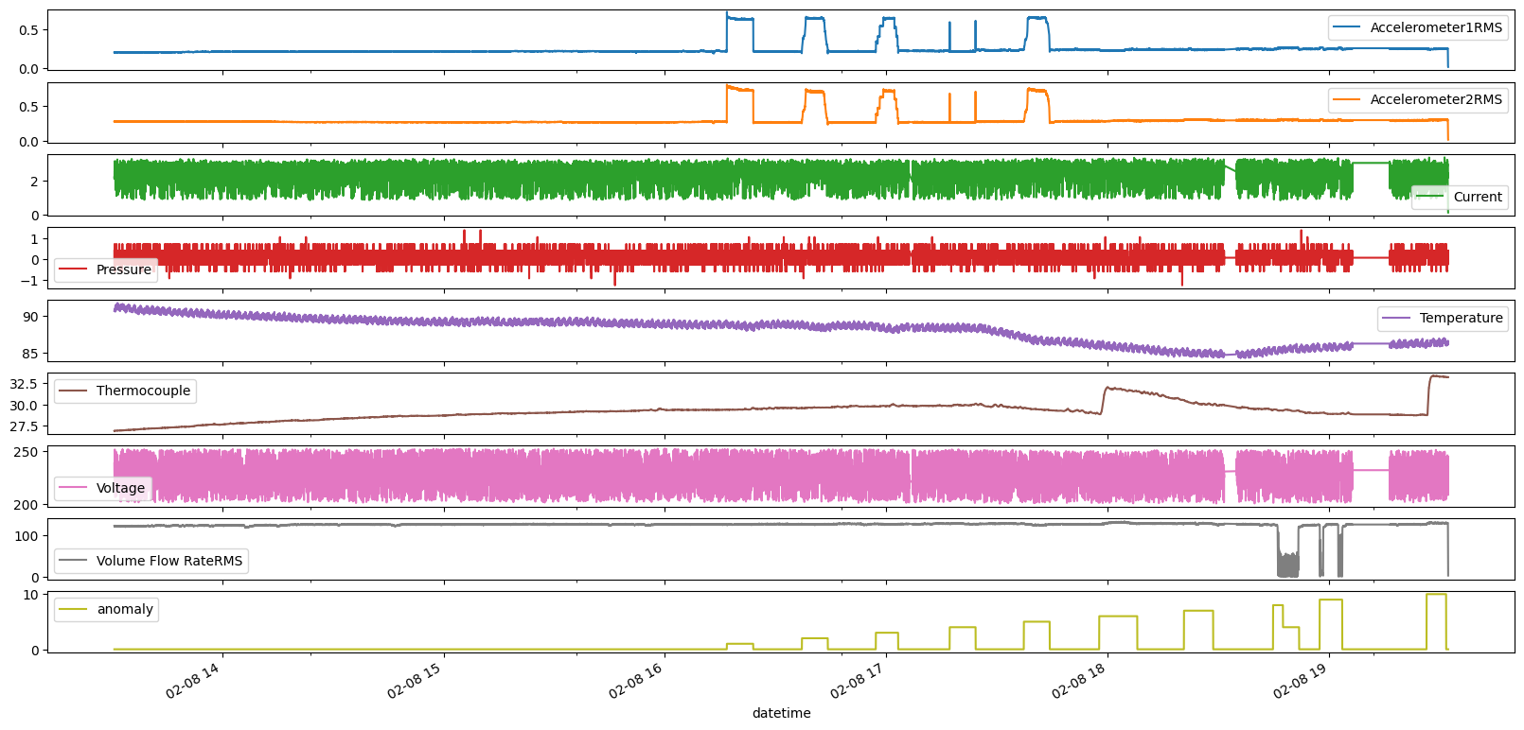
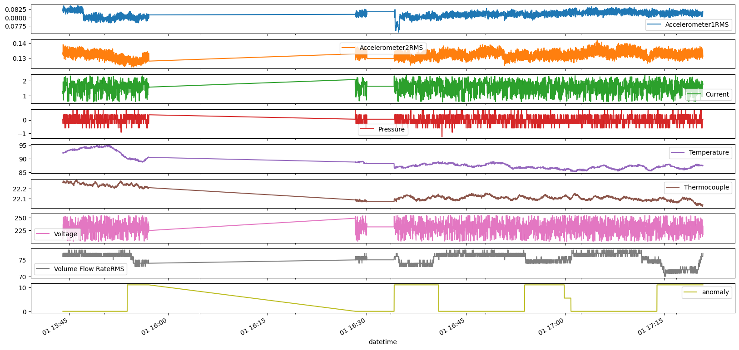
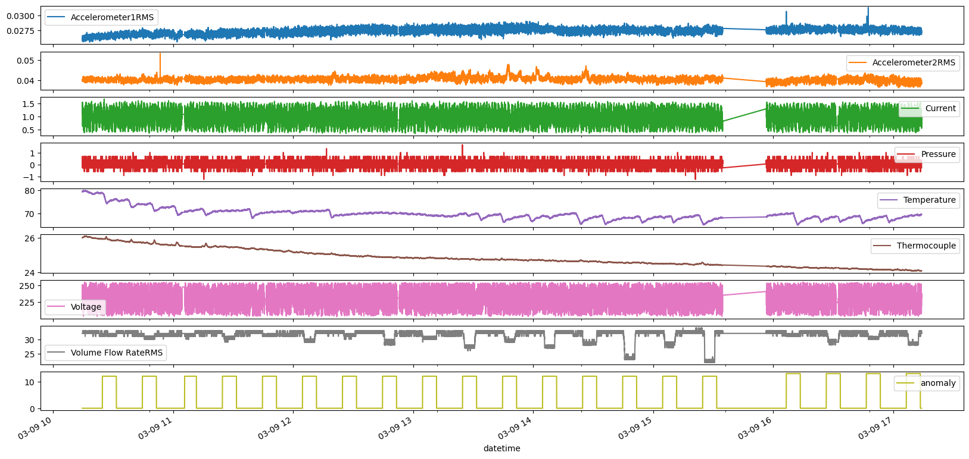
Data Sampling & Merging
Time series plots of the data set shows that the pump can operate at various operational states.
Various operational status can host different types of anomalies.
Not all features are shows significant deviation or spikes during anomalies.

Slide 17
Exploratory Data Analysis

Slide 18
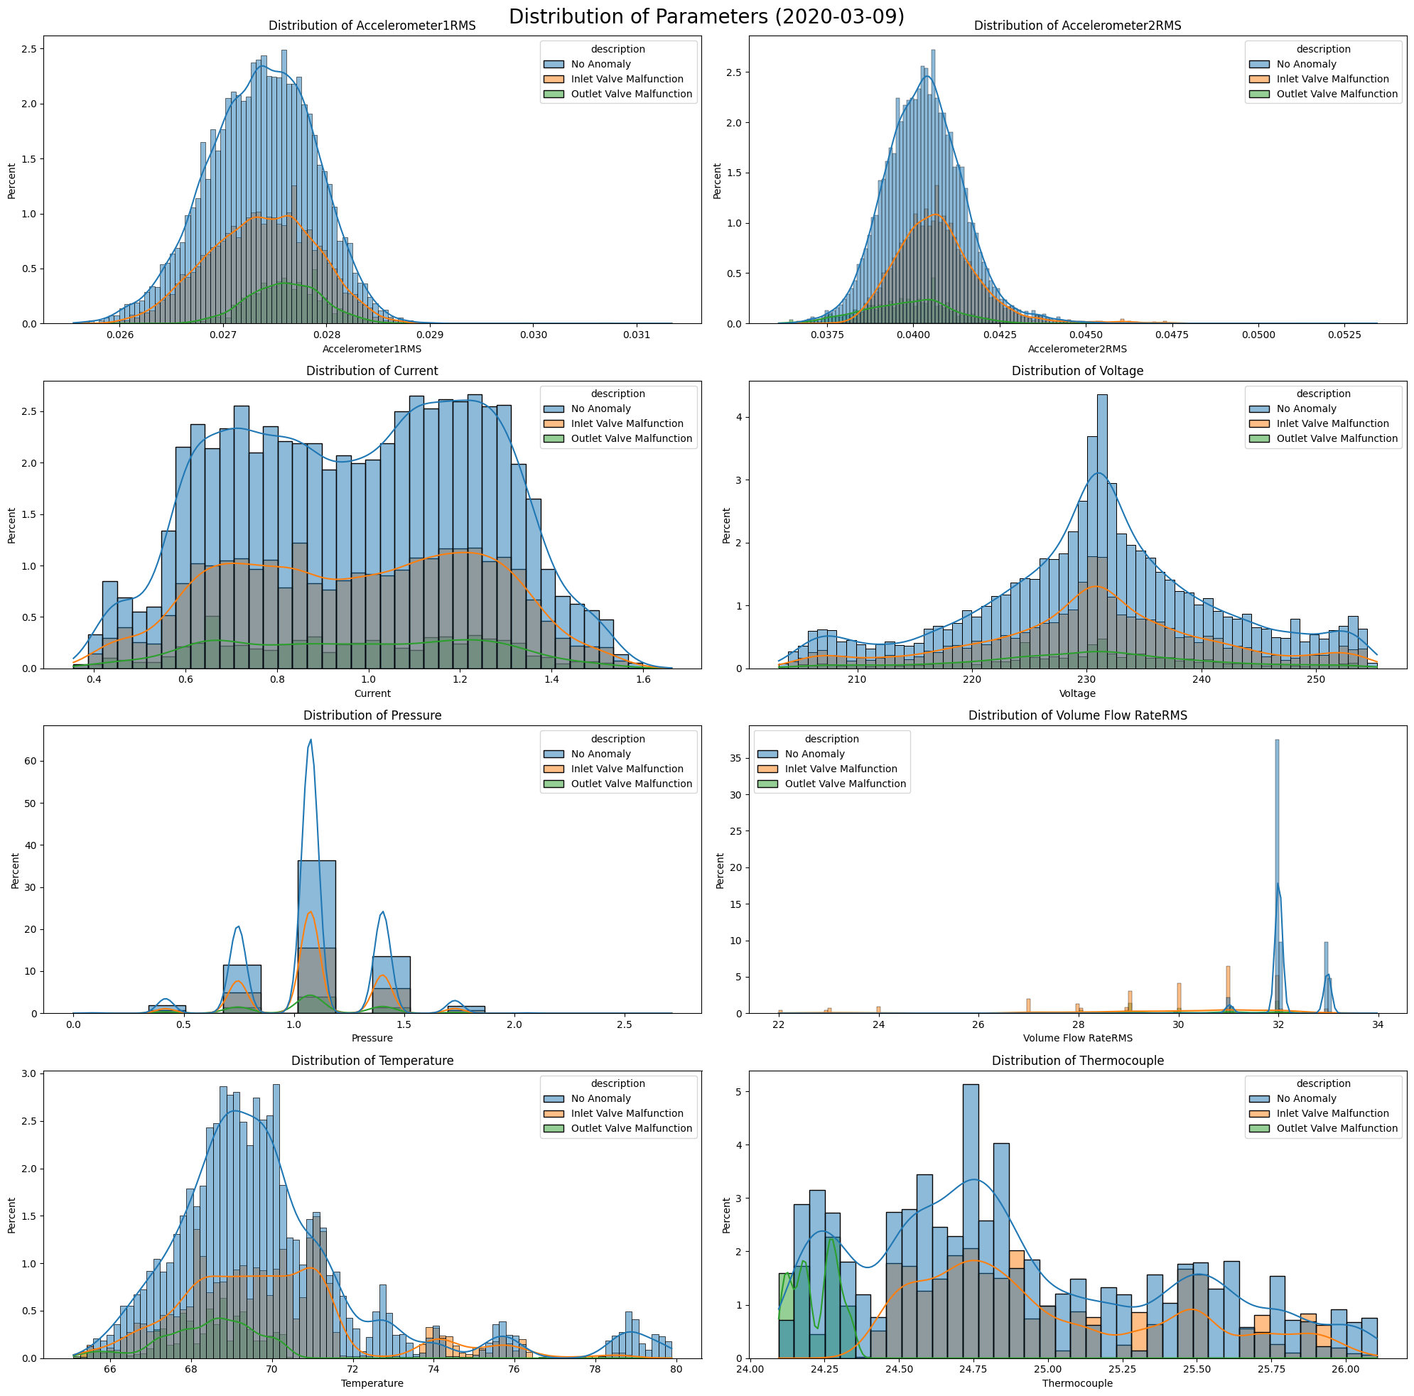
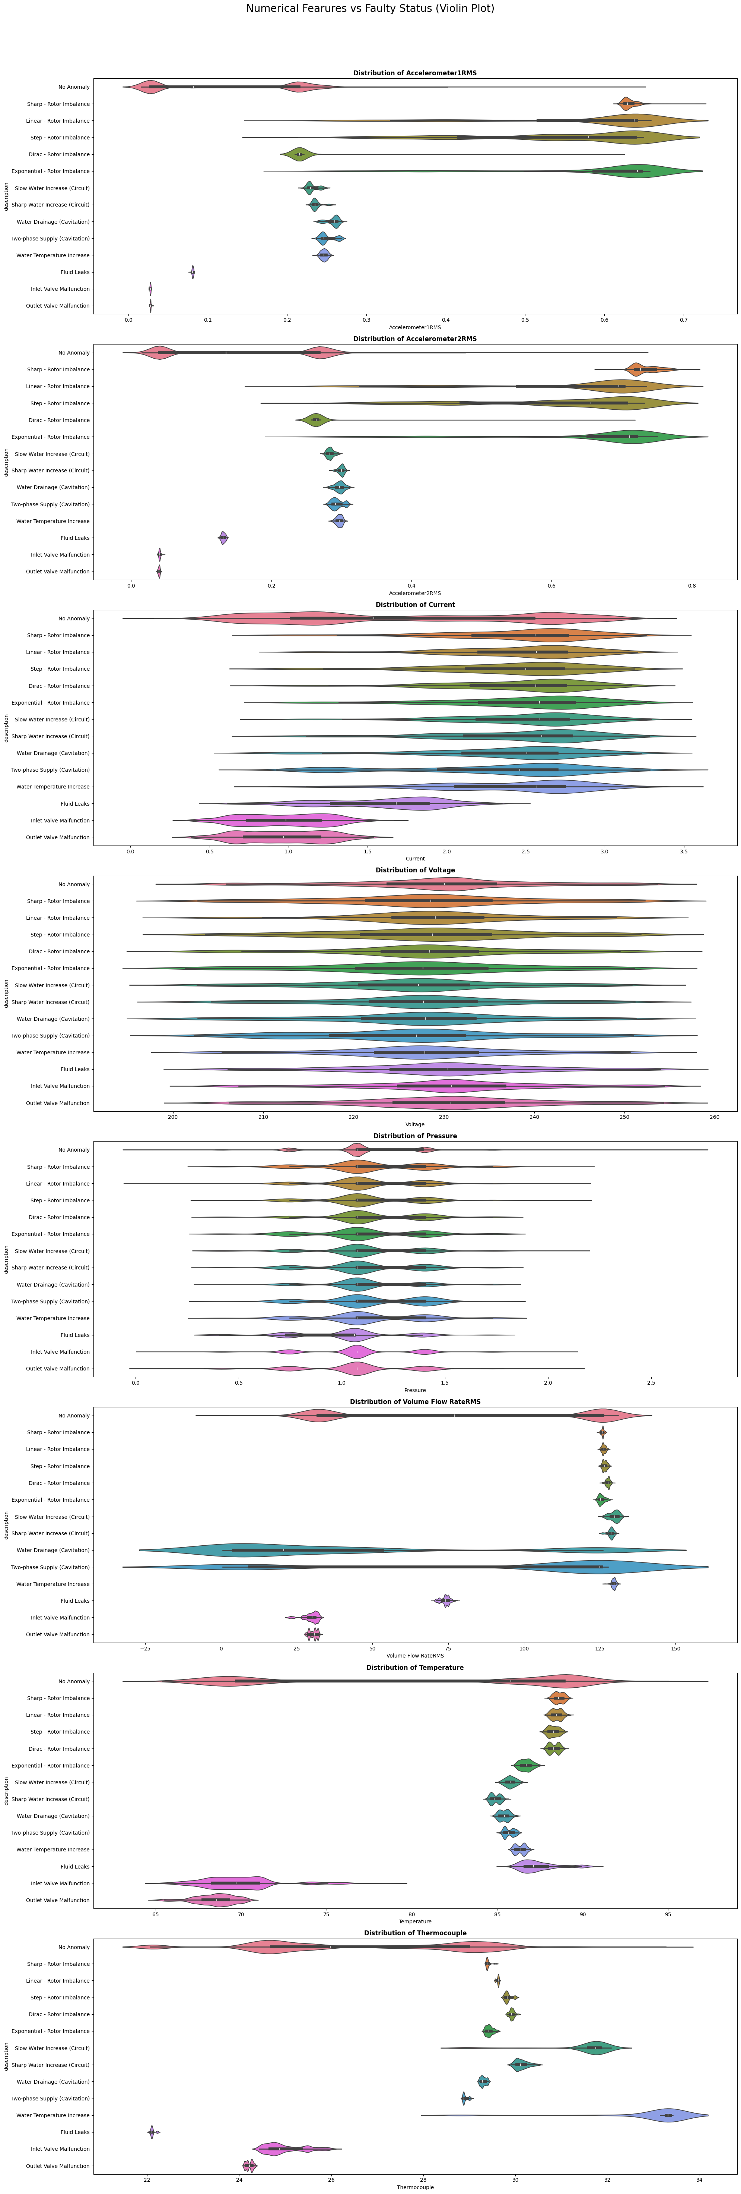
Univariate Analysis
Histogram of most of the features during anomalies differ from each other.
For some anomalies like Inlet & Outlet Valve Malfunction the histograms are overlapping with the normal data points.

Slide 19
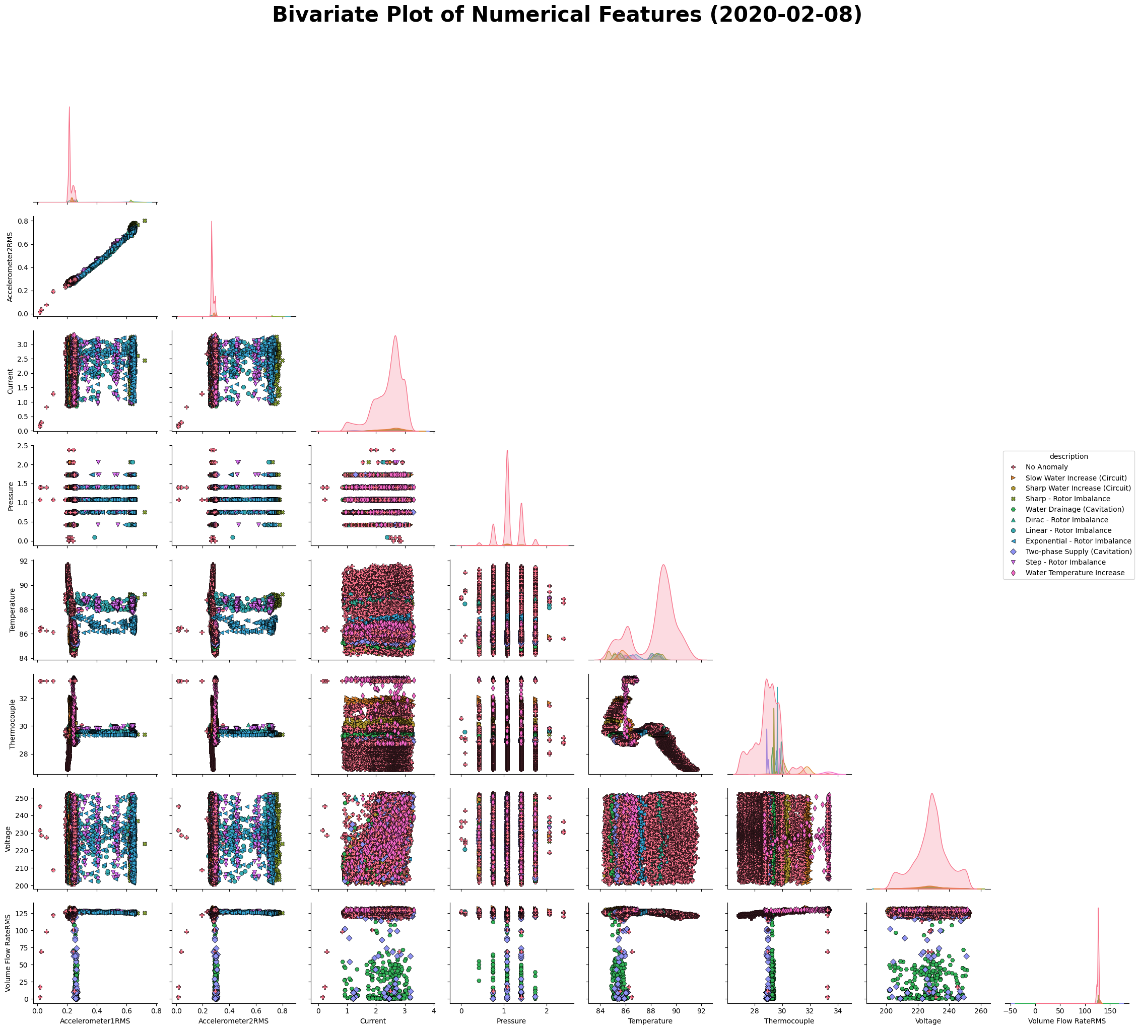
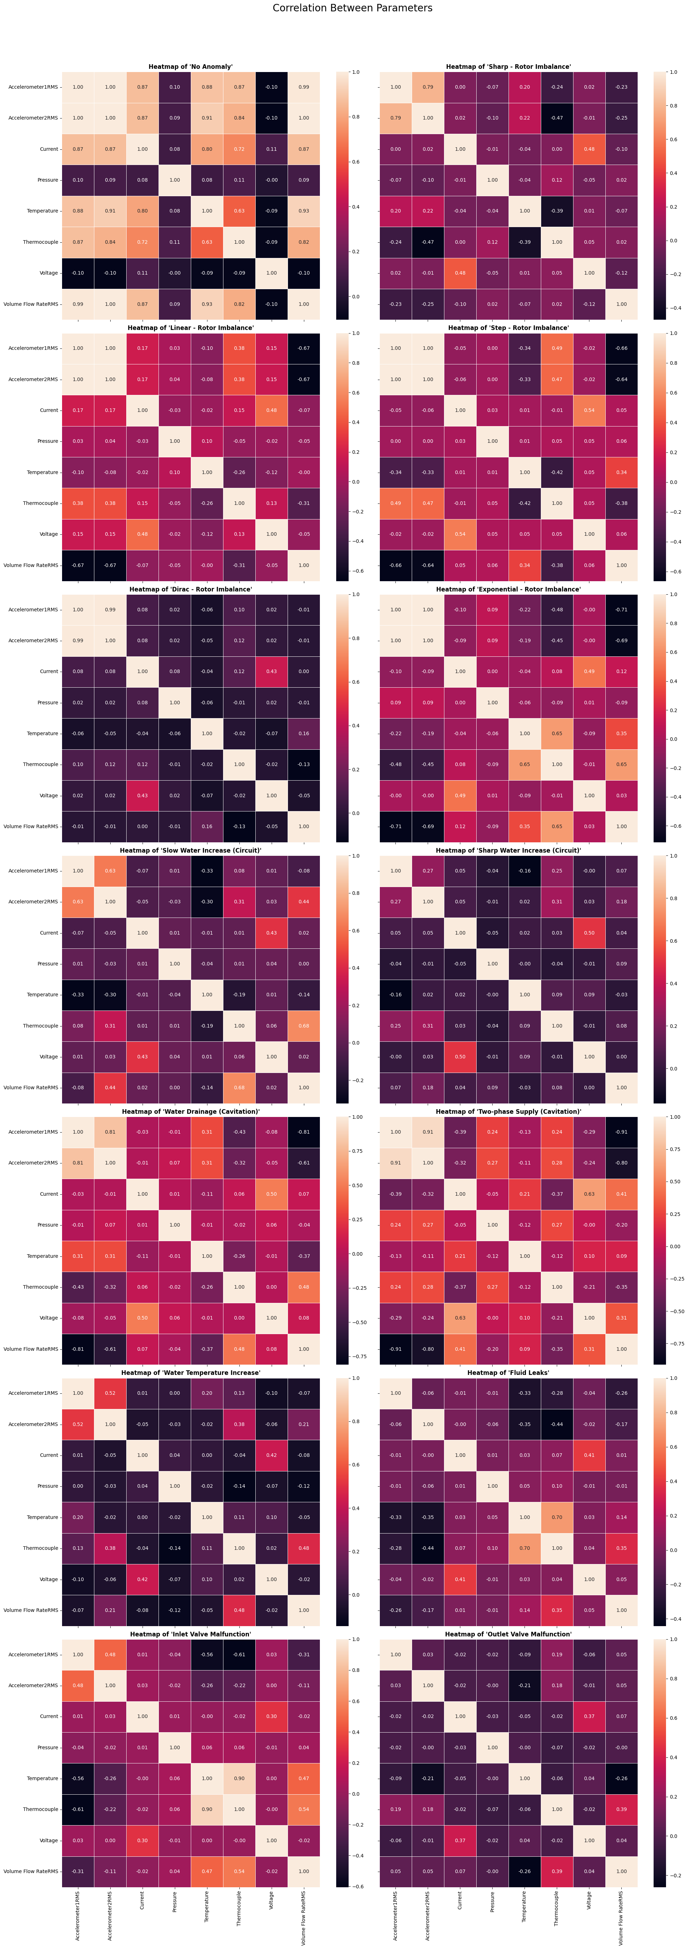
Bivariate Analysis
The normal data points have proper correlation among features.
Significant deviation in feature correlation can be observed for anomalies

Slide 20
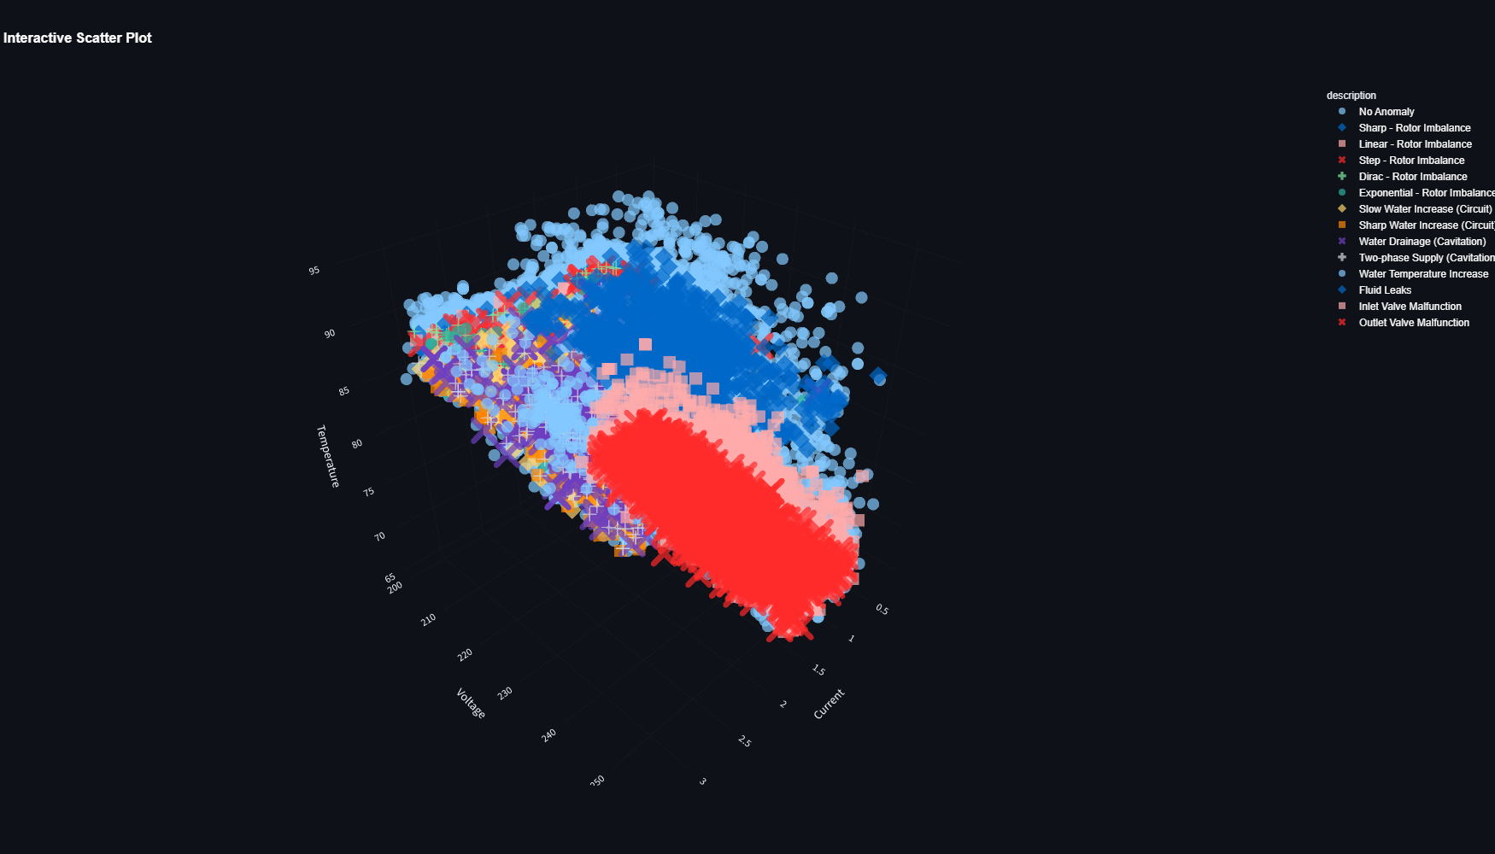
Multivariate Analysis
3D scatter plot shows unique cluster formations in comparison to normal data points and anomalies.
For some features these clusters are overlapping – difficult to distinguish

Slide 21
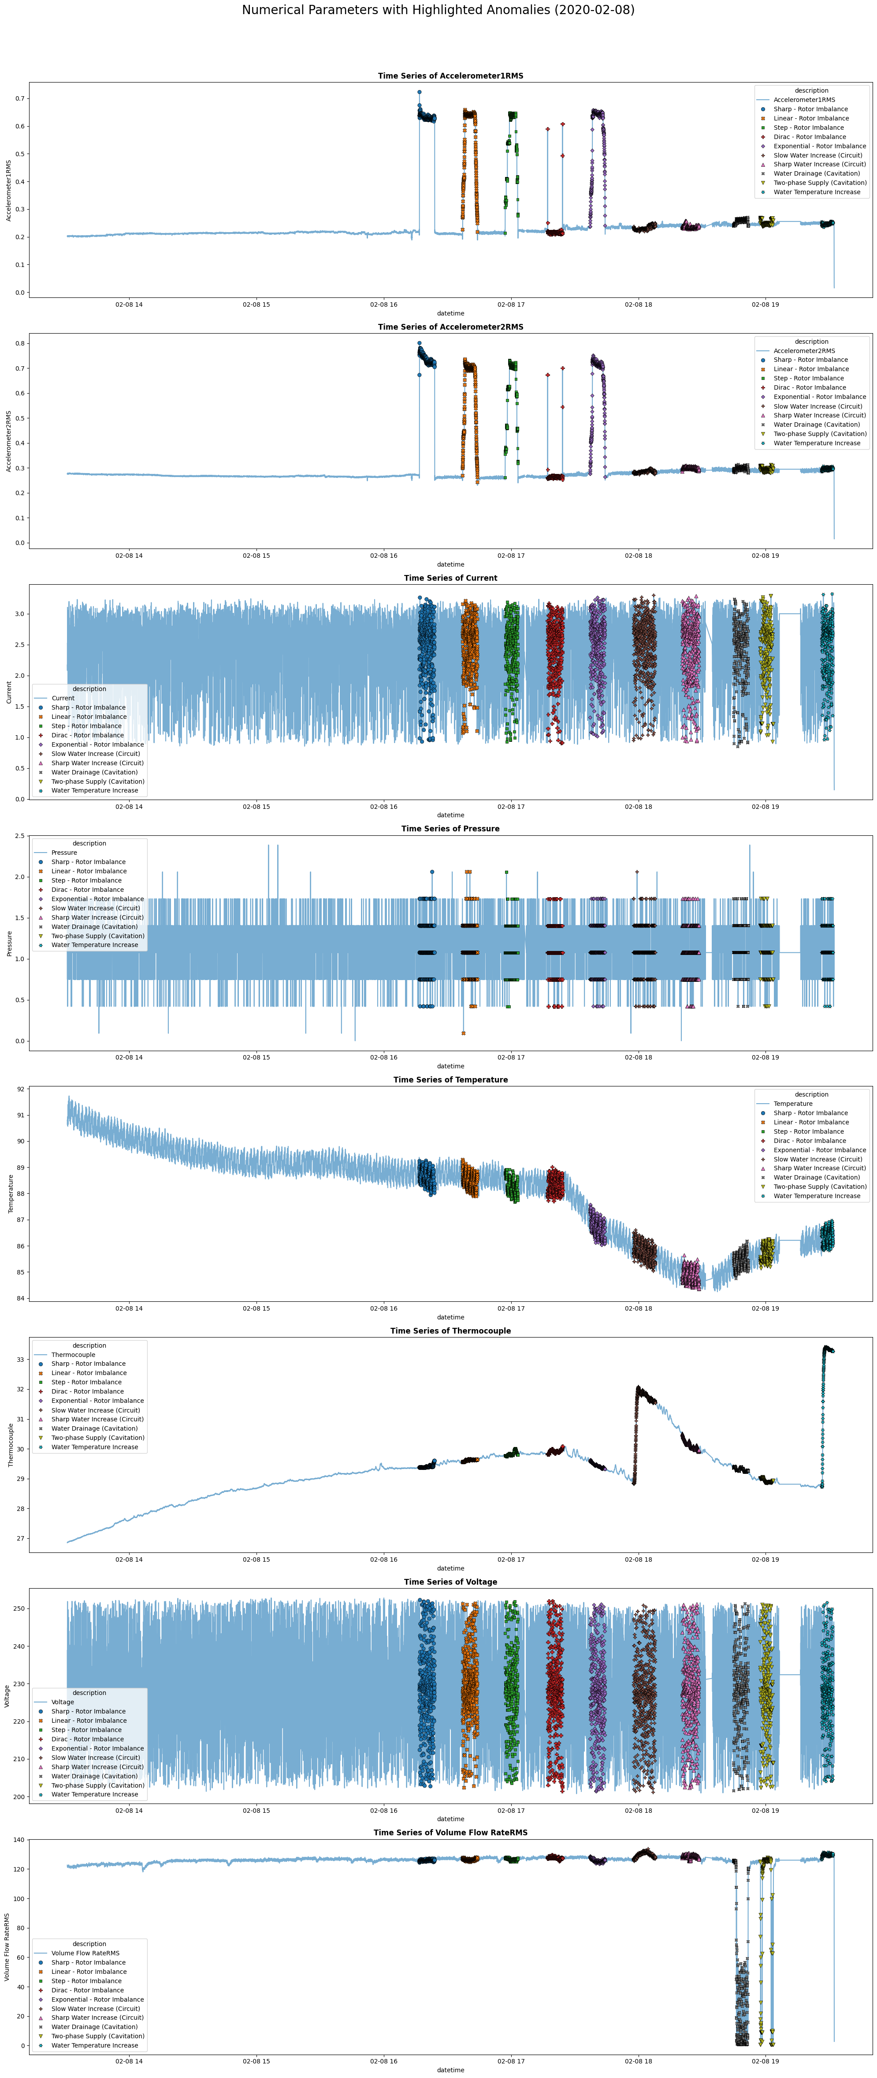
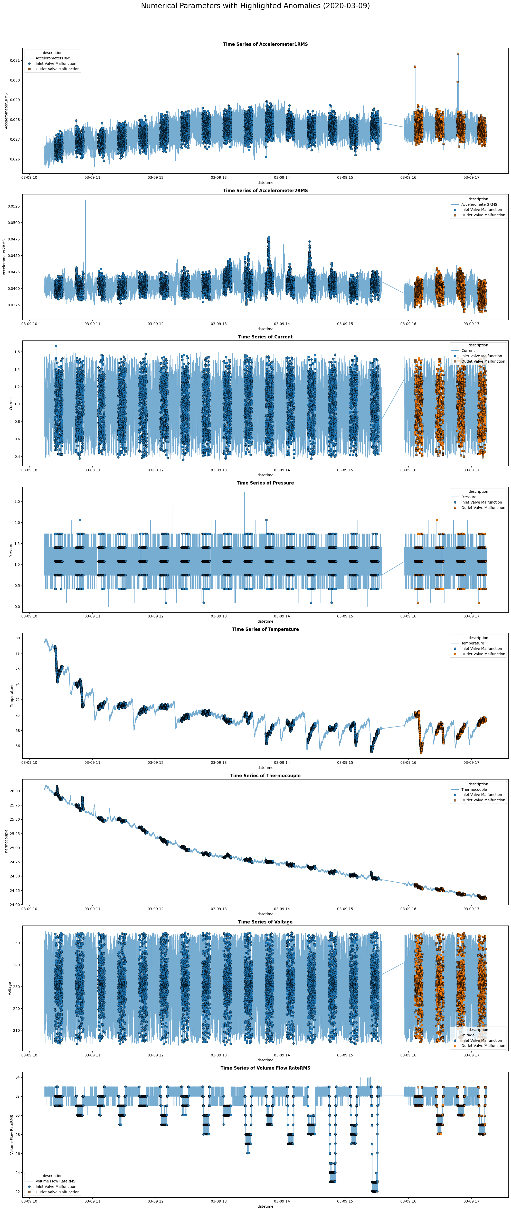
Time-series Analysis
Vibrational Features occasionally shows spikes during anomalies.
Temperature Features do not show any significant variation for anomalies.
Voltage, Current & Pressure do not show any significant variation for anomalies
Rate of flow of Fluid occasionally shows downward spikes during anomalies.

Slide 22
Feature Engineering

Slide 23




Interaction Features
Electrical Resistance
Flow Resistance
Operational Temperature Ratio
Operational Vibration
Specific Power
$$Electrical Resistance=\frac{Voltage}{Current}$$
$$Flow Resistance=\frac{Pressure}{Rate of flow of Fluid}$$
$$Operational Temperature Ratio=\frac{Temperature of Engine}{Temperature of Fluid}$$
$$Operational Vibration=\frac{Vibration along x−axis}{Vibration along y−axis}$$
$$Specific Power=\frac{Voltage ∗Current}{Rate of flow of Fluid}$$
Notes:
13.1.1 Electrical Resistance
• What : It is a measure of opposition to the flow of electric current in an electrical
circuit, typically measured in ohms (Ω).
• Why : Deviations in calculated electrical resistance from expected values can indicate
anomalies such as motor winding degradation, short circuits, or changes in mechanical
load that affect current draw for a given voltage.
13.1.2 Flow Resistance
• What : It is a measure of the opposition to fluid movement through a system, analogous
to electrical resistance, it represents the pressure drop required to achieve a
certain flow rate.
• Why : Increase in flow resistance for a given flow rate or pressure can indicate blockages,
increased friction due to scaling or debris, or issues with the pump itself, thus
signaling an anomaly in the system.
13.1.3 Operational Temperature Ratio
• What : It represents the relationship between the temperature of the pump’s engine
body and the temperature of the fluid being circulated.
• Why : Significant deviations in this metric from a normal range can indicate issues
such as inefficient heat transfer, motor overheating, or abnormal fluid heating due to
cavitation, thereby signaling an anomaly.
13.1.4 Operational Vibration
• What : It represents the combined magnitude of vibration in two perpendicular directions
on the pump, typically measured in g2.
• Why : Increase in Operational Vibration beyond normal thresholds can directly indicate
mechanical issues such as imbalance, misalignment, bearing wear, or cavitation
within the pump or motor, thus serving as a strong anomaly indicator.
13.1.5 Specific Power
• What : It is a measure of the electrical power consumed by the pump per unit of fluid
flow rate, indicating the energy required to move a certain volume of fluid, typically measured in Watt per Liter per Minute (W/(L/min)).
• Why : Increase in Specific Power for a given operating point can indicate reduced
pump efficiency due to issues like wear, cavitation, or blockages, thereby signaling an
anomaly.

Slide 24
Difference Features
Vibrational Balance
Temperature Balance
$$Vibrational Balance=Vibration (along y−axis) −Vibration (along x−axis)$$
$$Temperature Balance=Temperature of Engine −Temperature of Fluid$$
Notes:
13.2.1 Vibrational Balance
• What : It measures the disparity in vibration magnitudes between two perpendicular
axes (x and y) on the pump, typically measured in g.
• Why : Increase in Vibrational Balance can indicate an imbalance in the system’s
vibration, potentially pointing to issues like misalignment or uneven bearing wear.
13.2.2 Temperature Balance
• What : It is the difference between the engine body temperature and the fluid temperature,
indicating the thermal equilibrium or disparity within the pump system,
typically measured in ◦C.
• Why : Change in Temperature Balance from its normal operating range can signal
issues like inefficient cooling of the motor, excessive heat generation from the fluid (e.g.,
due to cavitation), or an external heat imbalance, thereby indicating an anomaly.

Slide 25

Efficiency & Performance Features
Hydraulic Power
Electrical Power
Pump Efficiency
$$Hydraulic Power=\frac{\left(Flow Rate ∗Fluid Density ∗g ∗Differencial Head\right)}{1000}$$
$$Electrical Power=Voltage ∗Current ∗Power Factor$$
$$Pump Efficiency=\frac{Hydraulic Power}{Electrical Power}$$
Notes:
13.3.1 Hydraulic Power
• What : It is the measure of useful power transferred by the pump to the fluid, calculated
as the product of fluid pressure, flow rate, and a conversion factor, representing
the energy imparted to move the fluid, typically measured in kilo-Watt (kW).
• Why : Drop in Hydraulic Power relative to the electrical power input indicates a loss
of pump efficiency or internal issues, serving as a strong indicator of an anomaly.
13.3.2 Electrical Power
• What : It is the measure of the rate at which electrical energy is transferred to the
motor, calculated as the product of Voltage and Current (and power factor for AC
systems), typically measured in kilo-Watt (kW).
• Why : Unexpected increases or fluctuations in Electrical Power, without corresponding
changes in pump output, can indicate issues like motor overloading, winding problems,
or increased mechanical resistance in the pump, thus signaling an anomaly.
13.3.3 Pump Efficiency
• What : It is the ratio of the hydraulic power delivered to the fluid to the electrical
power consumed by the motor, indicating how effectively the pump converts electrical
energy into useful fluid energy.
• Why : Decrease in Pump Efficiency for a given operating condition directly signals
degradation, internal wear, cavitation, or blockages within the pump, making it a
highly effective anomaly detector.

Slide 26

Higher Order Interactive Features
Vibration Intensity Ratio
Vibration per Unit Flow
Engine Temperature per Unit Power
Efficiency & Temperature Balance Ratio
$$Vibration Intensity Ratio=\frac{Vibration (along x−axis)}{Vibration (along y−axis)}$$
$$Vibration per Unit Flow=\frac{Operational Vibration}{Rate of flow of Fluid}$$
$$Engine Temperature per Unit Power=\frac{Engine Temperature}{Power}$$
$$Efficency \& Temperature Balance Ratio=\frac{Pump Efficiency}{Temperature Balance}$$
Notes:
13.4.1 Vibration Intensity Ratio
• What : It is the ratio of vibration magnitudes from two different accelerometer sensors,
indicating the relative vibration levels across different points of the pump.
• Why : Deviation of the Vibration Intensity Ratio from its expected value (often near
1 for balanced systems) can indicate an imbalance, misalignment, or a localized fault,
thereby signaling an anomaly.
13.4.2 Vibration per Unit Flow
• What : It is a metric that relates the level of pump vibration to the volume of fluid
being moved, showing vibration intensity relative to operational output.
• Why : Increase in Vibration per Unit Flow can occur when the flow rate is not
proportionally high, it can point to issues like cavitation, internal impeller damage, or
bearing problems not directly related to the hydraulic load, thus signaling an anomaly.
13.4.3 Engine Temperature per Unit Power
• What : It is a metric indicating the motor’s operating temperature in relation to the
electrical power it consumes, typically measured in ◦C / W.
• Why : Unusual increase in Engine Temperature Per Unit Electrical Power suggests
issues such as motor winding problems, cooling system failure, or increased internal
friction, thereby signaling an anomaly.
13.4.4 Efficiency & Temperature Balance Ratio
• What : It is a comparative metric that evaluates the relationship between the pump’s
efficiency and the difference between engine and fluid temperatures.
• Why : A disproportionate relationship between a drop in efficiency and the motor/
fluid temperature balance can help distinguish between hydraulic problems (e.g.,
worn impeller) and electrical/motor-related issues, thus aiding in anomaly detection.

Slide 27
Fluctuation Features
Operational Vibration Fluctuation
Temperature Fluctuation
Thermocouple Fluctuation
Volume Flow Rate Fluctuation
Hydraulic Power Fluctuation
Electrical Power Fluctuation
$$Operational Vibration Fluctuation=Operational Vibration Fluctuation \left(time t+1\right)$$
$−Operational Vibration Fluctuation (time t)$
$$Temperature Fluctuation=Temperature Fluctuation \left(time t+1\right)$$
$−Temperature Fluctuation (time t)$
$$Thermocouple Fluctuation=Thermocouple Fluctuation \left(time t+1\right)$$
$−Thermocouple Fluctuation (time t)$
$$Volume Flow Rate Fluctuation=Volume Flow Rate Fluctuation \left(time t+1\right)$$
$−Volume Flow Rate Fluctuation (time t)$
$$Hydraulic Power Fluctuation=Hydraulic Power Fluctuation \left(time t+1\right)$$
$−Hydraulic Power Fluctuation (time t)$
$$Electrical Power Fluctuation=Electrical Power \left(time t+1\right)$$
$−Electrical Power (time t)$
Notes:
13.5.1 Operational Vibration Fluctuation
• What : It represents the variability or instability in the product of the two accelerometer
readings, indicating changes in the overall vibration pattern over time, typically
measured in g2.
• Why : Sudden or sustained increases in Operational Vibration Fluctuations can signal
dynamic instabilities, loosening components, or the onset of faults like cavitation or
bearing damage, thereby indicating an anomaly.
13.5.2 Temperature Fluctuation
• What : It represents the variability or instability in the temperature readings of the
electric motor body.
• Why : Increased Engine Temperature Fluctuations can indicate inconsistent cooling,
intermittent overloading, or electrical issues within the motor, thereby signaling an
anomaly.
13.5.3 Thermocouple Fluctuation
• What : It represents the variability or instability in the temperature readings of the
fluid within the circulation loop.
• Why : Elevated Fluid Temperature Fluctuations can suggest erratic flow, intermittent
cavitation, or issues with external heat exchange in the fluid loop, thereby signaling
an anomaly.
13.5.4 Volume Flow Rate Fluctuation
• What : It represents the variability or instability in the rate at which fluid is flowing
through the circulation loop.
• Why : Increase in Volume Flow Rate Fluctuation can indicate cavitation, blockages,
air entrainment, or issues with the pump’s prime, thereby signaling an anomaly.
13.5.5 Hydraulic Power Fluctuation
• What : It represents the variability or instability in the useful power delivered by the
pump to the fluid.
• Why : Increase in Hydraulic Power Fluctuation can point to intermittent issues with
pump performance, such as partial cavitation, varying system resistance, or inconsistent
fluid delivery, thereby signaling an anomaly.
13.5.6 Electrical Power Fluctuation
• What : It represents the variability or instability in the power consumed by the
electric motor driving the pump.
• Why : Increase in Electrical Power Fluctuation can indicate unstable motor operation,
intermittent electrical faults, or varying mechanical loads on the pump, thereby
signaling an anomaly.

Slide 28
Modelling & Evaluation

Slide 29
Statistical Models
• The Percentile method stands out as the best-performing model by a significant margin,
demonstrating superior accuracy, precision, recall, and F1-score due to its excellent
balance of true positives and true negatives, and low false positive rates.
• The Local Outlier Factor (LOF) is the second-best model, showing good overall performance.
• The Z-Score method, while excellent at detecting true positives, suffers severely from
high false positives, making it unreliable.
• The Inter Quartile Range (IQR) and k-Nearest Neighbors (k-NN) methods are the
weakest performers, showing poor results across most evaluation metrics.
Z-Score Method
Multivariate Gaussian Model
Interquartile Range (IQR)
Percentile Method
k-Nearest Neighbors
Local Outlier Factor
Notes:
• Z-Score Method
– Description : Measures how many standard deviations an observation is from
the mean.
– Usefulness for Anomaly Detection : Identifies anomalies as data points that
fall beyond a certain number of standard deviations from the mean in a univariate
distribution.
• Multivariate Gaussian Model
– Description : Models data points as following a multi-dimensional Gaussian
distribution.
– Usefulness for Anomaly Detection : Flags anomalies as data points with a
very low probability of occurring under the
• Inter Quartile Range (IQR)
– Description : A measure of statistical dispersion, calculated as the difference
between the 75th and 25th percentiles.
– Usefulness for Anomaly Detection : Defines anomalies as observations that
fall outside a specified range (e.g., 1.5 times the IQR) from the first or third
quartile.
• Percentile Method
– Description : Ranks observations based on their values and defines thresholds
at specific percentile points.
– Usefulness for Anomaly Detection : Identifies anomalies as data points that
fall into the lowest or highest specified percentiles of the data distribution.
• k-Nearest Neighbors
– Description : A non-parametric method that classifies a data point based on
the majority class of its ’k’ nearest neighbors.
– Usefulness for Anomaly Detection : Detects anomalies by identifying data
points that have a low density of neighbors or are far from their ’k’ nearest neighbors.
• Local Outlier Factor
– Description : Measures the local deviation of a data point with respect to its
neighbors.
– Usefulness for Anomaly Detection : Identifies anomalies as data points that
are significantly less dense than their neighbors, making it effective for detecting
outliers in varying density regions.

Slide 30
Machine Learning Models
• Supervised models significantly outperform unsupervised models in this comparison,
especially in terms of overall accuracy and balanced F1-Scores.
• XGBoost is the best-performing model overall, exhibiting exceptional balance and high
scores across all key metrics (Accuracy, Precision, Recall, F1-Score).
• Random Forest Classifier is a very close second to XGBoost, also demonstrating excellent
and well-balanced performance.
• Logistic Regression is a strong contender within supervised learning, offering robust
performance.
K-Mean Clustering
Isolation Forest
One-Class SVM
Logistic Regression
SVM
Random Forest Classifier
XGBoost Classifier
Notes:
• Z-Score Method
– Description : Measures how many standard deviations an observation is from
the mean.
– Usefulness for Anomaly Detection : Identifies anomalies as data points that
fall beyond a certain number of standard deviations from the mean in a univariate
distribution.
• Multivariate Gaussian Model
– Description : Models data points as following a multi-dimensional Gaussian
distribution.
– Usefulness for Anomaly Detection : Flags anomalies as data points with a
very low probability of occurring under the
• Inter Quartile Range (IQR)
– Description : A measure of statistical dispersion, calculated as the difference
between the 75th and 25th percentiles.
– Usefulness for Anomaly Detection : Defines anomalies as observations that
fall outside a specified range (e.g., 1.5 times the IQR) from the first or third
quartile.
• Percentile Method
– Description : Ranks observations based on their values and defines thresholds
at specific percentile points.
– Usefulness for Anomaly Detection : Identifies anomalies as data points that
fall into the lowest or highest specified percentiles of the data distribution.
• k-Nearest Neighbors
– Description : A non-parametric method that classifies a data point based on
the majority class of its ’k’ nearest neighbors.
– Usefulness for Anomaly Detection : Detects anomalies by identifying data
points that have a low density of neighbors or are far from their ’k’ nearest neighbors.
• Local Outlier Factor
– Description : Measures the local deviation of a data point with respect to its
neighbors.
– Usefulness for Anomaly Detection : Identifies anomalies as data points that
are significantly less dense than their neighbors, making it effective for detecting
outliers in varying density regions.

Slide 31
Deep Learning Models
• Both AE and VAE models show extremely high True Positive (TP) rates but are
severely hampered by very high False Positive (FP) rates across all tested thresholds.
• Consistently low Precision and extremely low F1-Scores for both models, indicates a
poor balance between detecting true anomalies and minimizing false alarms.
• The Recall values are also extremely low, which, when combined with high True Positive
(TP), strongly suggests an underlying issue in detecting such anomalies.
• Contrary to expectation, VAE did not perform better than AE; the latter achieved a
slightly higher F1-Score and marginally better precision.
Autoencoder
Variational Autoencoder
Notes:
• Z-Score Method
– Description : Measures how many standard deviations an observation is from
the mean.
– Usefulness for Anomaly Detection : Identifies anomalies as data points that
fall beyond a certain number of standard deviations from the mean in a univariate
distribution.
• Multivariate Gaussian Model
– Description : Models data points as following a multi-dimensional Gaussian
distribution.
– Usefulness for Anomaly Detection : Flags anomalies as data points with a
very low probability of occurring under the
• Inter Quartile Range (IQR)
– Description : A measure of statistical dispersion, calculated as the difference
between the 75th and 25th percentiles.
– Usefulness for Anomaly Detection : Defines anomalies as observations that
fall outside a specified range (e.g., 1.5 times the IQR) from the first or third
quartile.
• Percentile Method
– Description : Ranks observations based on their values and defines thresholds
at specific percentile points.
– Usefulness for Anomaly Detection : Identifies anomalies as data points that
fall into the lowest or highest specified percentiles of the data distribution.
• k-Nearest Neighbors
– Description : A non-parametric method that classifies a data point based on
the majority class of its ’k’ nearest neighbors.
– Usefulness for Anomaly Detection : Detects anomalies by identifying data
points that have a low density of neighbors or are far from their ’k’ nearest neighbors.
• Local Outlier Factor
– Description : Measures the local deviation of a data point with respect to its
neighbors.
– Usefulness for Anomaly Detection : Identifies anomalies as data points that
are significantly less dense than their neighbors, making it effective for detecting
outliers in varying density regions.

Slide 32
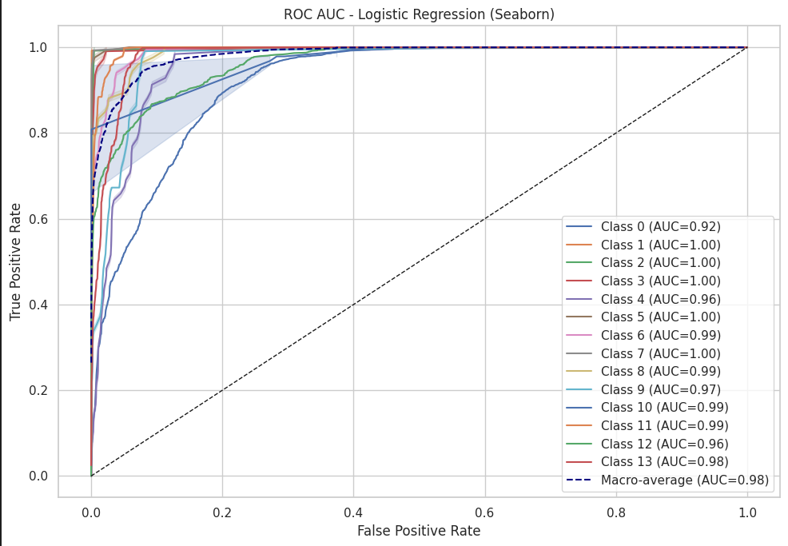
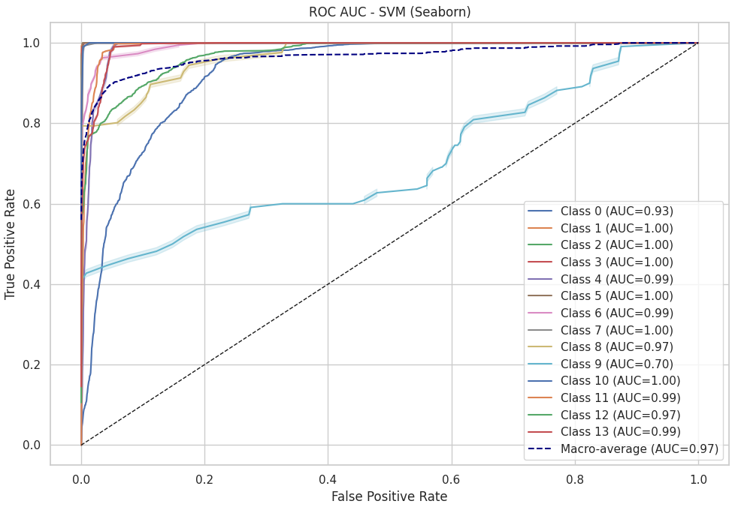
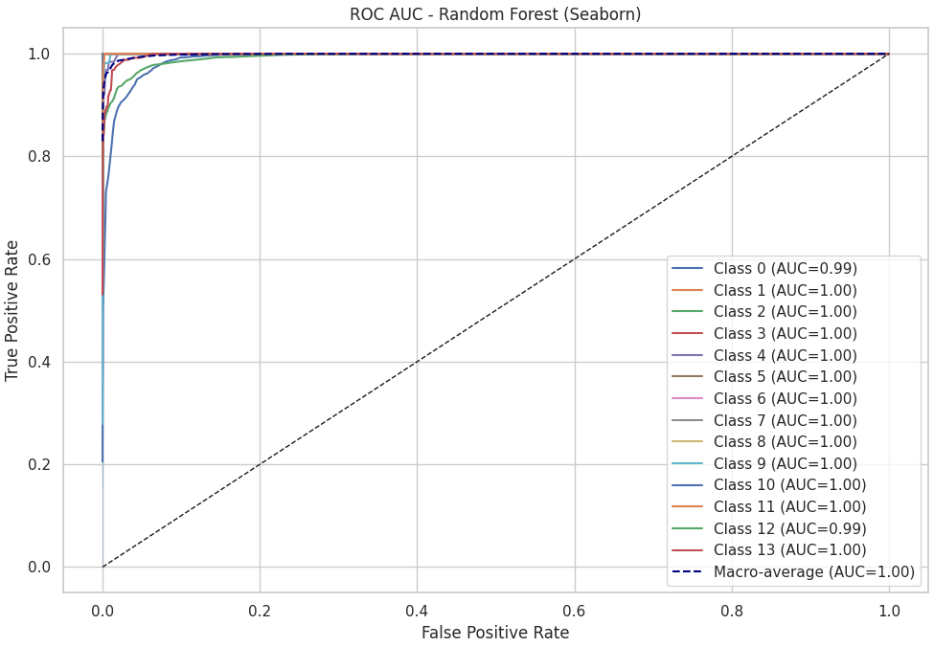
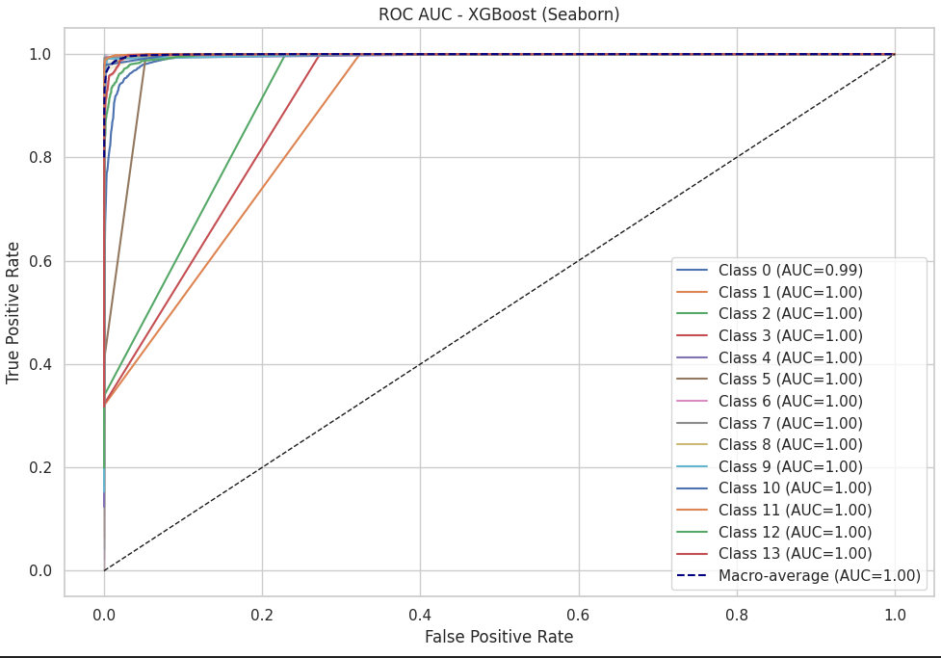
Additional Evaluation Plots (GridSearchCV)

Slide 33
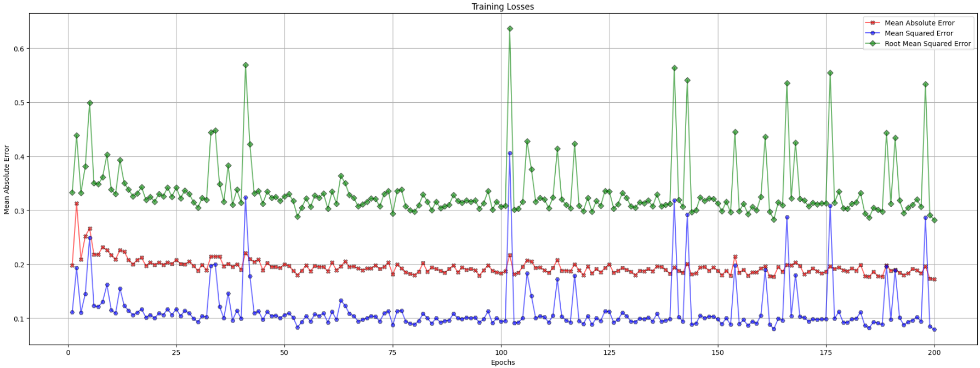
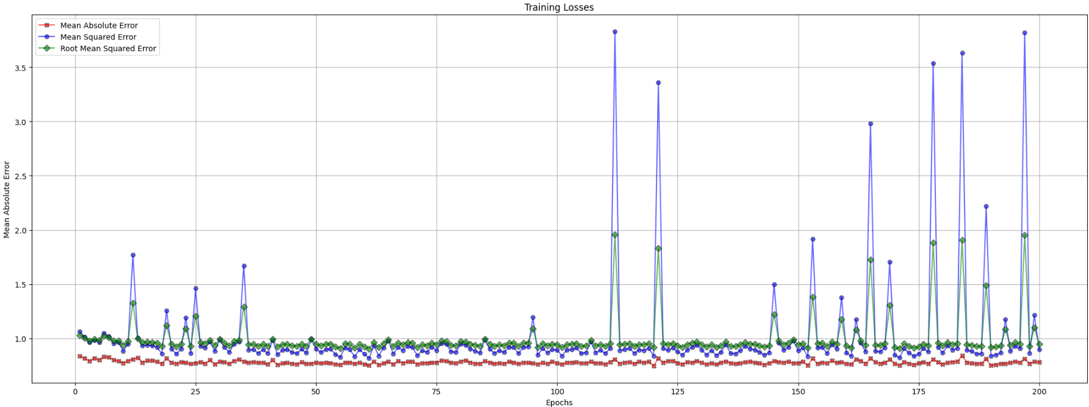
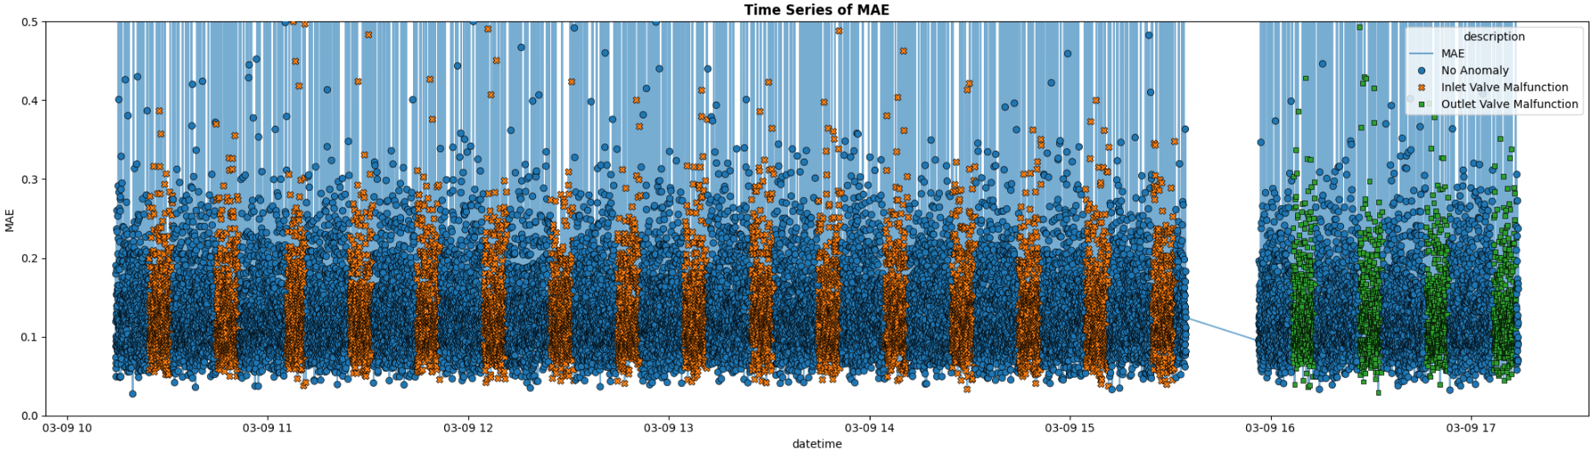
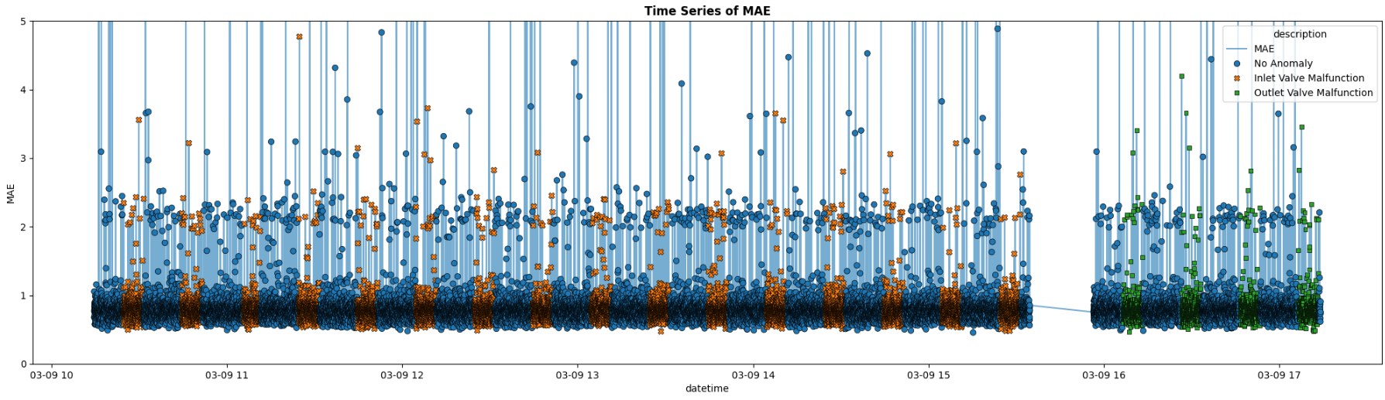
Additional Evaluation Plots

Slide 34
Solution Plan

Slide 35




Dissertation Workflow
Supervised Model Training
Statistical Reports
Data Source
Unsupervised Model Training
VAE Model Training
Anomaly Score
Function
*The technology to be used to represent the reports in the presentation layer are yet to be decided.
Wrangling
Feature Scaling
Feature Engineering
GAN Model Training
Synthetic Data Generation
Model Evaluation
Data Preprocessing
Data Preprocessing Pipeline
Presentation Layer*
Modelling Pipeline

Slide 36
Future Work

Slide 37
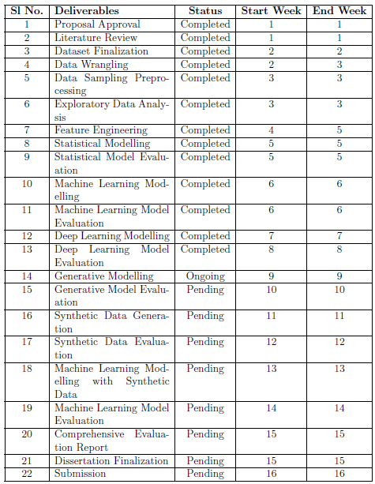
Planner
*The dissertation planner is subject to change depending on the project timeline and new discoveries.

Slide 38
Thank You

Slide 39
QA & Demo

