Slide 1
Security Vulnerability Findings
Presented By: Mohammad Saif Baig
Date:

Slide 2
Agenda
Overview of Engagement
Summary of Findings
Detailed Vulnerabilities
Risk Assessment
Recommendations
Next Steps

Slide 3
Engagement Overview
Objective:
To identify security vulnerabilities, evaluate the robustness of the system, ensure compliance with standards.
Scope:
In-Scope: Web application, APIs (/api/login, /api/user), Backend database (SQL Server).
Out-of-Scope: Third-party integrations
Limitations:

Slide 4
Summary of Findings

Slide 5
Summary of Findings
Total Vulnerabilities Identified: 10
Critical Severity: 3
High Severity: 3
Medium Severity: 4
Low Severity: 3
Highlights:
SQL Injection in the login API
Misconfigured CORS allowing unauthorized

Slide 6
Detailed Vulnerability Analysis

Slide 7
SQL Injection
Severity: High
Description:
SQL Injection is a type of vulnerability that allows attackers to interfere with the queries an application makes to its database. By manipulating input fields or parameters in a request, an attacker can execute arbitrary SQL commands to access, modify, or delete data in the backend database.
Analysis:
During the analysis, it was observed that the application’s login endpoint (/api/login) was vulnerable to SQL injection. The input field for the username parameter was not properly sanitized before being used in an SQL query, allowing malicious payloads to be executed.

Slide 8
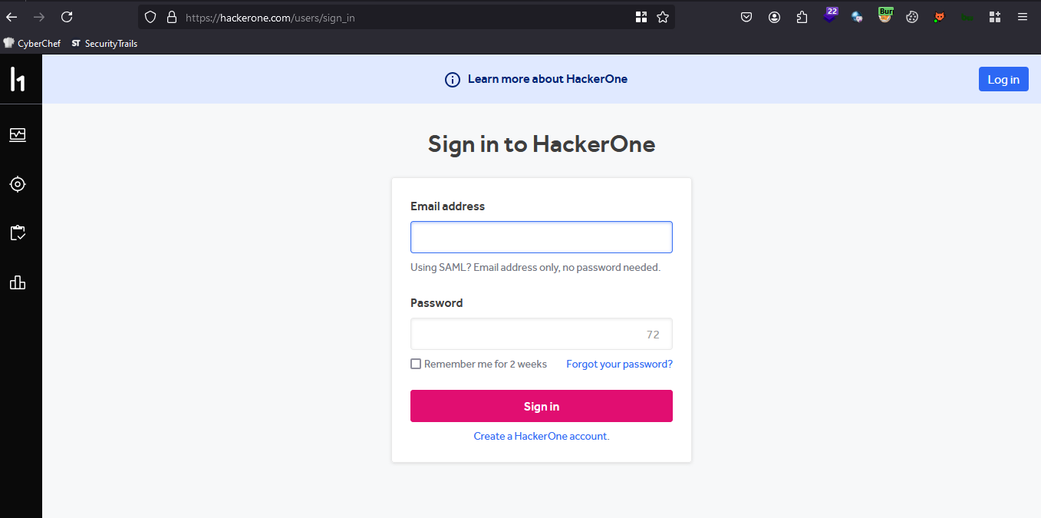
Proof of Concept
Step 1: Login to application

Slide 9
Impact
An attacker could bypass authentication and gain unauthorized access to user accounts.
Further exploitation could lead to:
Extraction of sensitive data (e.g., usernames, hashed passwords).
Modification or deletion of database records.
Potential privilege escalation if administrative accounts are compromised.

Slide 10
Recommendations
Implement parameterized queries or prepared statements to prevent direct embedding of user input in SQL queries.
Perform server-side input validation to reject malicious or unexpected inputs.
Use a Web Application Firewall (WAF) to detect and block SQL injection attempts.

Slide 11
Reference Links
https://owasp.org/www-community/attacks/SQL_Injection
https://portswigger.net/web-security/sql-injection

Slide 12
Thank You!

