Slide 1
Summer training presentation on comptia security+
Presented by:
Aditya Raj (11905310)

Slide 2
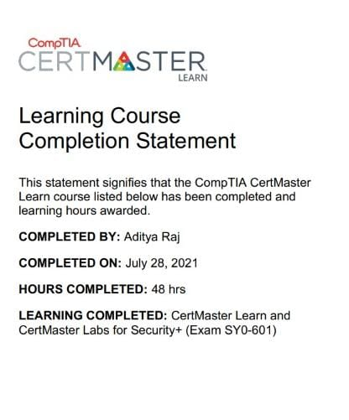
Summer Training Certificate By Comptia

Slide 3
INTRODUCTION
The Computing Technology Industry Association is an American non-profit trade association, issuing professional certifications for the information technology industry. It is considered one of the IT industry's top trade associations.
CompTIA Security+ is a global certification that validates the baseline skills you need to perform core security functions and pursue an IT security career
New research by IDC shows that candidates and staff with CompTIA A+ and CompTIA Security+ perform better than staff who are not certified.

Slide 4
Course outline
Comparing Security Roles and Security Controls
Identifying Social Engineering and Malware
Implementing Authentication Controls
Implementing Secure Network Protocols
Explaining Data Privacy and Protection Concepts
Summarizing Risk Management Concepts
Explaining Physical Security

Slide 5

Security Roles and Security Controls
Security controls are safeguards or countermeasures to avoid, detect, counteract, or minimize security risks to physical property, information, computer systems, or other assets.
A security role is a collection of privileges in a project. Those privileges are assigned as a set to various users or groups, on a project-by-project basis.

Slide 6
Social Engineering
Social engineering is the term used for a broad range of malicious activities accomplished through human interactions
Social engineering attack techniques
Pretexting
Phising
Spear phising
Social engineering prevention
Don’t open emails and attachments from suspicious sources
Use multifactor authentication
p your antivirus/antimalware software updated
It uses psychological manipulation to trick users into making security mistakes or giving away sensitive information.​

Slide 7
Malware
Malware is any software intentionally designed to cause damage to a computer, server, client, or computer network.
Types of malware include:
Computer viruses
Worms
Trojan horse
Ransomware
Spyware

Slide 8
Authentication controls
Authentication is any process by which a system verifies the identity of a user who wishes to access the system
Three main types of authentication are:
Something you know: a password or personal identification number (PIN)
Something you have: a token, such as bank card
Something you are: biometrics, such as fingerprints and voice recognition

Slide 9
Secure Network Protocols
Network security is one of the essential cybersecurity branches, and protocols play a vital role in securing the network.
Here are the lists of some popular network security protocols
IPSec protocol
SSL, i.e., Secure Sockets Layer
Secure Shell (SSH)
HyperText Transfer Protocol Secure (HTTPS)
Kerberos

Slide 10
Secure Mobile Solutions
Mobile Device Security refers to the measures designed to protect sensitive information stored on and transmitted by smartphones, tablets, and other portable devices
Security measures to be taken :
Establish, share, and enforce clear policies and processes
Password protection
Leverage biometrics
Avoid public Wi-Fi
Beware of apps

Slide 11
Data Privacy and Protection Concepts
What Is Data Protection?
Data protection is a set of strategies and processes you can use to secure the privacy, availability, and integrity of your data. It is sometimes also called data security or information privacy.
Why is data privacy important?
Data privacy concerns apply to all sensitive information that organizations handle, including that of customers, shareholders, and employees. Often, this information plays a vital role in business operations, development, and finances.
Data privacy helps ensure that sensitive data is only accessible to approved parties. It prevents criminals from being able to maliciously use data and helps ensure that organizations meet regulatory requirements

Slide 12
summarizing Risk Management Concepts
Risk management is the process of identifying, assessing and controlling threats to an organization's capital and earnings
The following steps outline the approach to risk management:
Identify the most significant risks arising from operations on an on-going basis.
Prioritize risks based on the likelihood of occurrence and potential impact.
Implement strategies to mitigate risks
Monitor effectiveness of risk management efforts.

Slide 13
Physical Security
Physical security is the protection of personnel, hardware, software, networks and data from physical actions and events that could cause serious loss or damage to an enterprise, agency or institution.
The three important components of physical security:
Access control
Surveillance
Security testing

Slide 14

Projects
Random Password Generator
Script To Decode Base64 encoded Text

Slide 15

conclusion

Slide 16

Thank you

