Slide 1





Batch Flow: A POS BASED SUPPLY CHAIN MANAGEMENT SYSTEM
Presented by:
Dranreb Vallesteros
Claire Alysa Teoxon
John Ismael Sandoval
PAGE 01

Slide 2
CHAPTER 1 INTRODUCTION
PAGE 02

Slide 3
Background of the Study:
Many bakeries still use manual methods to manage sales, inventory, and supplies.
These manual processes often cause delays, errors, and product shortages.
As customer demand increases, bakeries need more efficient systems to handle daily operations. A Point of Sale (POS) system is a tool that processes sales transactions and manages inventory.
This study focuses on developing a web-based POS and supply chain management system for bakeries. The system aims to improve efficiency, reduce errors, and enhance customer service.
PAGE 03

Slide 4
Problem Statement:
There are several factors that affect bakery operations and system adoption. One major issue is poor communication between subordinates and management, which can lead to rejection of system proposals.
Bakeries are also facing reduced visibility due to competition from larger and more popular bakeshops such as Goldilocks. Modern marketing strategies like “oven on wheels” have also changed customer preferences and market competition.
Because of these challenges, bakeries need better systems to stay competitive and organized.
This study aims to develop Batch Flow: A POS-Based Supply Chain Management System for bakery businesses.
PAGE 04

Slide 5
Manual and Time-Consuming Sales Transactions
Many bakery businesses still use manual methods such as handwritten receipts and calculators for customer transactions. This process takes a lot of time, especially during busy hours with many customers waiting in line.
These inaccurate transactions can lead to customer dissatisfaction and financial losses for the business. Because of these challenges, bakeries need a POS-based system that can automate transactions and improve the speed and accuracy of sales processing.
PAGE 05

Slide 6
Inaccurate Inventory Monitoring
The bakery faces difficulties in monitoring raw materials and finished products because of manual inventory recording. This can result in overstocking, product wastage, and shortages of important ingredients. Inaccurate inventory tracking also affects the bakery’s ability to meet customer demand consistently.
Because of this, an automated inventory management feature is needed to provide real-time stock monitoring and accurate inventory records.
PAGE 06

Slide 7
Lack of Real-Time Supply Chain Tracking
The current bakery system does not provide real-time monitoring of supplier transactions, deliveries, and purchase orders. This makes it difficult for management to track the movement of supplies from suppliers to the bakery.
Delays in deliveries and unrecorded transactions may disrupt production schedules and product availability. Without a centralized system, communication between suppliers and the bakery becomes less efficient.
The proposed system aims to improve supply chain operations through organized and real-time tracking of supply activities.
PAGE 07

Slide 8
Difficulty in Generating Sales and Inventory Reports
The bakery currently prepares reports manually by collecting records from different sources. This process is time-consuming and may lead to incomplete or inaccurate reports.
Delayed report generation affects management’s ability to make quick and informed business decisions.
Inaccurate reports may also impact financial monitoring, inventory planning, and sales analysis. By implementing the proposed system, the bakery can generate accurate sales and inventory reports faster and more efficiently.
PAGE 08

Slide 9
Limited Data Organization and Security
Manual record-keeping makes it difficult for the bakery to organize and secure important business information. Paper-based records are vulnerable to loss, damage, and unauthorized access. This may affect the reliability and accuracy of business data.
Inconsistent data storage can also lead to duplicated records and difficulty in retrieving important information.
Without proper security measures, sensitive sales and inventory data may be exposed to unauthorized individuals.
The proposed POS-based supply chain management system will improve data organization, storage, and security through a centralized computerized database system.
PAGE 09

Slide 10
General Objective:
The main purpose of Batch Flow: A POS-Based Supply Chain Management System is to help bakeries manage sales, inventory, suppliers, and transactions efficiently through a web-based platform.
Specific Objective:
To automate the bakery’s sales and inventory management processes using a web-based POS system.
To monitor and track product stocks, supplies, and deliveries in real time.
To improve transaction accuracy and reduce manual recording errors.
To provide organized reports for sales, inventory, and supply chain activities.
To help managers and administrators make better business decisions through accurate and updated information.
PAGE 10

Slide 11
Scope and Limitations:
It is designed for bakery businesses to manage sales transactions, inventory, and supply chain operations efficiently. The system includes features such as point-of-sale transactions, inventory monitoring, supplier and delivery tracking, and report generation for sales and stock management. It is intended to help bakery staff and administrators improve operational efficiency, accuracy, and record management.
Limitations:
• Limited only to bakery-related operations.
• Requires an internet connection.
• No online payment integration.
PAGE 11

Slide 12
Significance of the Study:
The proposed system, Batch Flow: A POS-Based Supply Chain Management System, is important because it improves the efficiency, accuracy, and management of bakery operations.
Bakery Owners and Management
Bakery owners and managers will benefit from accurate sales and inventory monitoring.
Employees and Cashiers
Employees and cashiers will benefit from faster and more organized transaction processing.
Customers
Customers will benefit from faster and more accurate service.
Future Researchers and Students
Future researchers and students may use this study as a reference for similar POS and supply chain management systems.
PAGE 12

Slide 13
Target Users:
Admin - Through the system, the admin can oversee bakery operations using one centralized platform.
Cashier - The cashier uses the Point-of-Sale (POS) feature to process customer transactions.
Manager - They use the system to review sales reports, inventory status, product demand, and employee performance.
Supplier - The system improves communication and supports timely restocking of ingredients and materials.
Customer - The system helps reduce waiting time, improve service quality, and maintain product availability.
PAGE 13

Slide 14
System Features:
Point-of-Sale (POS) Management
Inventory Management
Supply Chain Tracking
Sales Reporting
User Management
Product Management
Order Management
Stock Alerts
Dashboard Monitoring
Data Security and Backup
PAGE 14
PAGE 09

Slide 15
CHAPTER 2 RELATED LITERATURE AND SYSTEMS
PAGE 09
PAGE 15

Slide 16



Related Literature:
According to Duarte et al. (2021), effective production and inventory policies are important in bakery businesses to improve resource allocation and product quality.
Xu, Huang, Weng, and Do (2021) stated that integrated food supply chains in the baking industry improve customer service and operational efficiency through online ordering systems.
According to Bolarinwa and Fajebe (2021), inventory optimization improves bakery performance by balancing service levels, delivery lead time, and inventory turnover.
Liew, C. C., & Alduais, N. (2022) said that their study focused on developing a web-based inventory and customer management system for a retail bakery to improve the efficiency of sales, inventory tracking, and customer transactions.
Page 16

Slide 17
Related Systems:
This chapter presents the related systems relevant to the proposed web-based bakery management project entitled Batch Flow: A POS Based Supply Chain Management System. The reviewed systems provide insights into existing technologies and platforms used in point-of-sale operations, inventory monitoring, supply chain management, sales tracking, and customer management within bakery and food service businesses. Moreover, these systems were examined to identify their features, functionalities, strengths, and weaknesses that may contribute to the development of the proposed system.
Features:
Point-of-Sale (POS) transaction processing.
Inventory and menu management.
Online ordering and delivery integration.
Sales and analytics reporting.
Supplier and stock tracking.
Kitchen display and order management system.
PAGE 17

Slide 18
Strengths and Weaknesses
Strengths
Easy-to-use restaurant and bakery management interface.
Real-time inventory and sales monitoring.
Supports online ordering and multiple payment methods.
Provides detailed reports for business analysis.
Scalable for growing food businesses and multiple branches.
Weaknesses
Requires stable internet connection for full functionality.
High subscription and hardware costs for small businesses.
Limited flexibility because it uses proprietary payment processing.
Some users reported customer support and system bug issues.
PAGE 18

Slide 19
CHAPTER 3 SYSTEM ANALYSIS AND DESIGN
PAGE 19

Slide 20
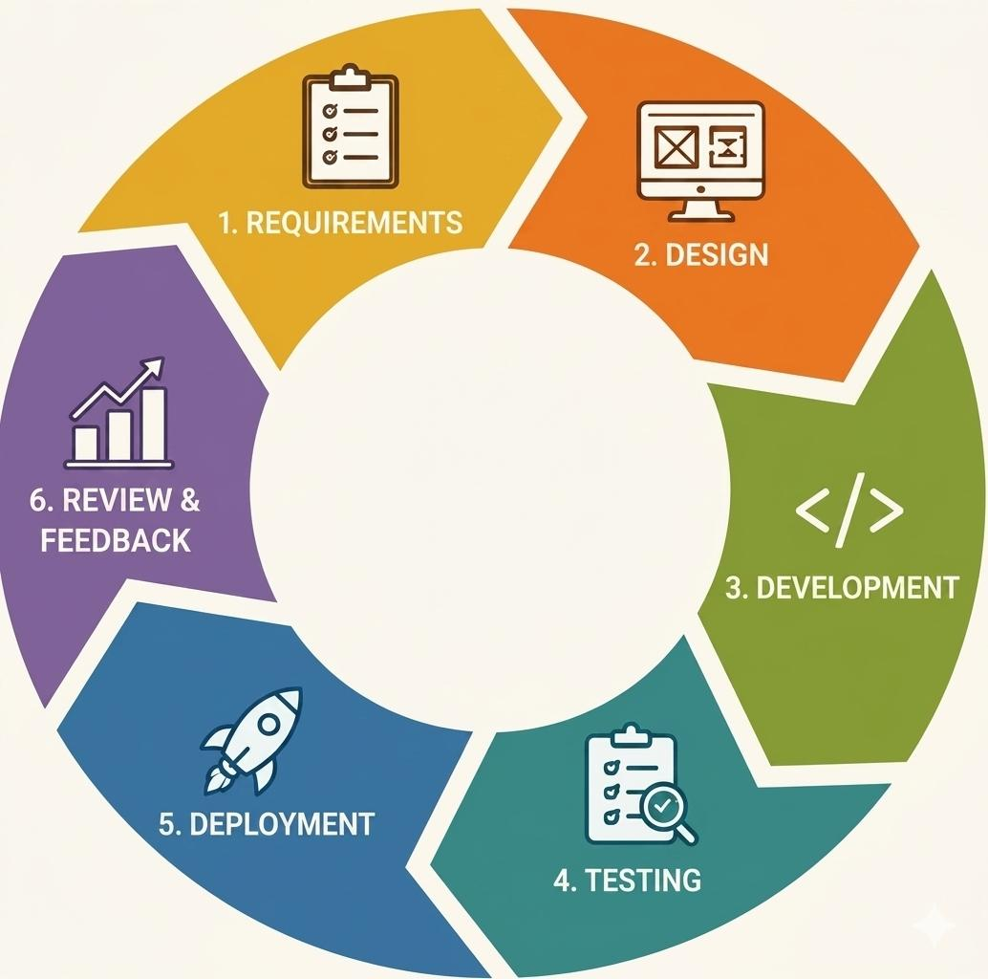
Development Methodology:
PAGE 20

Slide 21
Proposed System Features:
Operational Features:
Point-of-Sale (POS) Management.Inventory and Stock Monitoring.
Inventory Management
Supply Chain Management
Product Management
Sales Reporting and Analytics
MIS Features:
Management Reporting System
Decision Support Feature
Real-Time Data Monitoring
Inventory Information System
Customer Sales Tracking
User Management and Security
PAGE 21

Slide 22
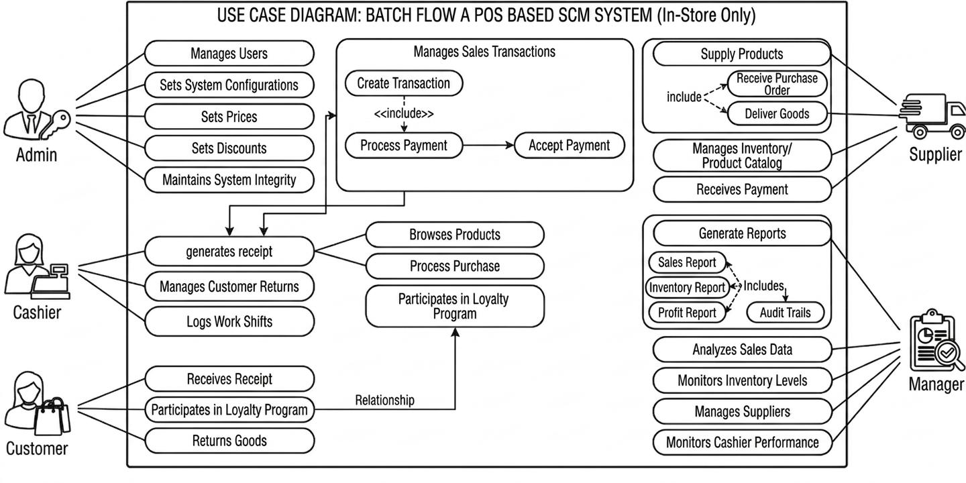
System Overview Diagram: System Flowchart
PAGE 22

Slide 23
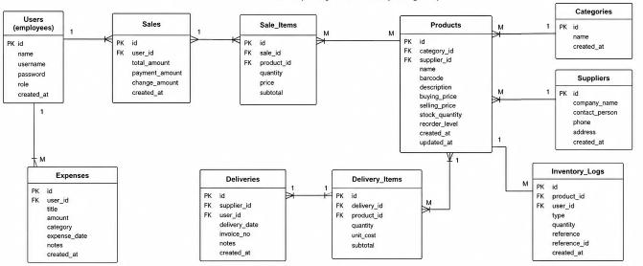
Database Design:
PAGE 23

Slide 24
Functional Requirements:
Secure Login and Logout
Sales Transaction Processing
Product and Price Management
Real-Time Inventory Monitoring
Supplier and Delivery Tracking
Report Generation
Low Stock Alerts
Customer Transaction Records
User Account and Access Management
Data Backup and Retrieval
PAGE 24

Slide 25
Non-Functional Requirements:
Performance
Security
Reliability
Usability
Scalability
Compatibility
PAGE 25

Slide 26
CHAPTER 4 SYSTEM DEVELOPMENT AND TESTING
PAGE 26

Slide 27
Development Tools and Technologies:
HTML
CSS
JavaScript
MySQL
MongoDB
PAGE 27

Slide 28
System Implementation:
How the system was developed:
Batch Flow: A POS-Based Supply Chain Management System was developed as a web-based platform to help bakery businesses manage sales, inventory, and supply chain operations efficiently. The system was created using web development technologies such as HTML, CSS, JavaScript, MySQL and MongoDB to provide a user-friendly and functional interface for bakery staff and administrators. The development focused on automating manual bakery processes, improving transaction accuracy, and providing organized data management.
PAGE 28

Slide 29
System Implementation
Development Process:
Planning Phase
Requirement Analysis
System Design
System Development
Testing Phase
Implementation Phase
Deployment Process:
The system database and source code were uploaded to a web server or hosting platform.
User accounts and system settings were configured for bakery staff and administrators.
Initial bakery products, inventory records, and supplier information were added to the database.
Users were trained on how to use the POS, inventory, and reporting features of the system.
The system was deployed for daily bakery operations and monitored regularly for maintenance and updates.
PAGE 29

Slide 30
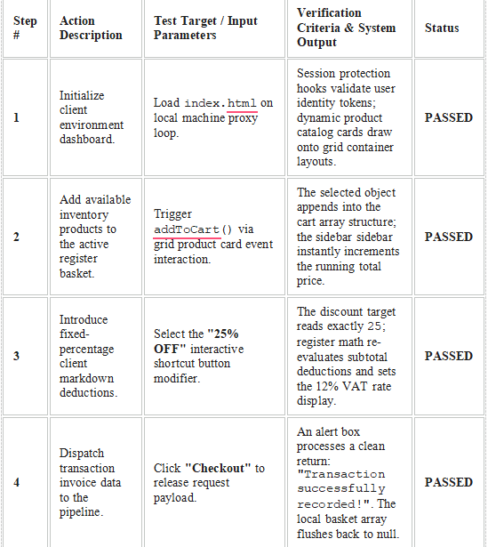
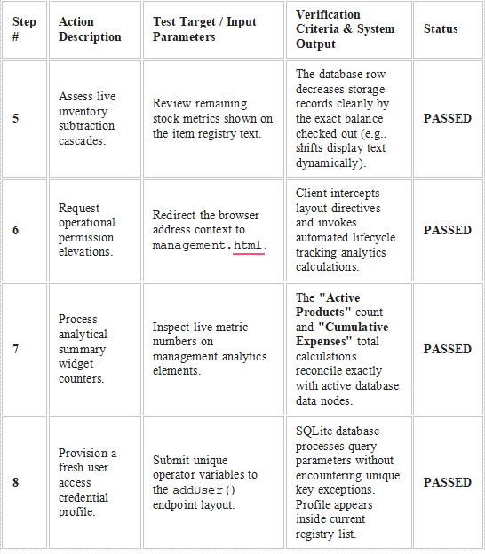
Testing and Evaluation Test Case
PAGE 30

Slide 31
CHAPTER 5 CONCLUSION AND RECCOMENDATION
PAGE 31

Slide 32
Conclusion:
The development of Batch Flow: A POS-Based Supply Chain Management System successfully achieved its goal of creating an efficient and reliable web-based platform for bakery operations.
The system integrated important business processes such as POS transactions, inventory monitoring, supply chain coordination, sales tracking, and order management into one centralized platform.
By using modern web technologies and the Agile development methodology, the project provided a user-friendly and responsive system for bakery businesses.
The system improved operational workflow, enhanced data accuracy, reduced manual workloads, and provided real-time access to business information.
PAGE 32

Slide 33
Reccomendation:
For future improvements, it is recommended that Batch Flow: A POS-Based Supply Chain Management System continue enhancing its functionality and adaptability to meet the growing needs of bakery businesses.
Improving the user interface and user experience can make the system easier to use for administrators, cashiers, managers, suppliers, and customers.
Possible upgrades include developing a mobile application version for easier access through smartphones and tablets.
In the future, the system may also integrate Artificial Intelligence features for automated demand forecasting, smart inventory recommendations, and customer behavior analysis.
These enhancements can help Batch Flow become a more advanced, efficient, and competitive bakery management solution.
PAGE 33

Slide 34

THANK YOU FOR LISTENING!
PAGE 34

