Slide 1

FACULTY OF COMPUTING
SESSION: 2020/2021 SEMESTER 2
UHL2422 ENGLISH FOR TECHNICAL COMMUNICATION
NAME | Matric ID
CHUAH HENG YANG | CA19136
MUHAMMAD DANIAL BIN MOHAMMAD RIZWAN | CA19143
MUHAMMAD AIDIL SYAZWAN BIN HAMDAN | CA19144
HO CHEE HOU | CA19134

Slide 2
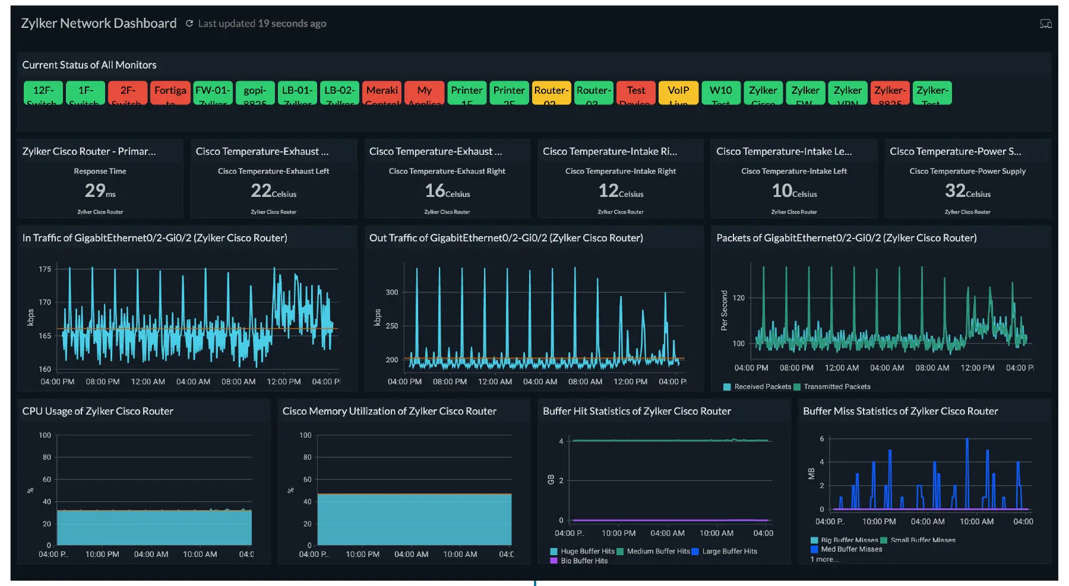

Background
- Support More Traffic flow - Better Network Performance

Slide 3




Problem Statement
- Storage - Speed - Cost - Maintenance and
Management

Slide 4
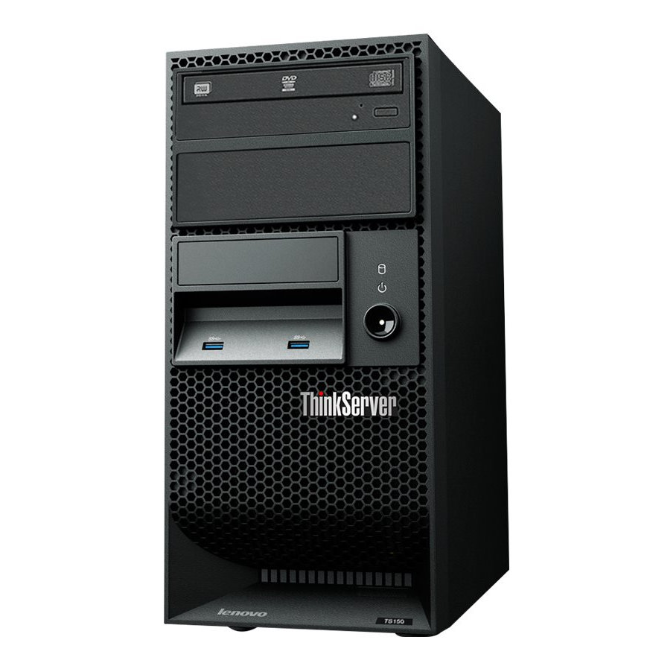

Options & Comparison
- Lenovo ThinkServer TS150 - Dell PowerEdge T30

Slide 5

Storage

Slide 6
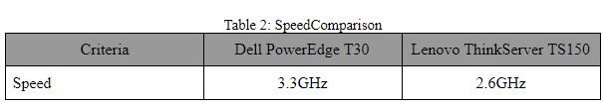
Speed

Slide 7
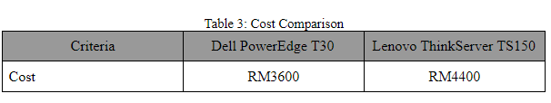
Cost

Slide 8
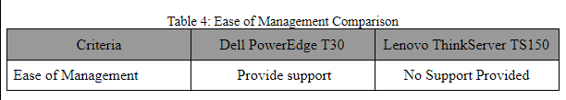
Ease of management

Slide 9
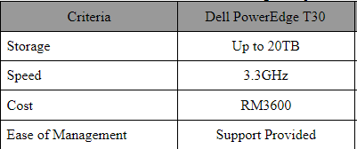
Conclusion

