Slide 1
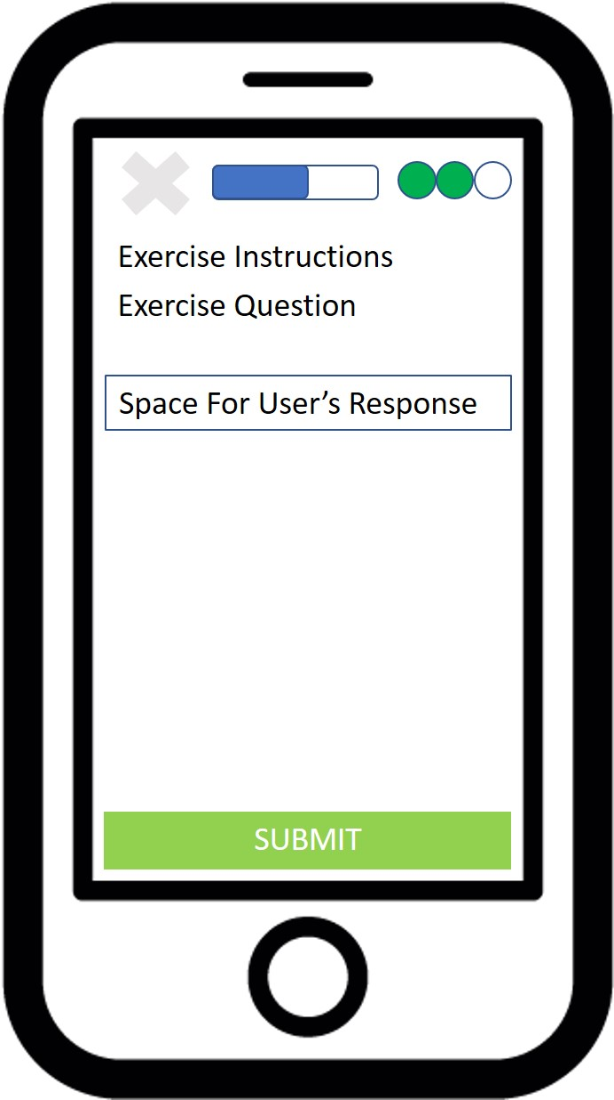
Diagram lesson_attempt_global_elements
Exit Lesson Button
Life Meter
Lesson Progress Bar
Exercise Body
Response Submit Button

