Slide 1
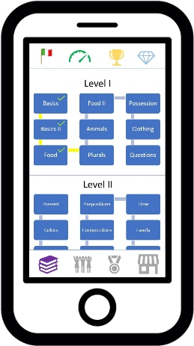
Diagram 3
Upper Button Bar
900
Lower Button Bar
Lower Button Bar

