Slide 1
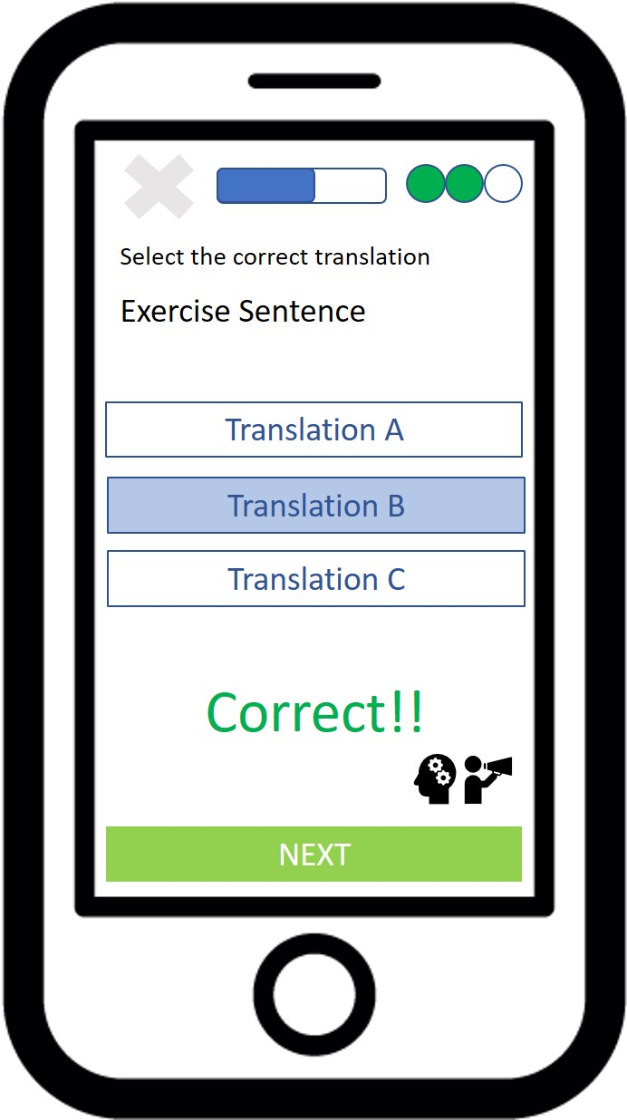
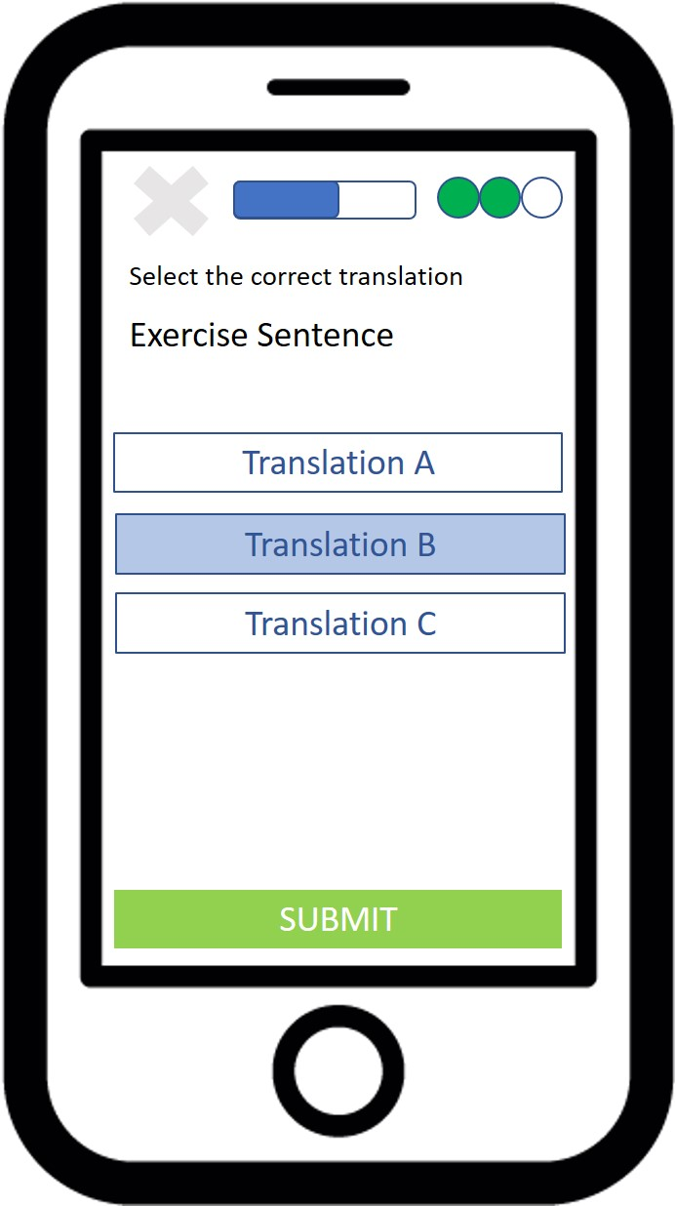
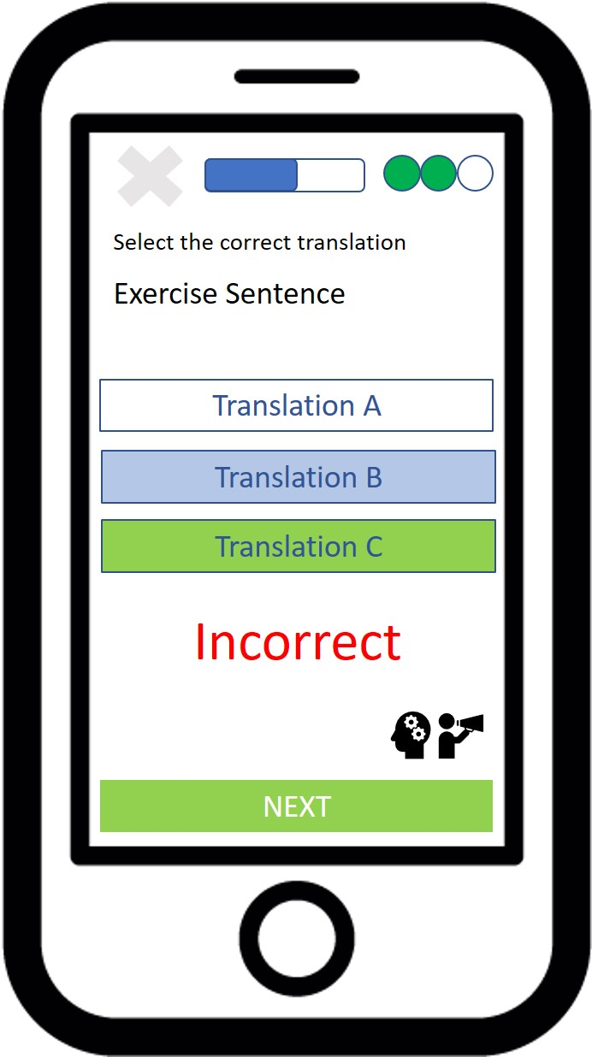
Diagram textual_challenge_mult_choice_response_results
Correct Response Given
Incorrect Response Given

