Slide 1
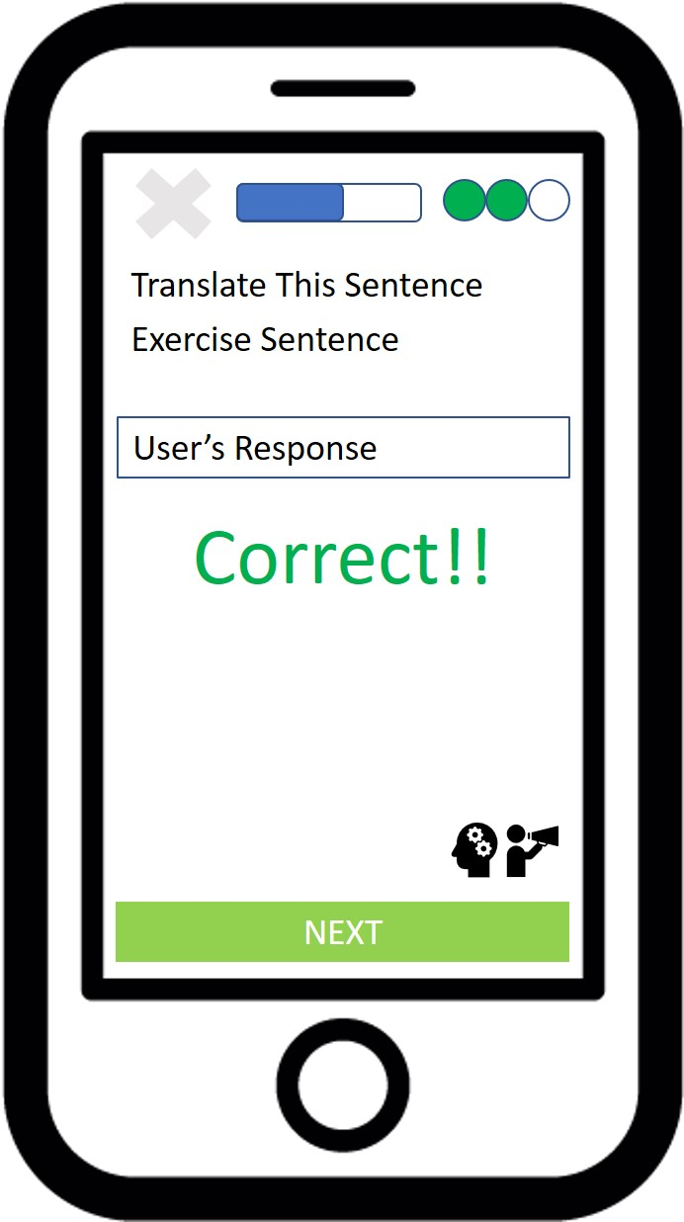
Diagram exercise_tools
Launch Cognizant Tutor Button
Flag as problematic exercise Button

