Slide 1

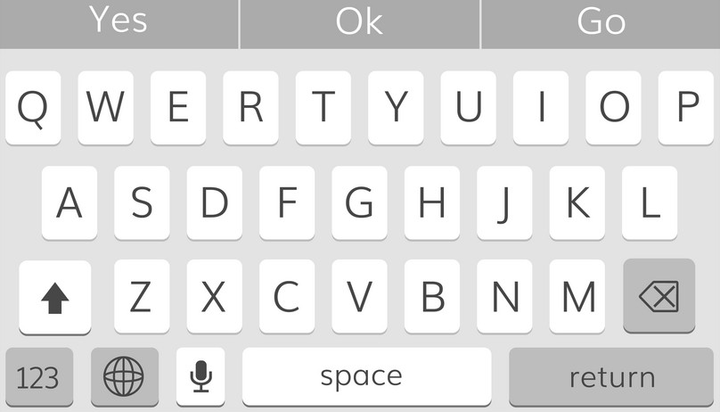



Welcome back!!
Let’s get started!!
Exercise Instructions
Exercise Question
User’s Response
Language
Lizzard
Incorrect
Correct Answer
Correct!!
Translation A
SUBMIT
Translation B
Translation C

Slide 2

Speak this sentence
Exercise Sentence
Response Recorded
Correct!!
NEXT

Slide 3













Slide 4


Distinct Edge Between Consecutive Completed Modules
Edge
Level I
Basics
Basics
Basics II
Food
Plurals
Animals
Food II
Possession
Clothing
Questions
Module (Node)
Part I/II
Lesson 8/10
Completed Module (Node)
BEGIN
Level II
Module (Node)
Present
Colors
Food
Plurals
Conjuntctions
Prepositions
Time
Family
Questions

Slide 5









Joe
Luis B.
Lizzard Exp
Liselot Nayan

Slide 6
Joe
Luis B.
Lizzard Exp
Liselot Nayan

Slide 7
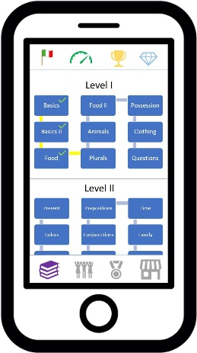

Slide 8
Splash Screen
Existing User?
User Account Creation Interface
Training Program Interface
Social Media Interface
Health and Practice Interface
Weekly League Standing Interface
Trophy Collection Interface
App Store Interface

