Slide 1
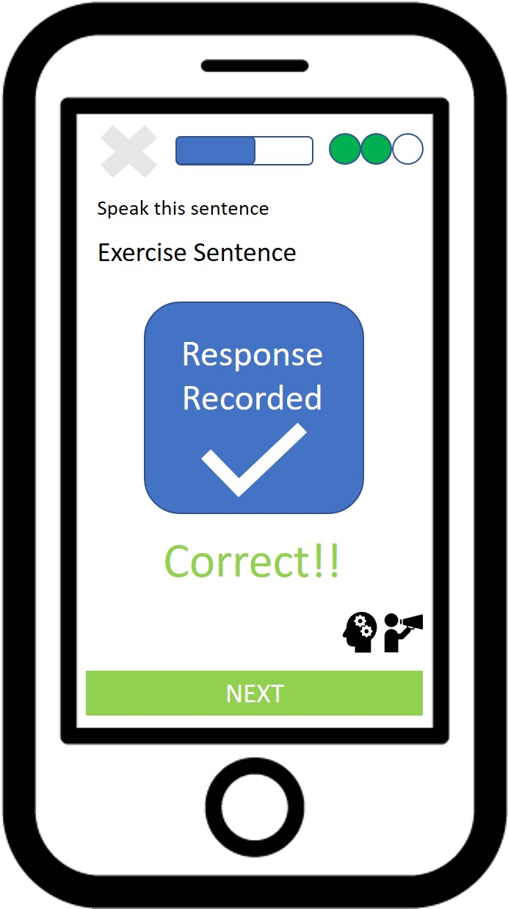
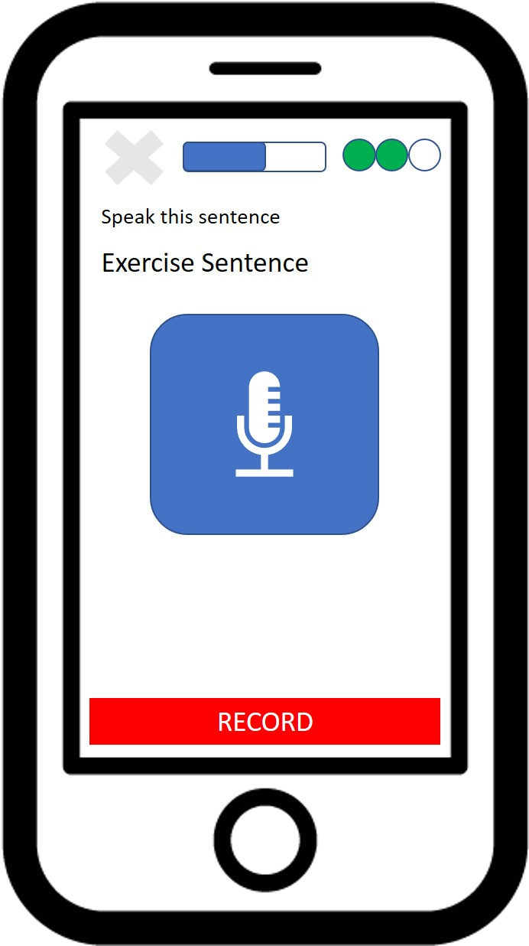

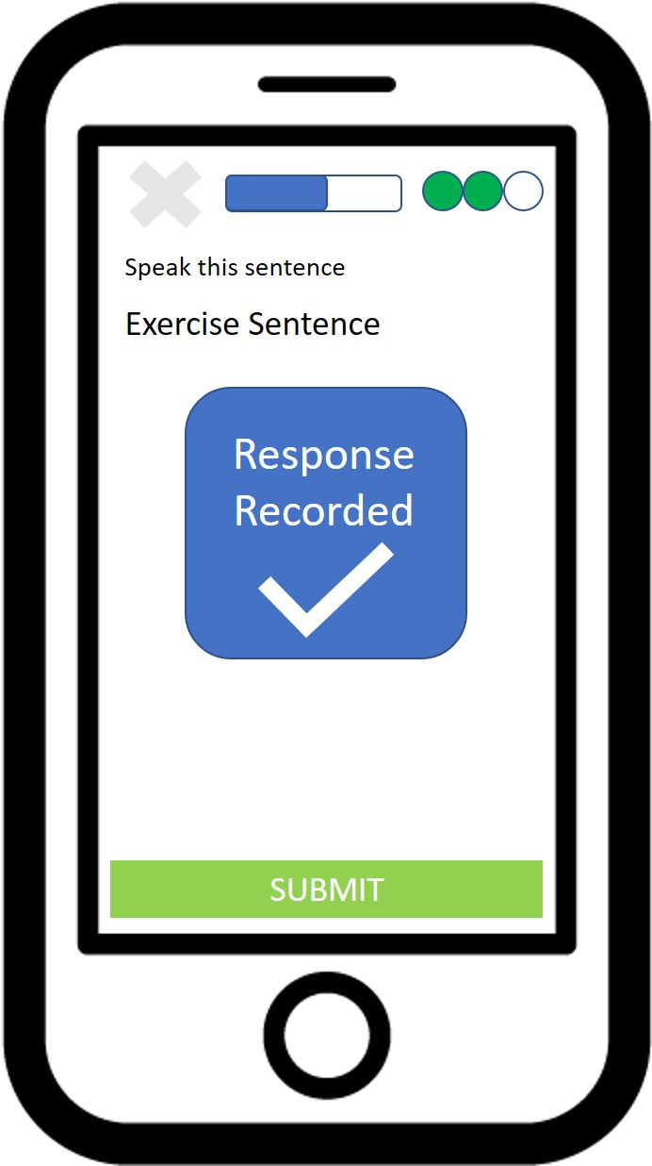

Diagram Textual Challenge Voice Response Results
No
User speaks response into microphone
Yes
Press Microphone Button to end recording of response
Recording
Verified For Machine’s Understanding of Response?
Press Microphone Button to begin recording response
Press SUBMIT Button to receive results

