Slide 1
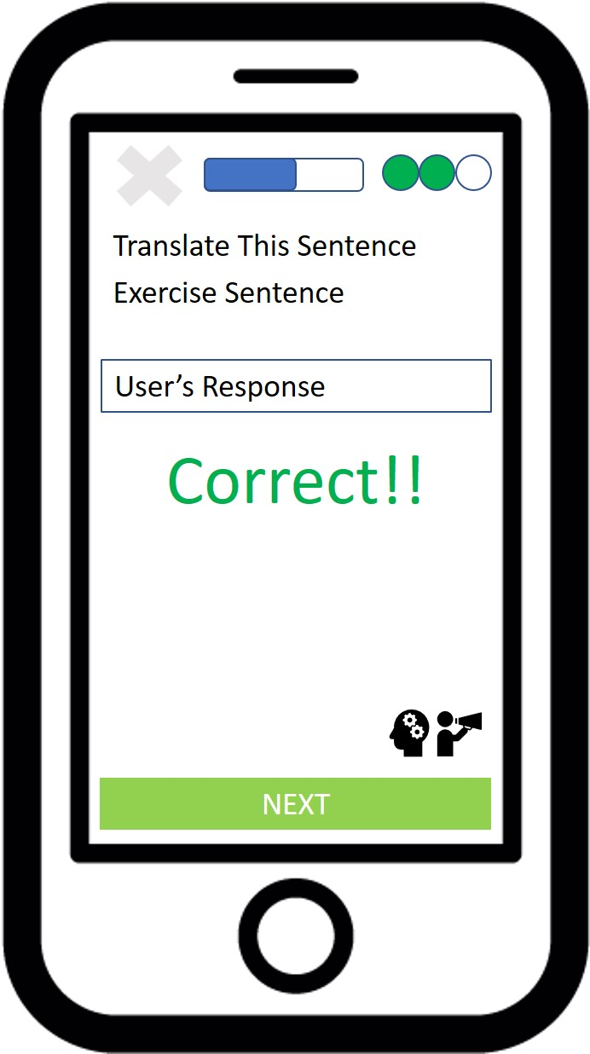
Launch Cognizant Tutor Button
Flag as problematic exercise Button

