Slide 1
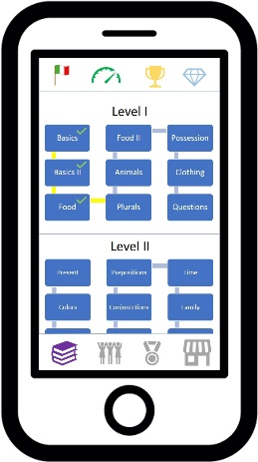
Diagram 2
Trophy Collection Access Button
Health and Practice Access Button
Language Selector Access Button
Upper Button Bar
900
Rewards Points
Display Icon
Weekly League Standings
Access Button
App Store
Access Button
Social Media
Access Button
Training Program
Access Button
Lower Button Bar

