Slide 1
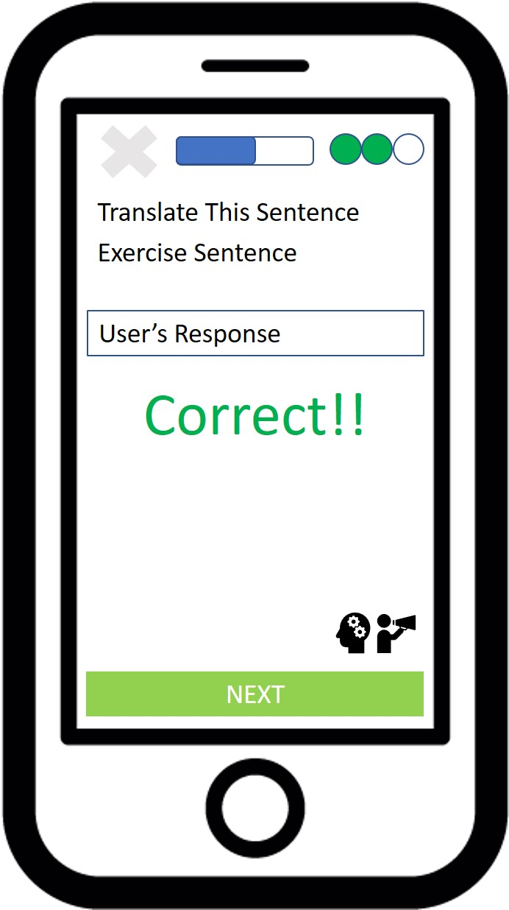
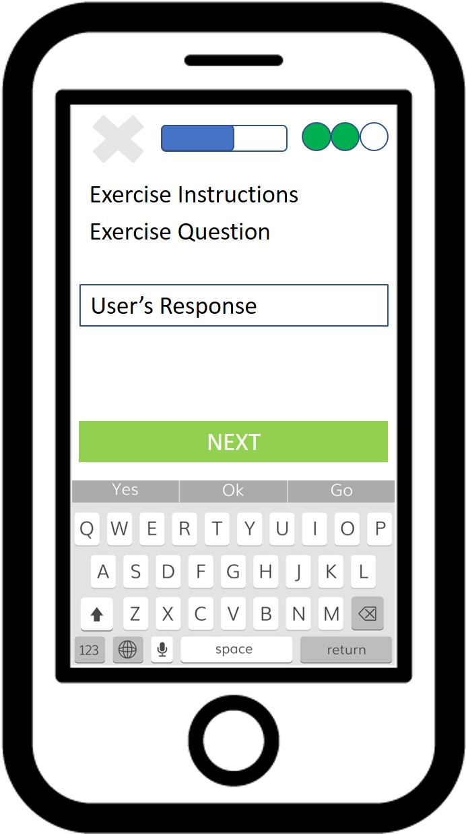
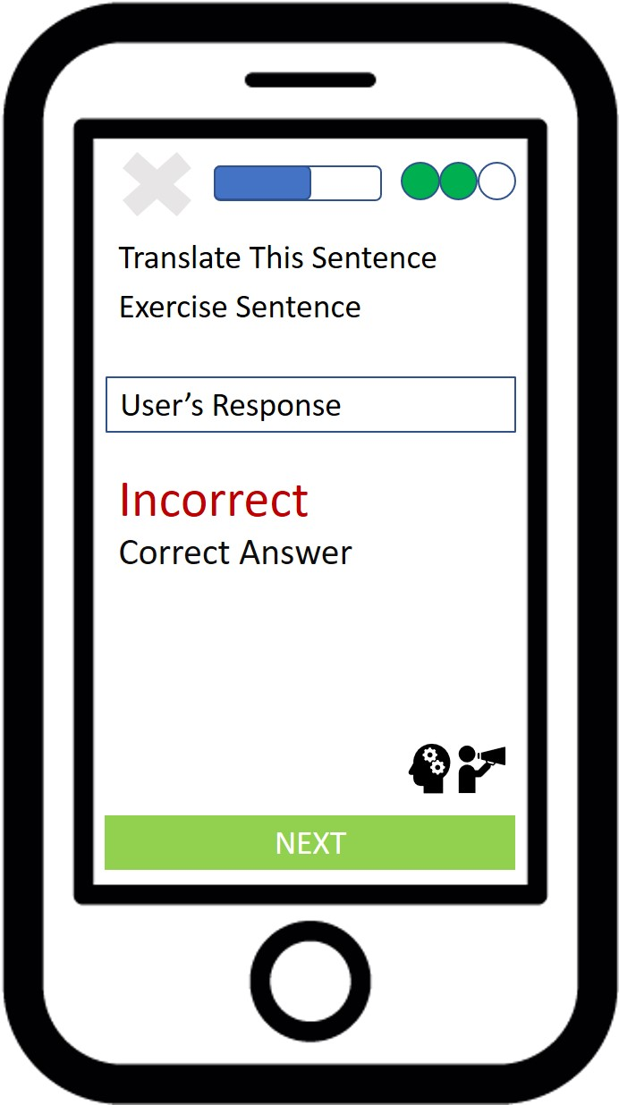
Diagram exercise_textual_challenge_textual_response_results
Correct Response Given
Incorrect Response Given

