Slide 1
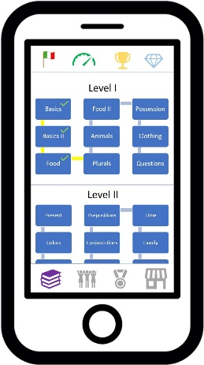
Diagram 3
Upper Button Bar
900
Main Window
Lower Button Bar

