Slide 1
Covariance Combination
Minimum Variance Portfolio By hour as combination of
Covariance matrix of that specific hour of the day
Covariance Matrix of all hours of day
All data is minutely.
Covariance Matrix = Delta * Daily Covariance + (1- Delta) * Specific Hour Covariance
Using the 10 day lookback we established as optimal in previous work for daily covariance matrix
1 month of data for each hour (21*60) = 1260 minutes

Slide 2
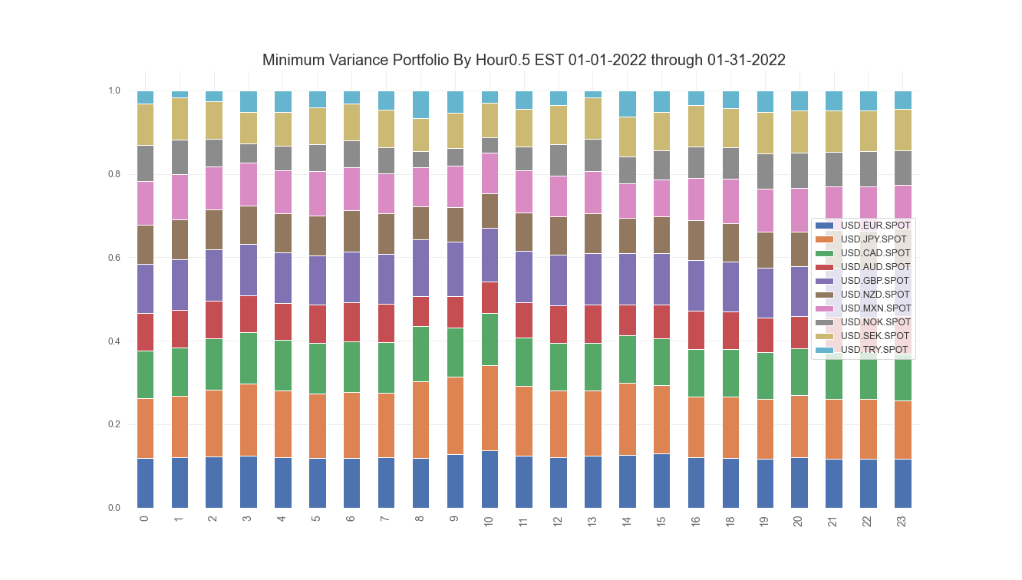
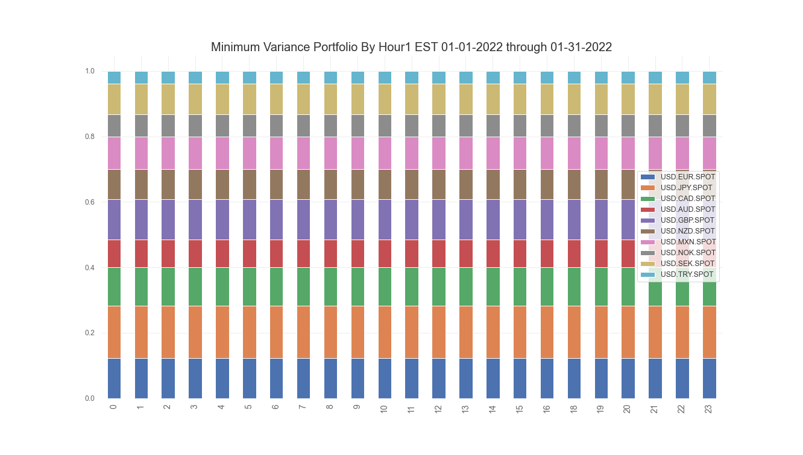
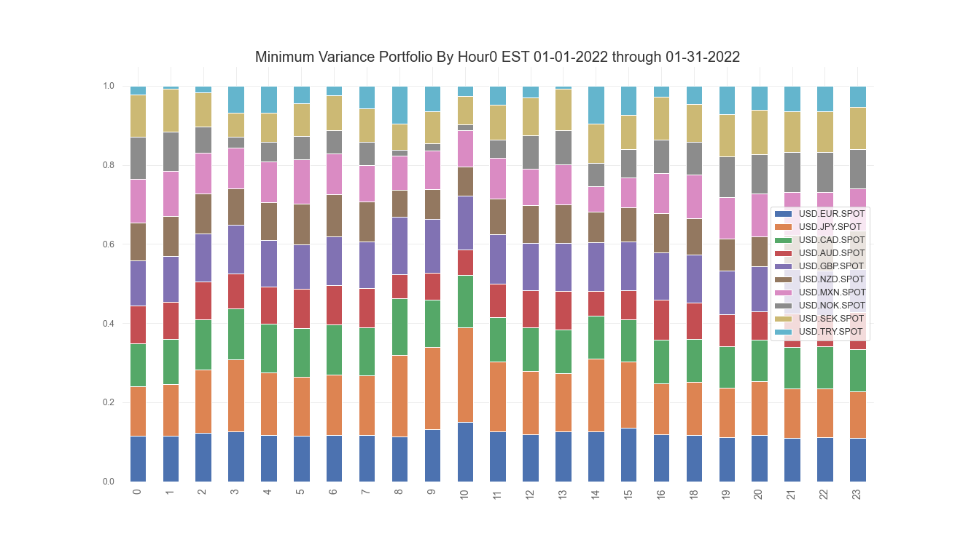
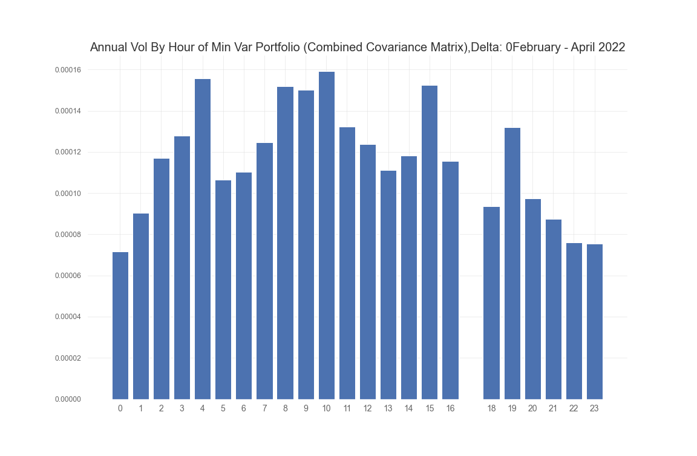
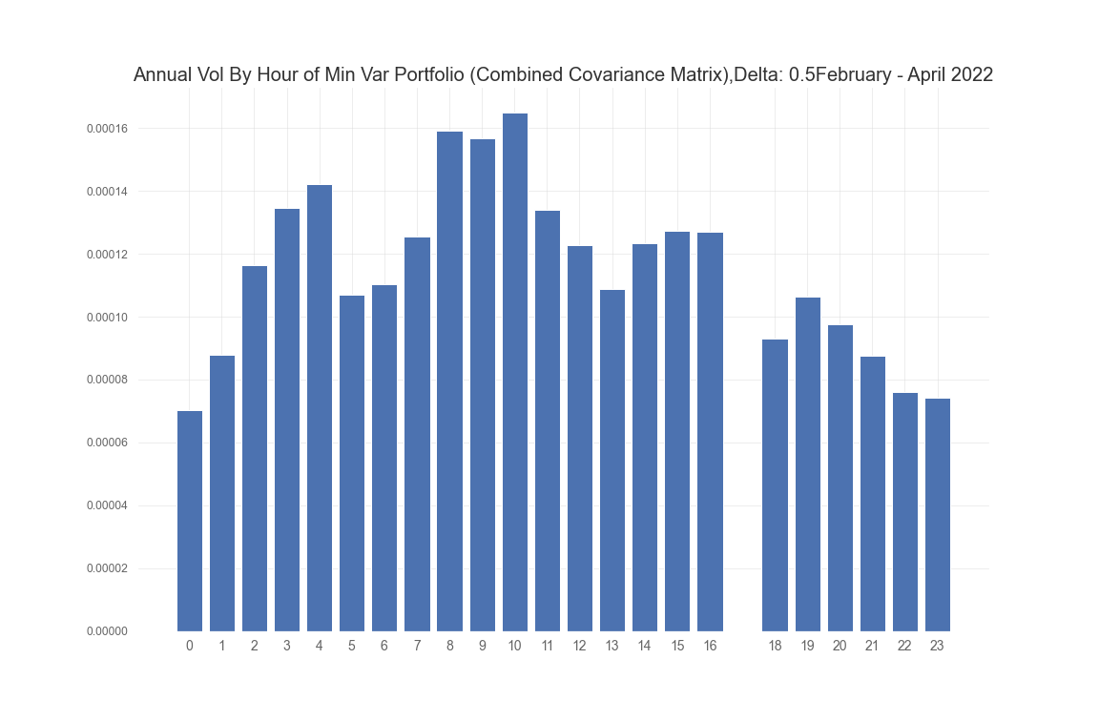
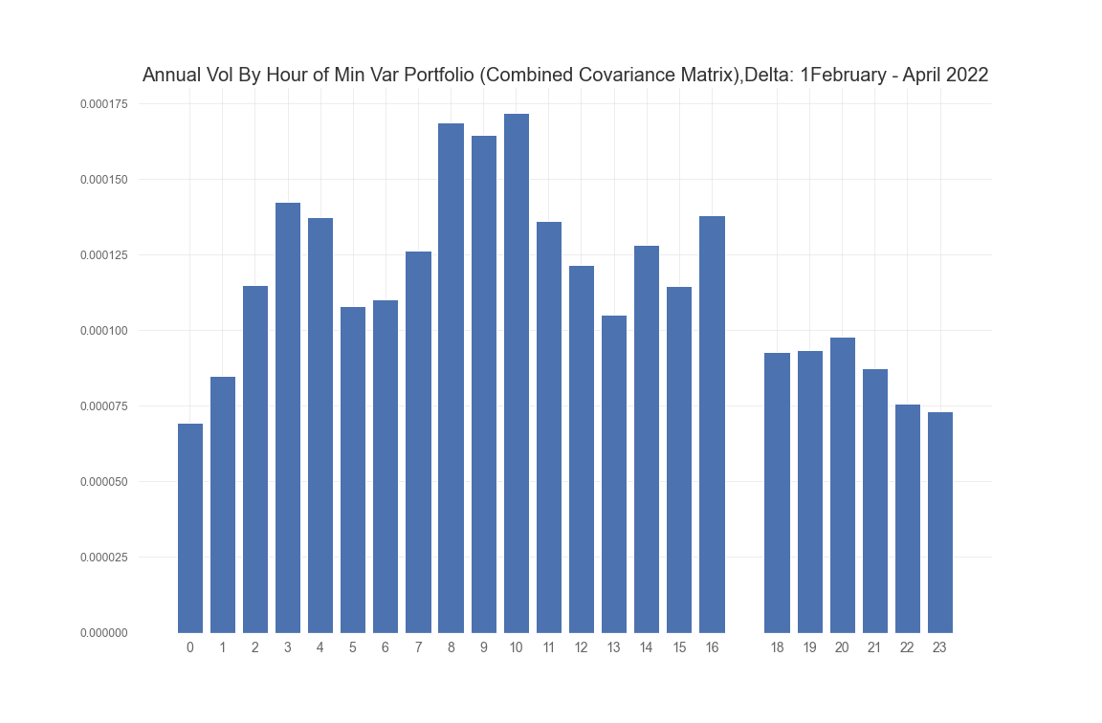
Delta 0 Delta .5 Delta 1

Slide 3
Covariance Combination thoughts
Resulting minimum variance portfolios appear to be linear combination of the 2.
Some hours have better results by using their hour’s covariance matrix, some are better using all data.

