Slide 1



Teaching a language model to chat like you
Taught by Imad Saddik

Slide 2
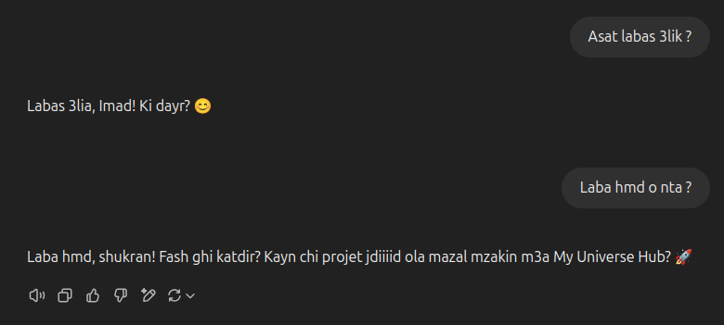
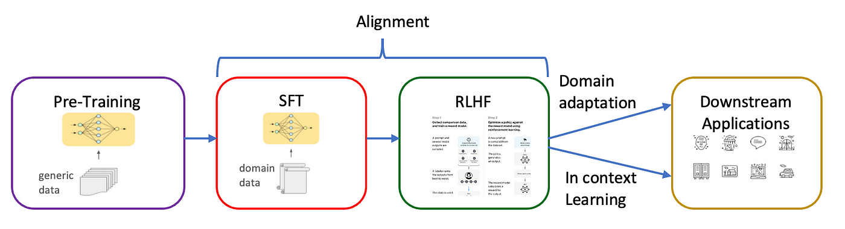
Why ?
See if we can mathematically simulate how a person talks.
Bring someone who died back to life? In the form of a language model.
Learn the full pipeline: data extraction, processing, and model training.
LLMs struggle with Moroccan Darija.
Medium article

Slide 3

How ?
Data extraction
Group chats.
Personal conversations.

Slide 4

How ?
Data extraction
Combine the extracted text
Sequence of text
Raw data

Slide 5



How ?
Data extraction
Combine the extracted text
BPE algorithm & text encoding
Wikipedia article
Hugging Face course
Andrej Karpathy’s video

Slide 6
How ?
Data extraction
Combine the extracted text
BPE algorithm
Text encoding
IDs
The
he
labas
Imad = 1
1
Mod = 2
I’
Imad
Fore = 3
Encode the
text
ello
mod
large
2
large = 4
model
...
fore
si
Vocabulary

Slide 7
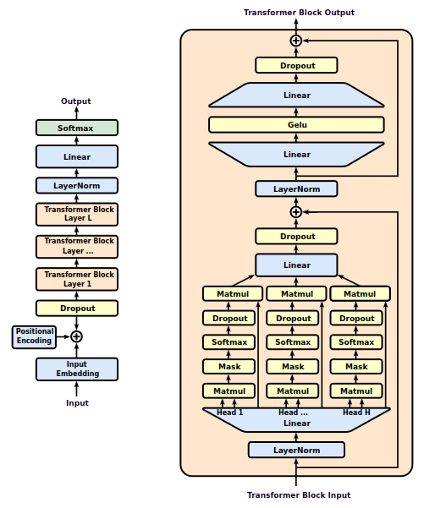
How ?
Data extraction
Combine the extracted text
BPE algorithm
Text encoding
Create the model
StatQuest video

Slide 8
How ?
Data extraction
Combine the extracted text
BPE algorithm
Text encoding
Create the model
Data splitting & model training

Slide 9
How ?
Data extraction
Combine the extracted text
BPE algorithm
Text encoding
Create the model
Data splitting & model training
Prepare the fine-tuning dataset
Base model
The model learned to simulate the training data.
It can only do next token prediction.
Not useful.
Fine-tuning dataset

Slide 10
How ?
Data extraction
Combine the extracted text
BPE algorithm
Text encoding
Create the model
Data splitting & model training
Prepare the fine-tuning dataset
Base model
The model learned to simulate the training data.
It can only do next token prediction.
Not useful.
The person you want to imitate
Fine-tuning dataset

Slide 11
How ?
Data extraction
Combine the extracted text
BPE algorithm
Text encoding
Create the model
Data splitting & model training
Prepare the fine-tuning dataset
Fine-tune the base model
Base model
Assistant
The model now is able to mimic the person we chose in the dataset.
The model is useful.

Slide 12
How ?
Data extraction
Combine the extracted text
BPE algorithm
Text encoding
Create the model
Data splitting & model training
Prepare the fine-tuning dataset
Fine-tune the base model
Base model
Assistant
The model now is able to mimic the person we chose in the dataset.
The model is useful.
Finding the best dataset is a challenging task.

Slide 13
Let’s start

Slide 14



DATA EXTRACTION

Slide 15
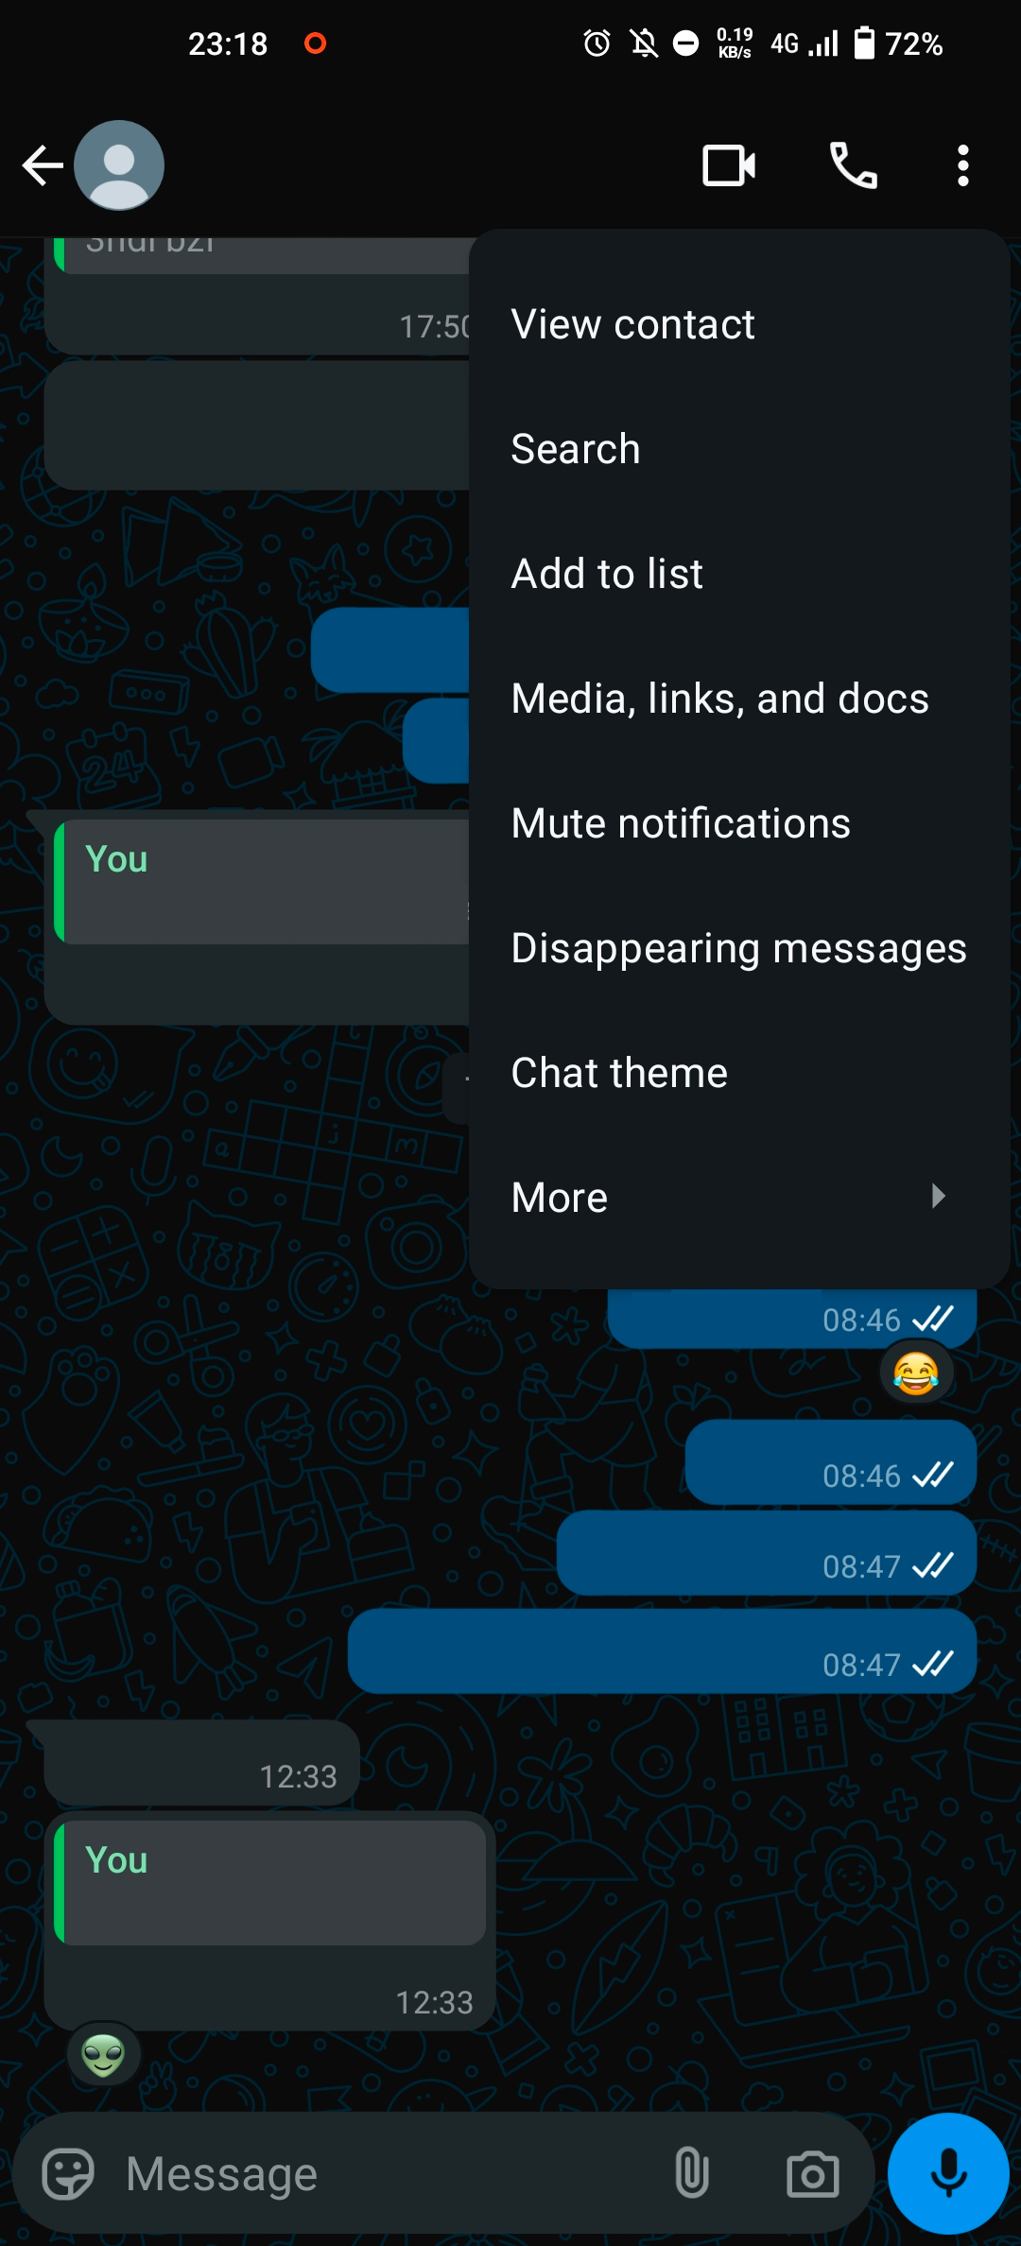
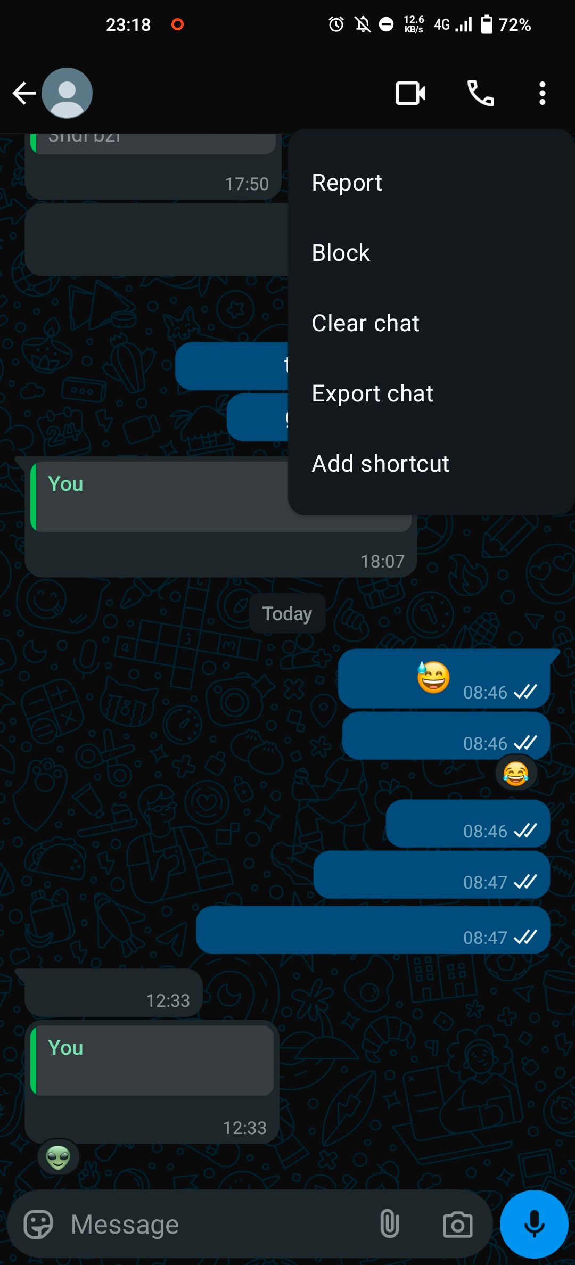
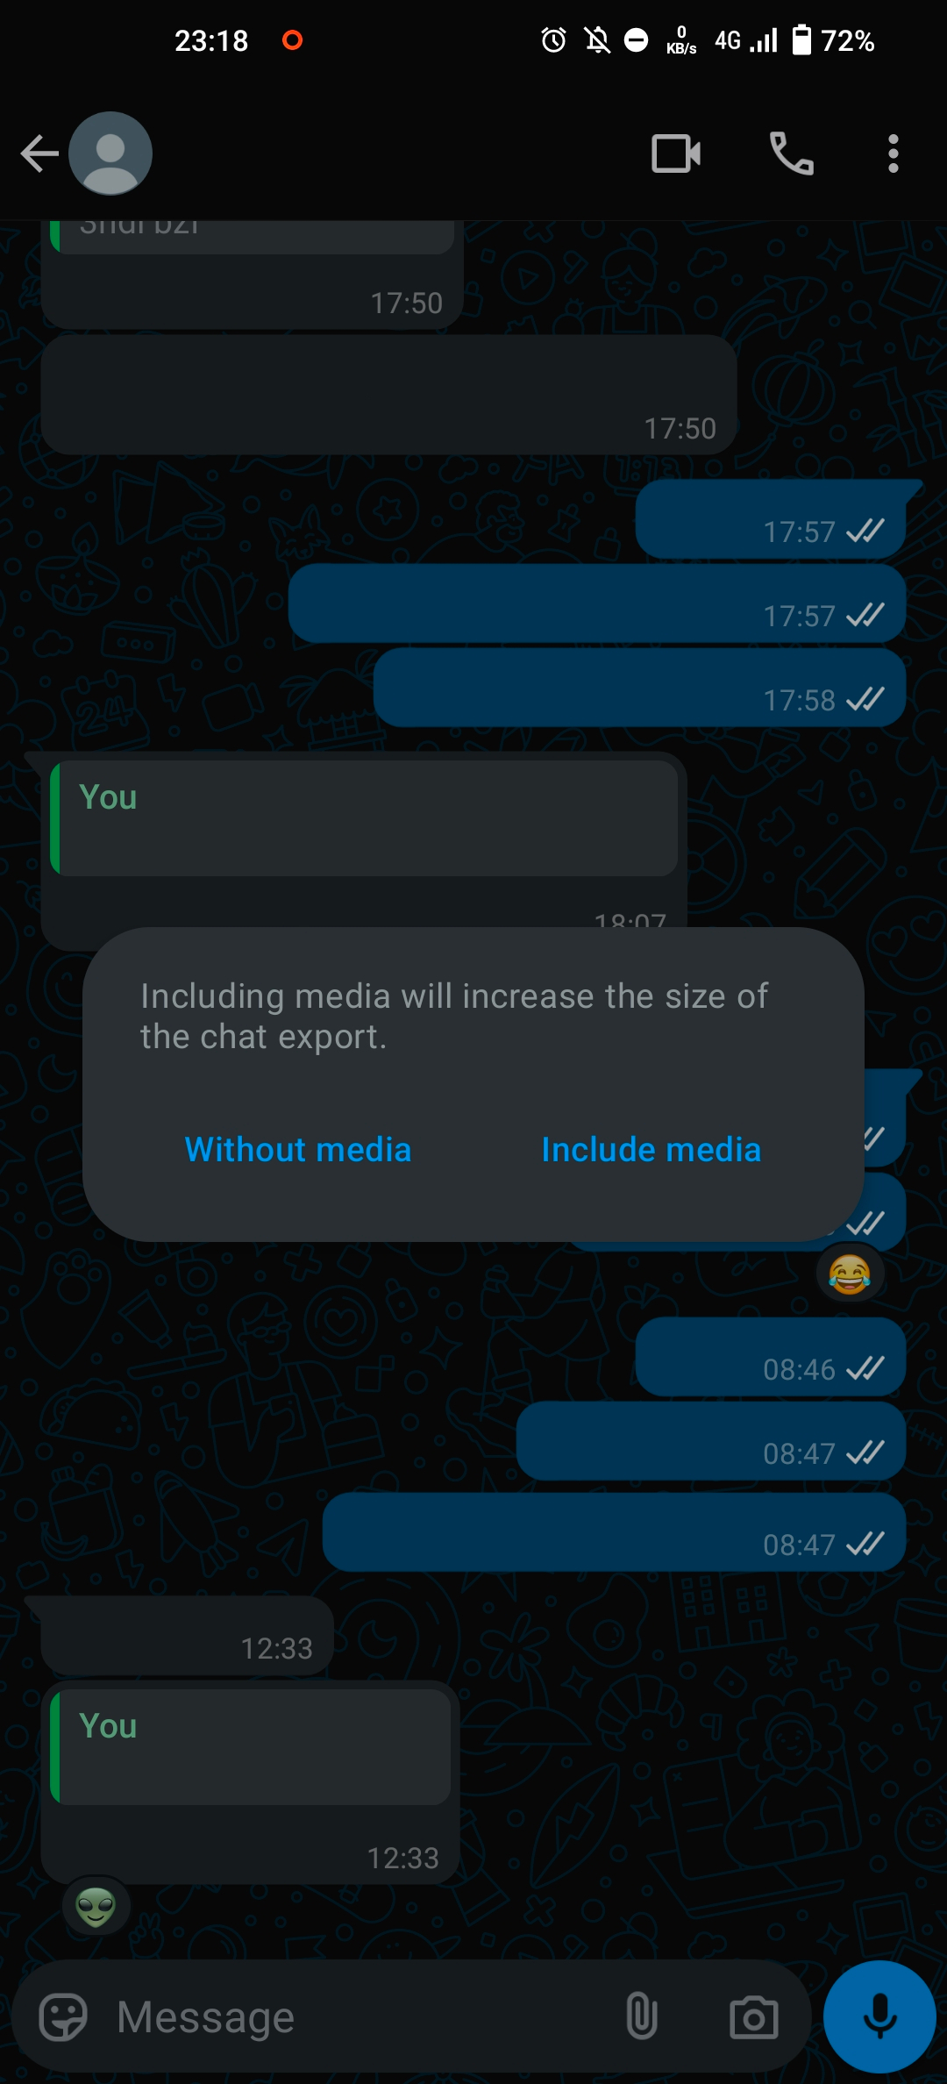
Data extraction
Extracting the data from WhatsApp is a manual process.
Follow these steps:

Slide 16
Data extraction
Export data
01/04/2069, 04:20 - You: Hello world!

Slide 17
Data extraction
Export data
Filters
Remove links
Remove special tags like <Media omitted>, <You deleted this message>
Remove email addresses
Remove tagging
...

Slide 18
Data extraction
Concatenate
Export data
Filters
One big sequence of text

Slide 19
Let’s code

