Slide 1
Cinema Ticketing System
System Analysis and Design
Spring 2015

Slide 2
case study
CMS project aims to provide customers the facility to book tickets and gather information about movies online. The user can browse movie listings and make bookings. In this project, we describe our system by providing DFD on some functions. Administrator can add, update and delete data (movie, room, schedule…) which will update the dynamic web pages. Also, administrator can check the statistic information from the system.

Slide 3
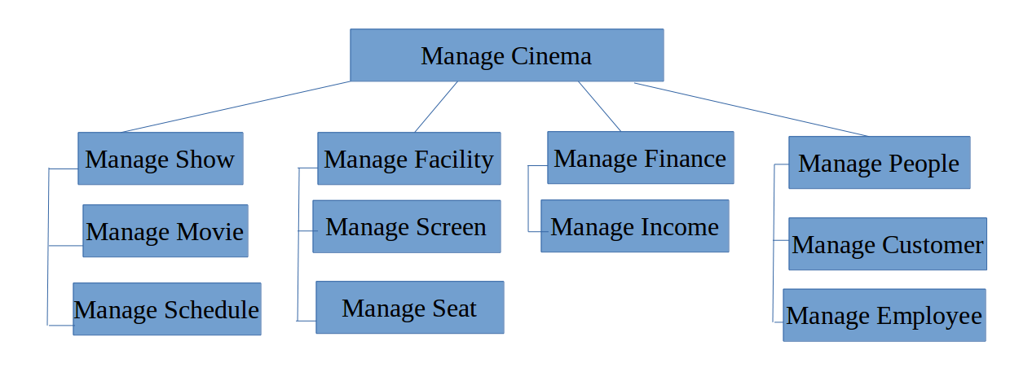
BFD

Slide 4
analysis phase
Requirements:
Functional:
Search and browse
Review and rate
Read news and subscribe
Book tickets
Manage account information
Promote
Sell and reserve tickets (for moderators)
Manage (for administrators)
Reports (visible to administrators only)

Slide 5
analysis phase
Non-functional:
Operational
Performance
Security
Cultural

Slide 6
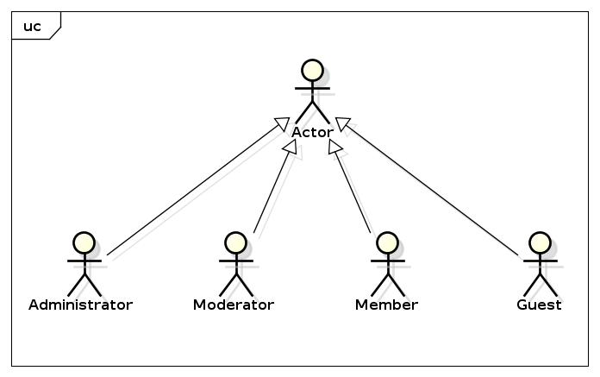
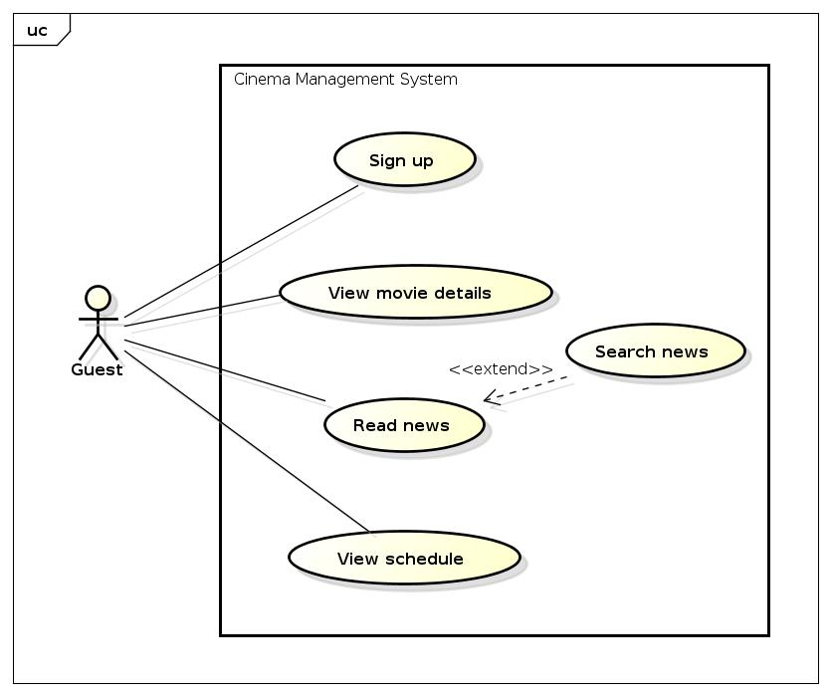
analysis phase
Use case diagram:

Slide 7
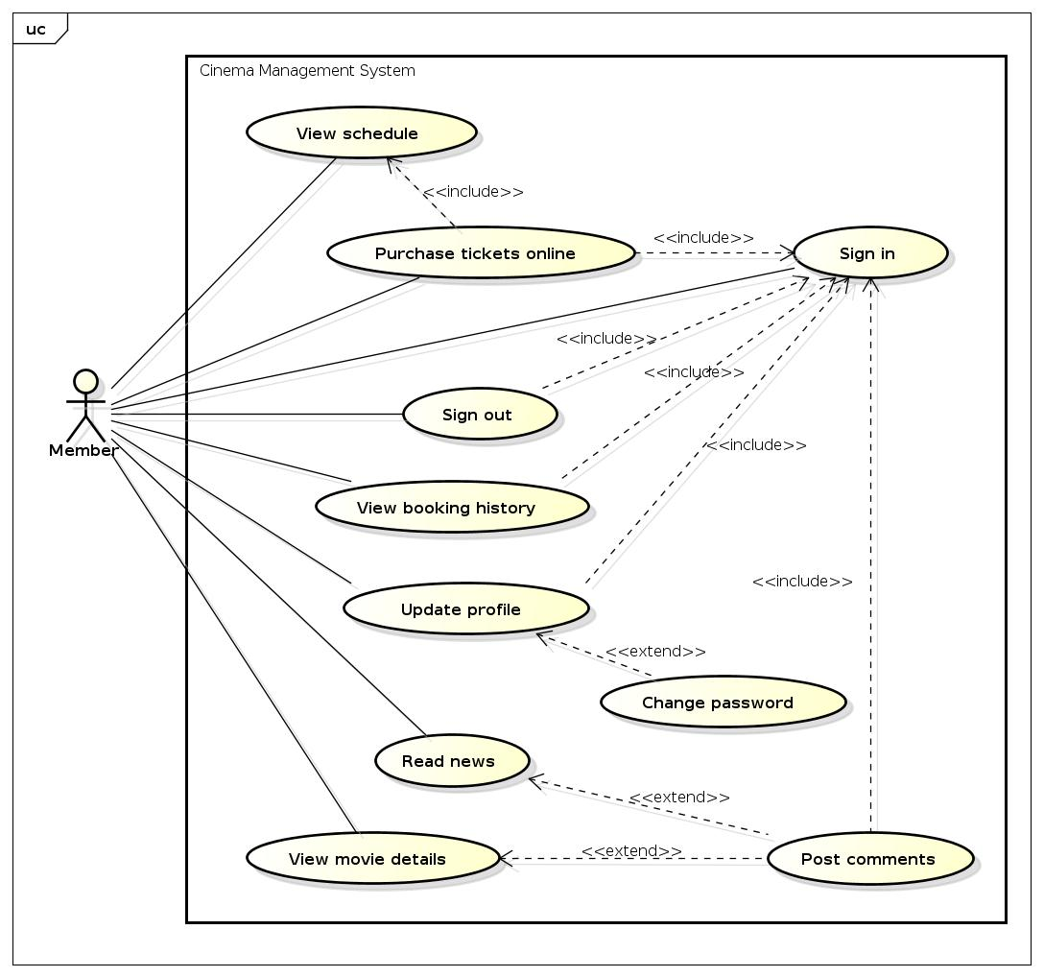

Slide 8
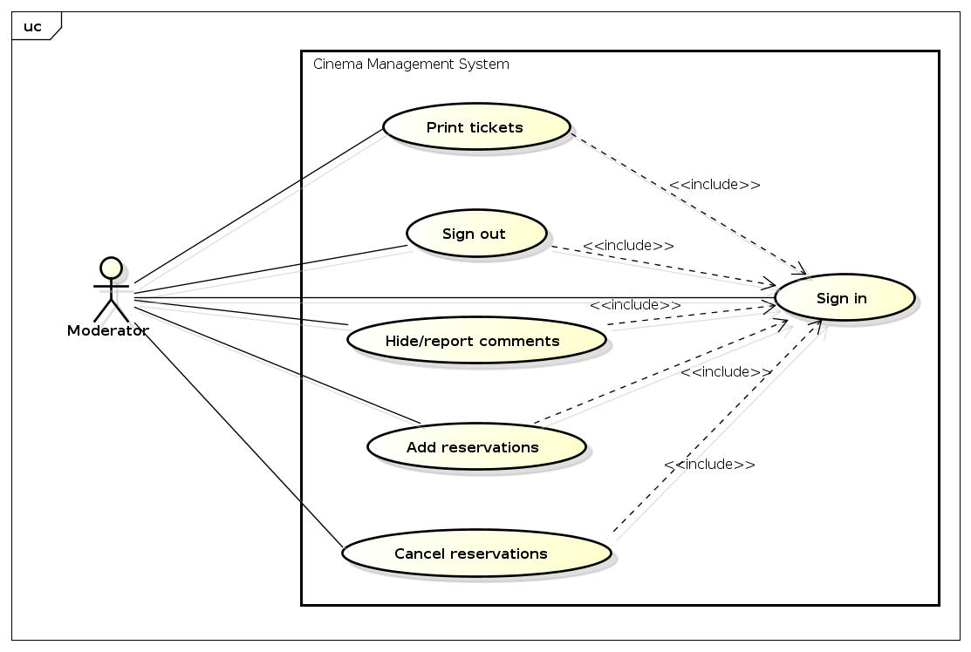

Slide 9
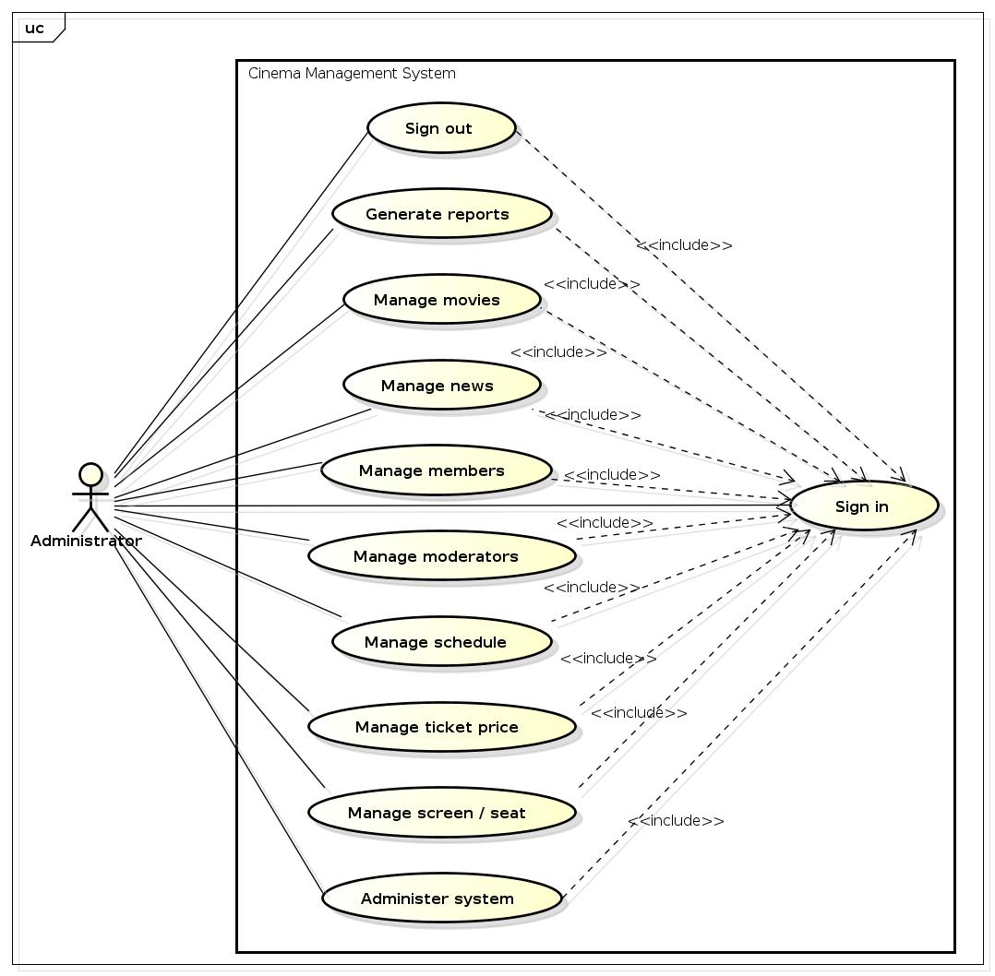

Slide 10
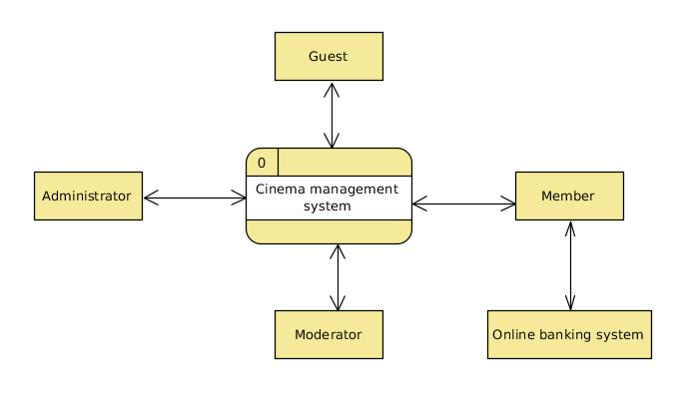
analysis phase
Context diagram:

Slide 11
analysis phase
Requirements:
Functional:
Search and browse
Review and rate
Read news and subscribe
Book tickets
Manage account information
Promote
Sell and reserve tickets (for moderators)
Manage (for administrators)
Reports (visible to administrators only)

Slide 12
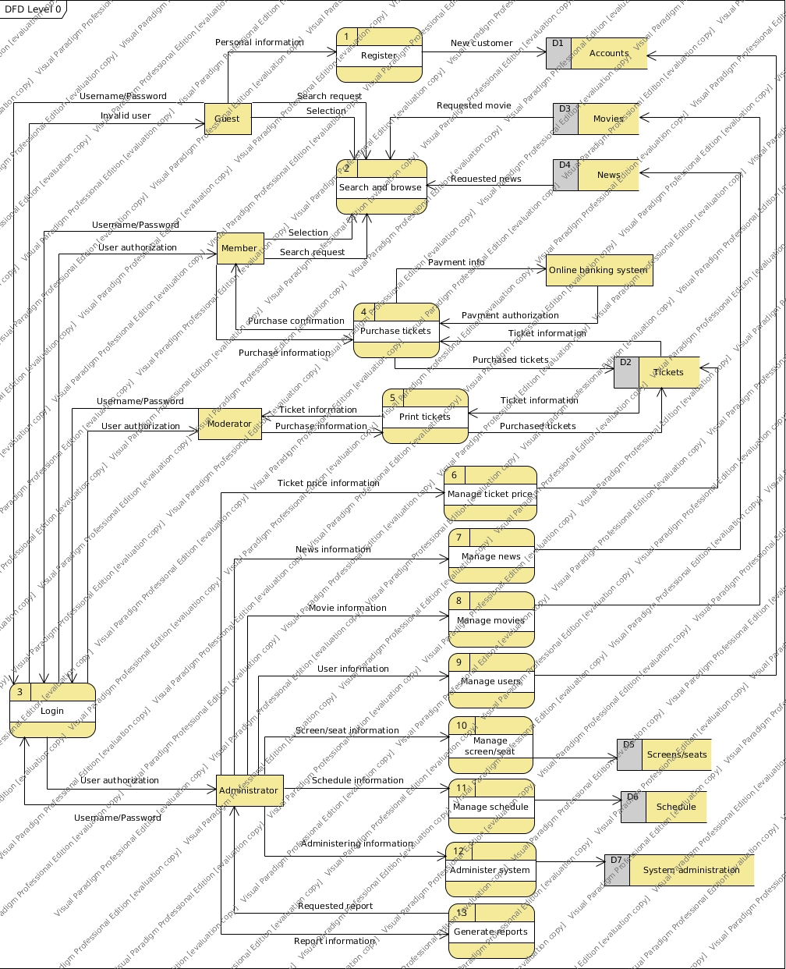
analysis phase
Data flow diagram:

Slide 13
design phase
Acquisition strategy:
Strategy: Custom development
Benefit
Allow developers to be flexible and creative in solving business problems
Build technical skills and functional knowledge within the company
Reason
The business is unique
Time frame is flexible

Slide 14
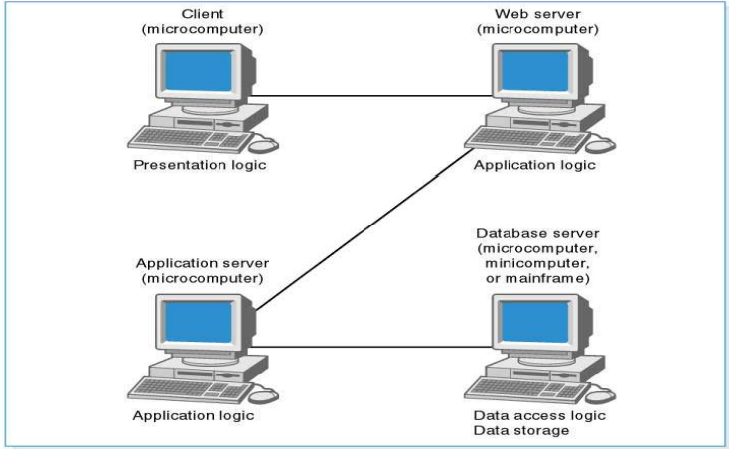
design phase
Architecture design:
Four-tiered client-server architecture

Slide 15
design phase:
Benefits:
More scalable
Better security control
Friendly maintenance
Friendly to adding new features
Greater reusability
More balanced load on different servers thanks to processing separation
Improved modularity of web-based system
Works with multiple vendors/products
Limitations:
Greater load on network
More difficult to implement and test

Slide 16
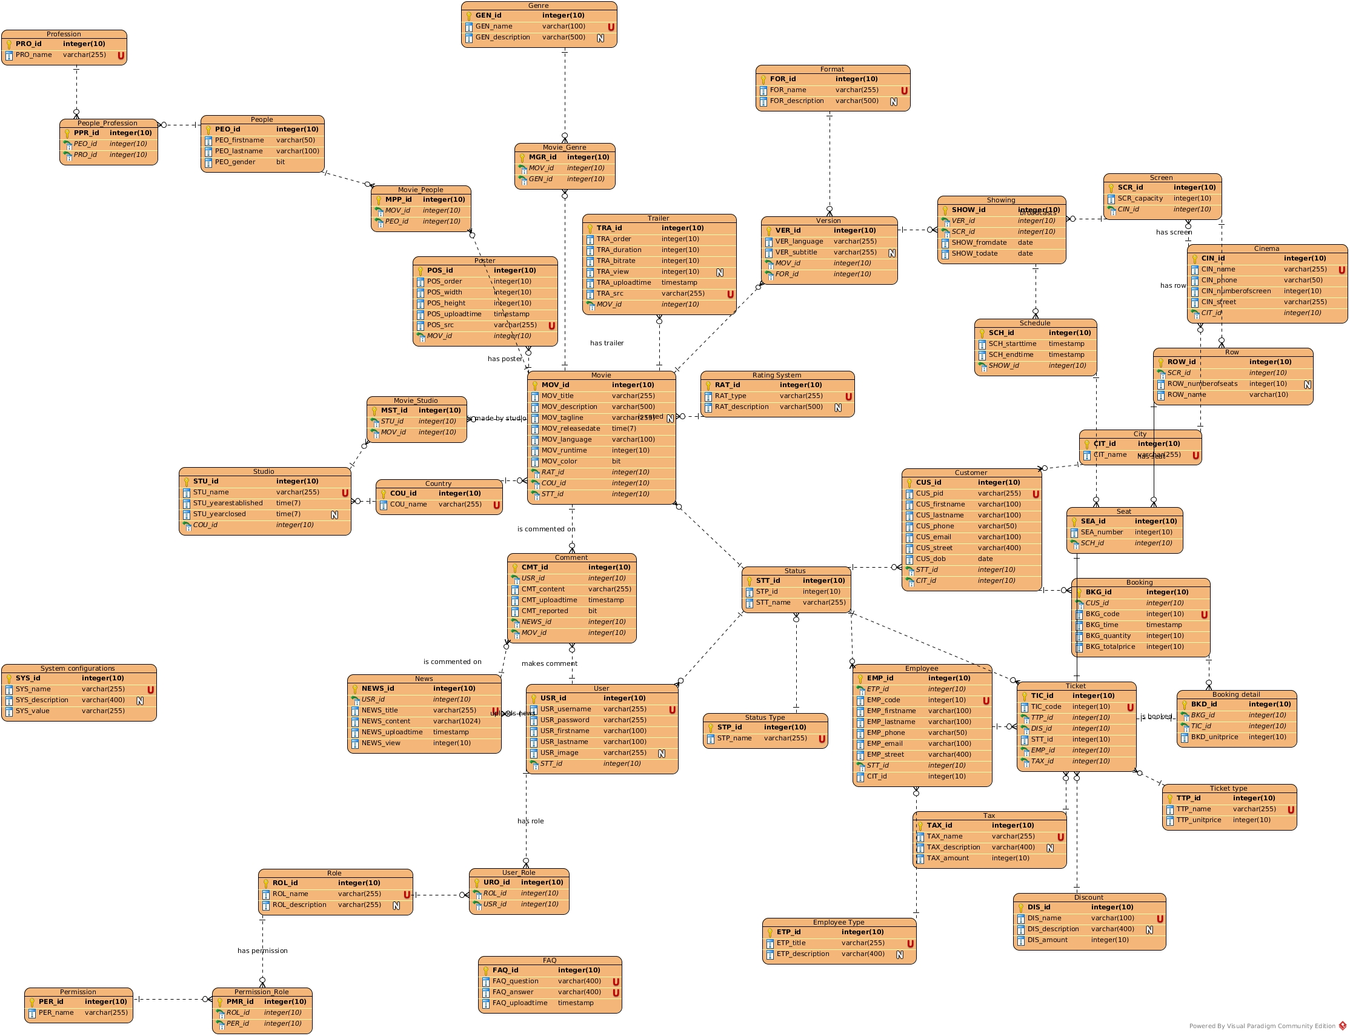
design phase
Database design:

Slide 17
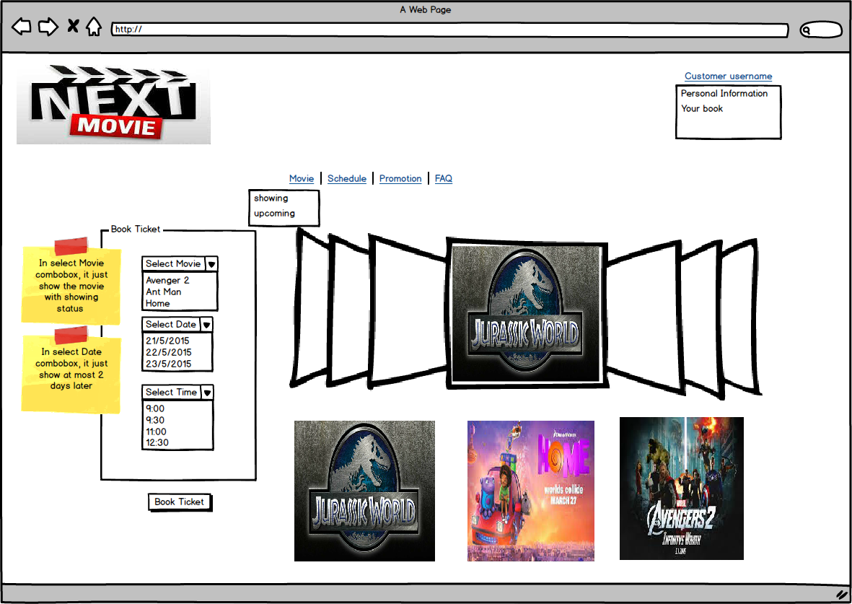
design phase
User interface :
Home Page
*See full interfaces in attached file.

