Slide 1
Maze Runner
“Enter Group Name”
Tyler Atkinson and Dylan Menchetti

Slide 2
Abstract
An object (Runner) seeks to find a path through a simply-connected maze. Three algorithms(Junction Origination, Wall-Follower, Manhattan Distance) will be compared by both timed trials and efficiency in junction choices (least to most) to evaluate traversal complexity. We found that Junction Origination performed at complexity O(n^{1.49}) Wall Follower Left performed at complexity O(n^{0.86}) and Wall Follower Right performed at complexity O(n^{0.75}) Manhattan distance performed at complexity O(n^{0.03}).

Slide 3
Introduction
A maze runner is only able to see what vertices are adjacent to it and must use this information to find a path between the initial and final vertex in a simply connected maze. We implemented three algorithms and compared which ones made it through in the least amount of steps. Each maze size is four-times larger than the last, excluding large to ‘crazy’ which is fifty-three times larger.

Slide 4
Problem Statement
An instance of a runner object seeks to reach the end of the maze. Three different objects will use three different algorithms to solve four different maze-types of varying sizes and complexities, fifty times each for a total of two-hundred runs. The objective is to evaluate the complexity of each algorithm’s ability to solve the maze based on amount necessary steps vs. the actual solution path step-sum.
Ratio=Avg.(G_{{mS}}(V_{{stepsT}})/Avg.(G_{{mS}}(V_{{F},}E_{F})) Where G_{{mS}} is a set of graphs at a particular size, V_{{stepsT}} is the steps that were taken by the runner on that graph, V_{{F}} is the set of vertices that compose E_{F}, the edge that leads directly from start position to end position. Complexity is therefore the growth size between small → medium and medium → large, such that Complexity =Ratio_{Medium→Large} - Ratio_{Small→Medium}

Slide 5
Informal Algorithms
Junction-Origination - When confronted with a dead-end, the Maze-Runner will return to last junction with an open path. Junction paths are chosen randomly.
Wall-Follower - At outset, right or left is selected. The Maze-Runner will always take the right or left hand junction selection, respectively.
Manhattan Distance - The Maze-Runner uses its knowledge of the endpoint to approximate the distance between the two. Junction choices are made to shorten this distance.

Slide 6

Defining a Maze
A Maze is composed of a directed acyclic graph G(V,E) where V is a vertex (x,y,z) where (x,y) are cartesian coordinates on a given graph and z refers to edge 0 or edge 1. The (x,y) refer to physical coordinates on the graph, while z is a boolean value indicating if the vertex is a wall or not.
Each vertex has a degree between 0-4, determined by adjacent vertices with z-type 0
Junctions defined as vertices degree > 2
2 Sets of Edges (E_{{Wall}},E_{{Path}})

Slide 7
Defining the Maze Runner
Runner (R) is an object bound by the Maze that is free to move through any vertex of z-type 0.
At a junction, a runner is given an array of available vertices, not including those that have already been traversed.
R consists of Vertex_{start},Vertex_{end},Vertex_{current}, and Vertex_{previous}.
R is defined by its calculateMove()
At degree < 3 all runners perform the same, having only 1 option to move to
At degree >= 3 is where each performs differently

Slide 8
Junction-Origination
When R encounters a junction, it picks a pseudo-random vertex adjacent to vertex_{current} that R has yet to traverse
If R gets stuck with no more adjacent, untraversed vertices, then R backtracks to the previous junction and chooses a new vertex.

Slide 9
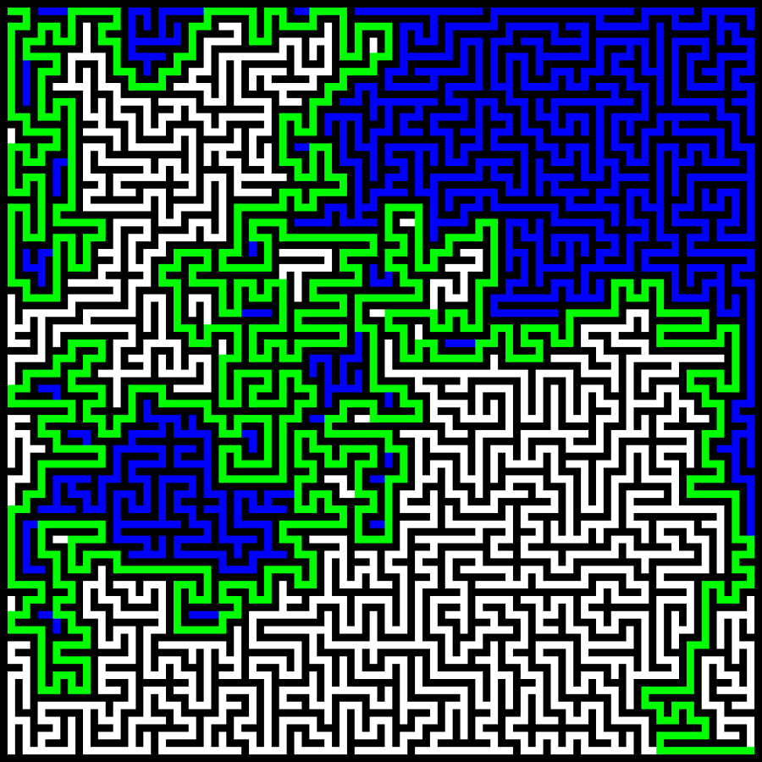
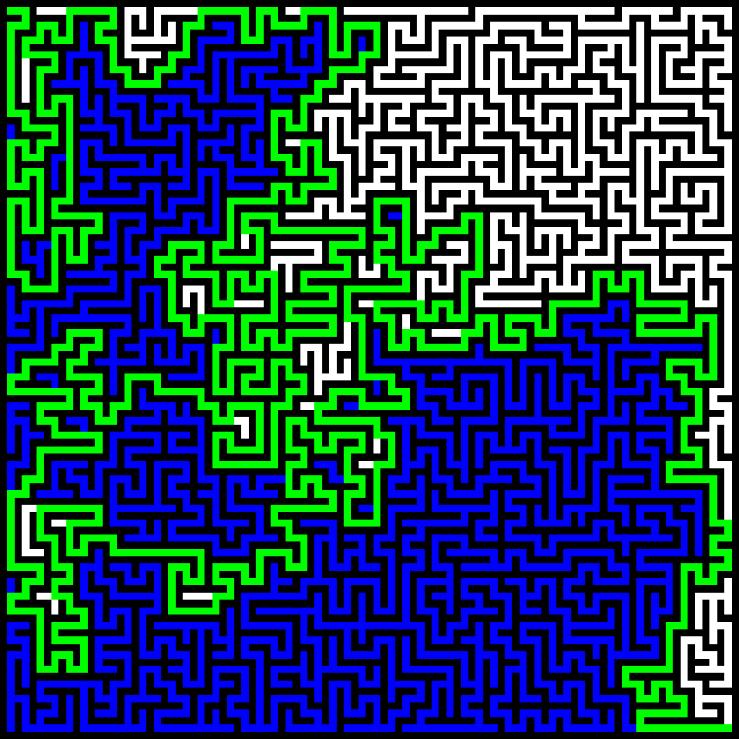
Wall Follower
On initialization, either right or left is chosen.
At a junction, it always chooses the vertex in the chosen direction.
If that vertex is either already traversed or a wall, then it rotates itself in the chosen direction, until a vertex in the correct direction is found
It also rotates when it is stuck, traveling back the way that it came until it is back at the junction, now facing a different direction then the original visit

Slide 10
Manhattan Distance
When R encounters a junction, it calculates the distance from each available vertex to vertex_{end} . Then, it travels to the vertex with the shortest distance and repeats this process for each junction.
When it becomes stuck, it backtracks to last junction and picks from the new available points the vertex with the least distance.

Slide 11
Notable Constraints
The Maze must be simply-directed or consist of a directed acyclic graph, with no loops or directed cycles. Indicating that there is no way to begin at a particular vertex and follow a directed sequence of edges to loop back to the first vertex.
Each runner has limited omniscience, holding knowledge of what direction it is facing and where the end vertex is (without knowing the path to arrive there).

Slide 12
Context
Our implementation of a Maze along with solving algorithms is directly associate with graph theory, and understood through the vast contributions to the field. As far backs a Euler’s first theory in 1736, to more recent implementations concerning robotic pathfinding (“MicroMouse” competitions) and “Marangoni Flow” implementations using surface tension and pH gradients.

Slide 13
Experimental Procedure
Implement the 3 algorithms as separate runner objects
Generate 200 mazes of varying size (50 for small/medium/large/crazy)
Small: 51x51 verticies
Medium: 101x101 verticies
Large: 201x201 verticies
Crazy: 1467x1467 verticies
Let the runners traverse each maze, recording how many steps were taken
Compare ratios (steps taken vs. solution edge length) for each maze vs. the next maze size and find the difference in growth to evaluate complexity.

Slide 14
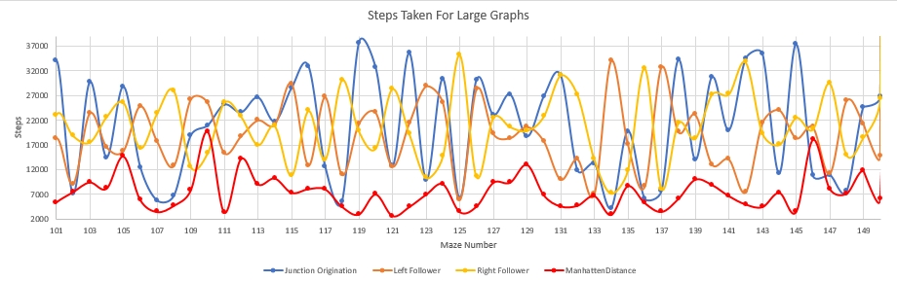
Results and Conclusions(Graphical Representation)

Slide 15
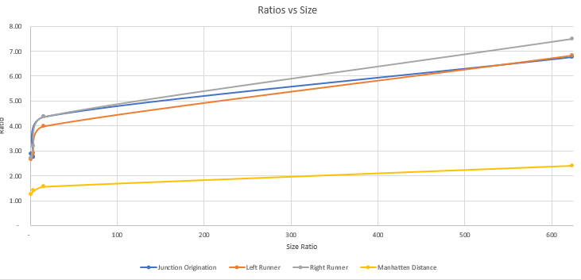
Results and Conclusions(Graphical Representation)
Ratio vs Size with the Crazy size included

Slide 16
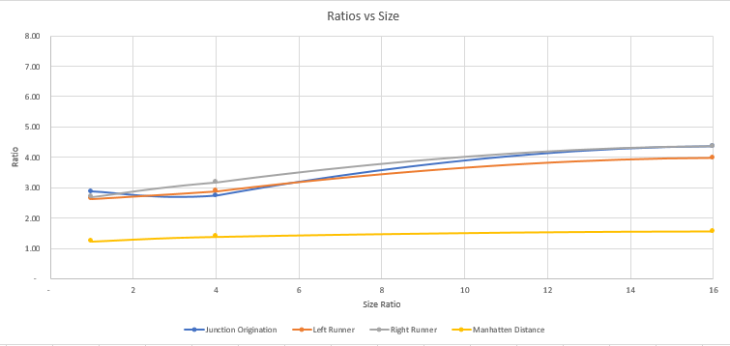
Results and Conclusions(Graphical Representation)
Ratio vs Size with the Crazy size excluded

Slide 17
Results and Conclusions
We found that Junction Origination performed at complexity O(n^{1.49}) Wall Follower Left performed at complexity O(n^{0.86}) and Wall Follower Right performed at complexity O(n^{0.75}) Manhattan distance performed at complexity O(n^{0.03}).
We found that each algorithm performed linearly, despite Manhattan distance traversing less steps than the other 3 on almost every maze. Each responded to increasing maze size and complexity in O(n).

Slide 18
Future Work
GPS Navigation Systems
Robotics
Modeling of information and processes (network)
Any application that involves relationships between multiple points across a graphical implementation stand to benefit from solving algorithms; these can consist in a variety of the science, such as the representations of molecular structures or as top-level as regional association and importance concerning conservation efforts.

Slide 19
Questions?

Slide 20
Exam Questions
What is the overall complexity across each maze-solving algorithm?
What method differentiates each algorithm?
What are the two sets of edges that define the maze?
What are the differences in degrees 0-4?
What type of graph is the maze composed of?

