Slide 1

Task 4 – Dashboard Design
Data Analyst Internship
By: Rishabh Singh

Slide 2
Dataset Overview
Superstore Sales Dataset
Fields Used
Kaggle Open Source
Sales, Profit
Order Date, Region
Category, Sub-Category
Month-Year, Year
Profit Margin

Slide 3
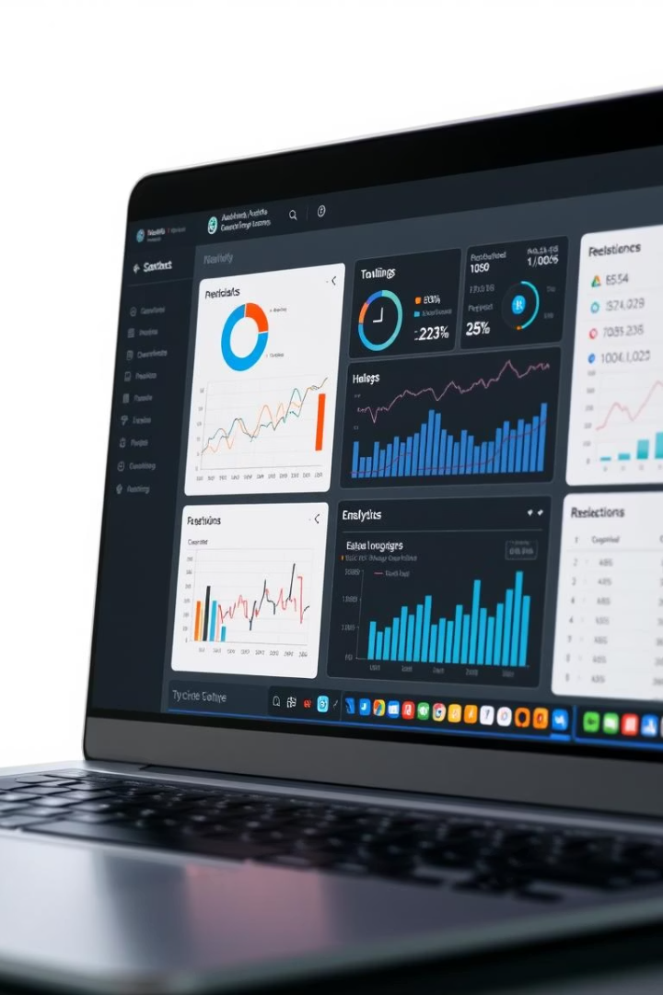
Dashboard Layout
Pages Created
Sales Overview, Profit Analysis
Trend Analysis
Interactive Features
Slicers, Page Navigation
Tooltips, Sorted Visuals

Slide 4
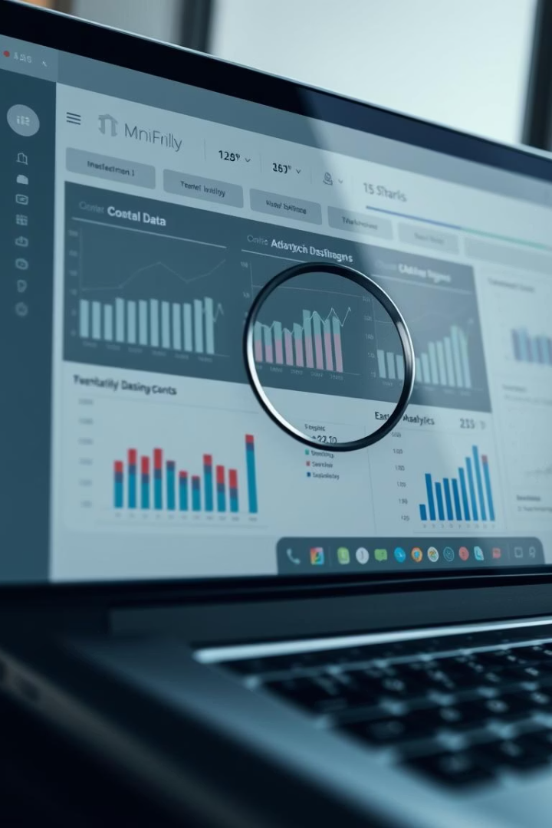
Visuals & Insights
Key Visuals
KPI Cards, Line Chart
Stacked Column, Clustered Column
Insights
West Region: Highest Profit Margin
Office Supplies: Lower Profit
Seasonal Trends: Q4 Across Years

Slide 5
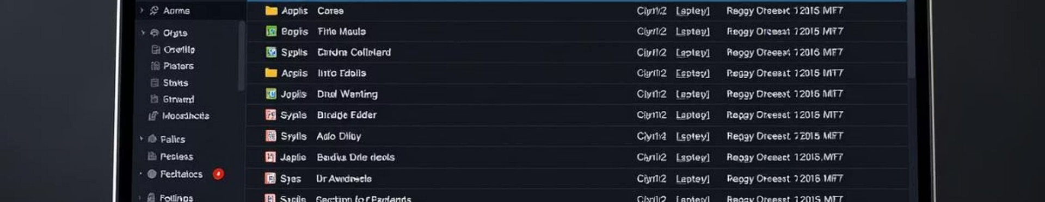

GitHub & Submission
GitHub Repo
.pbix File, Dataset
PPT, README.md

