Slide 1

Agent Skills
Teaching AI Agents
How to Work
PRESENTED BY
Thaarani T S

Slide 2

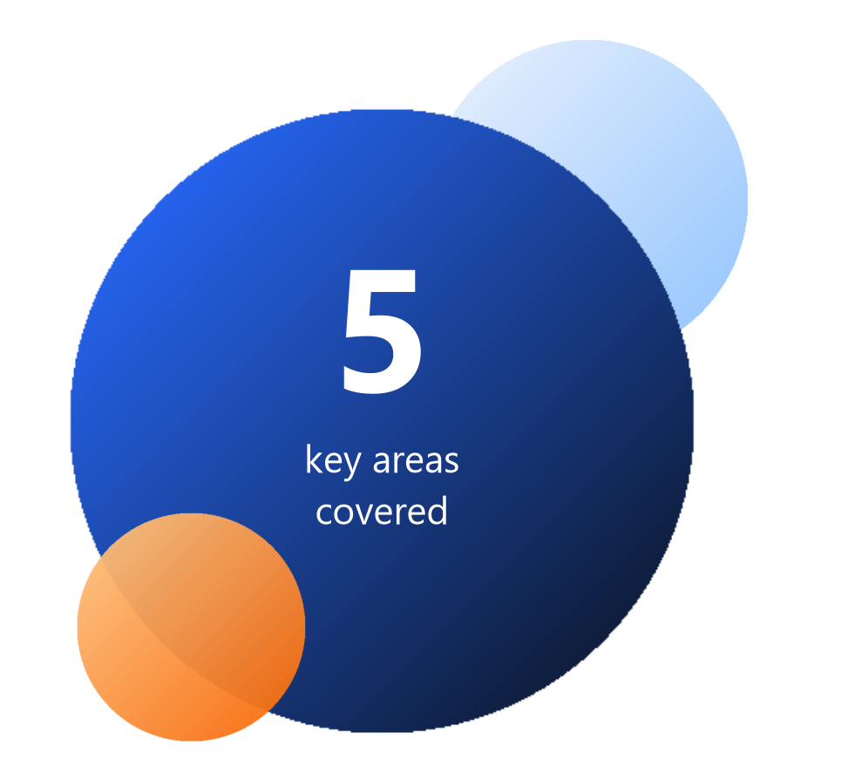
What This Topic Covers
AGENDA
01
What is an agent skill?
A folder that teaches an agent one procedure.
02
Why use skills?
Consistent results, a smaller context, reuse across teams.
03
How do I write one?
Folder, steps, description, then test.
04
How do I use existing skills?
Find, install, invoke, adapt.
How do skills work with MCP?
Skills decide how; MCP supplies what.
05

Slide 3
What Is an Agent Skill?
01 · WHAT
A reusable playbook for one task
● A folder that teaches the agent one recurring procedure.
● SKILL.md is the only required file.
● Frontmatter name + description tell the agent when.
● Markdown body tells the agent how, step by step.
● Scripts and references load only when a step asks.
release-notes/
├── SKILL.md required
├── scripts/ optional
│ └── fetch_prs.sh
├── references/ optional
│ └── EDGE-CASES.md
└── assets/ optional
└── template.md

Slide 4
Inside SKILL.md
01 · WHAT
Frontmatter → when
name + description stay resident and decide whether to load.
---
name: writing-release-notes
description: Converts merged PRs into user-facing
release notes. Use when the user asks for
release notes, a changelog, or what shipped.
---
# Writing Release Notes
## Steps
1. Identify the previous tag. If unknown, ask.
2. Collect merged PRs since that tag.
3. Sort into Breaking / Features / Fixes.
## Before returning, verify
- [ ] No internal items leaked
- [ ] Breaking changes have migration notes
Steps → how
Numbered, verb-first actions. Loaded only when triggered.
Checklist → quality
The agent audits its own draft before returning.

Slide 5

Why Skills? Prompts Alone Drift
02 · WHY
Same prompt, run three times: “Write release notes for v2.1”
Run 1
Run 2
Run 3
## v2.1
- fix: null deref
- feat: export API
Raw commit titles
v2.1 brings exciting
improvements across
the board!
Fluent, but no facts
Fixed: login crash
(PR #482)
# PR #482 does not exist
Invented PR number
Same prompt, same model, three answers. A skill fixes the procedure.

Slide 6
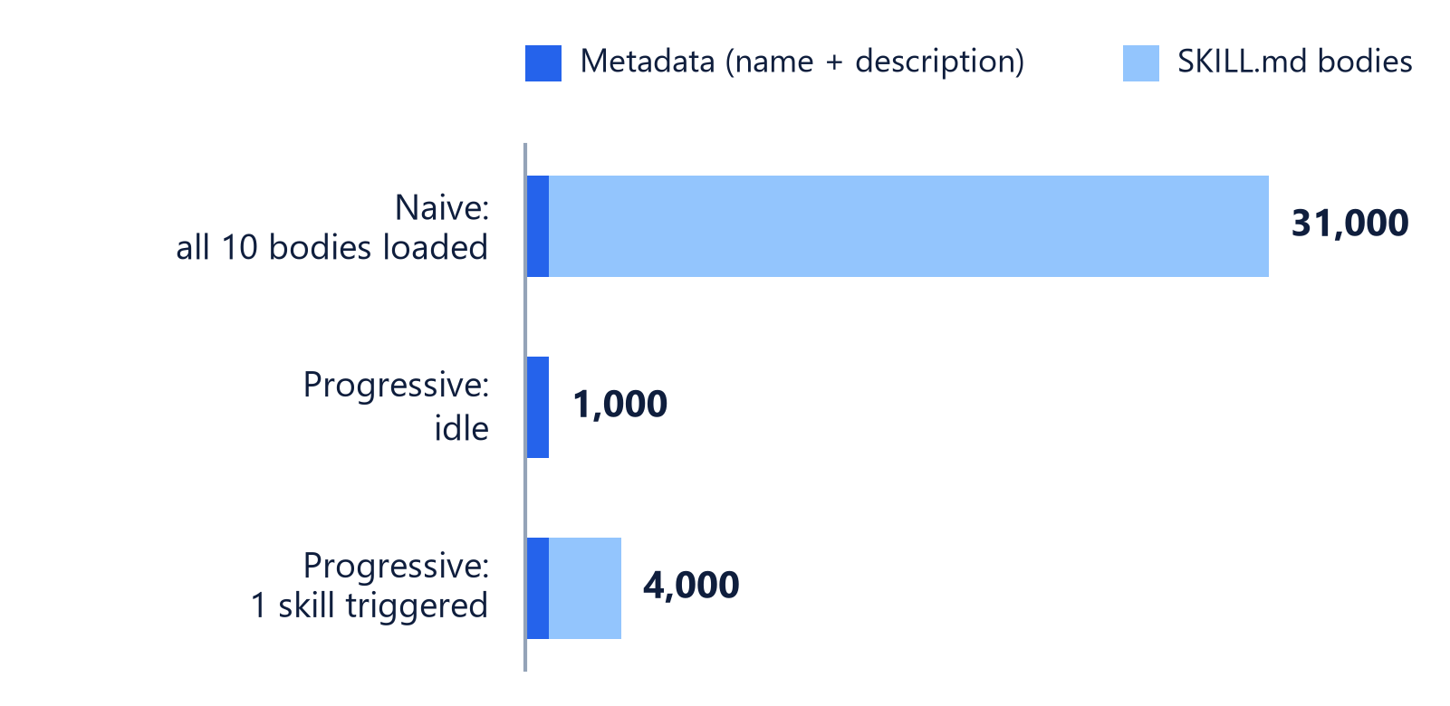
Why Skills? Context Loads on Demand
02 · WHY
1 · Discovery
At startup, only name + description load: ~100 tokens.
2 · Activation
A task matches the description; full SKILL.md loads.
3 · Execution
Agent follows steps; runs scripts or reads files as needed.
Tokens resident in context for 10 skills. Illustrative: ~100 metadata + ~3,000 body each.

Slide 7




Why Skills? What Teams Gain
02 · WHY
Domain expertise
Capture specialist processes as reusable instructions and resources.
Repeatable workflows
Turn multi-step tasks into consistent, auditable procedures.
Reusable anywhere
Build once, then use it in any compatible agent.
Small context
Many skills on hand; full instructions load only when needed.
Write the procedure once. Every agent run follows it.

Slide 8



How to Write a Skill in 3 Steps
03 · WRITE
Create the folder
Step 1 · ≈ 2 min
Write the body
Step 2 · ≈ 5 min
Describe, then test
Step 3 · ≈ 3 min
.agents/skills/
writing-standups/
SKILL.md
Folder name = name field.
## Steps
1. Read today's commits.
2. Group by ticket.
Verb-first steps + checklist.
description: Drafts
standup notes. Use
when asked for...
Try 3 phrasings, fresh session.
Then iterate: every stumble on messy input becomes an edge-case entry.

Slide 9

Write a Description That Triggers
03 · WRITE
BAD
GOOD
description: Helps with
documentation.
Vague: the router has nothing to match.
description: Creates professional
README.md files. Use when the user
asks to write, generate, or improve
a README, project docs, or a repo
landing page.
What + when + words users actually type.
1 Write it last, for the router.
2 Third person: what + when.
3 Add 3+ user phrasings.

Slide 10
Debug a Skill That Misbehaves
03 · WRITE
Symptom | Root cause | Fix
Never activates | Description too vague | Add “Use when…” + trigger phrases
Fires on unrelated asks | Description too broad | Narrow scope, add exclusions
Silently never loads | name ≠ folder name | Make them identical
Loads, ignores steps | Body is prose | Rewrite as numbered imperatives
Output varies each run | No constraints or checklist | Add constraints + verify list

Slide 11




How to Use an Existing Skill
04 · USE
Find
Install
Invoke
Adapt
Team repo, anthropics/skills, or a public catalog.
Copy the folder into .agents/skills/ or use the CLI.
Ask naturally, or type /skill-name to force it.
Edit steps to your conventions, then commit.
# install a published skill into this repo
npx skills add anthropics/skills --skill pdf
# or invoke one by name in Agent chat
/writing-release-notes for v2.1
Read before you run
Skills can include scripts. Review SKILL.md and scripts/ like any dependency.

Slide 12
Where Skills Live in Each Tool
04 · USE
Host | Skill locations | Invocation
Claude Code | .claude/skills/ | Auto, or /skill-name
Cursor | .cursor/ or .agents/skills/ | Auto, or / in Agent
OpenAI Codex | .agents/skills/ | Auto by description
GitHub Copilot | .github/skills/ | Auto by description
Gemini CLI, Cline | Often .agents/skills/ | Varies by host
More clients in the showcase at agentskills.io/clients.

Slide 13
Using Skills in Cursor
04 · USE
Procedures that ship with the repo
● Project skills: .cursor/skills/ inside the repo.
● Personal skills: ~/.cursor/skills/ across all projects.
● Agent auto-selects a skill when a request matches.
● Type / in Agent chat to run one by name.
● MCP servers add live tools in the same session.
your-repo/
├── .cursor/
│ └── skills/
│ ├── reviewing-pull-requests/
│ │ └── SKILL.md
│ └── writing-release-notes/
│ └── SKILL.md
└── src/
# In Agent chat
/reviewing-pull-requests

Slide 14



MCP: What the Agent Can Reach
05 · WITH MCP
Host
Cursor, Claude Code
MCP Client
1:1 link per server
MCP Server
Exposes capabilities
Your Systems
GitHub, Postgres, Slack
Tools
Resources
Prompts
Actions the agent invokes.
create_issue()
run_query()
send_message()
Data the agent can read.
file://...
postgres://...
repo://README
Templates users pick.
/summarize-pr
/triage-bug

Slide 15
Skills vs MCP: Different Jobs
05 · WITH MCP
 | MCP | Agent Skills
Answers | What can the agent reach? | How should the agent behave?
Unit | A server exposing tools | A folder with SKILL.md
Always in context | Every tool schema | Name + description only
Loads fully | Always | On trigger
Best for | Live data and actions | Procedures and conventions
Built with | Code: a server process | Markdown + optional scripts
MCP = what the agent can reach. Skills = how it behaves.

Slide 16
Better Together: Skill + MCP
05 · WITH MCP
User asks: "Write release notes for v2.1"
Steps 1–4, then 5–8
● Agent
● Skill drives the steps
● MCP supplies live data
Agent calls MCP tool list_merged_prs()
1
5
Agent scans skill descriptions
Tool returns PR table + breaking-change hints
2
6
writing-release-notes matches; SKILL.md loads
Agent drafts, then runs the checklist
3
7
Step 1 says: "collect merged PRs"
Structured release notes returned
4
8

Slide 17

Skill, MCP, or Both?
05 · WITH MCP
Write a skill
Add an MCP server
Use both together
USE WHEN
It is a repeatable procedure or team convention.
EXAMPLES
● Code review checklist
● Commit message style
USE WHEN
The agent needs live data or must take actions.
EXAMPLES
● Query Postgres
● Open a GitHub issue
USE WHEN
A procedure that depends on live data.
EXAMPLES
● Release notes from PRs
● Incident report from logs
Neither? A project rule or a plain prompt is enough.

Slide 18


Three takeaways
1 A skill packages a proven procedure, so every run follows the same steps.
2 Skills save context: only the name and description load until a skill is needed.
3 Skills define how the work is done; MCP connects the agent to live tools and data.
Scan for the spec and docs
agentskills.io/specification
cursor.com/docs/skills
docs.claude.com · Agent Skills

Slide 19
Thank you

