Slide 1
X-Ray Simulation Study
Group E

Slide 2
Table of contents
01
02
02
03
04
Introduction
Introduction to the problem
SIMUL8 Base Model
Initial base model we have created
SIMUL8 Model – New Machine
Test result when operating using the new machine
Key Findings
Summary of the findings and recommendations

Slide 3
Introduction
Our team has been contracted by a local regional hospital to design a model and conduct a simulation study of their X-ray department.
The hospital has had several complaints from the patients about the waiting times, the study that we have conducted should help the hospital evaluate possible changes which might improve the operations of the department.
We will be using 'SIMUL8' which is an icon-based simulation tool to build the base model that the hospital is currently operating and we will identify the possible modifications which could be implemented to improve efficiency and reduce the waiting times.
Discrete Event Simulation (DES) is "a powerful technique for optimizing processes and making confident, impactful decisions" (SIMUL8 Corporation, 2023).
Notes:
Limitation of DES – although creating simulations can be a powerful technique for optimizing processes and making impactful decisions we have to keep in mind that this is only a simulation and not a real thing and there are a lot of factors to be considered.

Slide 4
Assumptions
The complaints about waiting times were directed towards the wait for the X-Ray Print/Visual Check as this is the only queue that experienced significant traffic in the model.
The X-Ray Print Machine would possess the same working/waiting percentages throughout its lifespan
The rate of arrival for casualty and hospital patients would stay unchanged
The 4 X-Ray rooms will always be available to be utilised

Slide 5
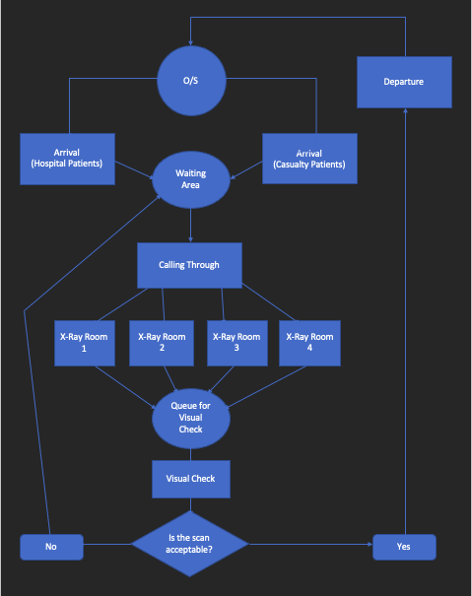
Activity Cycle Diagram
Before preparing the structure of a DES, we have created an Activity Cycle Diagram (ACD) as it describes the interactions among the objects in a system.
The rectangle represents the Activity
The oval represents the Queue
The diamond represents the Decision
Notes:
Before preparing the structure of a DES, we have created an Activity Cycle Diagram (ACD) as it describes the interactions among the objects in a system and will help us with the model creation. We have based the ACD as well as the SIMUL8 Base Model on the information regarding the process from the local regional hospital.

Slide 6
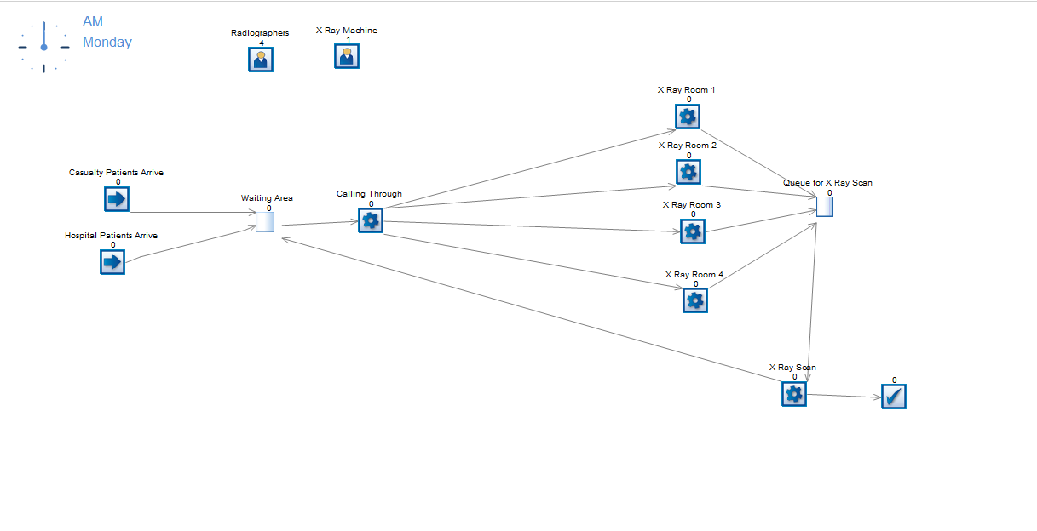
SIMUL8 Base Model
Notes:
Resources
4 Radiographers and 1 X-Ray Plate Machine
Base Model
We start off the simulation with the two arrivals (Entry Points) – one illustrating the Hospital Patients (arriving once per 9 minutes, exponential) and the other entry point illustrating Casual Patients (arriving once per 30 minutes, exponential).
Both of the entry points enter the 'Waiting area', prioritising the casualty patients over hospital patients. The 'Waiting Area' is then linked to the 'Calling Through' where the patients are called in to 1 of 4 X-Ray Rooms. The 'calling through' activity takes a constant 2 minutes per casualty patients and constant 5 minutes for hospital patients.
Once the patient enters the X Ray Room, they get attended by the Radiographers which are the floating resource. 'Casualty Patients' take an average of 7 minutes for this process which is Erlang distributed with a shape parameter of 3. Where as 'Hospital Patients' take 3 minutes and have a shape parameter of 3.
After, the X-Ray Room we proceed to the X-Ray Scan activity which represents the X-Rays scan's being printed and checked whether they are acceptable or not. If the print is acceptable the process will finish with the 'End Point'. However, if the prints are unacceptable, the patients will go back to the 'Waiting Area' and wait to be rescanned. The chance of the scan prints being acceptable a85% being acceptable – 15% Unacceptable)
The Casualty patients who require a rescan will have priority over the Casualty patients that just arrived. Similarly, the Hospital patients who require a rescan will have priority over the Hospital patients who have just arrived.
VISUAL LOGIC
To complete the model we had to use Visual Logic, which is a language within the software which allows the user to describe exactly how you want the simulation to behave. We have created 2 labels; First one called 'Type of Patients', where we have assigned a fixed value to each patient – Casualty Patients (1) and Hospital Patients (2) - This label has allowed us to set different times in a singular activity. Second label is called 'Prioritisation', we have set a separate value to each patient (Casualty Patients = 2 and Hospital Patients = 4), this number would then decrement after the X-Ray Print has been done and the patients who need a rescan would go back with a new value (Casualty Patients (Rescan) = 1 and Hospital Patients (Rescan) = 3). From there we have selected an option called 'Prioritise label from low to high', and assigned this option to every queue and activity.

Slide 7
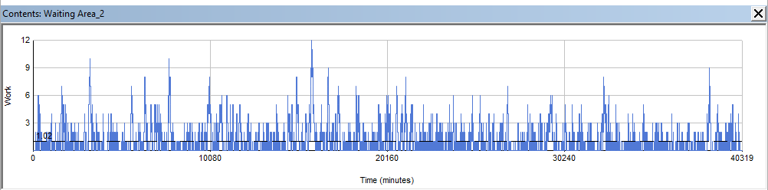
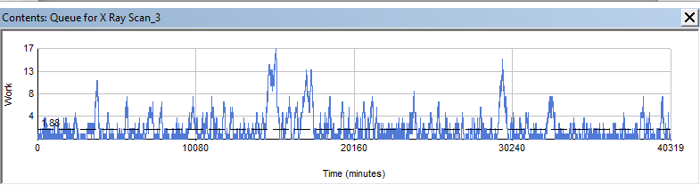
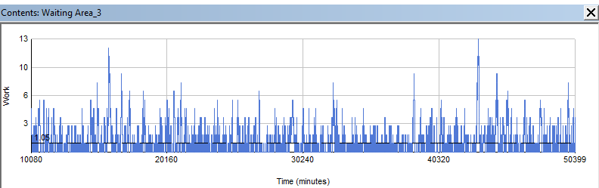
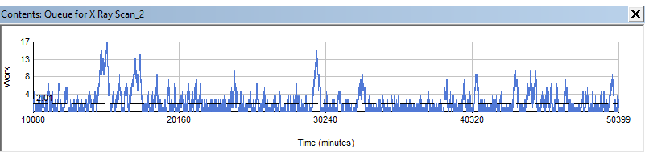
Warm-up Period
Time Graph of 'Waiting Area' before Warm-up period
Time Graph of 'X-Ray Scan' before Warm-up period
Time Graph of 'Waiting Area' after Warm-up period
Time Graph of 'X-Ray Scan' after Warm-up period
Notes:
- We have replicated the experiment 1000 times by choosing to run the trial a 1000 times within SIMUL8, This should gives us a large sample. The warm up period didn't show any significant changes however we have decided to include it as it show great practice.

Slide 8
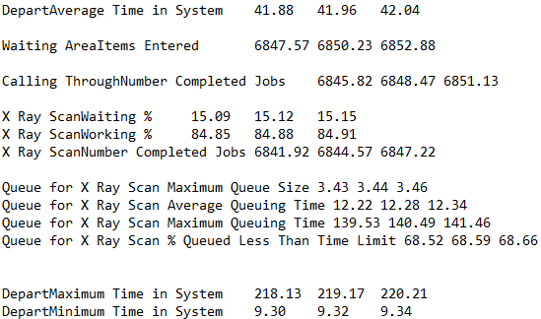
Key Results of Base Model
These are the results that we had agreed were most important to look at for both the base and new model.
To obtain these results we have run 5000 trials for one month to ensure that the results we have are accurate.
These results display times that are based on the on the use of the base time taken for the X-Ray film processing times of 5 minutes.

Slide 9
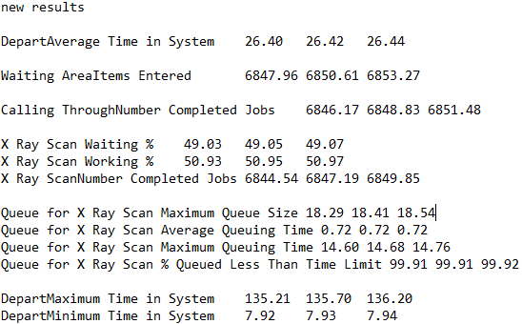
Key Results of New Model
These results display times are based on the on the use of the base time taken for the X-Ray film processing times of 3 minutes.
To obtain these results we have run 5000 trials for one month to with the new updated time for the X-Ray film processing machine ensure that the results we have are accurate.
X-Ray scan waiting % is a lot higher than the base model meaning that it was used less giving it a better life expectancy

Slide 10
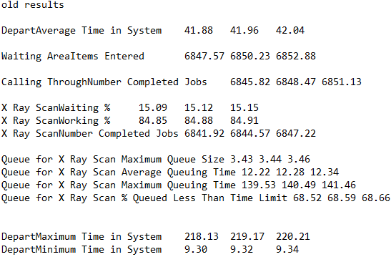
Comparison of results after Implementing the New Machine

Slide 11
Real-world modelling
Is it worth it?
Consider the initial problem!
Less time in the system overall therefore there is room for more patients to be seen
Affect of utilisation on the lifespan of the X-Ray film machines (Medical equipment life expectancy list, 2011)
Have casualty patients return to waiting area (Use of x-rays in the A&E department, 2017)

Slide 12
References
SIMUL8 Corporation, 2023. What is Simulation? Available at: https://www.simul8.com/what-is-simulation [Accessed: 5th January 2023]
Medical equipment life expectancy list, 2011. Available at: https://ohiocea.files.wordpress.com/2011/04/medical-equipment-life-expectancy-list.pdf
Use of x-rays in the Accident and Emergency Department and Urgent Care Centre, 2017. Available at: https://www.nth.nhs.uk/content/uploads/2017/07/AE4082-use-of-x-rays-in-the-ae-dept-july-2017.pdf

Slide 13
Affidavit % Contribution
Group | Candidate Number | Contribution (%)
E | F233458 | 33.3
E | F234559 | 33.3
E | B924622 | 33.3

