Slide 1

Average per completed trip (33,331 trips)
CMPG321 · ADVANCED DATABASES · PHASE 2
R363.53
Where does the money go after a rider pays?
Driver payout
–R31.27
Estimated fuel cost
Driver earnings, platform commission and payout optimisation in South African ride-hailing
R332.26
Data Alchemists · Group 36
Estimated net earnings
Notes:
Open with the question that drives the whole project: after a rider pays, how much reaches the driver, and once fuel is taken off, is it a living wage? The three circles show the answer for the average completed trip. 10 seconds.

Slide 2





Group 36 – Data Alchemists
Thabo Prince Motau
Botshelo Mathe
Fani Mabaso
Mfezeko Gubelana
Mabote Kgaugelo Pertunia
Group Leader
Member
Member
Member
Member
Student No: 40853942
40853942@mynwu.ac.za
+27 63 002 8070
Student No: 50102583
50102583@mynwu.ac.za
+27 79 352 0444
Student No: 44330243
44330243@mynwu.ac.za
+27 71 798 6296
Student No: 50789244
50789244@mynwu.ac.za
+27 84 767 1225
Student No: 41409914
41409914@mynwu.ac.za
+27 72 748 4332
North-West University · CMPG321 Advanced Databases
Notes:
Introduce the five members. Each member can say which part they handled (database, RQs, report, video). 10 seconds.

Slide 3
Six questions follow the money from fare to wage
RQ1
Fares, commission and payout across Uber, Bolt and Dual-Platform
Focus area
After a rider pays for an Uber or Bolt trip, does what is left for the driver, once fuel is counted, add up to a living wage?
How strongly commission % drives the share of fare drivers keep
RQ2
RQ3
Which ride category pays best, in rand and as share of fare
RQ4
How distance, duration, peak periods and surge affect payout
Hybrid focus: Driver Earnings, Commission & Payout, plus vehicle and ride-category analysis. Seven cities, completed trips only.
RQ5
Which city and ride-category combination pays the most
RQ6
After fuel, does hourly net pay beat the R30.23 minimum wage?
Notes:
Recap Phase 1. The six RQs are a sequence: platform, commission, category, trip conditions, city plus category, and finally net hourly earnings after fuel, RQ6, which is the signature question. 15 seconds.

Slide 4
The dataset: 50,000 trips across seven cities
50,000
Drivers and vehicles
Riders and zones
800 drivers with one vehicle each; commission 20-25%
1,200 riders and 9 pricing zones in seven cities
trips from 1 March 2025 to 31 March 2026
33,331
Reviews
Cancelled trips
25,055 reviews: only about half of trips are rated
8,417 by rider, 8,252 by driver; zero fare and payout
completed trips (66.7%) behind every earnings query
7
Value ranges
A rule that holds
Distance 0-48 km, duration 0-182 min, surge 1.0-2.4
On completed trips, fare minus commission equals payout
cities from Cape Town to Vanderbijlpark
Notes:
Describe the data in one breath: 50,000 trips between March 2025 and March 2026 in seven cities, of which 33,331 were completed and 16,669 cancelled, with 8,417 cancelled by riders and 8,252 by drivers. Cancelled trips have zero fare and payout, so every earnings query uses completed trips only. Each driver has exactly one vehicle, and only about half of trips have a review. One rule holds on every completed trip: total fare minus commission equals driver payout. About15 seconds.

Slide 5
A constrained PostgreSQL schema built for analysis
7
Primary keys everywhere
Foreign keys enforce links
Readable VARCHAR IDs such as DRV_00001 and VEH_00001 keep the source identifiers
Vehicles to drivers; trips to riders, drivers and zones; fares and reviews to trips
linked tables with enforced keys
22
CHECK constraints guard domains
Right data types
Commission 0–1, rating 0–5, allowed status, category and payment values
NUMERIC for rand amounts, TIMESTAMP for requests, DATE for onboarding
CHECK constraints guard values and domains
8
NOT NULL and UNIQUE
Indexes on query paths
Key fields are mandatory and license_plate is unique
Foreign keys, timestamp, status and ride category speed joins and filters
indexes on join and filter columns
Notes:
Explain the design choices that earn marks under Database Design: keys, constraints, data types and relationships. Show 02_create_tables.sql in the demo. 20 seconds.

Slide 6
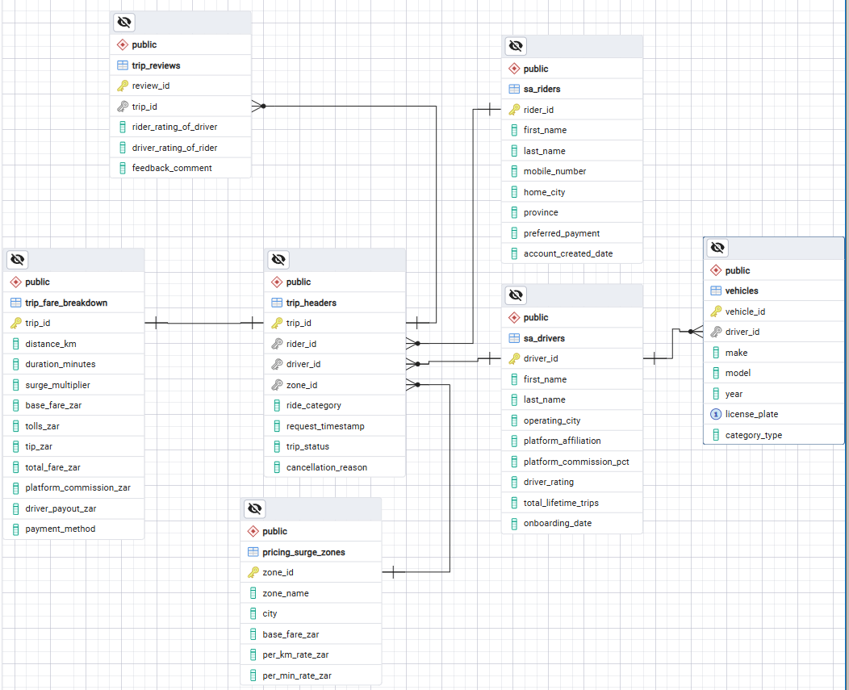
Entity-relationship diagram: trips connect every table
Generated from the live database
ERD exported from pgAdmin 4, exactly as implemented in PostgreSQL.
Relationships
Driver to vehicles: one to many (the data holds one vehicle per driver)
Driver, rider and zone to trips: one to many
Trip to fare breakdown: one to one (shared primary key)
Trip to reviews: one to many (about half of trips are reviewed)
Keys and constraints
Gold key: primary key. Grey key: foreign key. license_plate is UNIQUE.
Notes:
Walk the diagram left to right: riders, drivers and zones all feed trip_headers; each trip has one fare breakdown and zero or one review row; vehicles belong to drivers. Replace or complement this slide with a pgAdmin ERD screenshot if you generated one. 20 seconds.

Slide 7
From CSV files to a validated, indexed database
1
Restore
2
Validate
3
Index
4
Query
The master database ships as one PostgreSQL .backup file, restored in pgAdmin 4 so every member has an identical copy
04_validation.sql counts the rows in every table to confirm a complete load
05_indexes.sql adds eight indexes on join, date, status and category columns
RQ queries use completed trips only, and several run inside read-only transactions
800
1,200
800
50,000
50,000
25,055
drivers
riders
vehicles
trip headers
fare records
reviews
Of the 50,000 trips, 33,331 are completed and 16,669 are cancelled. Cancelled trips carry zero distance, duration and payout, so they are excluded from earnings measures.
Notes:
Show the restored database in pgAdmin and run 04_validation.sql live. Make sure the row counts on screen match the CSVs: 800 / 1,200 / 800 / 50,000 / 50,000 / 25,055. 15 seconds.

Slide 8
SQL techniques: advanced SQL in every question
Technique | RQ1 | RQ2 | RQ3 | RQ4 | RQ5 | RQ6
Multi-table joins | ● | ● | ● | ● | ● | ●
LEFT JOIN |  |  | ●
GROUP BY and aggregates | ● | ● | ● | ● | ● | ●
HAVING |  |  | ● |  | ●
CTEs |  | ● | ● | ● | ● | ●
Subqueries |  |  | ● |  |  | ●
Window functions (RANK, DENSE_RANK, AVG OVER) |  | ● | ● |  | ●
PERCENTILE_CONT and CORR |  |  | ● | ●
CASE and EXTRACT |  |  |  | ● |  | ●
READ ONLY transaction and TEMP tables |  |  | ● |  |  | ●
NULLIF guards on every division | ● | ● | ● | ● | ● | ●
Plus additional_advanced_queries.sql: platform shares, city ranks, a monthly trend using LAG, and a subquery filter.
Notes:
Rubric: SQL Query Development. This matrix comes from the techniques in our saved SQL files. Every question joins the trip tables to drivers, zones or vehicles, aggregates, and guards divisions with NULLIF. Common table expressions appear in five questions, window functions in three, HAVING in two. RQ3 adds a LEFT JOIN, a median with PERCENTILE_CONT and a READ ONLY transaction; RQ4 uses CASE banding, EXTRACT for peak hours and CORR; RQ6 uses temporary tables for fuel rates and prices. The extra file adds a monthly trend using LAG. About 20 seconds.

Slide 9
Advanced SQL, tested for performance
117 ms
Joins
Aggregation
Multi-table INNER JOINs plus a LEFT JOIN so no trip is dropped
GROUP BY with AVG, SUM, COUNT; HAVING with a scalar subquery
peak vs off-peak query (4A) over 33,331 trips
230 ms
Analytical functions
CTEs and CASE logic
RANK, DENSE_RANK, PERCENTILE_CONT and CORR
CTEs for staged steps; CASE for bands and fuel-price matching
peak x surge CTE query (4E), the most complex RQ4 query
6
Transactions and safety
Why sequential scans
Read-only transactions; NULLIF guards division by zero
COMPLETED matches 67% of rows, so a full scan beat the index
research questions, each answered by its own SQL file
Notes:
Rubric: SQL Query Development. Name the techniques: joins (INNER and LEFT), GROUP BY and HAVING, subqueries, window functions, CTEs, transactions. Performance: EXPLAIN ANALYZE gave 117 ms for 4A and 230 ms for 4E over 33,331 rows. PostgreSQL chose sequential scans because the COMPLETED filter keeps about 67% of the table, so reading it all is cheaper than the index; joins and sorts ran in memory. Show the EXPLAIN ANALYZE output in the demo. 20 seconds.

Slide 10
RQ1–2: Bolt drivers keep about R26 more per trip than Uber drivers
Share of commissionable fare the driver keeps
Bolt · 20%
80.20%
Dual-Platform · 22%
78.22%
Uber · 25%
75.26%
The 4.94 percentage-point gap between Bolt and Uber almost exactly matches the 5-point difference in commission rate, so the commission is applied linearly to the fare excluding tips. Tips pass to the driver in full.
Notes:
RQ1: Bolt has the highest average fare (R467.13) and the highest payout (R377.56); Uber has the highest commission (R110.65) and lowest payout (R351.25). RQ2: retention falls almost one-for-one with commission. Demo: run RQ1.sql and RQ2.sql (INNER JOINs, CTE, RANK window function, subquery). 40 seconds.

Slide 11
RQ3: Ride category barely changes what a driver earns
R4.10
gap between the best category (Standard) and the worst (Comfort)
≈79%
of the fare reaches the driver in every category (78.87%–78.92% average trip ratio)
Notes:
Standard has the highest average payout and the most completed trips (8,507), but all four categories sit within about R4 and about 79% payout-to-fare. Category is not a meaningful lever. Demo RQ3.sql: it uses PERCENTILE_CONT, window RANK and a scalar subquery in HAVING. 20 seconds.

Slide 12
RQ4: Distance and surge drive payout; tips barely register
Peak trips pay R482.20 against R324.33 off-peak, mostly because average surge is 1.71 against 1.13. Longer trips pay more in total, but short trips pay more per hour: R451 under 15 minutes, R286 over 60.
Notes:
Distance (0.754) and duration (0.735) have the strongest correlation with payout, then surge (0.527); tips are negligible (0.074). Correlation is not causation. Demo RQ4.sql: CASE bands, EXTRACT(HOUR), CORR. 40 seconds.

Slide 13
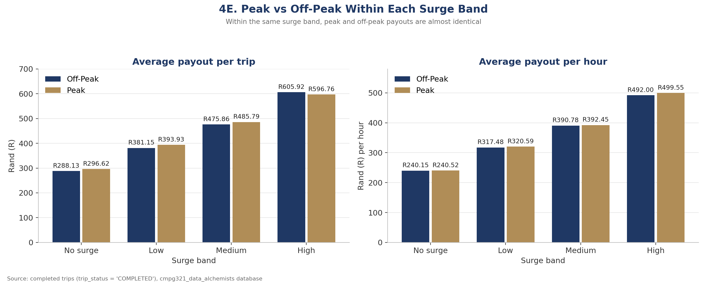
RQ4 proof: surge, not the clock, lifts peak pay
72% of peak trips are medium or high surge, against 14% of off-peak trips. Within the same surge band, peak and off-peak payouts are almost identical.
Notes:
Key point of this slide. About 20 seconds.

Slide 14
RQ5: City beats category, and Cape Town takes the top four spots
Highest payout per trip
Highest payout per km
Highest payout per hour
R456.41
R20.71
R375.86
Cape Town · Budget (1,297 trips)
Cape Town · Large Capacity
Cape Town · Large Capacity
City | Budget | Standard | Comfort | Large Capacity
Cape Town | R456.41 | R443.77 | R442.38 | R449.28
Johannesburg | R400.02 | R419.39 | R402.89 | R409.34
Durban | R385.57 | R393.76 | R380.59 | R376.78
Pretoria | R354.55 | R352.96 | R350.75 | R368.87
Gqeberha | R319.51 | R327.66 | R332.02 | R321.12
Vanderbijlpark | R322.09 | R319.24 | R324.75 | R327.45
Potchefstroom | R310.97 | R300.31 | R306.55 | R302.76
Average payout per completed trip. Cape Town's lowest cell (R442.38) beats Johannesburg's highest (R419.39), so the city matters more than the category.
Notes:
Combinations with fewer than 30 trips were excluded, but every cell here has between 945 and 1,341 trips. Read the heatmap down the columns: the city sets the colour, not the category. Cape Town is darkest in every column, and its lowest cell, R442.38, beats Johannesburg's highest, R419.39. The best category depends on the measure: Budget wins raw payout in Cape Town, Large Capacity wins per kilometre and per hour. About25 seconds.

Slide 15
RQ6: Every city clears the R30.23 benchmark after estimated fuel
R262.52
net per on-trip hour, against R28.79 and R30.23 benchmarks
Read with care
Counts trip time only: no waiting time, maintenance, insurance, tyres or depreciation. Before fuel the figure is R287.22 per trip hour.
Notes:
Estimated cost = distance x litres per 100 km / 100 x monthly Petrol 95 price (inland vs coastal). Average fuel cost is only R31.27 per trip. The honest caveat: the hourly rate divides by trip duration only, so true hourly pay is lower once idle time is considered. Demo RQ6.sql: CTE, CASE-based price matching, multi-table joins. 35 seconds.

Slide 16
RQ6: city moves net pay far more than the car does
Cities range from R218 to R333 per hour (a R115 spread); vehicle models only from R256 to R273 (R17). Where you drive matters far more than what you drive.
Notes:
The city effect dwarfs the vehicle effect. Net earnings per hour range from R218 in Potchefstroom to R333 in Cape Town, a spread of about R115, while the nine vehicle models only range from about R256 to R273, a spread of about R17. Fuel is a small cost, so the car you drive changes little. Every city and every model is far above both minimum-wage benchmarks. About20 seconds.

Slide 17
What the findings mean for drivers, platforms and policy
1
Drivers
2
Platforms
3
Policy and advocacy
Commission is the clearest lever: Bolt keeps R26 more per trip than Uber
Operate in Cape Town where possible
Chase surge and peak windows; short trips pay more per hour
A 5-point commission gap moves driver retention by about 5 points
Ride category is not a differentiator: payouts sit within R4
Surge is where payout rises fastest
Headline hourly pay clears R30.23 after fuel
But idle time and vehicle costs are unmeasured
Utilisation data is needed before calling it a living wage
Notes:
Turn findings into actions for the three audiences from Phase 1: drivers, platform operators and policy makers. 25 seconds.

Slide 18
Estimates, not profit, and where we go next
Limitations
Questions?
Fuel cost uses model-level consumption assumptions and monthly Petrol 95 prices
Hourly figures count trip time only, not waiting or idle time
Maintenance, insurance, tyres and financing are not deducted
Results show association, not causation
Only about half of trips have a review record
Possible extensions: vehicle age and driver rating effects, plus utilisation data to turn estimated net pay into a true hourly wage.
Data Alchemists · Group 36
Notes:
Close by naming the limitations honestly, then invite questions. 15 seconds.

