Slide 1
Module 6: Data Link Layer
Introduction to Networks v7.0 (ITN)
Notes:
Cisco Networking Academy Program
Introduction to Networks v7.0 (ITN)
Module 6: Data Link Layer

Slide 2
Module Objectives
Module Title: Data Link Layer
Module Objective: Explain how media access control in the data link layer supports communication across networks.
Topic Title | Topic Objective
Purpose of the Data Link Layer | Describe the purpose and function of the data link layer in preparing communication for transmission on specific media.
Topologies | Compare the characteristics of media access control methods on WAN and LAN topologies.
Data Link Frame | Describe the characteristics and functions of the data link frame.
Notes:
2
6.0 - Data Link Layer - Introduction
6.0.2 – What will I learn to do in this module?

Slide 3
6.1 Purpose of the Data Link Layer
Notes:
6 - Data Link Layer
6.1 - Purpose of the Data Link Layer

Slide 4
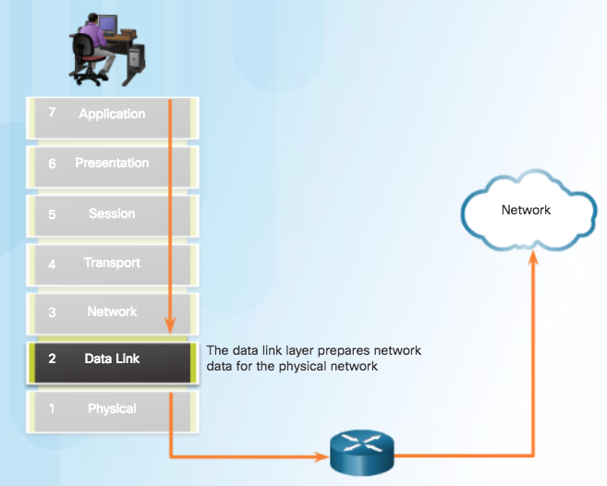
Purpose of the Data Link Layer The Data Link Layer
Notes:
4.3 – Data Link Layer Protocols
4.3.1 – Purpose of the Data Link Layer
4.3.1.1 – The Data Link Layer

Slide 5
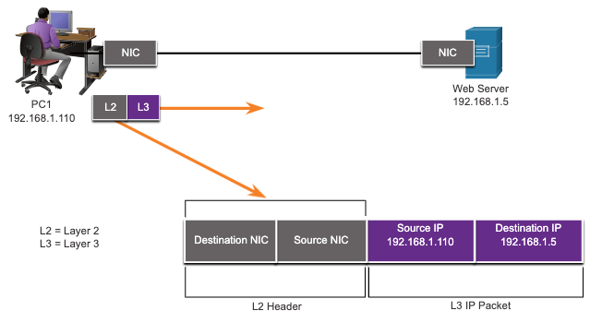
Purpose of the Data Link Layer The Data Link Layer
The Data Link layer is responsible for communications between end-device network interface cards.
It allows upper layer protocols to access the physical layer media and encapsulates Layer 3 packets (IPv4 and IPv6) into Layer 2 Frames.
It also performs error detection and rejects corrupts frames.
Media access
Notes:
6 – Data Link Layer
6.1 – Purpose of the Data Link Layer
6.1.1 – The Data Link Layer

Slide 6
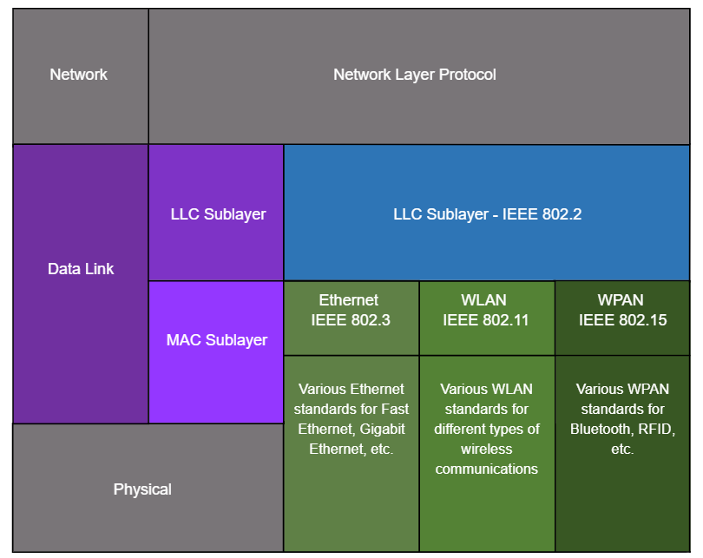
Purpose of the Data Link Layer IEEE 802 LAN/MAN Data Link Sublayers
IEEE 802 LAN/MAN standards are specific to the type of network (Ethernet, WLAN, WPAN, etc).
The Data Link Layer consists of two sublayers. Logical Link Control (LLC) and Media Access Control (MAC).
The LLC sublayer communicates between the networking software at the upper layers and the device hardware at the lower layers.
The MAC sublayer is responsible for data encapsulation and media access control.
Notes:
6 – Data Link Layer
6.1 – Purpose of the Data Link Layer
6.1.2 – IEEE 802 LAN/MAN Data Link Sublayers

Slide 7
Purpose of the Data Link Layer Providing Access to Media
Packets exchanged between nodes may experience numerous data link layers and media transitions.
At each hop along the path, a router performs four basic Layer 2 functions:
Accepts a frame from the network medium.
De-encapsulates the frame to expose the encapsulated packet.
Re-encapsulates the packet into a new frame.
Forwards the new frame on the medium of the next network segment.
Notes:
6 – Data Link Layer
6.1 – Purpose of the Data Link Layer
6.1.3 – Providing Access to Media

Slide 8
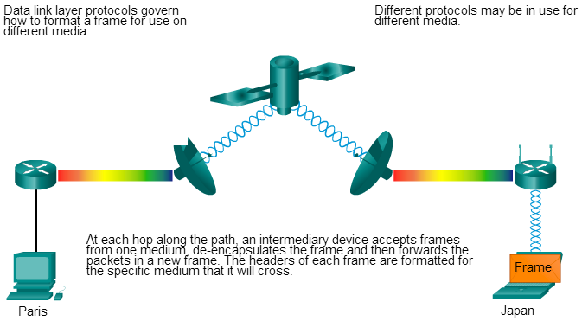
Purpose of the Data Link Layer Media Access Control
As packets travel from the source host to the destination host, they travel over different physical networks.
Physical networks can consist of different types of physical media such as copper wires, optical fibers, and wireless consisting of electromagnetic signals, radio and microwave frequencies, and satellite links.
Notes:
4.3 – Data Link Layer Protocols
4.3.1 – Purpose of the Data Link Layer
4.3.1.3 – Media Access Control

Slide 9
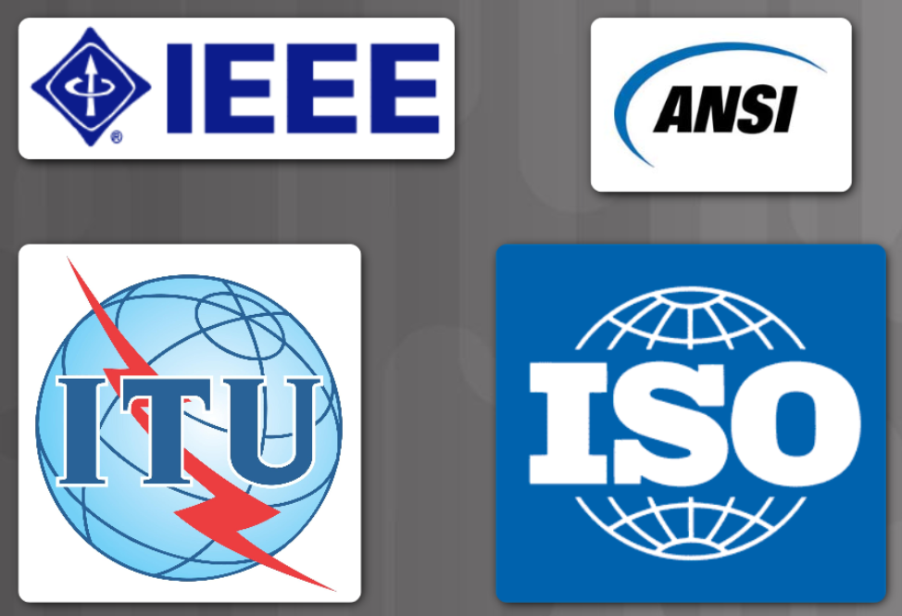
Purpose of the Data Link Layer Data Link Layer Standards
Data link layer protocols are defined by engineering organizations:
Institute for Electrical and Electronic Engineers (IEEE).
International Telecommunications Union (ITU).
International Organizations for Standardization (ISO).
American National Standards Institute (ANSI).
Notes:
6 – Data Link Layer
6.1 – Purpose of the Data Link Layer
6.1.4 – Data Link Layer Standards
6.1.5 – Check Your Understanding – Purpose of Data Link Layer

Slide 10
6.2 Topologies
Notes:
6 - Data Link Layer
6.2 - Topologies

Slide 11
Topologies Physical and Logical Topologies
The topology of a network is the arrangement and relationship of the network devices and the interconnections between them.
There are two types of topologies used when describing networks:
Physical topology – shows physical connections and how devices are interconnected.
Logical topology – identifies the virtual connections between devices using device interfaces and IP addressing schemes.
Notes:
6 – Data Link Layer
6.2 – Topologies
6.2.1 – Physical and Logical Topologies

Slide 12
Topologies WAN Topologies
There are three common physical WAN topologies:
Point-to-point – the simplest and most common WAN topology. Consists of a permanent link between two endpoints.
Hub and spoke – similar to a star topology where a central site interconnects branch sites through point-to-point links.
Mesh – provides high availability but requires every end system to be connected to every other end system.
Notes:
6 – Data Link Layer
6.2 – Topologies
6.2.2 – WAN Topologies

Slide 13
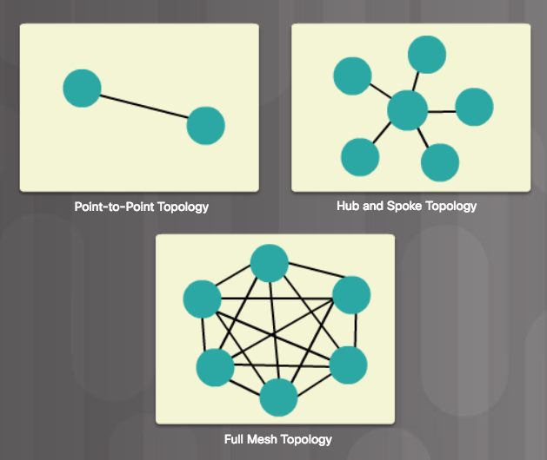
WAN Topologies Common Physical WAN Topologies
Point-to-Point - Permanent link between two endpoints.
Hub and Spoke - A central site interconnects branch sites using point-to-point links.
Mesh - Provides high availability, but requires that every end system be interconnected to every other system. Administrative and physical costs can be significant.
Notes:
4.4 – Media Access Control
4.4.2 – WAN Topologies
4.4.2.1 – Common Physical WAN Topologies

Slide 14
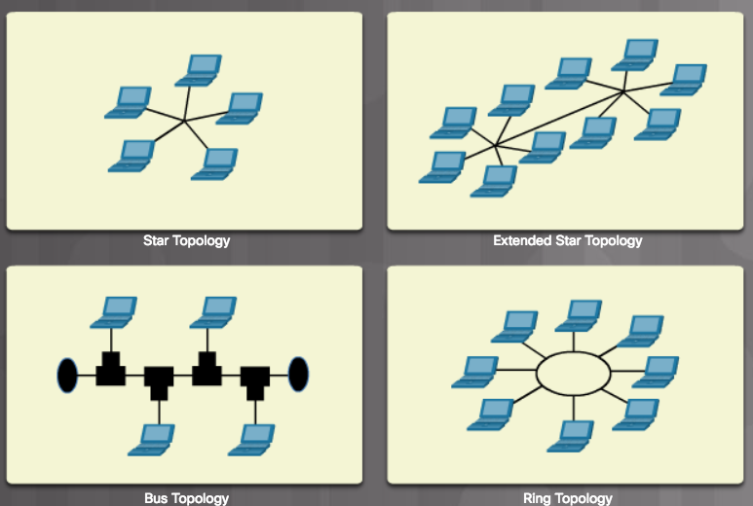
LAN Topologies Physical LAN Topologies
Star - End devices are connected to a central intermediate device. Use Ethernet switches.
Extended Star - Additional Ethernet switches interconnect other star topologies.
Bus - Used in legacy networks. All end systems are chained to each other and terminated in some form on each end. Switches are not required to interconnect the end devices. Bus topologies using coax cables were used in legacy Ethernet networks because it was inexpensive and easy to set up.
Ring - End systems are connected to their respective neighbor forming a ring. Unlike the bus topology, the ring does not need to be terminated. Ring topologies were used in legacy Fiber Distributed Data Interface (FDDI) and Token Ring networks.
Notes:
4.4 – Media Access Control
4.4.3 – LAN Topologies
4.4.3.1 – Physical LAN Topologies

Slide 15
Topologies Half and Full Duplex Communication
Half-duplex communication
Only allows one device to send or receive at a time on a shared medium.
Used on WLANs and legacy bus topologies with Ethernet hubs.
Full-duplex communication
Allows both devices to simultaneously transmit and receive on a shared medium.
Ethernet switches operate in full-duplex mode.
Notes:
6 – Data Link Layer
6.2 – Topologies
6.2.5 – Half and Full Duplex Communication

Slide 16
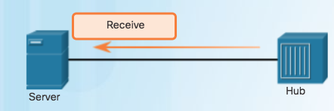
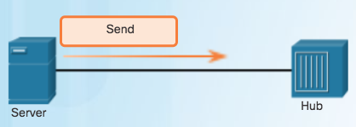
LAN Topologies Half and Full Duplex
Half-Duplex Communication
Both devices can transmit and receive on the media but cannot do so simultaneously.
Used in legacy bus topologies and with Ethernet hubs.
WLANs also operate in half-duplex.
Notes:
4.4 – Media Access Control
4.4.3 – LAN Topologies
4.4.3.2– Half and Full Duplex

Slide 17
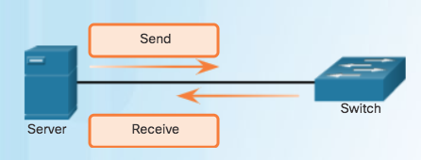
LAN Topologies Half and Full Duplex (Cont.)
Full-Duplex Communication
Both devices can transmit and receive on the media at the same time.
Data link layer assumes that the media is available for transmission for both nodes at any time.
Ethernet switches operate in full-duplex mode by default, but can operate in half-duplex if connecting to a device such as an Ethernet hub.
Notes:
4.4 – Media Access Control
4.4.3 – LAN Topologies
4.4.3.2– Half and Full Duplex

Slide 18
Topologies Access Control Methods
Contention-based access
All nodes operating in half-duplex, competing for use of the medium. Examples are:
Carrier sense multiple access with collision detection (CSMA/CD) as used on legacy bus-topology Ethernet.
Carrier sense multiple access with collision avoidance (CSMA/CA) as used on Wireless LANs.
Controlled access
Deterministic access where each node has its own time on the medium.
Used on legacy networks such as Token Ring and ARCNET.
Notes:
6 – Data Link Layer
6.2 – Topologies
6.2.6 – Access Control Methods

Slide 19
Topologies Contention-Based Access – CSMA/CD
CSMA/CD
Used by legacy Ethernet LANs.
Operates in half-duplex mode where only one device sends or receives at a time.
Uses a collision detection process to govern when a device can send and what happens if multiple devices send at the same time.
CSMA/CD collision detection process:
Devices transmitting simultaneously will result in a signal collision on the shared media.
Devices detect the collision.
Devices wait a random period of time and retransmit data.
Notes:
6 – Data Link Layer
6.2 – Topologies
6.2.7 – Contention-Based Access – CSMA/CD

Slide 20
Topologies Contention-Based Access – CSMA/CA
CSMA/CA
Used by IEEE 802.11 WLANs.
Operates in half-duplex mode where only one device sends or receives at a time.
Uses a collision avoidance process to govern when a device can send and what happens if multiple devices send at the same time.
CSMA/CA collision avoidance process:
When transmitting, devices also include the time duration needed for the transmission.
Other devices on the shared medium receive the time duration information and know how long the medium will be unavailable.
Notes:
6 – Data Link Layer
6.2 – Topologies
6.2.8 – Contention-Based Access – CSMA/CA
6.2.9 – Check Your Understanding - Topologies

Slide 21
6.3 Data Link Frame
Notes:
6 - Data Link Layer
6.3 - Data Link Frame

Slide 22
Data Link Frame The Frame
Data is encapsulated by the data link layer with a header and a trailer to form a frame.
A data link frame has three parts:
Header
Data
Trailer
The fields of the header and trailer vary according to data link layer protocol.
The amount of control information carried with in the frame varies according to access control information and logical topology.
Notes:
6 – Data Link Layer
6.3 – Data Link Frame
6.3.1 – The Frame

Slide 23
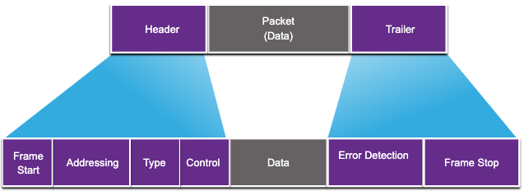
Data Link Frame Frame Fields
Field | Description
Frame Start and Stop | Identifies beginning and end of frame
Addressing | Indicates source and destination nodes
Type | Identifies encapsulated Layer 3 protocol
Control | Identifies flow control services
Data | Contains the frame payload
Error Detection | Used for determine transmission errors
Notes:
6 – Data Link Layer
6.3 – Data Link Frame
6.3.2 – Frame Fields

Slide 24
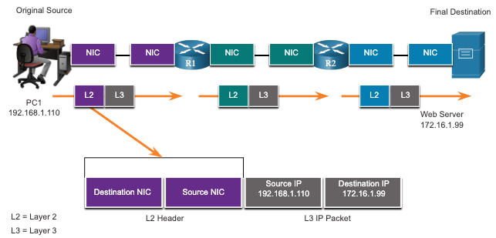
Data Link Frame Layer 2 Addresses
Also referred to as a physical address.
Contained in the frame header.
Used only for local delivery of a frame on the link.
Updated by each device that forwards the frame.
Notes:
6 – Data Link Layer
6.3 – Data Link Frame
6.3.3 – Layer 2 Address

Slide 25
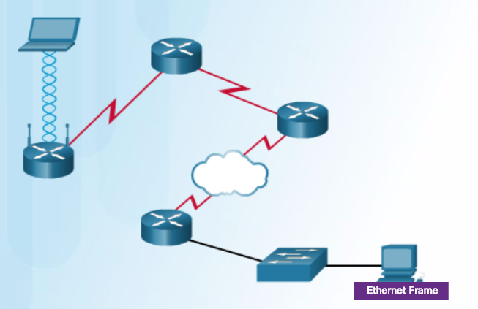

Data Link Frame LAN and WAN Frames
Layer 2 protocol used for a topology is determined by the technology.
Data link layer protocols include:
Ethernet
802.11 Wireless
Point-to-Point Protocol (PPP)
HDLC
Frame Relay
Notes:
4.4 – Media Access Control
4.4.4 – Data Link Frame
4.4.4.5 – LAN and WAN Frames

Slide 26
6.4 Module Practice and Quiz
Notes:
6- Data Link Layer
6.4 - Module Practice and Quiz

Slide 27
Module Practice and Quiz What did I learn in this module?
The data link layer of the OSI model (Layer 2) prepares network data for the physical network.
The data link layer is responsible for network interface card (NIC) to network interface card communications.
The IEEE 802 LAN/MAN data link layer consists of the following two sublayers: LLC and MAC.
The two types of topologies used in LAN and WAN networks are physical and logical.
Three common types of physical WAN topologies are: point-to-point, hub and spoke, and mesh.
Half-duplex communications exchange data in one direction at a time. Full-duplex sends and receives data simultaneously.
In contention-based multi-access networks, all nodes are operating in half-duplex.
Examples of contention-based access methods include: CSMA/CD for bus-topology Ethernet LANs and CSMA/CA for WLANs.
The data link frame has three basic parts: header, data, and trailer.
Frame fields include: frame start and stop indicator flags, addressing, type, control, data, and error detection.
Data link addresses are also known as physical addresses.
Data link addresses are only used for link local delivery of frames.
Notes:
6 – Data Link Layer
6.4 – Module Practice and Quiz
6.4.1 – What did I learn in this module?
6.4.2 – Module Quiz – Data Link Layer

Slide 28
Module 6: Data Link Layer New Terms and Commands
Logical Link Control (LLC) Medial Access Control (MAC) Institute of Electrical and Electronic Engineers (IEEE) International Telecommunications Union (ITU) International Organization for Standardization (ISO) American National Standards Institute (ANSI) Physical Topology Logical Topology Half-duplex Full-duplex CSMA/CD CSMA/CA | Cyclic Redundancy Check (CRC) Contention-based access Controlled access

