Slide 1
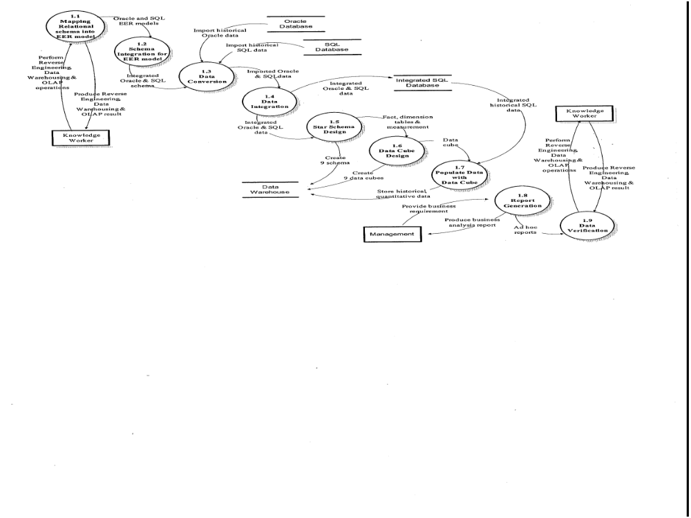
Methodology for Data warehousing with OLAP
2008/2/19

Slide 2
Data conversion: Customerized Program Approach
A common approach to data conversion is to develop customized programs to transfer data from one environment to another. However, the customized program approach is extremely expensive because it requires a different program to be written for each M source files and N target. Furthermore, these programs are used only once. As a result, totally depending on customized program for data conversion is unmanageable, too costly and time consuming.
2008/2/19

Slide 3
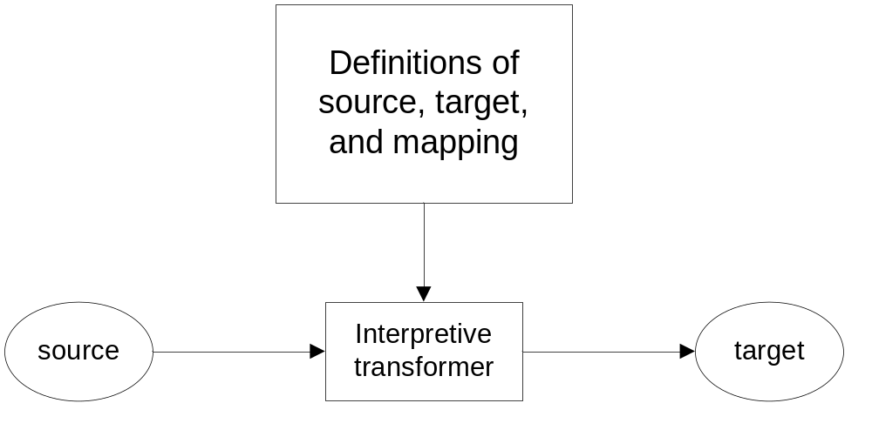
Interpretive Transformer approach of data conversion
2008/2/19
Interpretive transformer

Slide 4
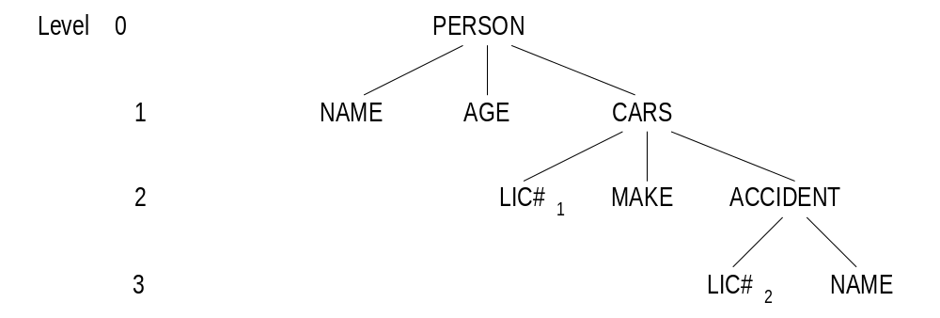
For instance, the following Cobol structure
can be expressed in using these SDDL statements:
Data Structure PERSON <NAME, AGE>
Instance CARS <LIC#1, MAKE>
N-tuples ACCIDENTS <LIC#2, NAME>
Relationship PERSON-CAR <NAME, LIC#1>
N-tuples CAR-ACCIDENT <LIC#1, LIC#2>
2008/2/19

Slide 5
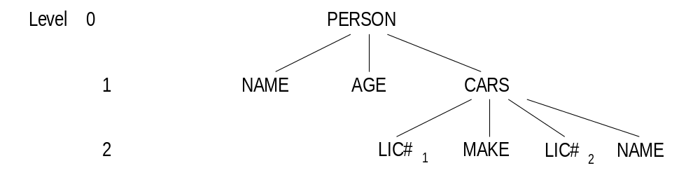
To translate the above three levels to the following two levels data structure:
the TDL statements are
FORM NAME FROM NAME
FORM LIC#1 FROM LIC#1
:
FORM PERSON IF PERSON
FORM CARS IF CAR AND ACCIDENT
2008/2/19

Slide 6
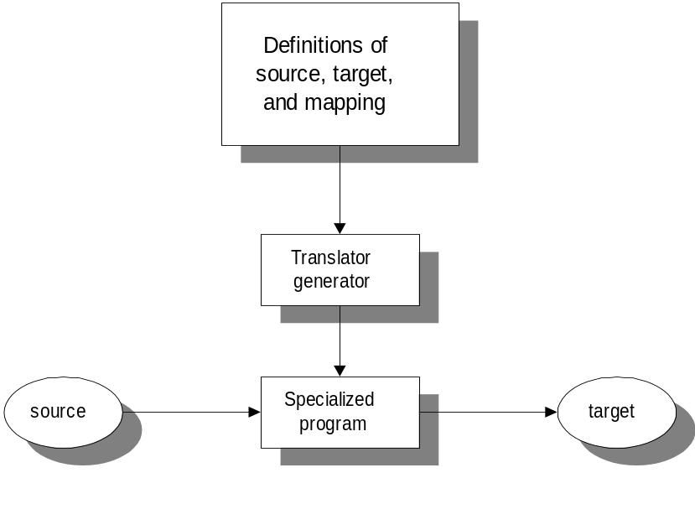
Translator Generator Approach of data conversion
Translator generator
2008/2/19

Slide 7
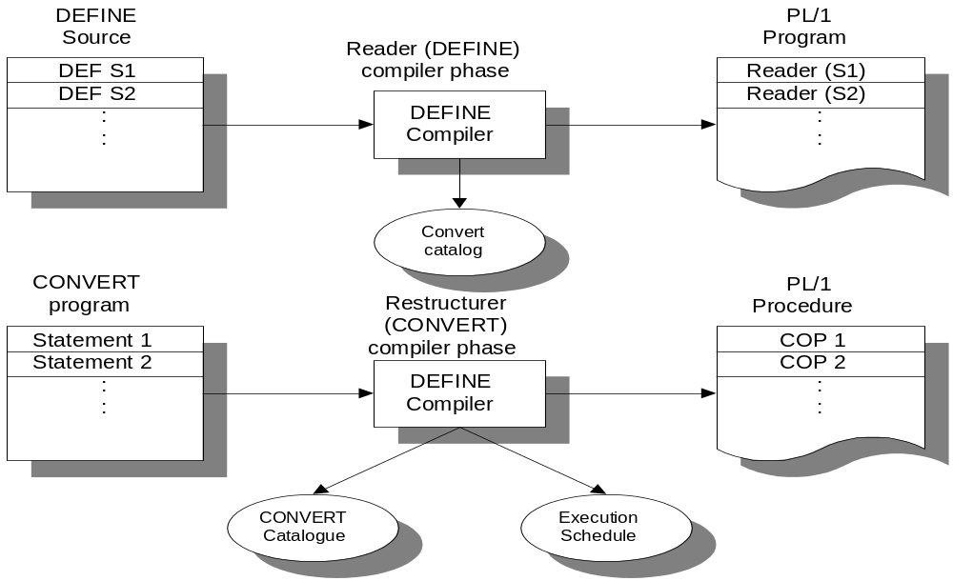
DEFINE and CONVERT compile phase
2008/2/19

Slide 8
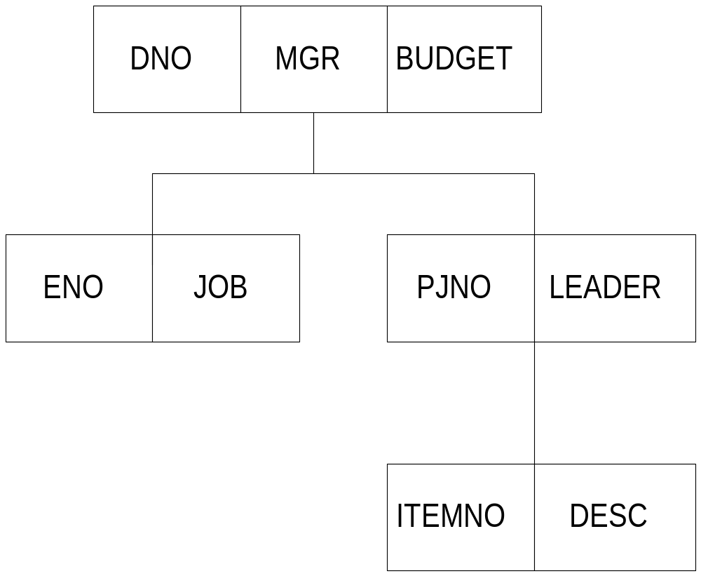
As an example, consider the following hierarchical database:
2008/2/19

Slide 9
Its DEFINE statements can be described in the following where for each DEFINE statement, a code is generated to allocate a new subtree in the internal buffer.
GROUP DEPT:
OCCURS FROM 1 TIMES;
FOLLOWED BY EOF;
PRECEDED BY HEX ‘01’;
:
END EMP;
GROUP PROJ:
OCCURS FROM 0 TIMES;
PRECEDED BY HEX ‘03’;
:
END PROJ;
END DEPT;
2008/2/19

Slide 10
For each user-written CONVERT statement, we can produce a customized program. Take the DEPT FORM from the above DEFINE statement:
T1 = SELECT (FROM DEPT WHERE BUDGET GT ‘100’); will produce the following program:
/* PROCESS LOOP FOR T1 */
DO WHILE (not end of file);
CALL GET (DEPT);
IF BUDGET > ‘100’
THEN CALL BUFFER_SWAP (T1, DEPT);
END
2008/2/19

Slide 11
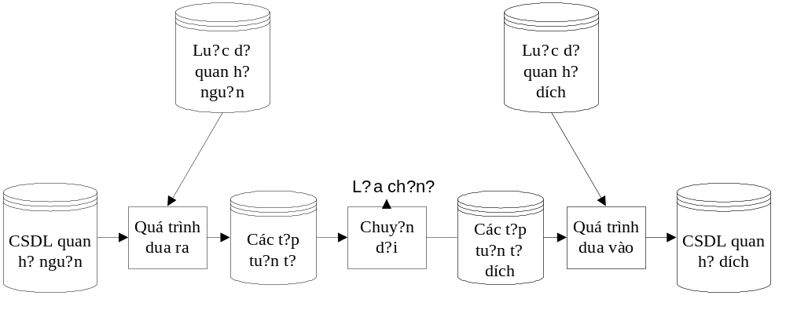
Data conversion: Logical Level Translation Approach
System flow diagram for data conversion from source relational to target relational
2008/2/19

Slide 12
Case study of converting a relational database from DB2 to Oracle
Business requirements
A company has two regions A and B.
Each region forms its own departments.
Each department approves many trips in a year.
Each staff makes many trips in a year.
In each trip, a staff needs to hire cars for transportation.
Each hired car can carry many staff for each trip.
A staff can be either a manager or an engineer.
2008/2/19

Slide 13
Data Requirements
Relation Department(*Department_id, Salary)
Relation Region_A (Department_id, Classification)
Relation Region_B (Department_id, Classification)
Relation Trip (Trip_id, *Car_model, *Staff_id, *Department_id)
Relation People (Staff_id, Name, DOB)
Relation Car (Car_model, Size, Description)
Relation Assignment(*Car_model, *Staff_id)
Relation Engineer (*Staff_id, Title)
Relation Manager (*Staff_id, Title)
ID: Department.Department_id ⊆ (Region_A.Department_id ∪ Region_B.Department_id)
ID: Trip.Department_id ⊆ Department.Department_id
ID: Trip.Car_model ⊆ Assignment.Car_model
ID: Trip.Staff_id ⊆ Assignment.Staff_id
ID: Assignment.Car_model ⊆ Car.Car_model
ID: Assignment.Staff_id ⊆ People.Staff_id
ID: Engineer.Staff_id ⊆ People.Staff_id
ID: Manager.Staff_id ⊆ People.Staff_id
Where ID = Inclusion Dependence, Underlined are primary keys and “*” prefixed are foreign keys.
2008/2/19

Slide 14
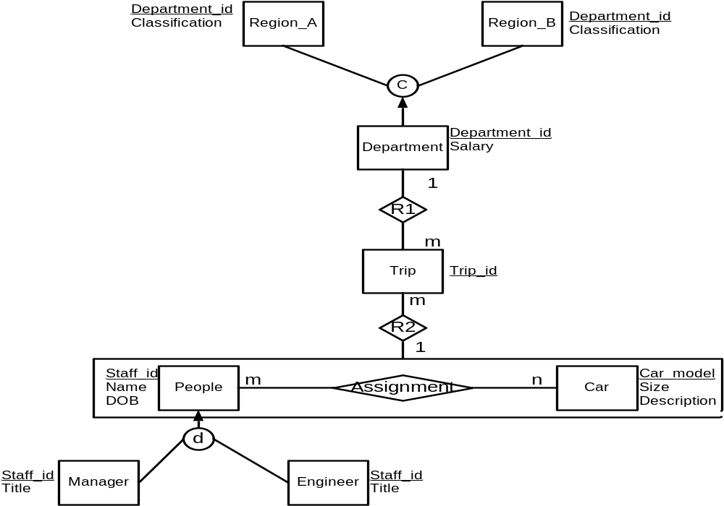
Extended Entity Relationship Model for database Trip
2008/2/19

Slide 15
Schema for target relational database Trip
Create Table Car
(CAR_MODEL character (10),
SIZE character (10),
DESCRIPT character (20),
STAFF_ID character (5),
primary key (CAR_MODEL))
Create Table Depart
(DEP_ID character (5),
SALARY numeric (8),
primary key (DEP_ID))
Create Table People
(STAFF_ID character (4),
NAME character (20),
DOB datetime,
primary key (STAFF_ID))
Create Table Reg_A
(DEP_ID character (5),
DESCRIP character (20),
primary key (DEP_ID))
Create Table Reg_B
(DEP_ID character (5),
DESCRIPT character (20),
primary key (DEP_ID))
2008/2/19

Slide 16
Schema for target relational database Trip (continue)
Create Table trip
(TRIP_ID character (5),
primary key (TRIP_ID))
Create Table Engineer
(TITLE character (20),
STAFF_ID character (4),
Foreign Key (STAFF_ID) REFERENCES People(STAFF_ID),
Primary key (STAFF_ID))
Create Table Manager
(TITLE character (20),
STAFF_ID character (4),
Foreign Key (STAFF_ID) REFERENCES People(STAFF_ID),
Primary key (STAFF_ID))
Create Table Assign
( CAR_MODEL character (10),
Foreign Key (CAR_MODEL) REFERENCES Car(CAR_MODEL),
STAFF_ID character (4),
Foreign Key (STAFF_ID) REFERENCES People(STAFF_ID),
primary key (CAR_MODEL,STAFF_ID))
ALTER TABLE trip ADD CAR_MODEL character (10) null
ALTER TABLE trip ADD STAFF_ID character (4) null
ALTER TABLE trip ADD Foreign Key (CAR_MODEL,STAFF_ID) REFERENCES Assign(CAR_MODEL,STAFF_ID)
2008/2/19

Slide 17
Data insertion for target relational database Trip
INSERT INTO trip_ora.CAR (CAR_MODEL,CAR_SIZE,DESCRIPT,STAFF_ID) VALUES ('DA-02 ', '165 ', 'Long car ', 'A001 ')
INSERT INTO trip_ora.CAR (CAR_MODEL,CAR_SIZE,DESCRIPT,STAFF_ID) VALUES ('MZ-18 ', '120 ', 'Small sportics ', 'B004 ')
INSERT INTO trip_ora.CAR (CAR_MODEL,CAR_SIZE,DESCRIPT,STAFF_ID) VALUES ('R-023 ', '150 ', 'Long car ', 'A002 ')
INSERT INTO trip_ora.CAR (CAR_MODEL,CAR_SIZE,DESCRIPT,STAFF_ID) VALUES ('SA-38 ', '120 ', 'New dark blue ', 'D001 ')
INSERT INTO trip_ora.CAR (CAR_MODEL,CAR_SIZE,DESCRIPT,STAFF_ID) VALUES ('WZ-01 ', '1445 ', 'Middle Sportics ', 'B004 ')
INSERT INTO trip_ora.DEPART (DEP_ID,SALARY) VALUES ('AA001', 35670)
INSERT INTO trip_ora.DEPART (DEP_ID,SALARY) VALUES ('AB001', 30010)
INSERT INTO trip_ora.DEPART (DEP_ID,SALARY) VALUES ('BA001', 22500)
INSERT INTO trip_ora.DEPART (DEP_ID,SALARY) VALUES ('BB001', 21500)
INSERT INTO trip_ora.PEOPLE (STAFF_ID,NAME,DOB) VALUES ('A001', 'Alexender ', '7-1-1962')
INSERT INTO trip_ora.PEOPLE (STAFF_ID,NAME,DOB) VALUES ('A002', 'April ', '5-24-1975')
INSERT INTO trip_ora.PEOPLE (STAFF_ID,NAME,DOB) VALUES ('B001', 'Bobby ', '12-5-1987')
INSERT INTO trip_ora.PEOPLE (STAFF_ID,NAME,DOB) VALUES ('B002', 'Bladder ', '1-3-1980')
INSERT INTO trip_ora.PEOPLE (STAFF_ID,NAME,DOB) VALUES ('B003', 'Brent ', '12-15-1979')
INSERT INTO trip_ora.PEOPLE (STAFF_ID,NAME,DOB) VALUES ('B004', 'Brelendar ', '8-18-1963')
INSERT INTO trip_ora.PEOPLE (STAFF_ID,NAME,DOB) VALUES ('C001', 'Calvin ', '4-3-1977')
INSERT INTO trip_ora.PEOPLE (STAFF_ID,NAME,DOB) VALUES ('C002', 'Cheven ', '2-2-1974')
INSERT INTO trip_ora.PEOPLE (STAFF_ID,NAME,DOB) VALUES ('C003', 'Clevarance ', '12-6-1987')
INSERT INTO trip_ora.PEOPLE (STAFF_ID,NAME,DOB) VALUES ('D001', 'Dave ', '8-17-1964')
INSERT INTO trip_ora.PEOPLE (STAFF_ID,NAME,DOB) VALUES ('D002', 'Davis ', '3-19-1988')
INSERT INTO trip_ora.PEOPLE (STAFF_ID,NAME,DOB) VALUES ('D003', 'Denny ', '8-5-1985')
INSERT INTO trip_ora.PEOPLE (STAFF_ID,NAME,DOB) VALUES ('D004', 'Denny ', '2-21-1998')
INSERT INTO trip_ora.REG_A (DEP_ID,DESCRIP) VALUES ('AA001', 'Class A Manager ')
INSERT INTO trip_ora.REG_A (DEP_ID,DESCRIP) VALUES ('AB001', 'Class A Manager ')
INSERT INTO trip_ora.REG_A (DEP_ID,DESCRIP) VALUES ('AC001', 'Class A Manager ')
INSERT INTO trip_ora.REG_A (DEP_ID,DESCRIP) VALUES ('AD001', 'Class A Assistnat ')
INSERT INTO trip_ora.REG_A (DEP_ID,DESCRIP) VALUES ('AE001', 'Class A Assistnat ')
INSERT INTO trip_ora.REG_A (DEP_ID,DESCRIP) VALUES ('AF001', 'Class A Assistnat ')
INSERT INTO trip_ora.REG_A (DEP_ID,DESCRIP) VALUES ('AG001', 'Class A Clark ')
INSERT INTO trip_ora.REG_A (DEP_ID,DESCRIP) VALUES ('AH001', 'Class A Assistant ')
INSERT INTO trip_ora.REG_B (DEP_ID,DESCRIPT) VALUES ('BA001', 'Class B Manager ')
INSERT INTO trip_ora.REG_B (DEP_ID,DESCRIPT) VALUES ('BB001', 'Class B Manager ')
INSERT INTO trip_ora.REG_B (DEP_ID,DESCRIPT) VALUES ('BC001', 'Class B Manager ')
INSERT INTO trip_ora.REG_B (DEP_ID,DESCRIPT) VALUES ('BD001', 'Class B Assistant ')
INSERT INTO trip_ora.REG_B (DEP_ID,DESCRIPT) VALUES ('BE001', 'Class B Assistant ')
2008/2/19

Slide 18
Data insertion for target relational database Trip (continue)
INSERT INTO trip_ora.REG_B (DEP_ID,DESCRIPT) VALUES ('BF001', 'Class B Assistant ')
INSERT INTO trip_ora.REG_B (DEP_ID,DESCRIPT) VALUES ('BG001', 'Class B Clark ')
INSERT INTO trip_ora.REG_B (DEP_ID,DESCRIPT) VALUES ('BH001', 'Class B Assistant ')
INSERT INTO trip_ora.TRIP (TRIP_ID) VALUES ('T0001')
INSERT INTO trip_ora.TRIP (TRIP_ID) VALUES ('T0002')
INSERT INTO trip_ora.TRIP (TRIP_ID) VALUES ('T0003')
INSERT INTO trip_ora.TRIP (TRIP_ID) VALUES ('T0004')
INSERT INTO trip_ora.ENGINEER (TITLE,STAFF_ID) VALUES ('Electronic Engineer ', 'A001')
INSERT INTO trip_ora.ENGINEER (TITLE,STAFF_ID) VALUES ('Senior Engineer ', 'B003')
INSERT INTO trip_ora.ENGINEER (TITLE,STAFF_ID) VALUES ('Electronic Engineer ', 'B004')
INSERT INTO trip_ora.ENGINEER (TITLE,STAFF_ID) VALUES ('Junior Engineer ', 'C002')
INSERT INTO trip_ora.ENGINEER (TITLE,STAFF_ID) VALUES ('System Engineer ', 'D001')
INSERT INTO trip_ora.ENGINEER (TITLE,STAFF_ID) VALUES ('Material Engineer ', 'D002')
INSERT INTO trip_ora.ENGINEER (TITLE,STAFF_ID) VALUES ('Parts Engineer ', 'D003')
INSERT INTO trip_ora.MANAGER (TITLE,STAFF_ID) VALUES ('Sales Manager ', 'A002')
INSERT INTO trip_ora.MANAGER (TITLE,STAFF_ID) VALUES ('Marketing Manager ', 'B001')
INSERT INTO trip_ora.MANAGER (TITLE,STAFF_ID) VALUES ('Sales Manager ', 'B002')
INSERT INTO trip_ora.MANAGER (TITLE,STAFF_ID) VALUES ('General Manager ', 'C001')
INSERT INTO trip_ora.MANAGER (TITLE,STAFF_ID) VALUES ('Marketing Manager ', 'C003')
INSERT INTO trip_ora.ASSIGN (CAR_MODEL,STAFF_ID) VALUES ('MZ-18 ', 'A002')
INSERT INTO trip_ora.ASSIGN (CAR_MODEL,STAFF_ID) VALUES ('MZ-18 ', 'B001')
INSERT INTO trip_ora.ASSIGN (CAR_MODEL,STAFF_ID) VALUES ('MZ-18 ', 'D003')
INSERT INTO trip_ora.ASSIGN (CAR_MODEL,STAFF_ID) VALUES ('R-023 ', 'B004')
INSERT INTO trip_ora.ASSIGN (CAR_MODEL,STAFF_ID) VALUES ('R-023 ', 'C001')
INSERT INTO trip_ora.ASSIGN (CAR_MODEL,STAFF_ID) VALUES ('R-023 ', 'D001')
INSERT INTO trip_ora.ASSIGN (CAR_MODEL,STAFF_ID) VALUES ('SA-38 ', 'A001')
INSERT INTO trip_ora.ASSIGN (CAR_MODEL,STAFF_ID) VALUES ('SA-38 ', 'A002')
INSERT INTO trip_ora.ASSIGN (CAR_MODEL,STAFF_ID) VALUES ('SA-38 ', 'D002')
INSERT INTO trip_ora.ASSIGN (CAR_MODEL,STAFF_ID) VALUES ('WZ-01 ', 'B002')
INSERT INTO trip_ora.ASSIGN (CAR_MODEL,STAFF_ID) VALUES ('WZ-01 ', 'B003')
INSERT INTO trip_ora.ASSIGN (CAR_MODEL,STAFF_ID) VALUES ('WZ-01 ', 'C002')
2008/2/19

Slide 19
Data insertion for target relational database Trip (continue)
UPDATE trip_ora52.TRIP
SET DEPT_ID= 'AA001'
, CAR_MODEL= 'MZ-18 '
, STAFF_ID= 'A002'
, CAR_MODEL= 'MZ-18 '
, STAFF_ID= 'A002'
WHERE TRIP_ID='T0001‘
UPDATE trip_ora52.TRIP
SET DEPT_ID= 'AA001'
, CAR_MODEL= 'MZ-18 '
, STAFF_ID= 'B001'
, CAR_MODEL= 'MZ-18 '
, STAFF_ID= 'B001'
WHERE TRIP_ID='T0002'
UPDATE trip_ora52.TRIP
SET DEPT_ID= 'AB001'
, CAR_MODEL= 'SA-38 '
, STAFF_ID= 'A002'
, CAR_MODEL= 'SA-38 '
, STAFF_ID= 'A002'
WHERE TRIP_ID='T0003'
UPDATE trip_ora52.TRIP
SET DEPT_ID= 'BB001'
, CAR_MODEL= 'SA-38 '
, STAFF_ID= 'D002'
, CAR_MODEL= 'SA-38 '
, STAFF_ID= 'D002'
WHERE TRIP_ID='T0004'
2008/2/19
Notes:
16

Slide 20
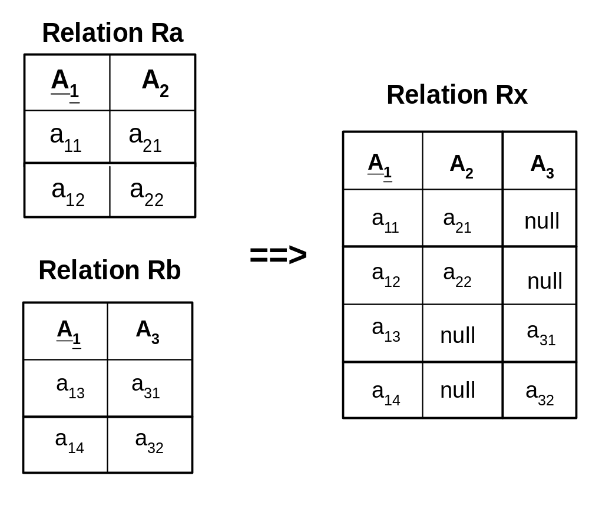
Data Integration
Step 1: Merge by Union
2008/2/19

Slide 21
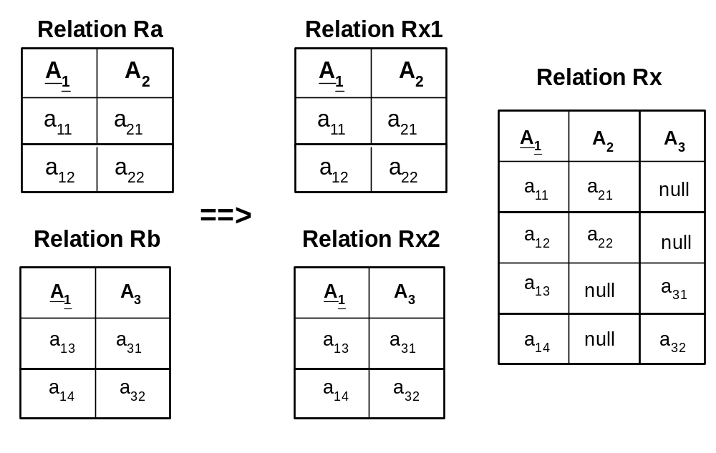
Step 2: Merge classes by generalization
2008/2/19

Slide 22
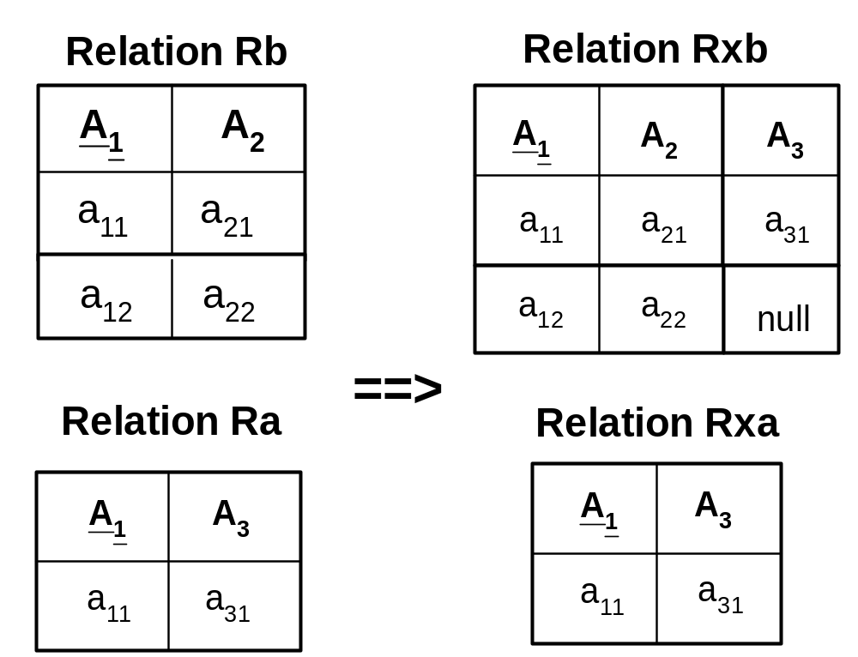
Step 3: Merge classes by inheritance
2008/2/19

Slide 23
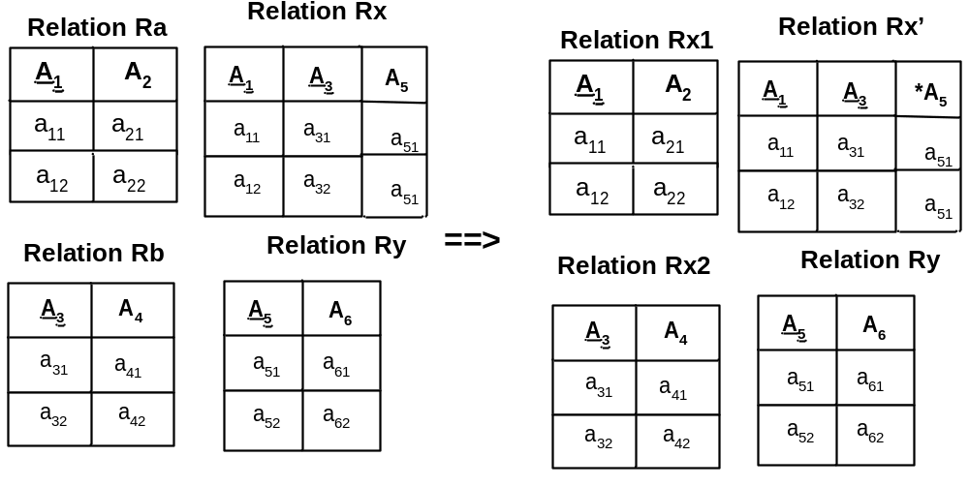
Step 4 Merge classes by aggregation
2008/2/19

Slide 24
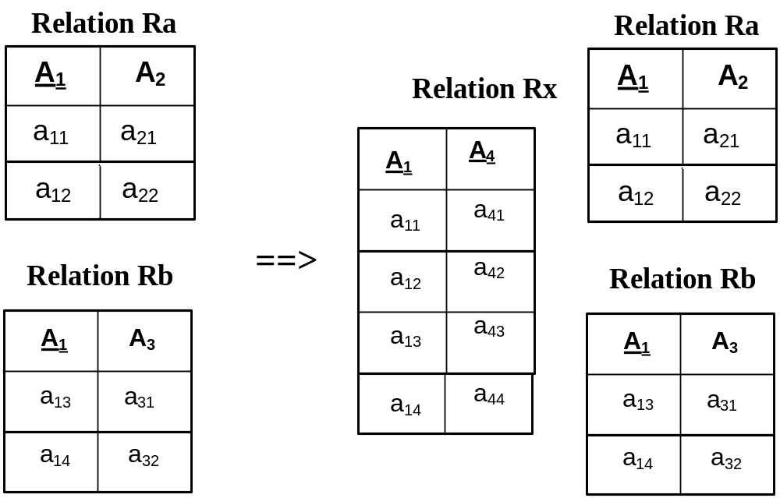
Step 5 Merge classes by categorization
2008/2/19

Slide 25
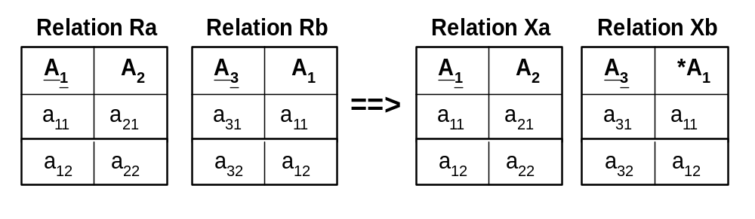
Step 6 Merge classes by implied relationship
2008/2/19

Slide 26
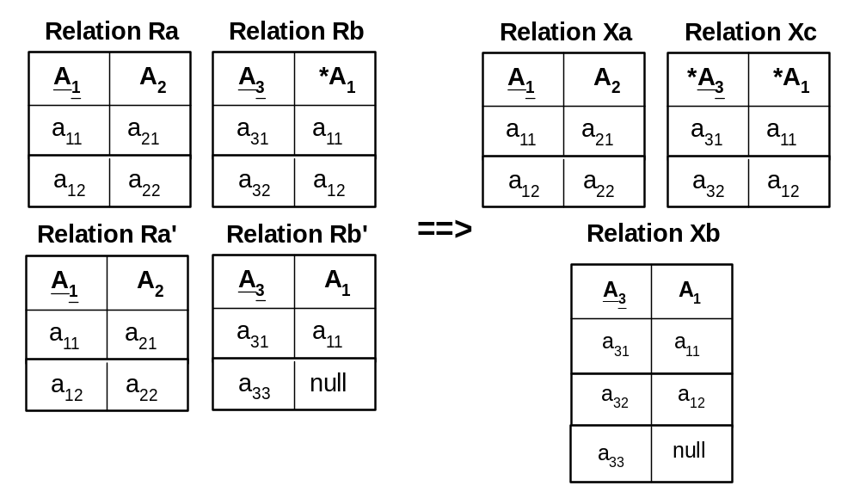
Step 7 Merge relationship by subtype
2008/2/19

Slide 27
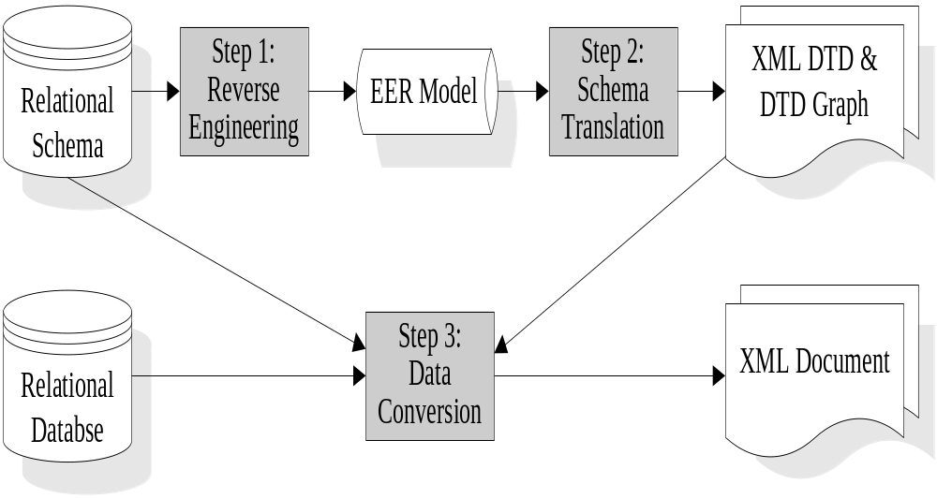
Data conversion from relational into XML
Architecture of Re-engineering Relational Database into XML Document
2008/2/19

Slide 28
Methodology of converting RDB into XML
As the result of the schema translation, we translate an EER model into different views of XML schemas based on their selected root elements. For each translated XML schema, we can read its corresponding source relation sequentially by embedded SQL starting a parent relation. The tuple can then be loaded into XML document according to the mapped XML DTD. Then we read the corresponding child relation tuple(s), and load them into XML document.
2008/2/19

Slide 29
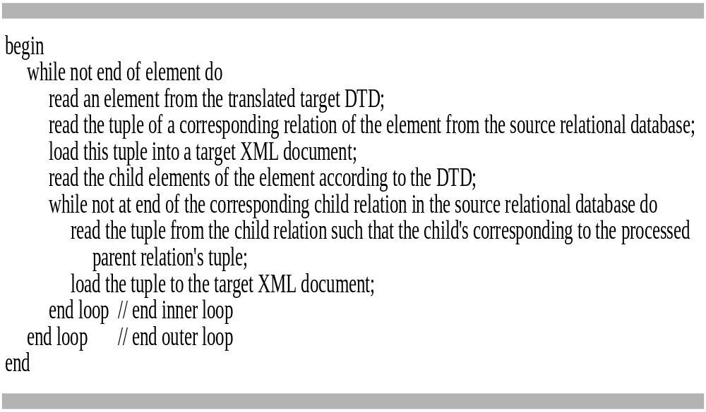
Algorithm of transforming RDB into XML
2008/2/19

Slide 30
Step 1: Reverse Engineering Relational Schema into an EER Model
By use of classification tables to define the relationship between keys and attributes in all relations, we can recover their data semantics in the form of an EER model.
2008/2/19

Slide 31
Step 2: Data Conversion from Relational into XML document
We can map the data semantics in the EER model into DTD-graph according to their data dependencies constraints. These constraints can then be transformed into DTD as XML schema.
2008/2/19

Slide 32
Step 2.1 Defining a Root Element
To select a root element, we must put its relevant information into an XML schema. Relevance concerns with the entities that are related to a selected entity by the user. The relevant classes include the selected entity and all its relevant entities that are navigable.
In an EER mode, we can navigate from entity to another entity in correspondence to XML hierarchical containment tree model.
2008/2/19

Slide 33
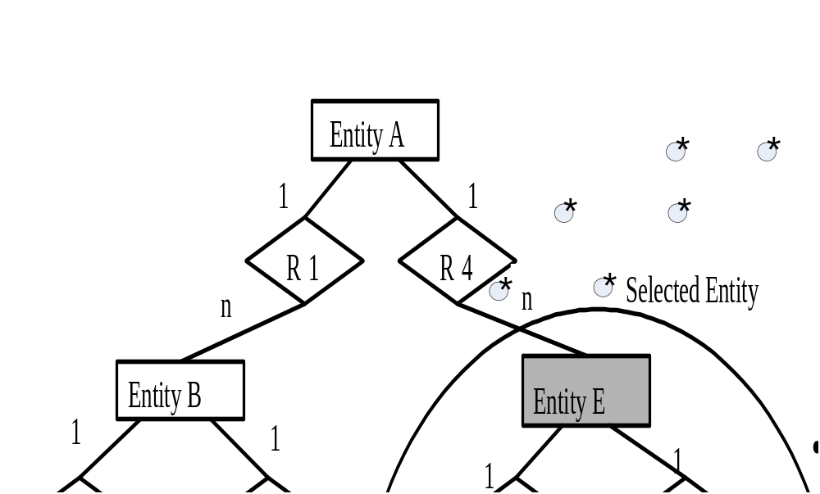
2008/2/19

Slide 34
Step 2.1 Mapping Cardinality from RDB to XML
In DTD, we translate one-to-one cardinality into parent and child element and one-to-many cardinality into parent and child element with multiple occurrences. In many-to-many cardinality, it is mapped into DTD of a hierarchy structure with ID and IDREF.
2008/2/19

Slide 35
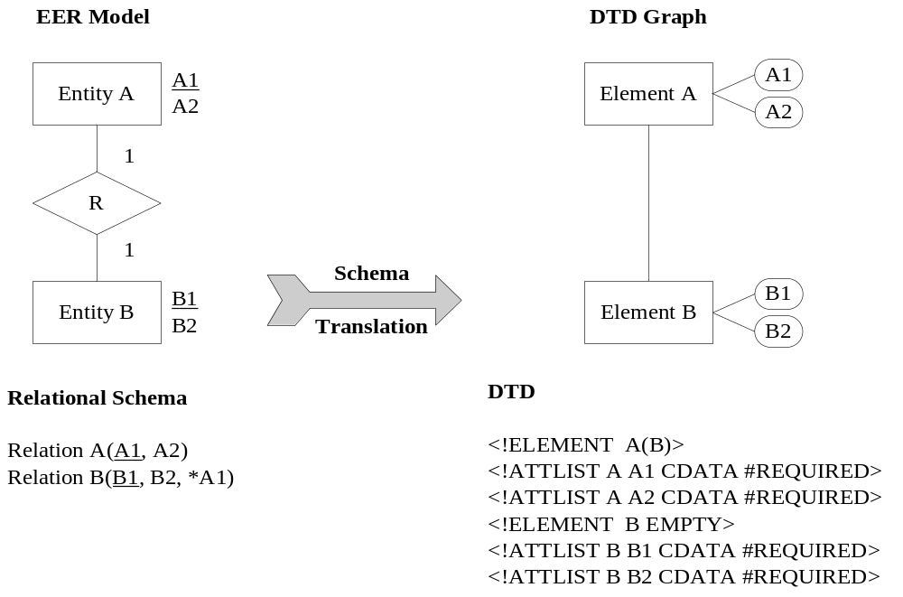
One-to-one cardinality
2008/2/19

Slide 36
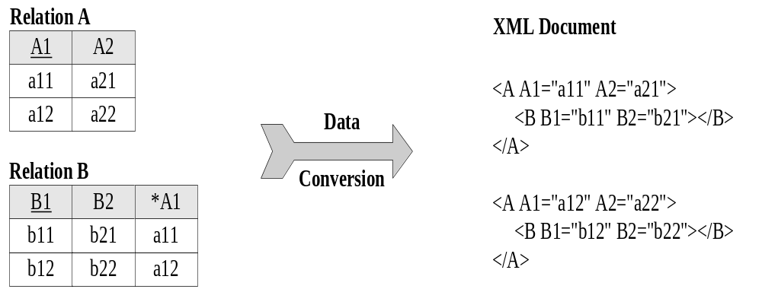
One-to-one cardinality
2008/2/19

Slide 37
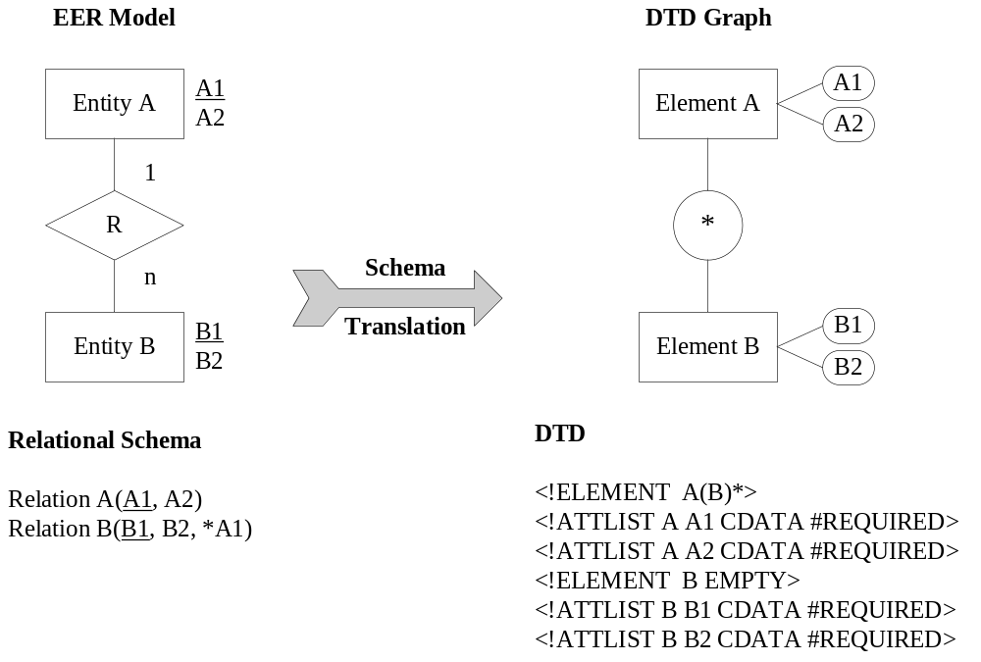
One-to-many cardinality
2008/2/19

Slide 38
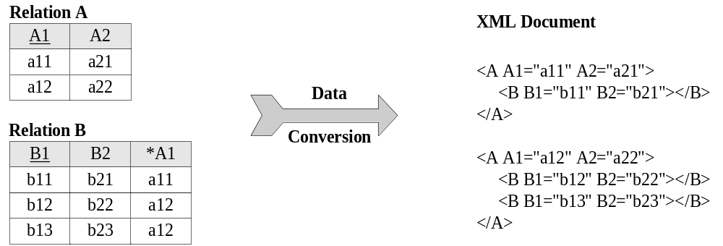
One-to-many cardinality
2008/2/19

Slide 39
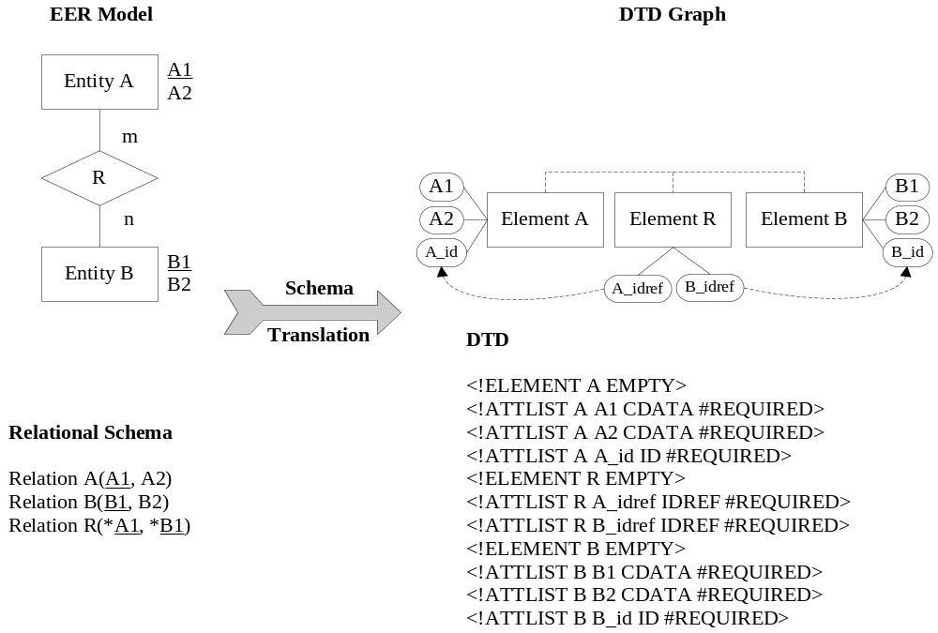
Many-to-many cardinality
2008/2/19

Slide 40
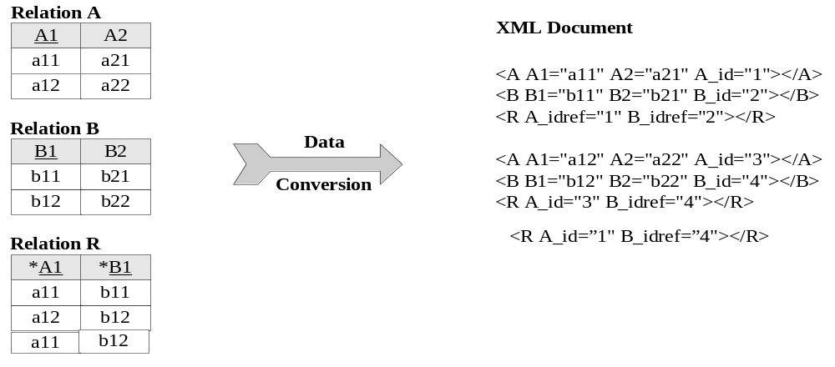
Many-to-many cardinality
2008/2/19

Slide 41
Case Study
Consider a case study of a Hospital Database System. In this system, a patient can have many record folders. Each record folder can contain many different medical records of the patient. A country has many patients. Once a record folder is borrowed, a loan history is created to record the details about it.
2008/2/19

Slide 42
Hospital Relational Schema
Relation Patient (HK_ID, Patient_Name)
Relation Record_Folder (Folder_No, Location, *HKID)
Relation Medical_Record (Medical_Rec_No, Create_Date, Sub_Type, *Folder_No)
Relation Borrower (*Borrower_No, Borrower_Name)
Relation Borrow (*Borrower_No, *Folder_No)
Where underlined are primary keys, prefixed with “*” are foreign keys
2008/3/1

Slide 43
Relational Data
Patient table HK_ID Patient name
E3766849 Smith
Record_Folder table Folder no Location *HKID
F_21 Hong Kong E3766849
F_24 New Territories E3766849
Borrower table Folder no Borrower no
F_21 B1
F_21 B11
F_21 B21
F_21 B22
F_24 B22
2008/3/1

Slide 44
Borrower_Name Table Borrower_no Borrower_name
B1 Johnson
B11 Choy
B21 Fung
B22 Lok
Medical_Record Table Medical_Rec_no Create_Date Sub_type Folder_no
M_311999 Jan-01-1999 W F_21
M_322000 Nov-12-1998 W F_21
M_352001 Jan-15-2001 A F_21
M_362001 Feb-01-2001 A F_21
M_333333 Mar-03-2001 A F_24
2008/2/19

Slide 45
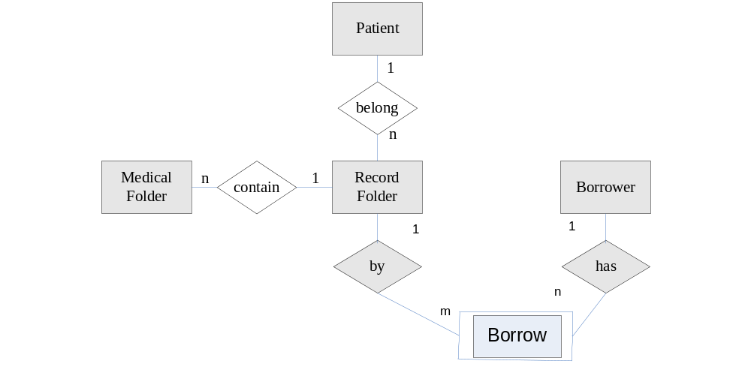
Step 1 Reverse engineer relational database into an EER model
2008/2/19

Slide 46
Step 2 Translate EER model into DTD Graph and DTD
In this case study, suppose we concern the patient medical records, so the entity Patient is selected. Then we define a meaningful name for the root element, called Patient_Records. We start from the entity Patient in the EER model and then find the relevant entities for it. The relevant entities include the related entities that are navigable from the parent entity.
2008/2/19

Slide 47
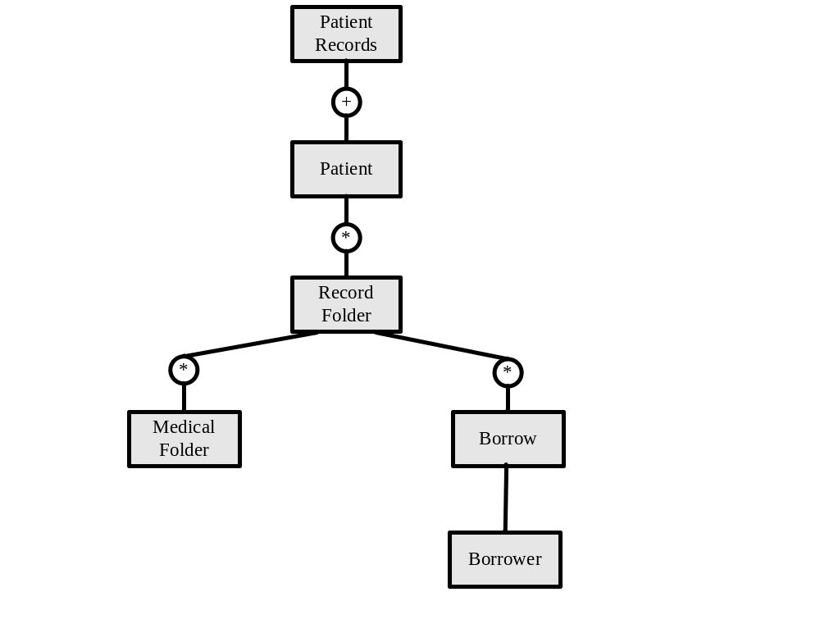
Translated Document Type Definition Graph
2008/2/19

Slide 48
Translated Document Type Definition
<!ELEMENT Patient_Records (Patient+)>
<!ELEMENT Patient (Record_Folder*)>
<!ATTLIST Patient HKID CDATA #REQUIRED>
<!ATTLIST Patient Patient_Name CDATA #REQUIRED>
<!ELEMENT Record_Folder (Borrow*, Medical_Record*)>
<!ATTLIST Record_Folder Folder_No CDATA #REQUIRED>
<!ATTLIST Record_Folder Location CDATA #REQUIRED>
<!ELEMENT Borrow (Borrower)>
<!ATTLIST Borrow Borrower_No CDATA #REQUIRED>
<!ELEMENT Medical_Record EMPTY>
<!ATTLIST Medical_Record Medical_Rec_No CDATA #REQUIRED>
<!ATTLIST Medical_Record Create_Date CDATA #REQUIRED>
<!ATTLIST Medical_Record Sub_Type CDATA #REQUIRED>
<!ELEMENT Borrower EMPTY>
<!ATTLIST Borrower Borrower_name CDATA #REQUIRED>
2008/3/1

Slide 49
Transformed XML document
Patient_Records>
<Patient Country_No="C0001" HKID="E3766849" Patient_Name="Smith">
<Record_Folder Folder_No="F_21" Location="Hong Kong">
<Borrow Borrower_No="B1">
<Borrower Borrower_name=“Johnson" />
</Borrow>
<Borrow Borrower_No="B11">
<Borrower Borrower_name=“Choy" />
</Borrow>
<Borrow Borrower_No="B21">
<Borrower Borrower_name=“Fung" />
</Borrow>
<Borrow Borrower_No="B22">
<Borrower Borrower_name=“Lok" />
</Borrow>
<Medical_Record Medical_Rec_No="M_311999" Create_Date="Jan-1-1999“, Sub_Type="W"></Medical_Record>
<Medical_Record Medical_Rec_No="M_322000" Create_Date="Nov-12-1998“, Sub_Type="W"></Medical_Record>
<Medical_Record Medical_Rec_No="M_352001" Create_Date="Jan-15-2001“, Sub_Type="A"></Medical_Record>
<Medical_Record Medical_Rec_No="M_362001" Create_Date="Feb-01-2001“, Sub_Type="A"></Medical_Record>
</Record_Folder>
<Record_Folder Folder_No="F_24" Location="New Territories">
<Borrow Borrower_No="B22">
<Borrower Borrower_name=“Lok" />
</Borrow>
<Medical_Record Medical_Rec_No="M_333333" Create_Date="Mar-03-01“, Sub_Type="A"></Medical_Record>
</Record_Folder>
</Patient>
2008/2/19

Slide 50
Reading Assignment
Chapter 4 Data Conversion of “Information Systems Reengineering and Integration” by Joseph Fong, Springer Verlag, pp.160-198.
2008/2/19

Slide 51
Lecture review question 6
How do you compare the pros and cons of using “Logical Level Translation Approach” with “Customized Program Approach” in data conversion?
2008/2/19

Slide 52
CS5483 Tutorial Question 6
Convert the following relational database into an XML document:
Relation Car_rental
Car_model Staff_ID *Trip_ID
MZ-18 A002 T0001
MZ-18 B001 T0002
R-023 B004 T0001
R-023 C001 T0004
SA-38 A001 T0003
SA-38 A002 T0001
Relation Trip
Trip_ID *Department_ID
T0001 AA001
T0002 AA001
T0003 AB001
T0004 BA001
Relation Department
Department_ID Salary
AA001 35670
AB001 30010
BA001 22500
2008/3/1

