Slide 1
Data Warehousing and Mining
Lecture 1
Course syllabus
Overview of data warehousing and mining
  Lecture slides modified from:
  Jiawei Han (http://www-sal.cs.uiuc.edu/~hanj/DM_Book.html)
  Vipin Kumar (http://www-users.cs.umn.edu/~kumar/csci5980/index.html)
  Joshep Fong (http://www.cs.cityu.edu.hk/~jfong/course/cs5483/)
  Slobodan Vucetic (http://www.ist.temple.edu/~vucetic/cis526fall2004.htm)

Slide 2
Course Syllabus
Textbook:
  1- J. Han, M. Kamber, Data Mining: Concepts and Techniques, 2006,second edition.
  2- Joseph Fong: Information Systems Reengineering and Integration, 2006, ISBN 978-1-84628-382-6, Second edition.
Topics:
  Overview of data warehousing and mining
  Data warehouse and OLAP technology
  Data preprocessing
  Mining association rules
  Classification and prediction
  Cluster analysis
  Mining complex types of data
Grading:
  (10%) Homework Assignments and Quizs
  (30%) Project
  (60%) Final Exam.
1

Slide 3
Course Syllabus
Late Policy and Academic Honesty:
  The projects and homework assignments are due in class, on the specified due date. NO LATE SUBMISSIONS will be accepted. For fairness, this policy will be strictly enforced.
  Academic honesty is taken seriously. You must write up your own solutions and code. For homework problems or projects you are allowed to discuss the problems or assignments verbally with other class members. You MUST acknowledge the people with whom you discussed your work. Any other sources (e.g. Internet, research papers, books) used for solutions and code MUST also be acknowledged. In case of doubt PLEASE contact the instructor.
Disability Disclosure Statement
  Any student who has a need for accommodation based on the impact of a disability should contact me privately to discuss the specific situation as soon as possible. Contact Disability Resources and Services at 215-204-1280 in 100 Ritter Annex to coordinate reasonable accommodations for students with documented disabilities.

Slide 4
Motivation:
“Necessity is the Mother of Invention”
Data explosion problem
  Automated data collection tools and mature database technology lead to tremendous amounts of data stored in databases, data warehouses and other information repositories
We are drowning in data, but starving for knowledge!
Solution: Data warehousing and data mining
  Data warehousing and on-line analytical processing
  Extraction of interesting knowledge (rules, regularities, patterns, constraints) from data in large databases

Slide 5

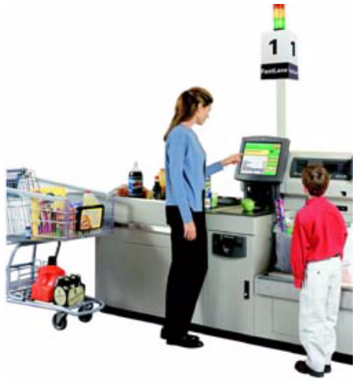
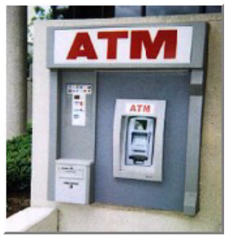
Why Mine Data? Commercial Viewpoint
Lots of data is being collected
and warehoused
  Web data, e-commerce
  purchases at department/
  grocery stores
  Bank/Credit Card
  transactions
Computers have become cheaper and more powerful
Competitive Pressure is Strong
  Provide better, customized services for an edge (e.g. in Customer Relationship Management)

Slide 6
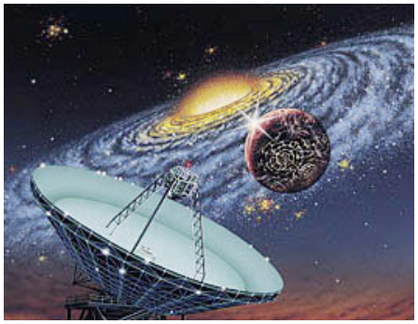
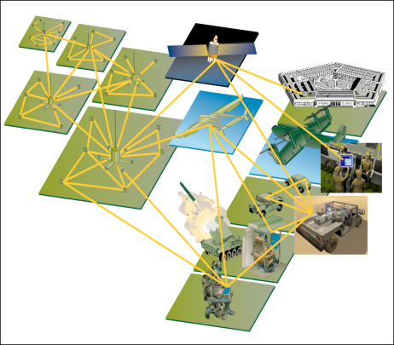
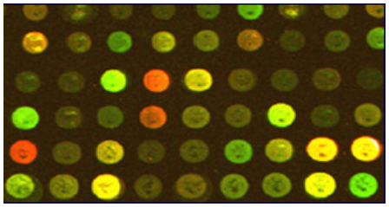

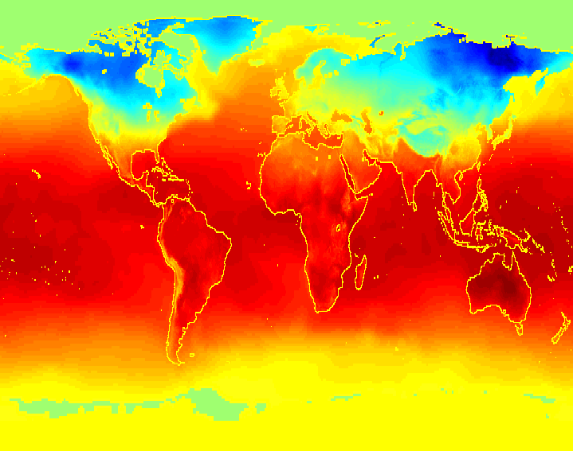
Why Mine Data? Scientific Viewpoint
Data collected and stored at
enormous speeds (GB/hour)
  remote sensors on a satellite
  telescopes scanning the skies
  microarrays generating gene
  expression data
  scientific simulations
  generating terabytes of data
Traditional techniques infeasible for raw data
Data mining may help scientists
  in classifying and segmenting data
  in Hypothesis Formation

Slide 7


What Is Data Mining?
Data mining (knowledge discovery in databases):
  Extraction of interesting (non-trivial, implicit, previously unknown and potentially useful) information or patterns from data in large databases
Alternative names and their “inside stories”:
  Data mining: a misnomer?
  Knowledge discovery(mining) in databases (KDD), knowledge extraction, data/pattern analysis, data archeology, business intelligence, etc.

Slide 8
Examples: What is (not) Data Mining?
What is not Data Mining?
  Look up phone number in phone directory
  Query a Web search engine for information about “Amazon”
What is Data Mining?
  Certain names are more prevalent in certain US locations (O’Brien, O’Rurke, O’Reilly… in Boston area)
  Group together similar documents returned by search engine according to their context (e.g. Amazon rainforest, Amazon.com,)

Slide 9
Data Mining: Classification Schemes
Decisions in data mining
  Kinds of databases to be mined
  Kinds of knowledge to be discovered
  Kinds of techniques utilized
  Kinds of applications adapted
Data mining tasks
  Descriptive data mining
  Predictive data mining

Slide 10
Decisions in Data Mining
Databases to be mined
  Relational, transactional, object-oriented, object-relational, active, spatial, time-series, text, multi-media, heterogeneous, legacy, WWW, etc.
Knowledge to be mined
  Characterization, discrimination, association, classification, clustering, trend, deviation and outlier analysis, etc.
  Multiple/integrated functions and mining at multiple levels
Techniques utilized
  Database-oriented, data warehouse (OLAP), machine learning, statistics, visualization, neural network, etc.
Applications adapted
  Retail, telecommunication, banking, fraud analysis, DNA mining, stock market analysis, Web mining, Weblog analysis, etc.

Slide 11
Data Mining Tasks
Prediction Tasks
  Use some variables to predict unknown or future values of other variables
Description Tasks
  Find human-interpretable patterns that describe the data.
Common data mining tasks
  Classification [Predictive]
  Clustering [Descriptive]
  Association Rule Discovery [Descriptive]
  Sequential Pattern Discovery [Descriptive]
  Regression [Predictive]
  Deviation Detection [Predictive]

Slide 12
Classification: Definition
Given a collection of records (training set )
  Each record contains a set of attributes, one of the attributes is the class.
Find a model for class attribute as a function of the values of other attributes.
Goal: previously unseen records should be assigned a class as accurately as possible.
  A test set is used to determine the accuracy of the model. Usually, the given data set is divided into training and test sets, with training set used to build the model and test set used to validate it.

Slide 13


Classification Example
categorical
categorical
continuous
class
Test
Set
Learn
Classifier
Training
Set
Model

Slide 14
Classification: Application 1
Direct Marketing
  Goal: Reduce cost of mailing by targeting a set of consumers likely to buy a new cell-phone product.
  Approach:
    Use the data for a similar product introduced before.
    We know which customers decided to buy and which decided otherwise. This {buy, don’t buy} decision forms the class attribute.
    Collect various demographic, lifestyle, and company-interaction related information about all such customers.
      Type of business, where they stay, how much they earn, etc.
    Use this information as input attributes to learn a classifier model.

Slide 15
Classification: Application 2
Fraud Detection
  Goal: Predict fraudulent cases in credit card transactions.
  Approach:
    Use credit card transactions and the information on its account-holder as attributes.
      When does a customer buy, what does he buy, how often he pays on time, etc
    Label past transactions as fraud or fair transactions. This forms the class attribute.
    Learn a model for the class of the transactions.
    Use this model to detect fraud by observing credit card transactions on an account.

Slide 16
Classification: Application 3
Customer Attrition/Churn:
  Goal: To predict whether a customer is likely to be lost to a competitor.
  Approach:
    Use detailed record of transactions with each of the past and present customers, to find attributes.
      How often the customer calls, where he calls, what time-of-the day he calls most, his financial status, marital status, etc.
    Label the customers as loyal or disloyal.
    Find a model for loyalty.

Slide 17
Classification: Application 4
Sky Survey Cataloging
  Goal: To predict class (star or galaxy) of sky objects, especially visually faint ones, based on the telescopic survey images (from Palomar Observatory).
      3000 images with 23,040 x 23,040 pixels per image.
  Approach:
    Segment the image.
    Measure image attributes (features) - 40 of them per object.
    Model the class based on these features.
    Success Story: Could find 16 new high red-shift quasars, some of the farthest objects that are difficult to find!

Slide 18



Classifying Galaxies
Early
Class:
Stages of Formation
Attributes:
Image features,
Characteristics of light waves received, etc.
Intermediate
Late
Data Size:
72 million stars, 20 million galaxies
Object Catalog: 9 GB
Image Database: 150 GB

Slide 19
Clustering Definition
Given a set of data points, each having a set of attributes, and a similarity measure among them, find clusters such that
  Data points in one cluster are more similar to one another.
  Data points in separate clusters are less similar to one another.
Similarity Measures:
  Euclidean Distance if attributes are continuous.
  Other Problem-specific Measures.

Slide 20
Illustrating Clustering
Euclidean Distance Based Clustering in 3-D space.
Intracluster distances
are minimized
Intercluster distances
are maximized

Slide 21
Clustering: Application 1
Market Segmentation:
  Goal: subdivide a market into distinct subsets of customers where any subset may conceivably be selected as a market target to be reached with a distinct marketing mix.
  Approach:
    Collect different attributes of customers based on their geographical and lifestyle related information.
    Find clusters of similar customers.
    Measure the clustering quality by observing buying patterns of customers in same cluster vs. those from different clusters.

Slide 22
Clustering: Application 2
Document Clustering:
  Goal: To find groups of documents that are similar to each other based on the important terms appearing in them.
  Approach: To identify frequently occurring terms in each document. Form a similarity measure based on the frequencies of different terms. Use it to cluster.
  Gain: Information Retrieval can utilize the clusters to relate a new document or search term to clustered documents.

Slide 23

Association Rule Discovery: Definition
Given a set of records each of which contain some number of items from a given collection;
  Produce dependency rules which will predict occurrence of an item based on occurrences of other items.
Rules Discovered:
{Milk} --> {Coke}
{Diaper, Milk} --> {Beer}

Slide 24
Association Rule Discovery: Application 1
Marketing and Sales Promotion:
  Let the rule discovered be
  {Bagels, … } --> {Potato Chips}
  Potato Chips as consequent => Can be used to determine what should be done to boost its sales.
  Bagels in the antecedent => Can be used to see which products would be affected if the store discontinues selling bagels.
  Bagels in antecedent and Potato chips in consequent => Can be used to see what products should be sold with Bagels to promote sale of Potato chips!

Slide 25
Association Rule Discovery: Application 2
Supermarket shelf management.
  Goal: To identify items that are bought together by sufficiently many customers.
  Approach: Process the point-of-sale data collected with barcode scanners to find dependencies among items.
  A classic rule --
    If a customer buys diaper and milk, then he is very likely to buy beer:

Slide 26
Regression
Predict a value of a given continuous valued variable based on the values of other variables, assuming a linear or nonlinear model of dependency.
Greatly studied in statistics, neural network fields.
Examples:
  Predicting sales amounts of new product based on advetising expenditure.
  Predicting wind velocities as a function of temperature, humidity, air pressure, etc.
  Time series prediction of stock market indices.

Slide 27





Deviation/Anomaly Detection
Detect significant deviations from normal behavior
Applications:
  Credit Card Fraud Detection
  Network Intrusion
  Detection

Slide 28
Data Mining and Induction Principle
Induction vs Deduction
Deductive reasoning is truth-preserving:
  All horses are mammals
  All mammals have lungs
  Therefore, all horses have lungs
Induction reasoning adds information:
  All horses observed so far have lungs.
  Therefore, all horses have lungs.

Slide 29
The Problems with Induction
From true facts, we may induce false models.
Prototypical example:
  European swans are all white.
  Induce: ”Swans are white” as a general rule.
  Discover Australia and black Swans...
  Problem: the set of examples is not random and representative
Another example: distinguish US tanks from Iraqi tanks
  Method: Database of pictures split in train set and test set; Classification model built on train set
  Result: Good predictive accuracy on test set;Bad score on independent pictures
  Why did it go wrong: other distinguishing features in the pictures (hangar versus desert)

Slide 30
Hypothesis-Based vs. Exploratory-Based
The hypothesis-based method:
  Formulate a hypothesis of interest.
  Design an experiment that will yield data to test this hypothesis.
  Accept or reject hypothesis depending on the outcome.
Exploratory-based method:
  Try to make sense of a bunch of data without an a priori hypothesis!
  The only prevention against false results is significance:
    ensure statistical significance (using train and test etc.)
    ensure domain significance (i.e., make sure that the results make sense to a domain expert)

Slide 31
Data Mining: A KDD Process
Knowledge
Pattern Evaluation
  Data mining: the core of knowledge discovery process.
Data Mining
Task-relevant Data
Data Selection
Data Preprocessing
Data Warehouse
Data Cleaning
Data Integration
Databases

Slide 32
Steps of a KDD Process
Learning the application domain:
  relevant prior knowledge and goals of application
Creating a target data set: data selection
Data cleaning and preprocessing: (may take 60% of effort!)
Data reduction and transformation:
  Find useful features, dimensionality/variable reduction, invariant representation.
Choosing functions of data mining
  summarization, classification, regression, association, clustering.
Choosing the mining algorithm(s)
Data mining: search for patterns of interest
Pattern evaluation and knowledge presentation
  visualization, transformation, removing redundant patterns, etc.
Use of discovered knowledge

Slide 33
Data Mining and Business Intelligence
Increasing potential
to support
business decisions
Making
Decisions
End User
Data Presentation
Business
Analyst
Visualization Techniques
Data Mining
Data
Analyst
Information Discovery
Data Exploration
Statistical Analysis, Querying and Reporting
Data Warehouses / Data Marts
OLAP, MDA
DBA
Data Sources
Paper, Files, Information Providers, Database Systems, OLTP

Slide 34
Data Mining: On What Kind of Data?
Relational databases
Data warehouses
Transactional databases
Advanced DB and information repositories
  Object-oriented and object-relational databases
  Spatial databases
  Time-series data and temporal data
  Text databases and multimedia databases
  Heterogeneous and legacy databases
  WWW

Slide 35
Data Mining: Confluence of Multiple Disciplines
Database
Technology
Statistics
Machine
Learning
Data Mining
Visualization
Information
Science
Other
Disciplines

Slide 36
Data Mining vs. Statistical Analysis
Statistical Analysis:
Ill-suited for Nominal and Structured Data Types
Completely data driven - incorporation of domain knowledge not possible
Interpretation of results is difficult and daunting
Requires expert user guidance
Data Mining:
Large Data sets
Efficiency of Algorithms is important
Scalability of Algorithms is important
Real World Data
Lots of Missing Values
Pre-existing data - not user generated
Data not static - prone to updates
Efficient methods for data retrieval available for use

Slide 37
Data Mining vs. DBMS
Example DBMS Reports
  Last months sales for each service type
  Sales per service grouped by customer sex or age bracket
  List of customers who lapsed their policy
Questions answered using Data Mining
  What characteristics do customers that lapse their policy have in common and how do they differ from customers who renew their policy?
  Which motor insurance policy holders would be potential customers for my House Content Insurance policy?

Slide 38
Data Mining and Data Warehousing
Data Warehouse: a centralized data repository which can be queried for business benefit.
Data Warehousing makes it possible to
  extract archived operational data
  overcome inconsistencies between different legacy data formats
  integrate data throughout an enterprise, regardless of location, format, or communication requirements
  incorporate additional or expert information
OLAP: On-line Analytical Processing
Multi-Dimensional Data Model (Data Cube)
Operations:
  Roll-up
  Drill-down
  Slice and dice
  Rotate

Slide 39
An OLAM Architecture
Mining query
Mining result
Layer4
User Interface
User GUI API
OLAM
Engine
OLAP
Engine
Layer3
OLAP/OLAM
Data Cube API
Layer2
MDDB
MDDB
Meta Data
Filtering&Integration
Database API
Filtering
Layer1
Data Repository
Data cleaning
Data
Warehouse
Databases
Data integration

Slide 40
DBMS, OLAP, and Data Mining
 | DBMS | OLAP | Data Mining
Task | Extraction of detailed and summary data | Summaries, trends and forecasts | Knowledge discovery of hidden patterns and insights
Type of result | Information | Analysis | Insight and Prediction
Method | Deduction (Ask the question, verify with data) | Multidimensional data modeling, Aggregation, Statistics | Induction (Build the model, apply it to new data, get the result)
Example question | Who purchased mutual funds in the last 3 years? | What is the average income of mutual fund buyers by region by year? | Who will buy a mutual fund in the next 6 months and why?

Slide 41
Example of DBMS, OLAP and Data Mining: Weather Data
DBMS:
Day | outlook | temperature | humidity | windy | play
1 | sunny | 85 | 85 | false | no
2 | sunny | 80 | 90 | true | no
3 | overcast | 83 | 86 | false | yes
4 | rainy | 70 | 96 | false | yes
5 | rainy | 68 | 80 | false | yes
6 | rainy | 65 | 70 | true | no
7 | overcast | 64 | 65 | true | yes
8 | sunny | 72 | 95 | false | no
9 | sunny | 69 | 70 | false | yes
10 | rainy | 75 | 80 | false | yes
11 | sunny | 75 | 70 | true | yes
12 | overcast | 72 | 90 | true | yes
13 | overcast | 81 | 75 | false | yes
14 | rainy | 71 | 91 | true | no

Slide 42
Example of DBMS, OLAP and Data Mining: Weather Data
By querying a DBMS containing the above table we may answer questions like:
What was the temperature in the sunny days? {85, 80, 72, 69, 75}
Which days the humidity was less than 75? {6, 7, 9, 11}
Which days the temperature was greater than 70? {1, 2, 3, 8, 10, 11, 12, 13, 14}
Which days the temperature was greater than 70 and the humidity was less than 75? The intersection of the above two: {11}

Slide 43
Example of DBMS, OLAP and Data Mining: Weather Data
OLAP:
Using OLAP we can create a Multidimensional Model of our data (Data Cube).
For example using the dimensions: time, outlook and play we can create the following model.
9 / 5 | sunny | rainy | overcast
Week 1 | 0 / 2 | 2 / 1 | 2 / 0
Week 2 | 2 / 1 | 1 / 1 | 2 / 0

Slide 44
Example of DBMS, OLAP and Data Mining: Weather Data
Data Mining:
Using the ID3 algorithm we can produce the following decision tree:
    outlook = sunny
      humidity = high: no
      humidity = normal: yes
    outlook = overcast: yes
    outlook = rainy
      windy = true: no
      windy = false: yes

Slide 45
Major Issues in Data Warehousing and Mining
Mining methodology and user interaction
  Mining different kinds of knowledge in databases
  Interactive mining of knowledge at multiple levels of abstraction
  Incorporation of background knowledge
  Data mining query languages and ad-hoc data mining
  Expression and visualization of data mining results
  Handling noise and incomplete data
  Pattern evaluation: the interestingness problem
Performance and scalability
  Efficiency and scalability of data mining algorithms
  Parallel, distributed and incremental mining methods

Slide 46
Major Issues in Data Warehousing and Mining
Issues relating to the diversity of data types
  Handling relational and complex types of data
  Mining information from heterogeneous databases and global information systems (WWW)
Issues related to applications and social impacts
  Application of discovered knowledge
    Domain-specific data mining tools
    Intelligent query answering
    Process control and decision making
  Integration of the discovered knowledge with existing knowledge: A knowledge fusion problem
  Protection of data security, integrity, and privacy

