Slide 1
DDoS Distributed denial of services attack

Slide 2
GROUP INTRODUCTION
Vũ Lê Duy
Nguyễn Bửu Thạch
Nguyễn Phúc Huy
MSSV: 20120278
MSSV: 20120576
MSSV: 21120469

Slide 3
TABLE OF CONTENTS
PREVENTION, DETECTION AND RECOVERY PROCESSES
INTRODUCTION OF DDOS
DDOS TYPES

Slide 4
WHAT IS DDOS
A distributed denial-of-service (DDoS) attack is a malicious attempt to disrupt the normal traffic of a targeted server, service or network by overwhelming the target or its surrounding infrastructure with a flood of Internet traffic
Think of DDoS as traffic jam, which preventing regular vehicles from getting to their destination

Slide 5
HOW DDOS ATTACK WORKS
Through the uses of compromised devices: computer, IOT devices like smartwatch,….. These can also be called bot (or botnet if there are plenty)
The attacker can direct an attack by sending remote instructions to each bot. These instruction varied between ways of attack
There are many types of attack. Some common types are:
Volumetric attacks
Protocol attacks
Application layer attacks (Layer 7 attacks)

Slide 6
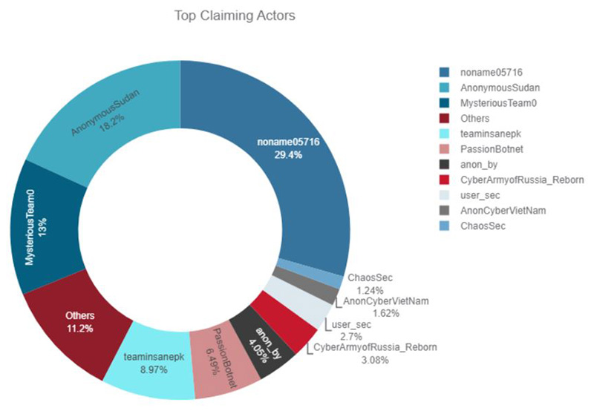
MOTIVE
Ideological and Social Causes: Hacktivists, activists, and individuals with strong convictions may launch DDoS attacks to disrupt operations, raise awareness, or silence opposing voices

Slide 7

MOTIVE
Malicious Competition: In the realm of business, DDoS attacks can be used by competitors to disrupt a rival's online presence and gain an unfair advantage
Financial Gain: DDoS attacks can be wielded as an extortion tool. Attackers may cripple an organization's online services and demand a ransom in exchange for restoring normalcy

Slide 8

MOTIVE
Personal Grudges and Vendetta: DDoS attacks can be fueled by personal vendettas or disgruntled individuals seeking revenge against an organization or individual
Purely Destructive Acts: In some cases, DDoS attacks might be motivated by a desire for chaos or disruption

Slide 9
Volumetric attack
Classic
Brute force
Layer 3 & 4
75% of DDoS attacks
Botnet – Machines infected with malware

Slide 10


Slide 11
DNS Reflection Floods
www.example.com
93.184.216.34
DNS servers are the “phonebooks” of the Internet.
Attacker floods a particular domain’s DNS servers to disrupt services.
Attacker sends many request to targeted DNS servers
The servers’ capacity are overwhelmed
Legitimate users can’t resolve website URL
Users can’t access website or service

Slide 12
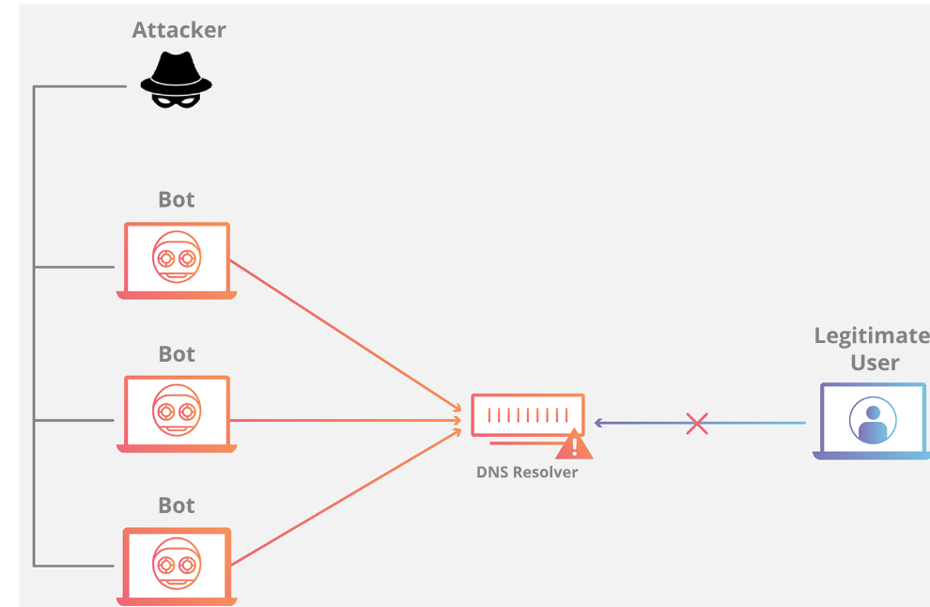

Slide 13
UDP floods
Attacker directs large amounts of UDP traffic to targeted system.
When a server receives a UDP packet at a port, it goes through two steps:
The server checks if any programs running are listening for requests at the port
If no programs are listening, the server responds with a ICMP packet to inform the sender that the destination was unreachable
This consumes server resources that should serve legitimate users.

Slide 14
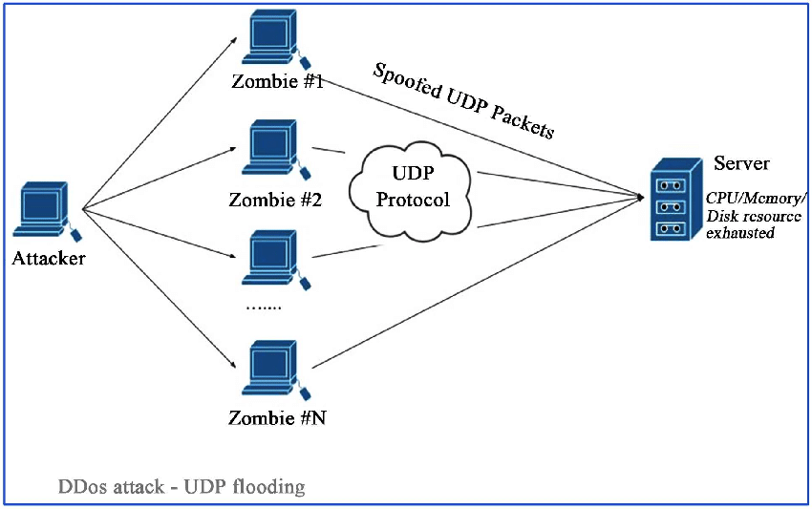

Slide 15
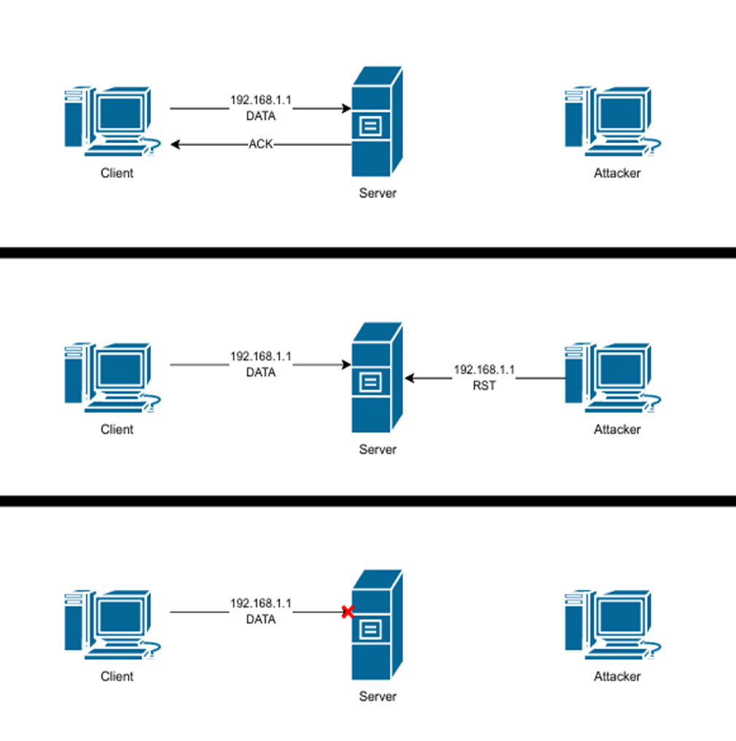
TCP Reset Attack
When a device needs to close a TCP connection unexpectedly, it sends a reset packet (RST) instructing the other computer to discard any additional packets it receives from the current connection.
Using spoofing methods, attackers make these reset packets appear to come from another machine, causing the target to terminate ongoing connections.

Slide 16
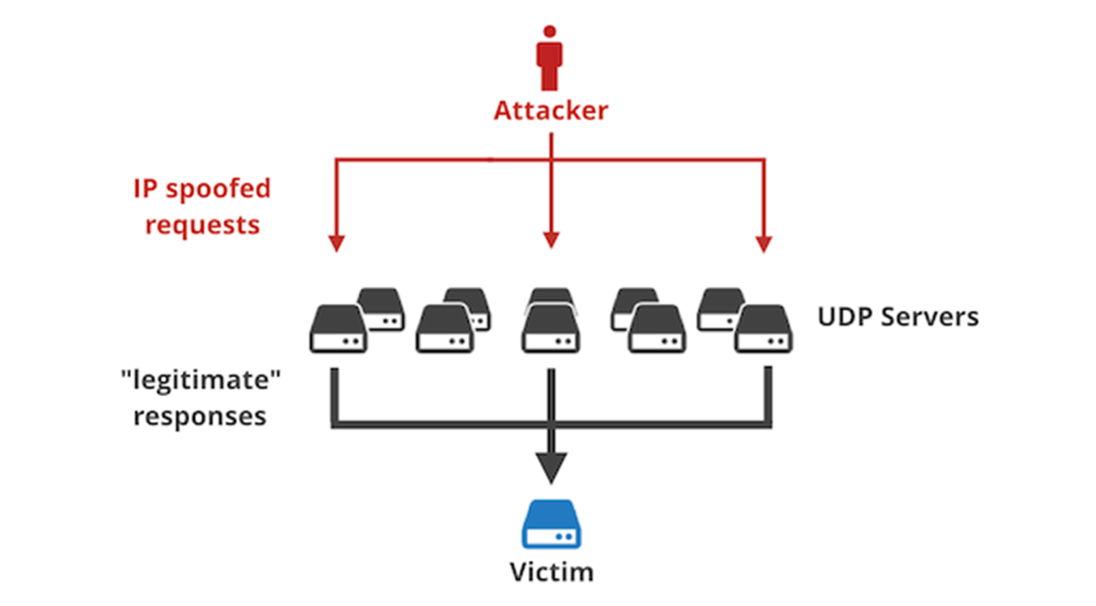
Reflection Amplification Attack
Attacker use a spoofed IP address to send queries to servers that send response that contain far more data than the request.
Because the attacker used the IP address of the target, the queried service responds to the target rather than the attacker’s machines.
In this way, attacker can use a small amount of effort and resources to mount a large volumetric attack.

Slide 17
Protocol Attack

Slide 18
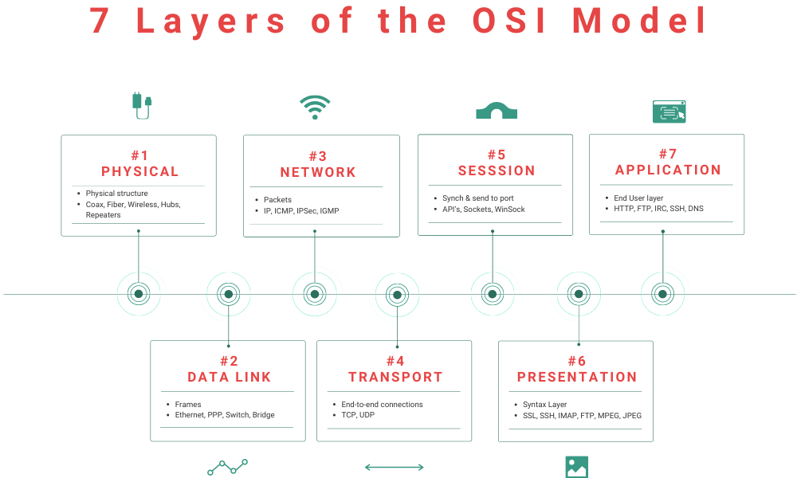
An introduction to Protocol Attack
Protocol attack take advantage of vulnerabilities in Layer 3 or Layer 4 of the OSI model, meaning they will use up memory, processor cores, or overload device resources or networks between systems. The system being targeted and the user at the other end.

Slide 19
Inner working of a Protocol Attack
The attacker sends a large number of packets or network requests to the target server via protocols such as HTTP, DNS, SIP, or TCP.
These requests may be forged or invalid, but the target server will have to process them as legitimate requests.
This processing consumes server resources, causing overload and making it unable to serve legitimate requests.
Finally, the target server is paralyzed, unable to provide services to users, leading to service interruption (Denial of Service - DoS).

Slide 20
Types of Protocol Attack
SYN Flood
Smurf DDoS
ICMP Flood
Attack that overloads the system by sending many SYN requests without completing the TCP connection.
Sends an ICMP Echo Request packet with a spoofed source address to the broadcast address, flooding the target system with responses.
Attack by sending a large number of ICMP ping requests, causing the target system to overload bandwidth and resources.

Slide 21
SYN Flood
Definition
A SYN flood (half-open attack) is a type of denial-of-service (DDoS) attack which aims to make a server unavailable to legitimate traffic by consuming all available server resources.
By repeatedly sending initial connection request (SYN) packets, the attacker is able to overwhelm all available ports on a targeted server machine, causing the targeted device to respond to legitimate traffic sluggishly or not at all.

Slide 22
Types of SYN Flood
Direct attack
Spoofed Attack
Distributed attack
In a SYN flood with no IP spoofing, the attacker uses their real IP. The attacker prevents responding to SYN-ACK packets, leaving connections half-open.
The attacker spoofs IP addresses on SYN packets to hide their identity.
Using a botnet. Each bot can also spoof IP addresses for further obfuscation.

Slide 23
Smurf DDoS
Definition
A Smurf attack is a distributed denial-of-service (DDoS) attack that exploits Internet Protocol (IP) broadcast addresses and spoofed source addresses to overload the targeted device or network with bogus traffic. It allows the attacker to amplify the amount of traffic generated, with the goal of overwhelming the target's network or device.

Slide 24
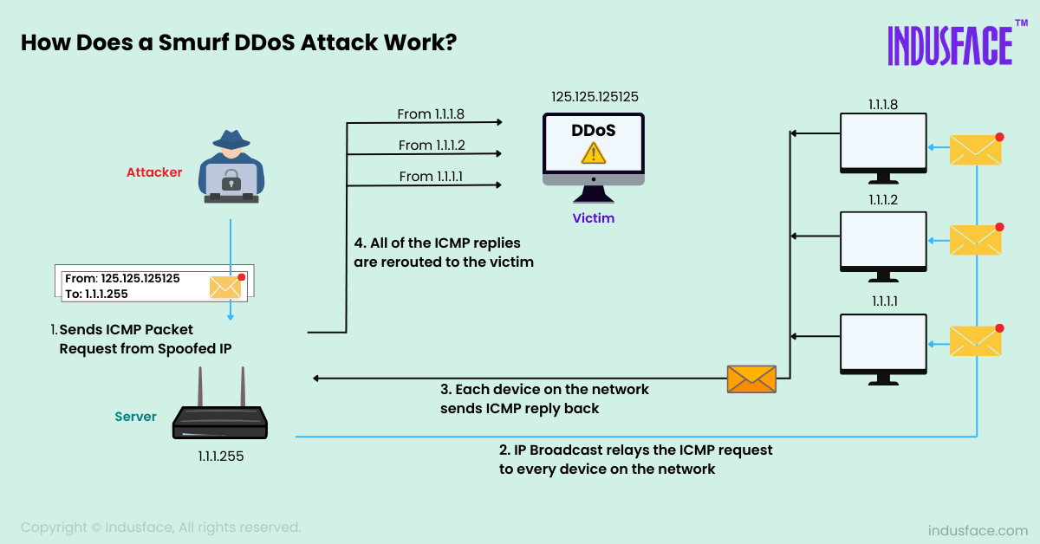
Smurf DDoS

Slide 25
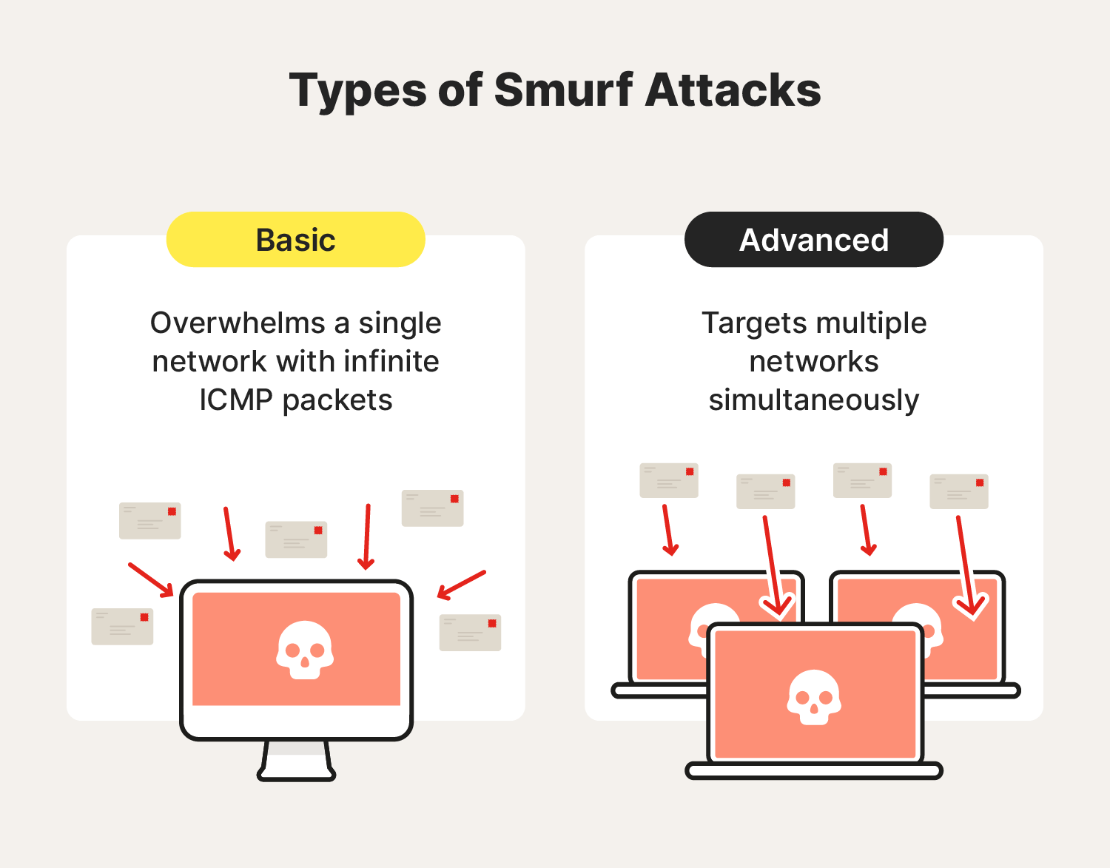

Slide 26
ICMP Flood
Definition
An ICMP flood is a denial-of-service attack in which an attacker attempts to overwhelm a targeted device with ICMP echo request packets, rendering the target inaccessible with normal traffic. When the attack traffic comes from multiple devices, the attack becomes a DDoS attack or a distributed denial-of-service attack.

Slide 27
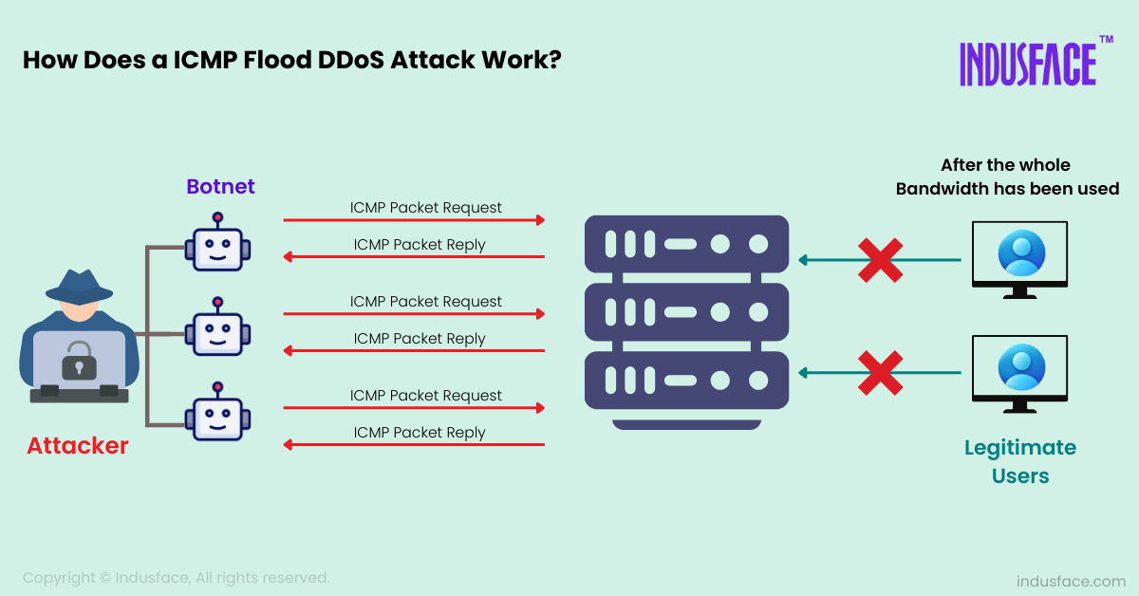
ICMP Flood

Slide 28
Types of ICMP Flood
Targeted local disclosed
Router disclosed
Blind ping
This ping flood attack targets a specific computer on a local network, using the specific IP address of the destination device..
This type of attack targets routers to disrupt communications between computers on a network. Attackers must have the internal IP address of the local router or switch.
This attack uses an external program to discover the IP address of a target computer router before launching the attack.

Slide 29
LAYER 7 ATTACK

Slide 30
An introduction to layer 7 attack
Definition
Also known as application layer attack
Target the top layer in the OSI model, including common
internet request such as HTTP GET and HTTP POST
Cost
Low compared to other type of DDoS

Slide 31
HTTP GET and POST attack
GET and POST function
GET is used to request data from a specified resource
POST is used to send data to a server to create/update a resource

Slide 32


HTTP Flood attack
GET can be seen as ordering a
cup of coffee
While POST is more akin to sending money to the bank for storage

Slide 33
HTTP Flood attack
HTTP GET attack
HTTP POST attack
Perform an attack by using multiple coordinated computers or other devices to send multiple requests for large images, files, or some other asset from a targeted server
Exploits the resource imbalance between server processing form submissions (resource-intensive) and client sending requests (low-resource). By overwhelming the server with POST requests, it becomes unable to respond, causing a denial-of-service

Slide 34
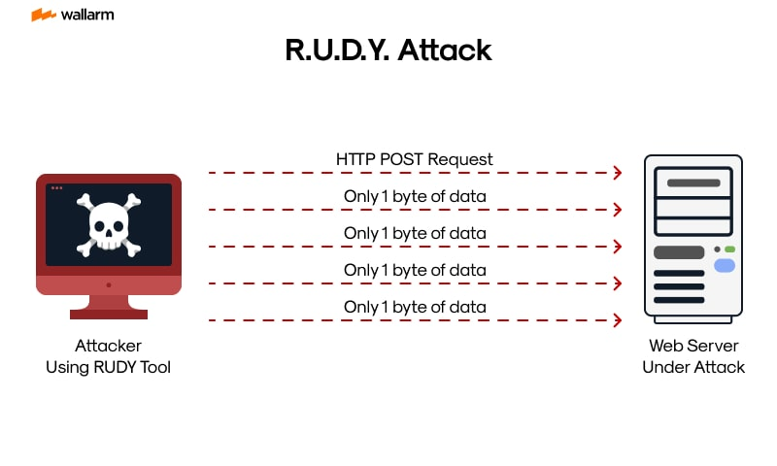
Low-and-Slow POST Attacks
Dispatches partial or dilatory HTTP form submissions making the attacked server, which expecting form completion, remains in an endless state of anticipation. This makes the server unresponsive to authentic requests

Slide 35
Fragmented HTTP Flood attack
Another type of low and slow attack
Botnets establish valid HTTP connections and can split the HTTP packets into tiny fragments which is sent as slowly as the server will allow

Slide 36

Single Session or Single Request Attack
Attempting to bypass DDoS defenses by exploiting a loophole in HTTP 1.1 to include many different requests within a single HTTP packet

Slide 37
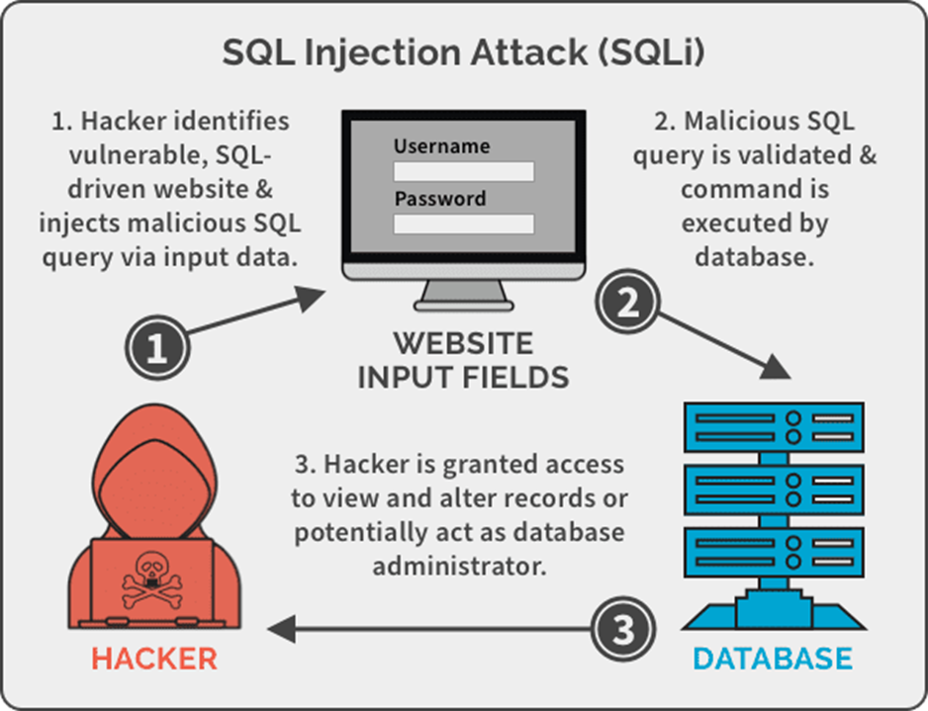
SQL Injection
While SQL injection isn’t a type of DDoS, it can be use as a mean to achieve DDoS through complex SQL queries which will consume the power of Web Server and the Database and Exhaust the Server resources

Slide 38
DDOS Prevention
Methods to prevent DDoS attacks

Slide 39


IP REPUTATION SYSTEM
IP addresses are assigned reputation value based on their past behaviors.
Clients with IP address with low reputation might have their requests less prioritized, throttled, or blocked completely (Blacklist).
248.184.115.228
30.2.149.125

Slide 40

Attack surface reduction
Limiting attack surface exposure can help minimize the effect of a DDoS attack
Restricting traffic to specific locations
Implementing a load balancer
Blocking communication from unused ports
Blocking outdated protocols and applications

Slide 41

Caching
A cache stores copies of requested content so that fewer requests are serviced by origin servers.
Using a content delivery network to cache resources can reduce the strain on an organization’s servers and make it more difficult for them to become overloaded by both legitimate and malicious requests.

Slide 42

Rate Limiting
Rate limiting restricts the volume of network traffic over a specific time period, preventing web servers from getting overwhelmed by requests from specific IP addresses.
Rate limiting can be used to prevent DDoS attacks that use botnets to spam an endpoint with an abnormal amount of requests at once.

Slide 43

Client Puzzle Protocol
Require all clients connecting to a server to correctly solve a mathematical puzzle before establishing a connection, if the server is under attack.
After solving the puzzle, the client would return the solution to the server, which the server would quickly verify, or reject and drop the connection.

Slide 44
Detection Signs and Ways to detect an ongoing DDoS attack

Slide 45
An IP address sends an unusually large number of requests in a short period of time.
The server responded with error 503 unavailable due to service outage.
Signs
Traffic source address repeatedly queries the same data beyond its TTL.
Network performance is unusually slow.
Strange traffic patterns appear, such as spikes at odd hours of the day or unusual traffic patterns.

Slide 46
Common techniques for detecting DDoS

Slide 47

Stream-based analytics
Stream-based Analytics is a technique for monitoring network traffic flows in real time, allowing systems to check for unusual changes or trends in traffic that may indicate an attack. This method focuses on factors such as volume, frequency and traffic type to identify abnormalities.

Slide 48


Packet-based analysis
Packet-based Analysis is a method of detailed analysis of individual data packets in a network traffic stream to identify patterns and abnormalities. The goal is to detect unusual characteristics in individual packets that may indicate a DDoS attack is in progress.
This method focuses on factors such as packet size, packet header, packet type, and other attributes to determine whether a packet is part of attack traffic or not.

Slide 49


Behavioral analysis
Behavioral Analysis is a method of monitoring and analyzing how network traffic changes over time, allowing the detection of anomalies based on traffic behavior. Instead of focusing solely on volume or frequency, this method focuses on how traffic occurs, thereby identifying unusual activity patterns that could be a sign of a DDoS attack.

Slide 50


Abnormal detection
Anomaly Detection is a method that uses machine learning algorithms to analyze and identify normal network traffic patterns, thereby identifying deviations from normal levels.
This method can "learn" and adapt to continuous changes in traffic, helping it detect new attacks that pattern-based methods may miss.

Slide 51


Cloud-based detection
Cloud-based Detection uses cloud computing services and technologies to reliably detect and mitigate DDoS attacks.
This approach often includes services such as DDoS protection from the cloud service provider, cloud security services, and specialized anti-DDoS platforms to ensure the network is fully protected.

Slide 52
Intrusion prevention system and intrusion detection system (IPS/IDS)
IDS monitors network traffic and alerts administrators to any unusual or suspicious activity.
IPS provides automatic response to prevent intruders and protect the system from hijacking or stolen data.
SolarWinds Security Event Manager, ManageEngine EventLog Analyzer, ManageEngine Log360, ESET Protect, Snort and OSSEC are some of the popular IDS/IPS software available in the market.

Slide 53
RECOVERY PROCESSES

Slide 54
GOAL
Restore operations
Minimize losses
Fix vulnerabilities quickly and thoroughly
Strengthen security to avoid future incidents

Slide 55
INCIDENT RECOVERY PLAN
The initial preparation stage
Threats, attacks, and malicious actors are identified in the second stage
Threat containment and control comprise the third stage
Cyberattacks and threats are eradicated in the fourth stage
The recovery phase of incident response occurs in the fifth stage
The sixth stage, used for follow-up and review, marks the end of the process
Optional stage

Slide 56
1ST STAGE
Identifying the affected assets and ensuring resources are in order: Communications systems, Data storage systems, Additional hardware and software, Internal security policies
Establish specific user roles and a hierarchy to hasten the recovery processes:
Incident response manager or coordinator
Incident response handlers and analysts
Human resources personnel
Public relations staff

Slide 57
2nd STAGE
Network scans, probes, and attempted break-ins
Improper system usage
Unauthorized user access
Denial-of-service attacks
Malicious software or code injection
Infrastructure or network investigations and inspections

Slide 58
3rd STAGE
Isolates the threat and mitigates any further damage
Solution:
To disconnect the affected machine or system from network.
Shut down entire system, including all servers, workstations, and network devices
Keep entire system operating throughout the entire incident recovery process. This approach is typically reserved for cases where sensitive data has not been compromised or when a cyberattack is not considered serious
This phase can be used to collect any evidence that may be pertinent to the security incident

Slide 59
4th STAGE
In most cases, the eradication phase follows a clear protocol:
Uninstalling or deleting the affected data or software
Running antivirus and antimalware scanners to confirm eradication
Rebooting or reinstalling the primary operating system (reserved for extreme cases)
Patching outdated systems
Restoring, recreating, or replacing any missing data
Notifying affected consumers or personnel

Slide 60
5th STAGE
- Testing out cyberdefense, some of the most popular include:
Network penetration testing
Vulnerability assessment
Simulated attacks and controlled hacks
Tabletop exercises and scenarios

Slide 61
FINAL STAGE
review as much pertinent information as possible during this step
interview any affected staff and, if possible, affected consumers

Slide 62
OPTIONAL STEPS
Threat Analysis and Investigation: (use in conjunction with step 6)
Information concerning the threat’s origin
Its usage in other security incidents
Whether there’s a chance for a secondary attack
Employee Onboarding and Training
Creating Customized Plan

