Slide 1
Chapter 1 Introduction to design thinking
Assoc. Prof. Dr. Thacha Lawanna

Slide 2
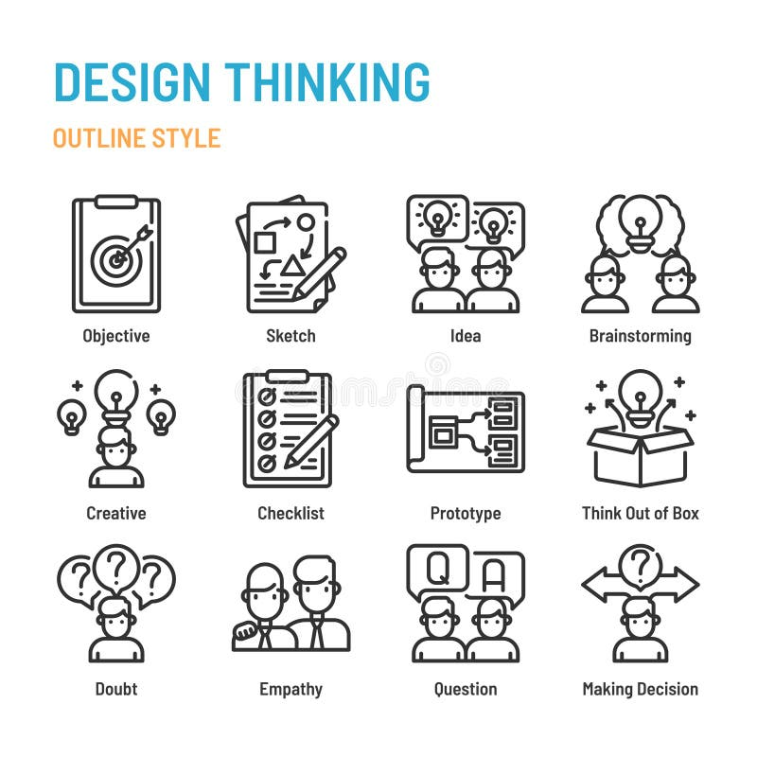
Objective of the Study:
To examine how emerging AI technologies reshape innovation processes across industries, focusing on the mechanisms through which AI enhances creativity, accelerates problem-solving, and enables new forms of value creation in future digital ecosystems.

Slide 3
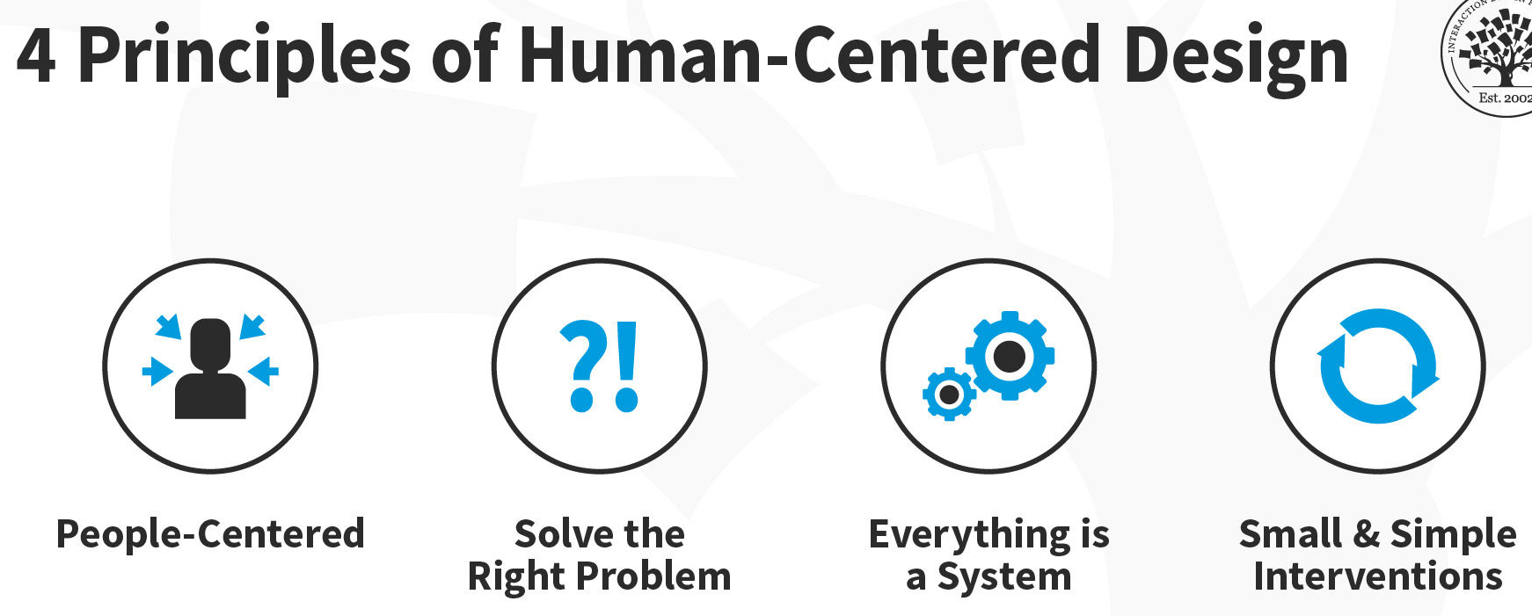
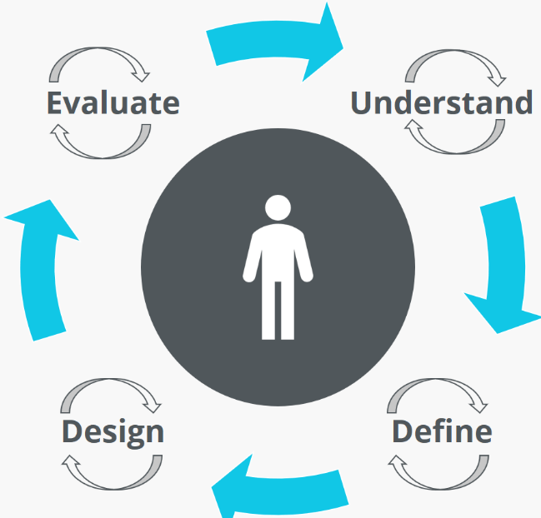
1. Human-Centered Design
Focuses on understanding users’ needs, emotions, and behaviors. This approach places people at the center of the design process, ensuring solutions are meaningful and relevant. Designers observe users in real contexts, gather insights, and use them to develop products or services that truly address their real problems.
Human-centered design (HCD) is a problem-solving approach that prioritizes the needs of real people throughout the design process to create solutions that are effective and tailored to users.

Slide 4
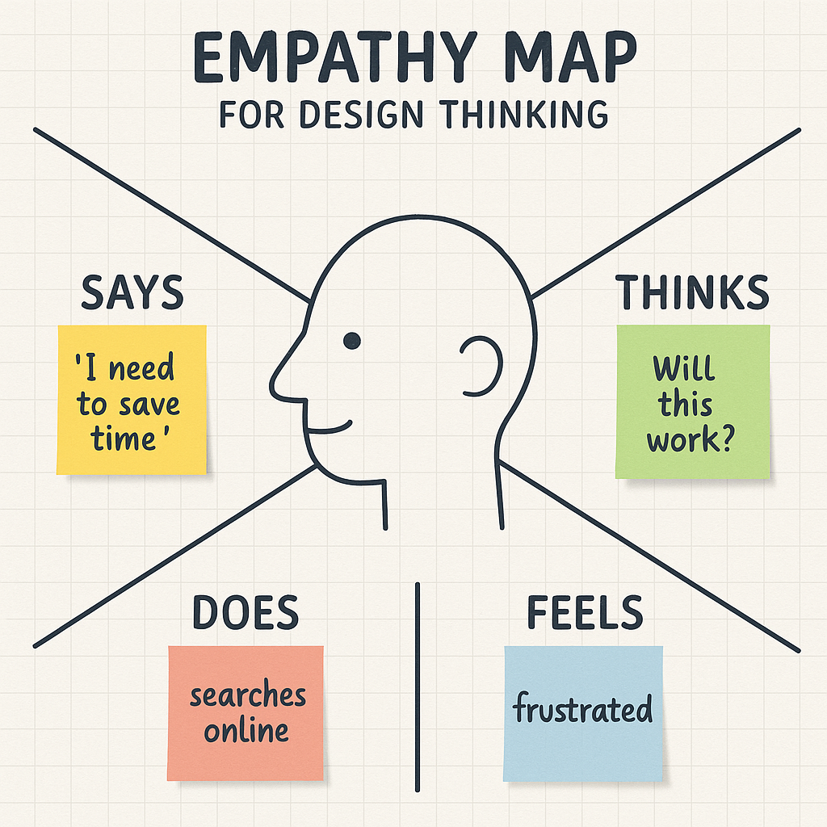
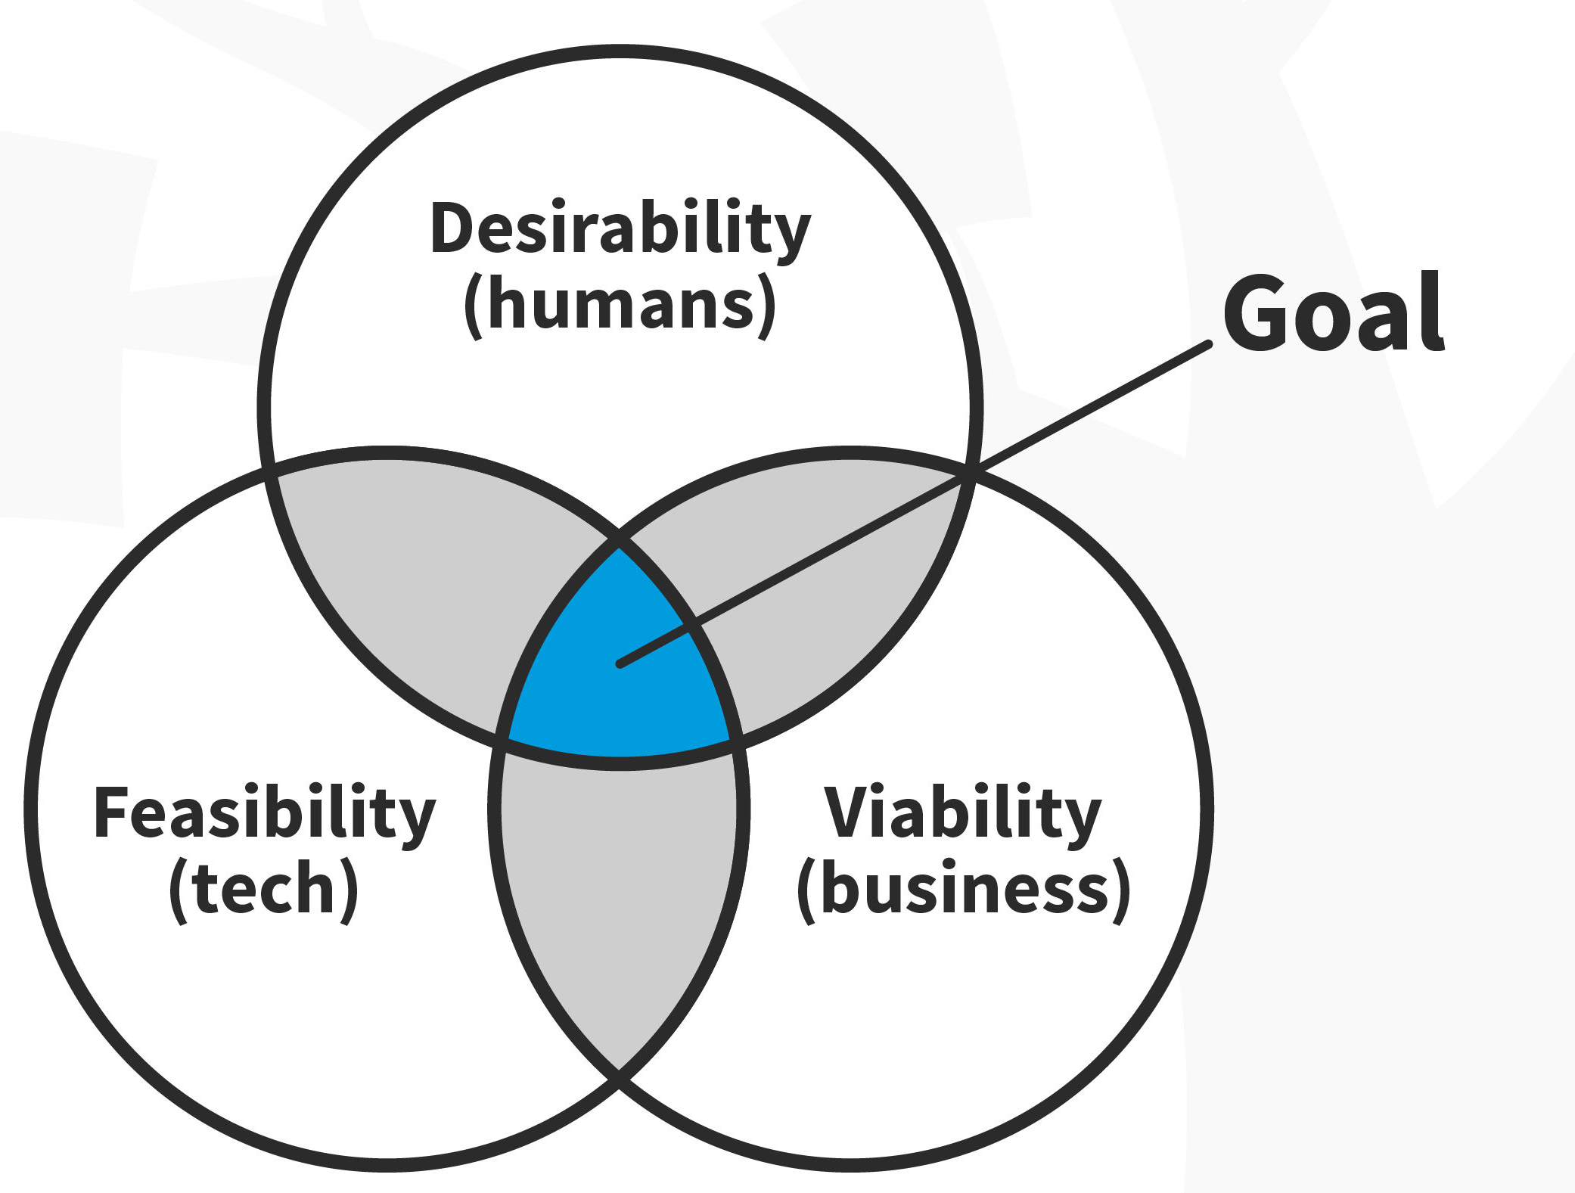
2. Empathy in Design
Empathy involves deeply understanding users by observing, interviewing, and engaging with them. It helps uncover hidden needs and motivations, enabling designers to create solutions that resonate. Empathy leads to more inclusive and effective innovations by prioritizing the user’s perspective throughout the design process.
Empathy is the first and most crucial step in the design thinking process, focusing on understanding users' feelings, needs, and perspectives.

Slide 5
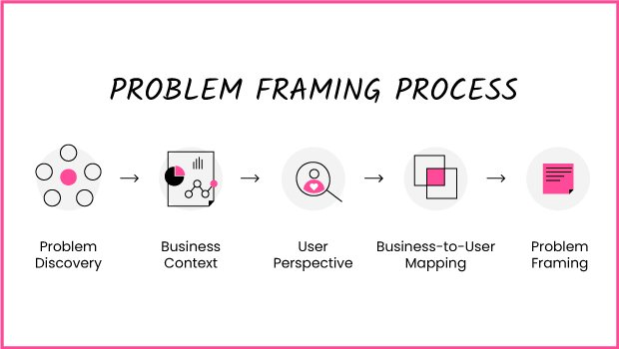
3. Problem Framing
Problem framing defines the design challenge clearly and correctly. Instead of focusing on symptoms, designers analyze root causes and perspectives to articulate an actionable and meaningful problem statement. Proper framing ensures the team works on the right issue and avoids solving the wrong problem.
Problem framing is a collaborative process used to clearly define a problem before seeking solutions, ensuring a team addresses the root cause instead of symptoms.

Slide 6
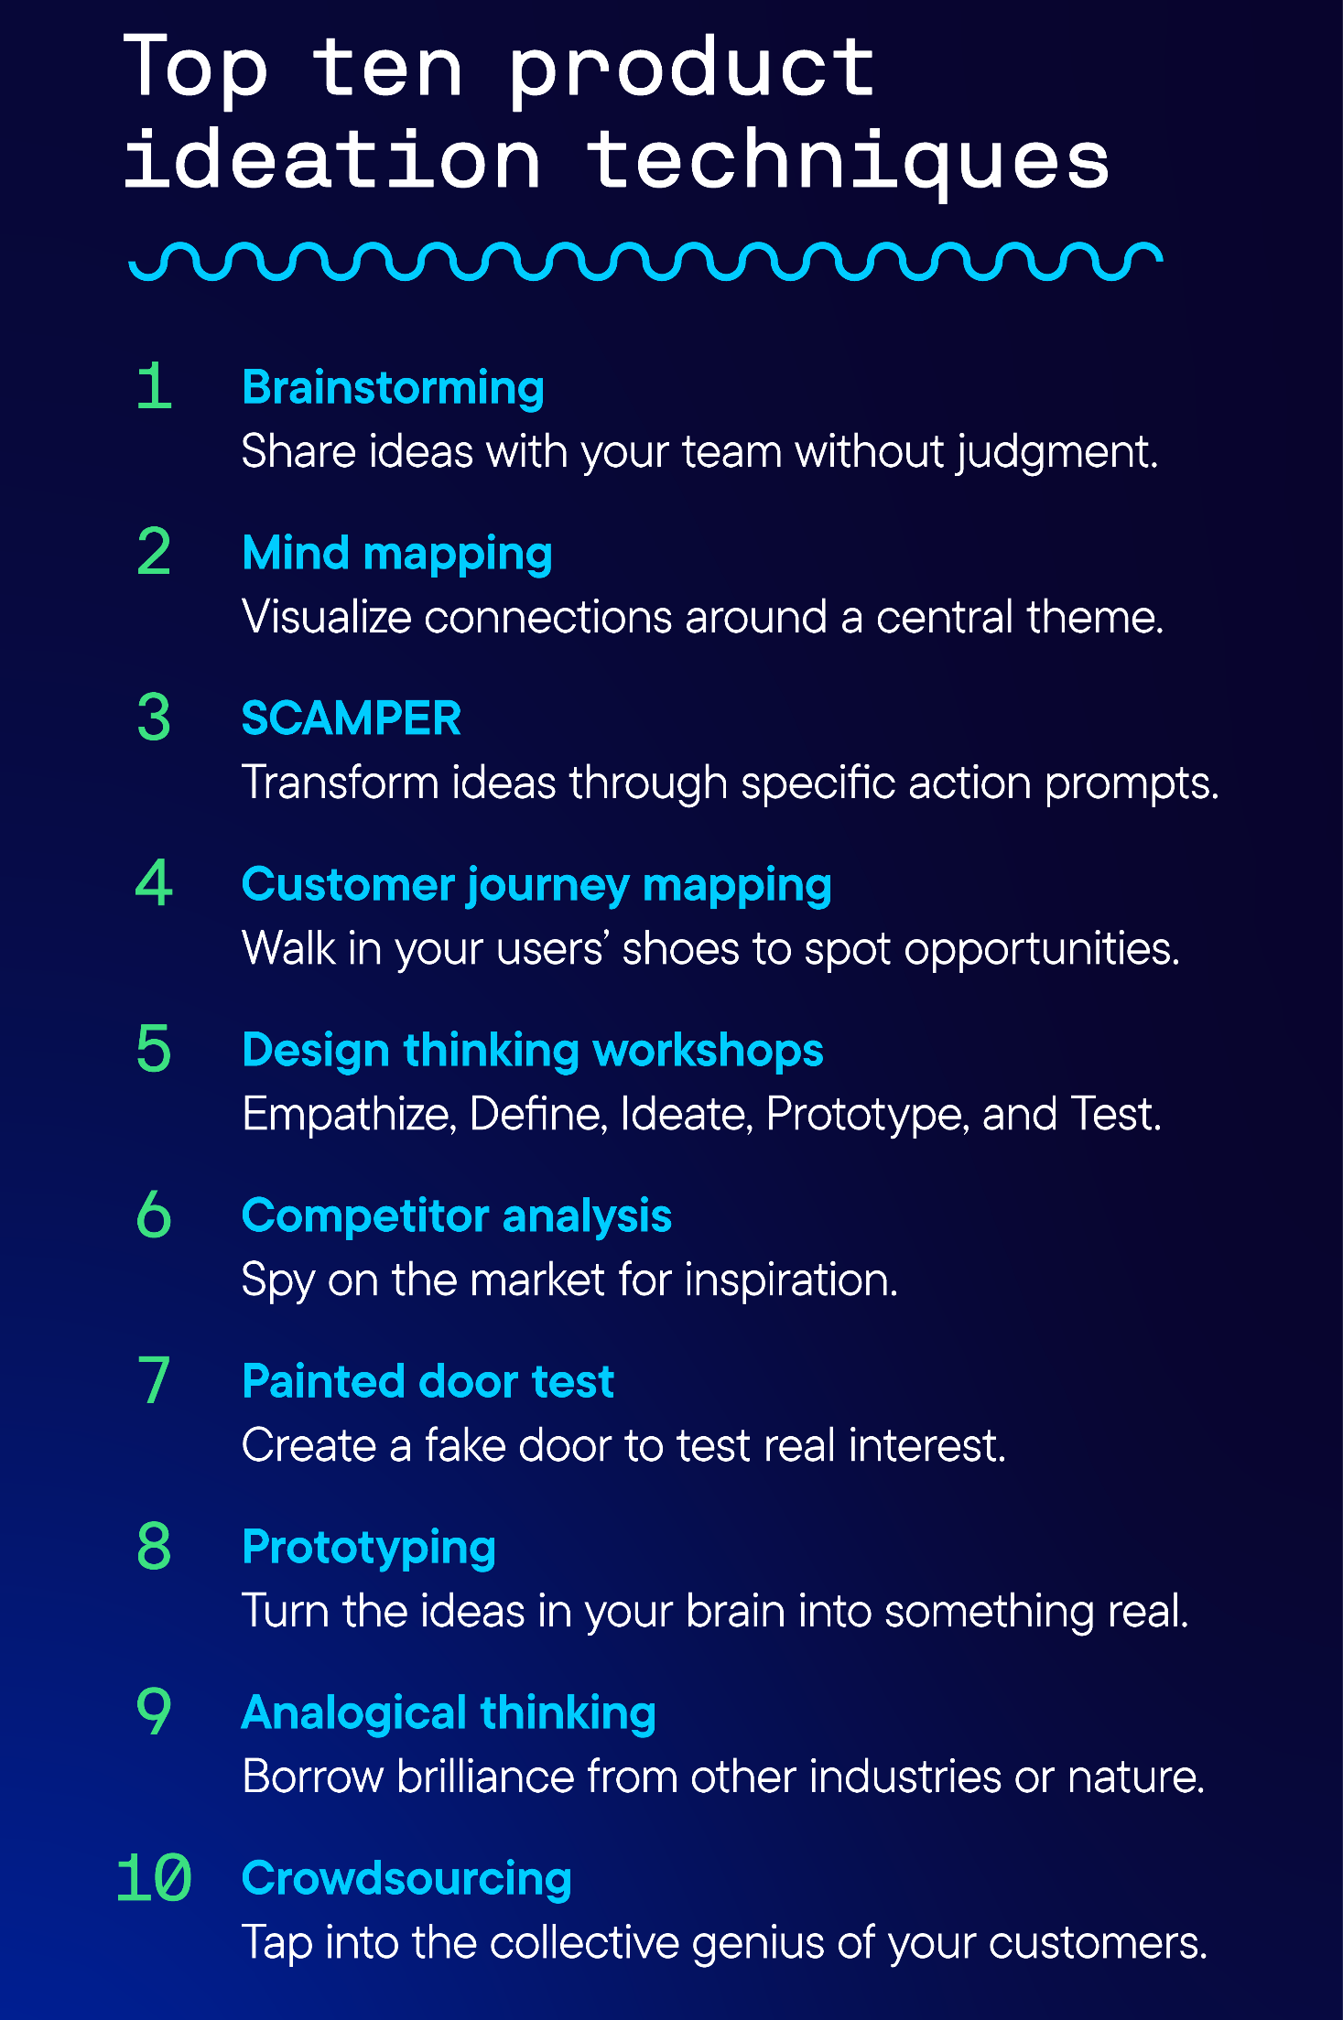
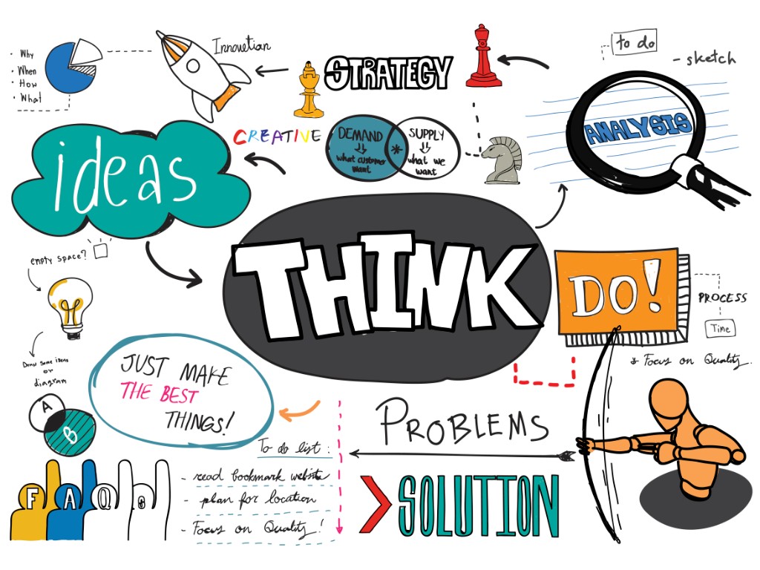
4. Ideation Techniques
Ideation generates a wide range of creative ideas without judgment. Techniques like brainstorming, mind mapping, and SCAMPER encourage divergent thinking. The goal is quantity over quality at this stage, allowing teams to explore unexpected possibilities before evaluating and narrowing down the most feasible ideas.
Ideation techniques are methods for generating new ideas, such as brainstorming, mind mapping, and Crazy 8s, which involve rapidly sketching ideas on a divided paper.

Slide 7
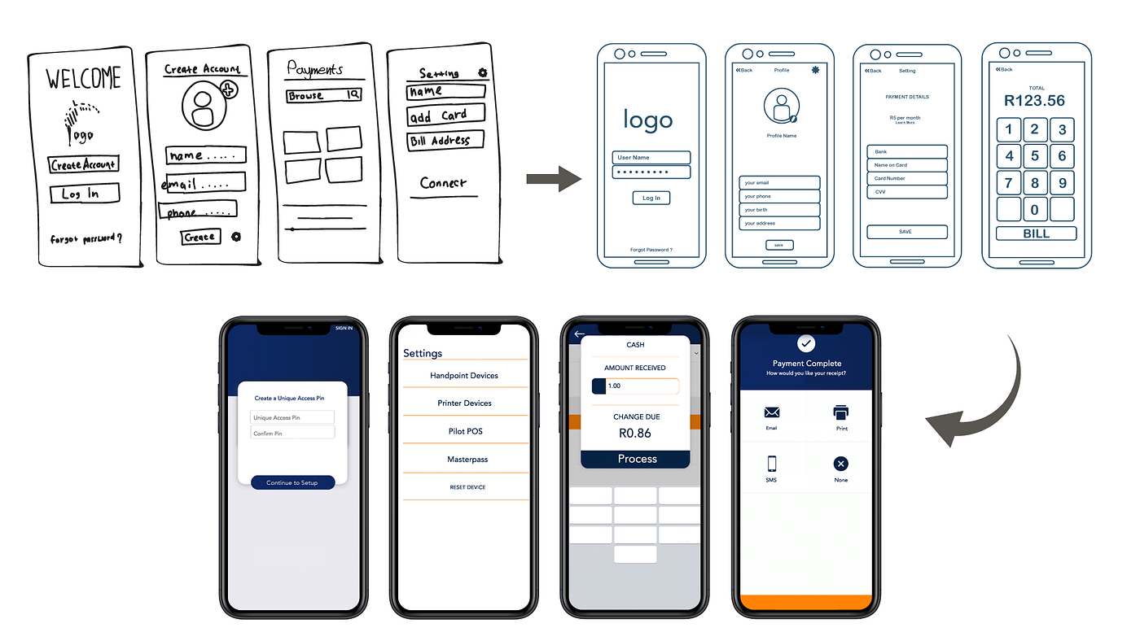
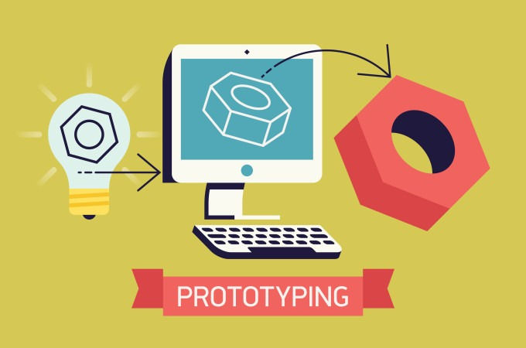
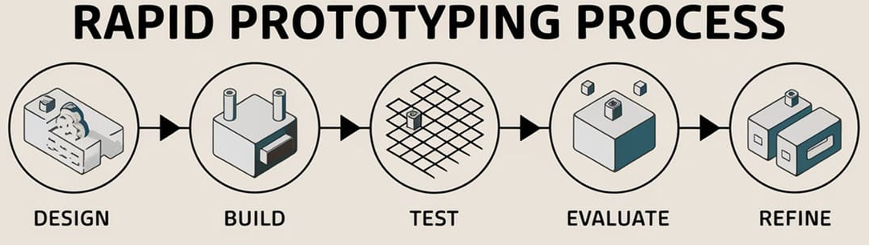
5. Prototyping
Prototyping creates simple, quick versions of ideas to test assumptions and gather feedback. Prototypes may be sketches, models, storyboards, or digital mock-ups. This stage helps visualize concepts, identify design flaws early, and reduce risk by iterating before committing to full development.
Prototyping is the process of creating a preliminary model or draft of a product to test and refine its design before building the final version.

Slide 8
Design tour program (one day trip) in Chiang Mai for me?
15 mins

Slide 9
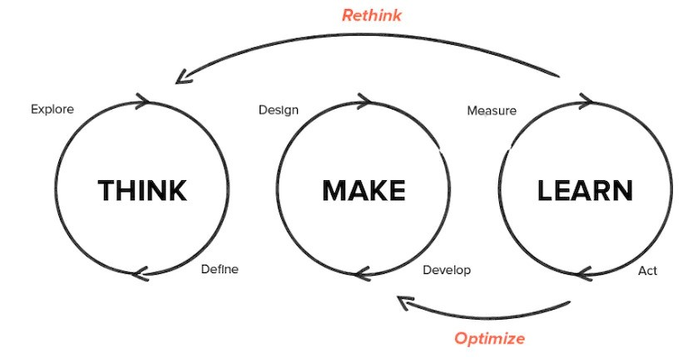
6. Rapid Experimentation
Rapid experimentation tests ideas quickly to learn what works. Designers implement fast, low-cost experiments to validate concepts with users. This process reduces uncertainty and promotes continuous improvement. It encourages a learning mindset, where failures are valuable data for refining solutions.
Rapid experimentation is an agile approach to product development that involves quickly testing hypotheses and assumptions through frequent, small-scale experiments to gather data and inform decisions.

Slide 10
Rapid Experimentation>> give the process of testing the ideas for producing mobile apps (delivery system)
>>diagram
Rapid Experimentation>> give testing the ideas that customers like to buy your product
Rapid Experimentation>> give testing the ideas that customers do not to buy your product

Slide 11
Rapid Experimentation>> give the process of testing the ideas for producing mobile apps (delivery system)
>>diagram
Step 1. Brain storm >>> all smart phone work >>solutions =37
Step 2. Select the appropriate solutions (2-3)
Step 3. Take action
Step 4. Evaluation

Slide 12

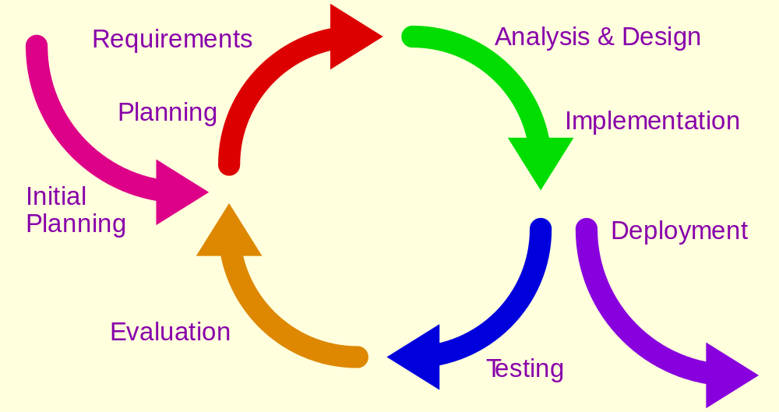
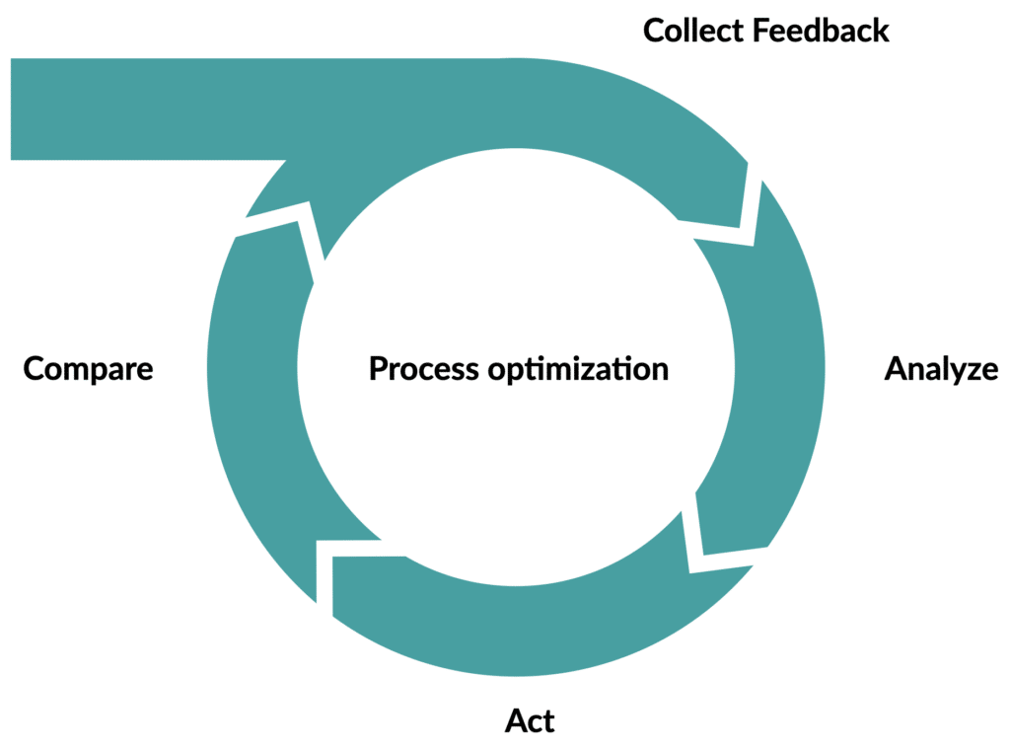
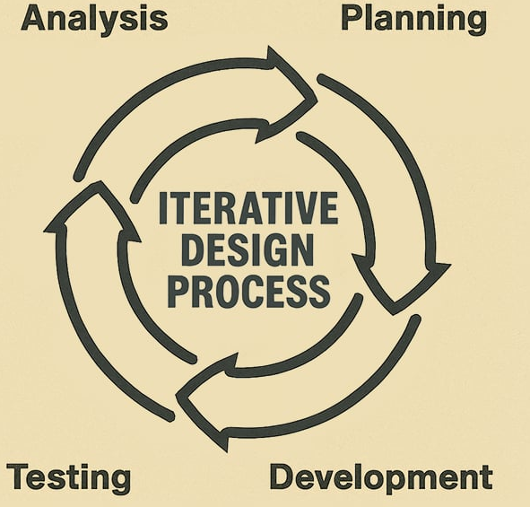
7. Feedback and Iteration
Feedback from real users guides improvement of the proposed solution. Iteration involves refining designs based on responses, observations, and new insights. Repeated cycles of testing and revising help ensure the final outcome meets user needs and achieves practical effectiveness.
Feedback and iteration is a continuous cycle of receiving, evaluating, and implementing user or stakeholder input to improve a product, service, or idea.

Slide 13
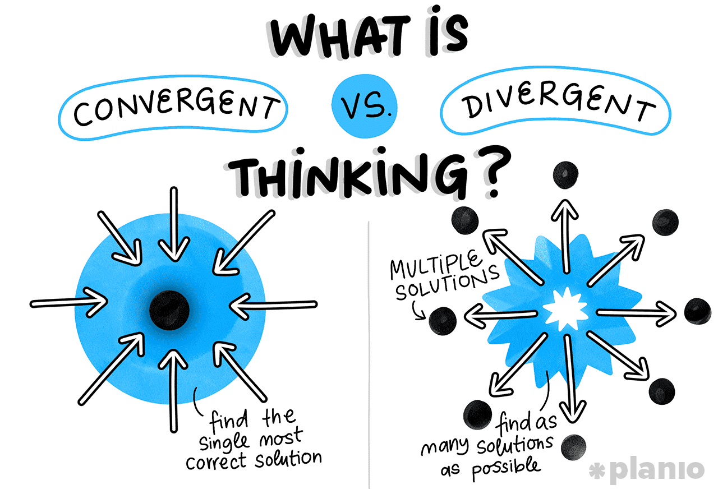
8. Divergent and Convergent Thinking
Divergent thinking expands possibilities by generating many ideas, while convergent thinking narrows them to select the best. Both modes complement each other in Design Thinking. Effective teams switch between these modes to balance creativity with practicality throughout the design process.
Divergent and convergent thinking are complementary cognitive processes used for problem-solving.

Slide 14
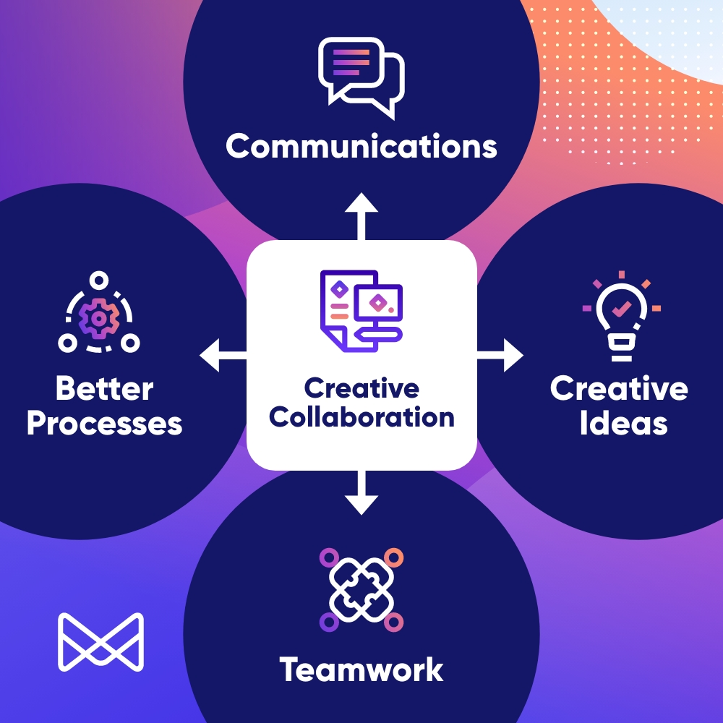
9. Collaborative Creativity
Design Thinking encourages teamwork and interdisciplinary collaboration. Diverse backgrounds contribute varied perspectives and skills, making solutions richer and more innovative. Collaboration ensures ideas are challenged, improved, and strengthened through discussion, shared understanding, and collective problem-solving.
Collaborative creativity is the process where two or more individuals work together to generate new and valuable ideas. I

Slide 15
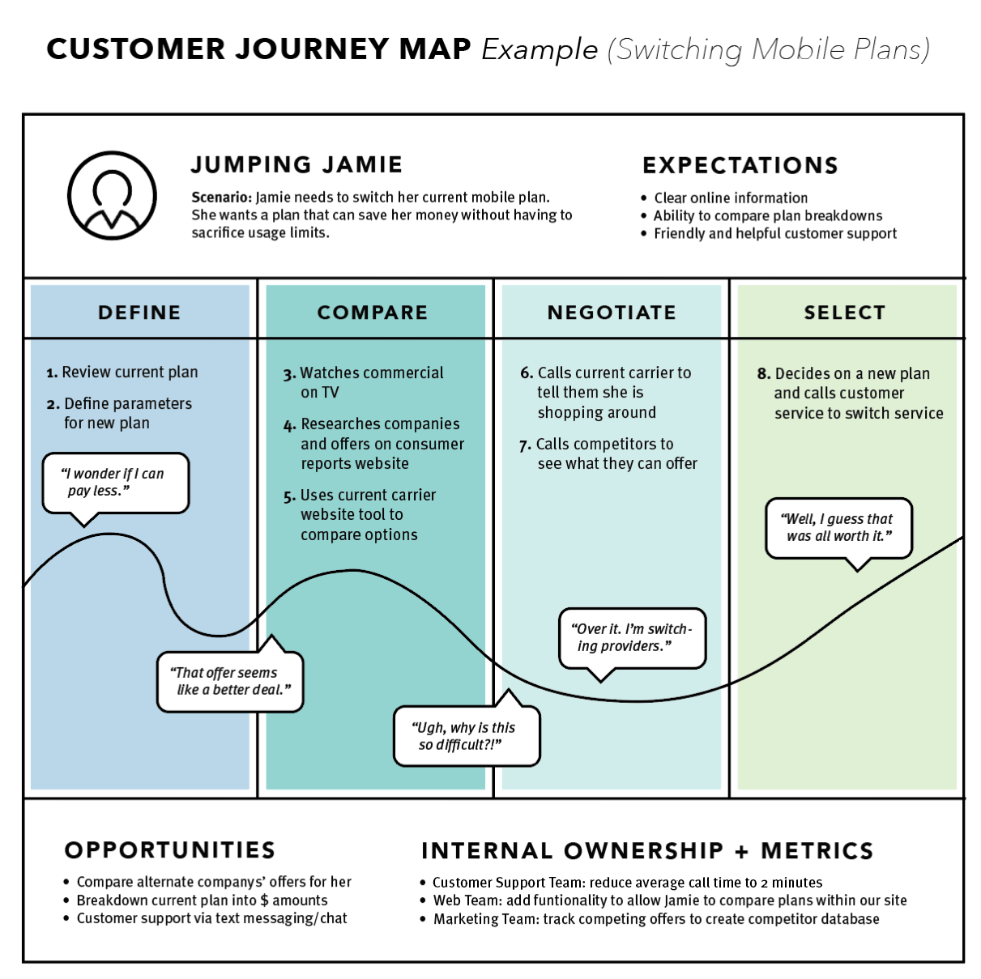
10. User Journey Mapping
A journey map visualizes users’ interactions, emotions, and pain points across their experience with a product or service. It helps identify challenges, opportunities, and moments that matter. Mapping reveals gaps and guides designers toward targeted, user-centered improvements.
A user journey map is a visual diagram that illustrates the steps a user takes to achieve a goal while interacting with a product or service.

Slide 16
Journey Mapping>>> you and your team are going to meet me at CU (Bangkok) tomorrow 18.00 pm.

Slide 17
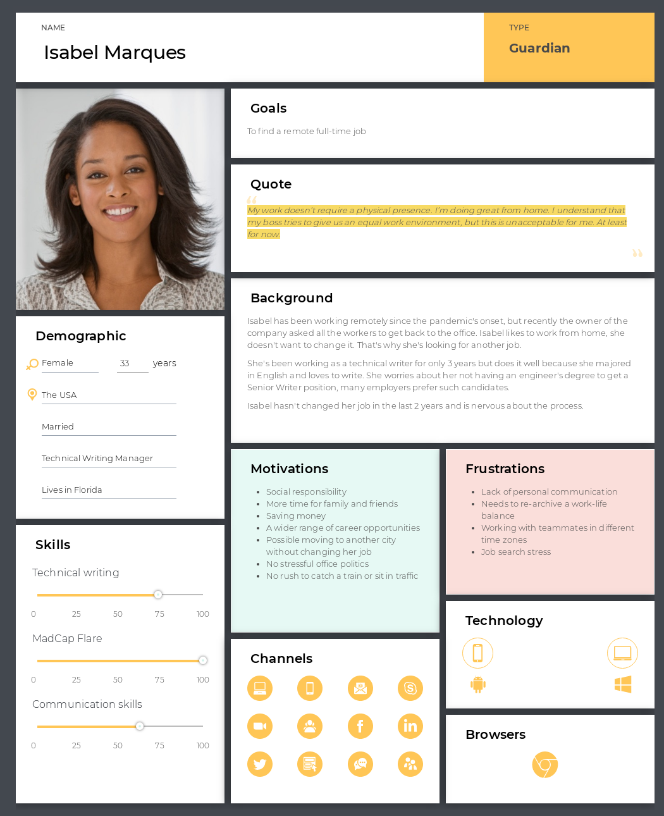
11. Persona Development
Personas represent fictional users based on real data. They capture user traits, goals, needs, and frustrations. Personas help designers remain focused on target users and ensure solutions are tailored to the right audience throughout the design process.
Persona development is the process of creating detailed, fictional representations of your target audience based on user research.

Slide 18
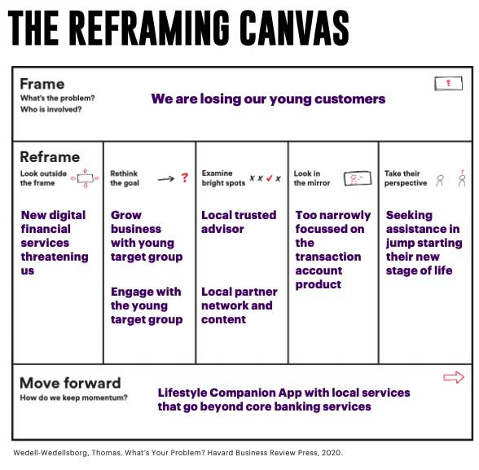
12. Problem Reframing
Reframing encourages looking at the problem from different angles to generate new insights. It challenges assumptions, reveals hidden opportunities, and encourages more innovative solutions. Reframing often turns a difficult issue into a more solvable or meaningful design challenge.
Problem reframing is a technique of looking at a problem from a different perspective to find innovative solutions that were not initially apparent.

Slide 19
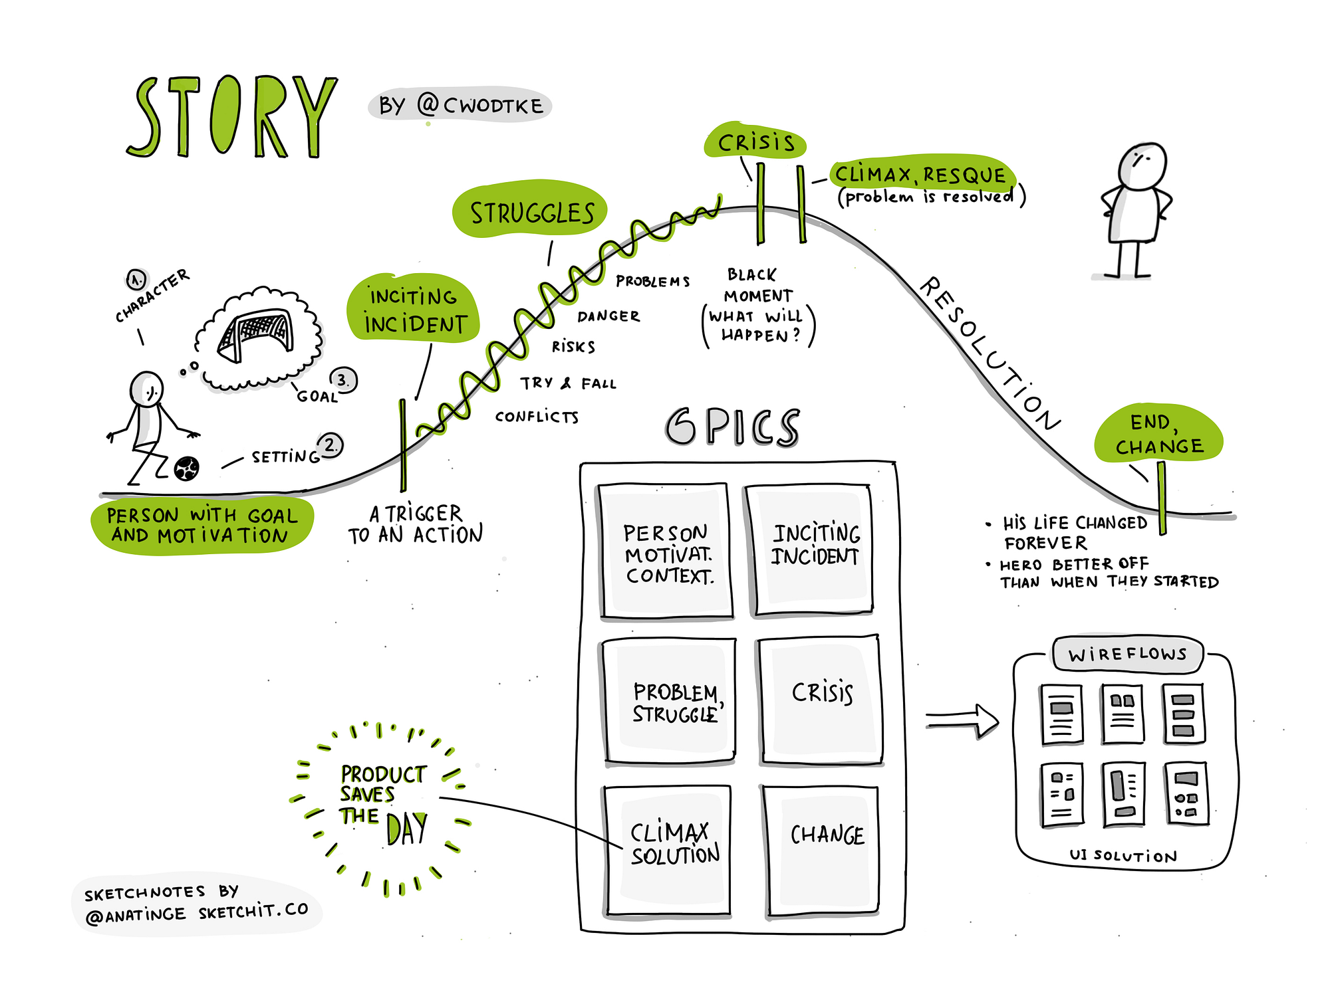
13. Storytelling in Design
Storytelling communicates ideas clearly and emotionally. Designers use narratives to explain user problems, illustrate journeys, and present solutions. Storytelling makes insights relatable, helps teams stay aligned, and persuades stakeholders of the value behind design decisions.
Storytelling in design is the use of narrative elements to create an emotional connection and convey meaning through a brand, product, or experience.

Slide 20
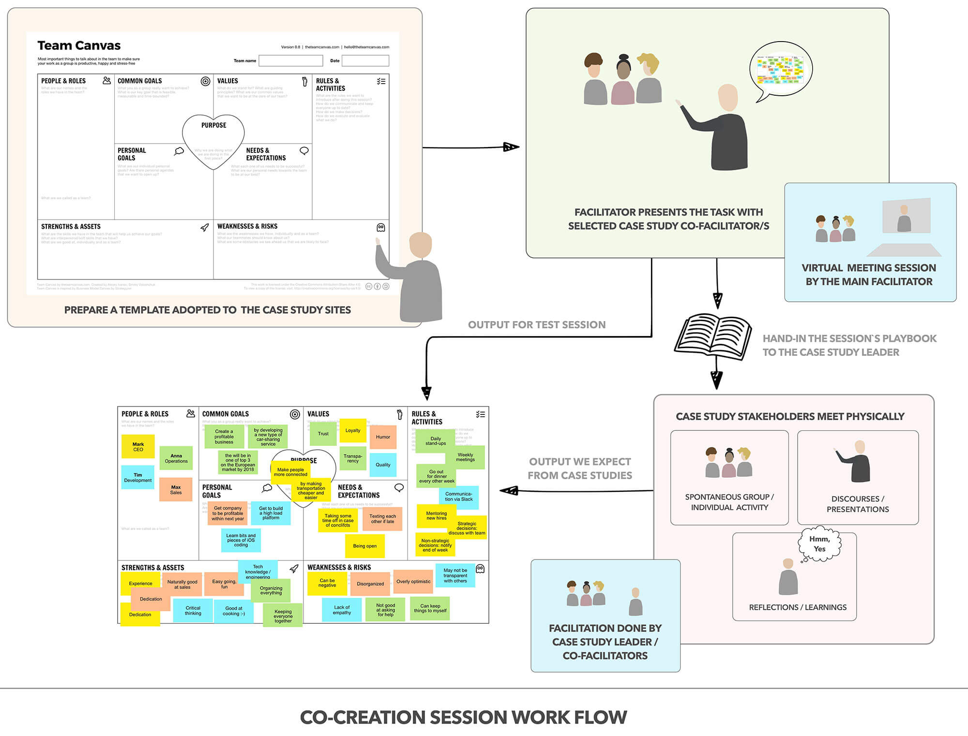
14. Co-Creation with Stakeholders
Co-creation involves collaborating directly with users, clients, or community members. This shared process increases ownership, ensures diverse viewpoints, and leads to more relevant solutions. Stakeholders feel valued and contribute valuable insights that designers might otherwise overlook.
Co-creation with stakeholders is a collaborative process where an organization works directly with external groups, such as customers, employees, and partners, to jointly create value through products, services, or solutions.

Slide 21
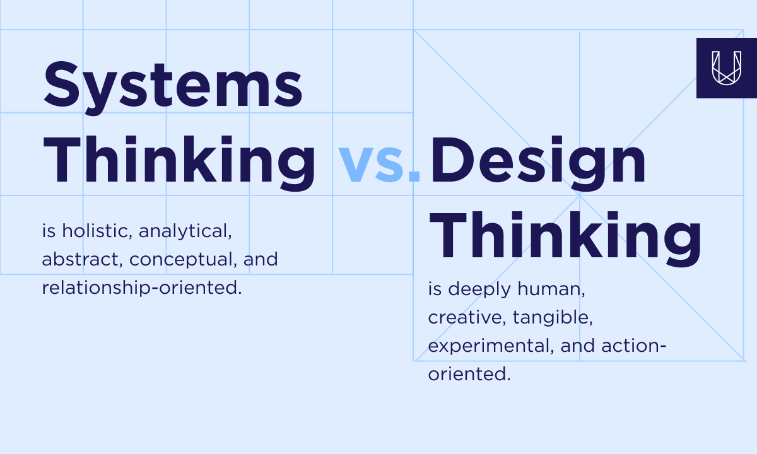
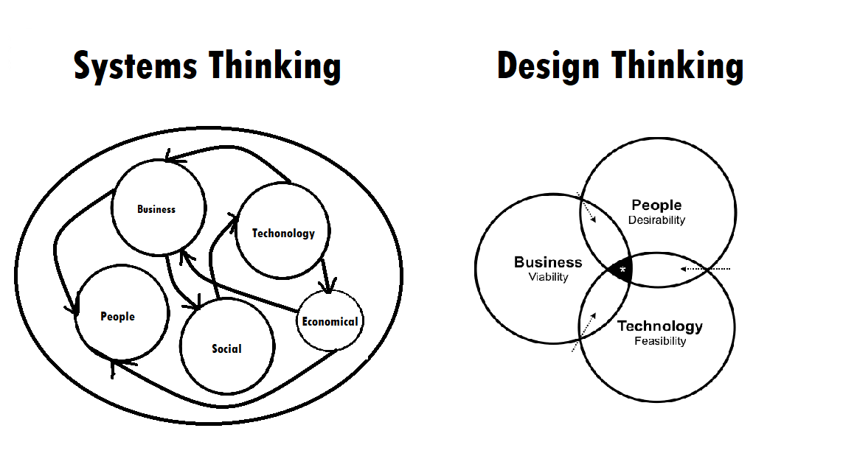
15. Systems Thinking
Systems thinking analyzes how various elements within a system interact. Designers use it to understand broader impacts, dependencies, and unintended consequences. By considering the whole system, solutions become more sustainable, scalable, and aligned with long-term outcomes.
Systems thinking is a holistic approach to problem-solving that focuses on how the different parts of a system interact, rather than just looking at isolated components.

Slide 22
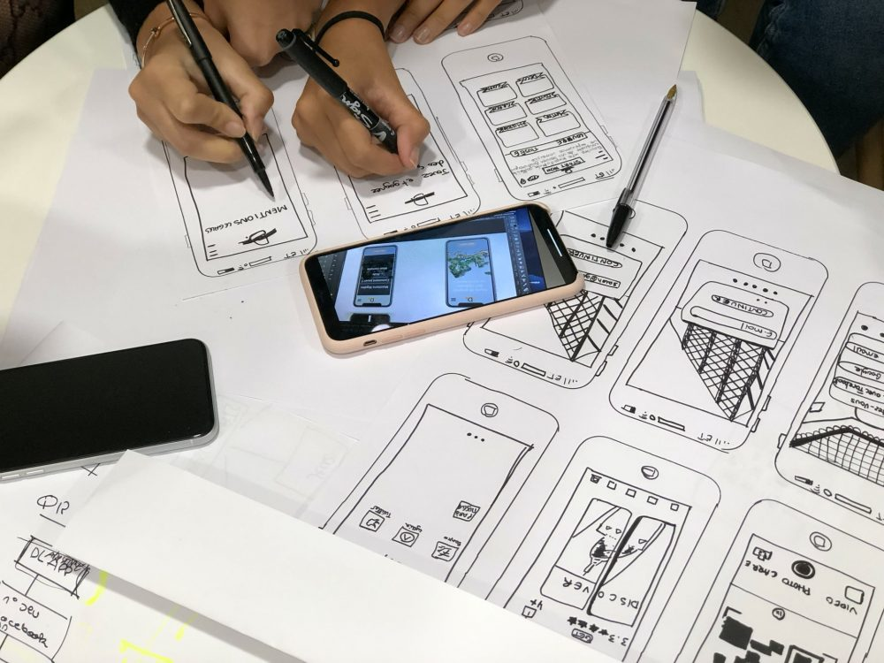
16. Prototype Testing
Testing evaluates how well a prototype works for real users. Designers gather feedback on usability, functionality, and emotional response. Testing uncovers issues early, validates design decisions, and supports data-driven improvement before final implementation.
Prototype testing is evaluating an early, simplified version of a product with real users to gather feedback and identify potential problems before full development begins.

Slide 23
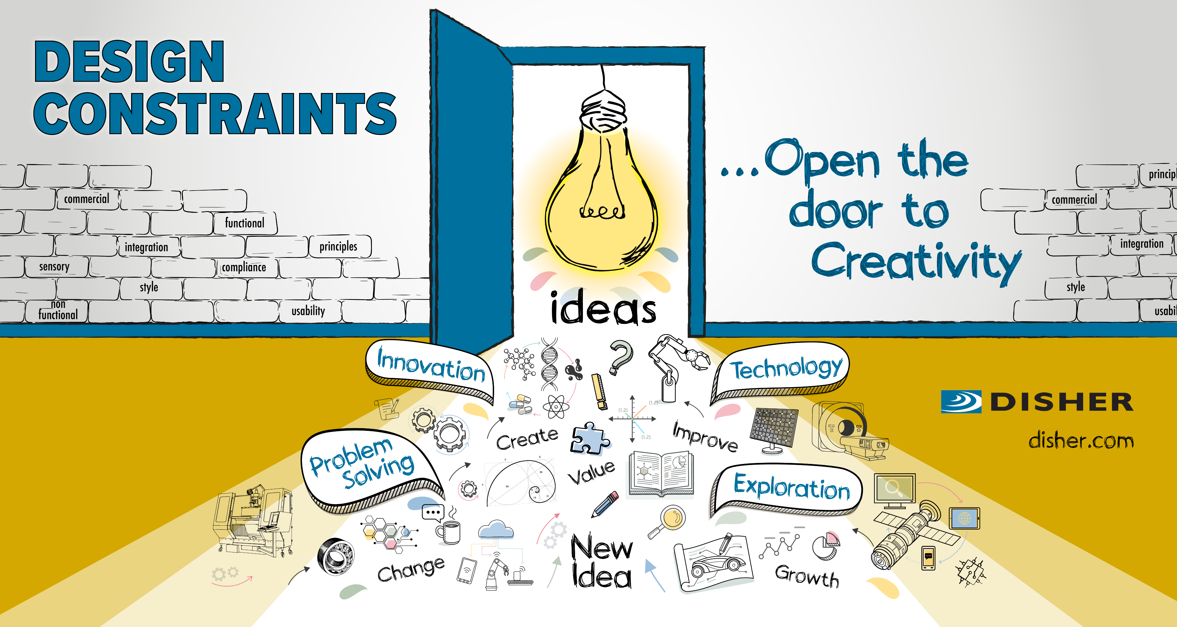
17. Design Constraints
Constraints include time, resources, technology, and user limitations. Understanding constraints helps guide realistic design decisions. Rather than limiting creativity, constraints often inspire more efficient and innovative solutions by forcing designers to think creatively within boundaries.
Design constraints are the limitations and requirements that a project must stick to, which can be physical, functional, or abstract.

Slide 24
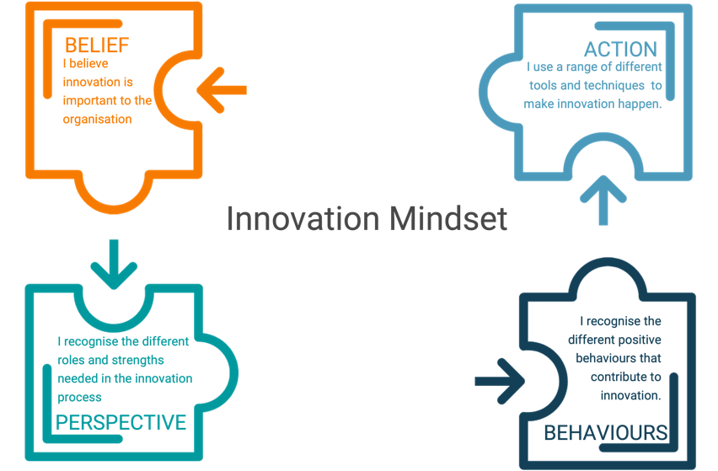
18. Innovation Mindset
An innovation mindset embraces curiosity, openness, and experimentation. It encourages risk-taking, learning from failure, and challenging traditional assumptions. This mindset supports continuous improvement and helps teams uncover unique and meaningful solutions.
An innovation mindset is a way of thinking that embraces change and opportunity through creative problem-solving, curiosity, and resilience.

Slide 25
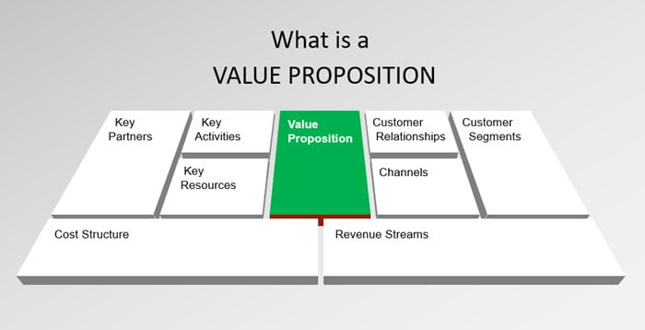
19. Value Proposition Development
A value proposition defines the benefit a solution provides to users. Designers clarify how the solution solves a problem, meets a need, or improves the user’s experience. A strong value proposition ensures the final output delivers meaningful and measurable value.
Value proposition development is the process of creating a concise statement that clearly explains the unique value a company's product or service offers to its target customers and why it is better than the competition.

Slide 26
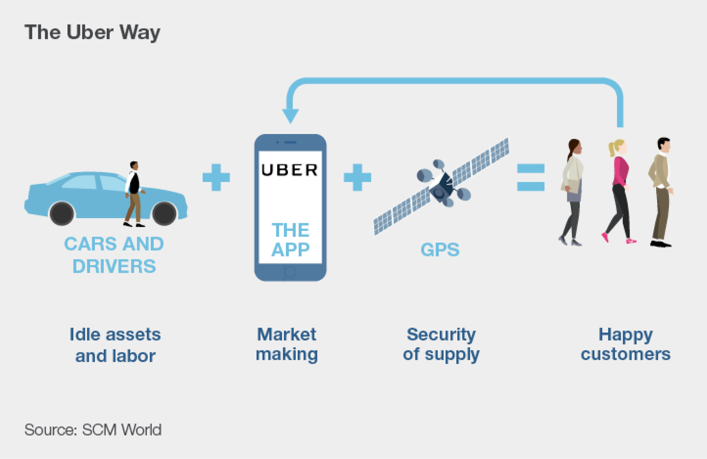
20. Real-World Application
Design Thinking applies to business, education, healthcare, technology, and public services. Its flexible nature allows it to solve diverse challenges. Real-world application emphasizes practicality—turning user insights and creative ideas into solutions that improve experiences and create measurable impact.
Design thinking is used in real-world applications across various sectors like technology, healthcare, education, and government to create human-centered solutions by focusing on user needs. Examples include DBS Bank using it to create the digibank mobile-only app, the City of Helsinki applying it to develop smart city solutions like the Kalasatama district, and companies like Uber and Airbnb using it to redesign services and platforms based on user pain points.

Slide 27
4 clear and simple points introducing Design Thinking:
  Human-Centered Approach
  Design thinking begins with understanding users’ needs, emotions, and real-life problems. Empathy is the foundation of every solution.
  Problem Redefinition
  Instead of accepting problems as given, design thinking encourages reframing them to discover underlying causes and better opportunities for innovation.
  Iterative Process
  Solutions are developed through cycles of prototyping, testing, and improving. Failure is seen as a learning step that guides better outcomes.
  Collaborative and Creative Mindset
  It brings together diverse perspectives—combining creativity, teamwork, and open-mindedness to generate innovative and practical solutions.

