Slide 1
Chapter 2 Digital landscape
Assoc. Prof. Dr. Thacha Lawanna

Slide 2
Objective of the Study:
To examine the current structure, trends, and technological developments within the digital landscape in order to understand how emerging digital technologies, platforms, and ecosystems shape innovation, user behavior, and organizational transformation.

Slide 3
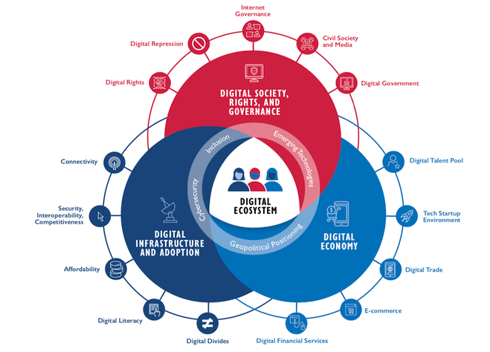
1. Digital Ecosystems
Digital ecosystems refer to interconnected platforms, technologies, users, and services that interact to create value. These ecosystems enable seamless data exchange, cross-platform collaboration, and innovation. Understanding their structure helps explain how digital businesses scale, how stakeholders interact, and how network effects strengthen competitive advantages in rapidly evolving digital environments.

Slide 4
Design Digital Ecosystems for Health Care, Education or E-Commerce System:
Give Definition
Background
Concept (Diagram)
Explain digitalization in such system

Slide 5
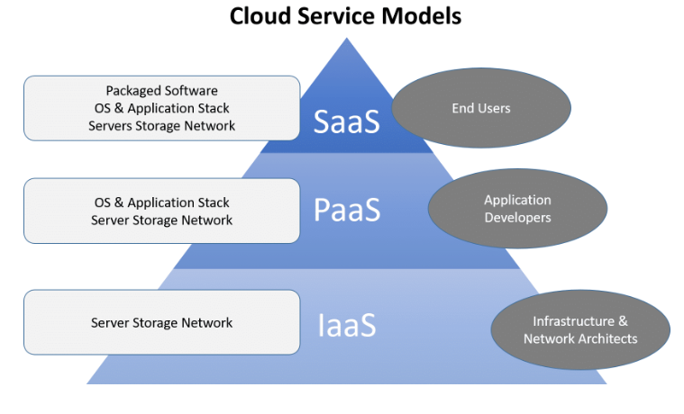
2. Cloud Computing Infrastructure
Cloud computing provides scalable, on-demand access to computing resources such as storage, processing power, and applications. It enables organizations to reduce costs, improve flexibility, and accelerate digital transformation. Cloud platforms support modern services like AI, data analytics, and IoT, becoming a fundamental backbone of global digital operations.

Slide 6
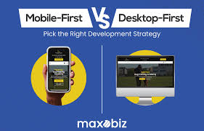
3. Mobile-First Digital Behavior
Mobile-first behavior reflects the dominance of smartphones as the primary digital access point for communication, commerce, and entertainment. This shift drives companies to design mobile-optimized platforms, apps, and services. It influences user expectations for speed, convenience, personalization, and seamless interaction across digital channels.

Slide 7
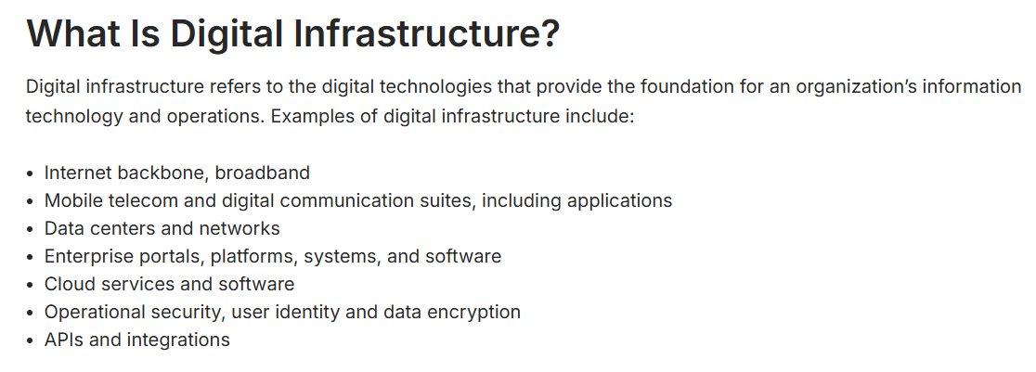

4. Social Media as a Digital Infrastructure
Social media platforms have evolved beyond communication tools into digital infrastructures supporting marketing, commerce, information exchange, and community building. Their algorithms shape user experiences, influence behavior, and drive engagement. Understanding these platforms is essential to analyze digital trends, consumer patterns, and the spread of digital culture globally.

Slide 8
Using Social Media (Commerce) for Online Business:
Business Idea (Flowchart(if any))
Product + Customer
Business Plan (Flowchart)
Business Run (Flowchart)

Slide 9
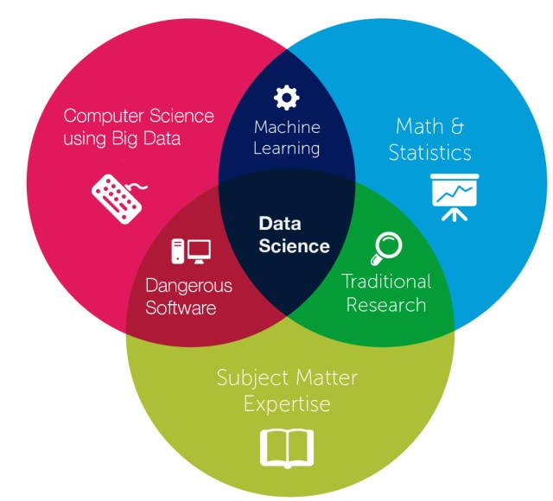
5. Data-Driven Decision Making
Data-driven decision making involves using big data, analytics, and machine learning to guide strategic choices. Organizations rely on real-time insights to optimize operations, improve customer experiences, and identify emerging trends. This approach enhances accuracy, reduces uncertainty, and supports digital innovation across industries.

Slide 11
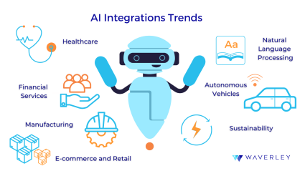
6. Artificial Intelligence Integration
AI integration refers to embedding AI capabilities—such as automation, prediction, and personalization—into digital systems and services. It transforms business processes, enhances efficiency, and enables intelligent customer interactions. AI drives competitiveness in the digital era by enabling smarter decision-making and innovation.

Slide 12
Design Artificial Intelligence Integration for digital marketing:
Choose any company (one)
Explain old marketing they use
Propose your AI-Marketing (Flowchart+pics)
Give expectations
https://www.youtube.com/watch?v=kQcq3rpne78
https://www.youtube.com/watch?v=s8AmkizQ39s

Slide 13

7. Cybersecurity in the Digital Era
Cybersecurity involves protecting digital systems, networks, and data from attacks and unauthorized access. As digital operations expand, risks such as hacking, data breaches, and ransomware grow. Effective cybersecurity frameworks ensure trust, safeguard assets, and maintain operational stability in increasingly interconnected environments.

Slide 14



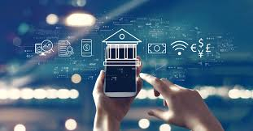
8. Digital Payment Innovations
Digital payment innovations include mobile wallets, QR payments, blockchain, and contactless technologies. These solutions offer convenience, speed, and security, transforming financial services. They support e-commerce growth, expand financial inclusion, and redefine customer expectations in both developed and emerging markets.

Slide 15
Design Digital Payment for your own business:
Give principal and reasons
Explain Old Digital Payment (Flowchart)
Propose New Digital Payment (Flowchart)
What are the remained problems
How to solve (Flowchart)

Slide 16
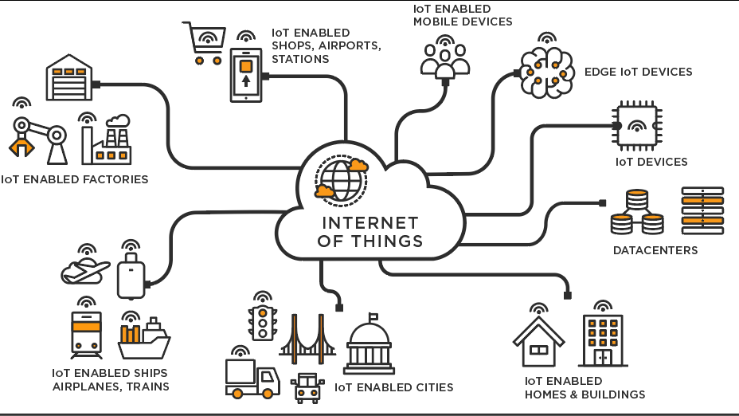
9. Internet of Things (IoT) Expansion
IoT connects physical devices—such as sensors, appliances, and machines—to the internet to enable real-time data exchange. This expansion supports smart homes, smart cities, and industrial automation. IoT enhances efficiency, improves monitoring, and opens new opportunities for digital innovation in everyday and industrial environments.

Slide 17

10. Digital Skills and Workforce Transformation
The digital landscape requires new skills such as data literacy, digital communication, AI understanding, and technology management. Organizations must reskill employees to adapt to automation and digital tools. Workforce transformation ensures competitiveness, boosts productivity, and prepares societies for rapidly changing technological demands.

