Slide 1
Chapter 3 Business Goals and Challenges
Assoc. Prof. Dr. Thacha Lawanna

Slide 2
Objective of the Study:
To analyze how business goals align with organizational challenges in order to identify critical factors that influence strategic decision-making and propose frameworks that enhance overall business performance and competitiveness.

Slide 3
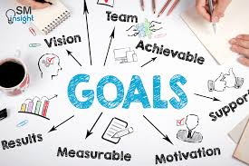
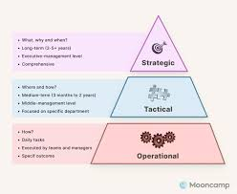
1. Strategic Goal Alignment
Understanding how organizational goals (?) align with long-term strategies (?) ensures that all departments move in the same direction. When alignment is strong, companies optimize resources, improve coordination, and reduce conflicting priorities. This knowledge helps managers design measurable objectives that support sustainable growth and competitive advantage.

Slide 4

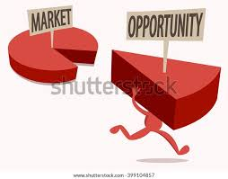
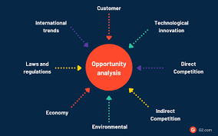
2. Market Opportunity Analysis
Identifying and evaluating market opportunities (?) helps businesses understand emerging trends, customer needs (?), and competitive gaps. This knowledge enables organizations to forecast demand, prioritize high-value segments, and develop strategies that capture new revenue streams. It is essential for reducing uncertainty and guiding effective business expansion.

Slide 5
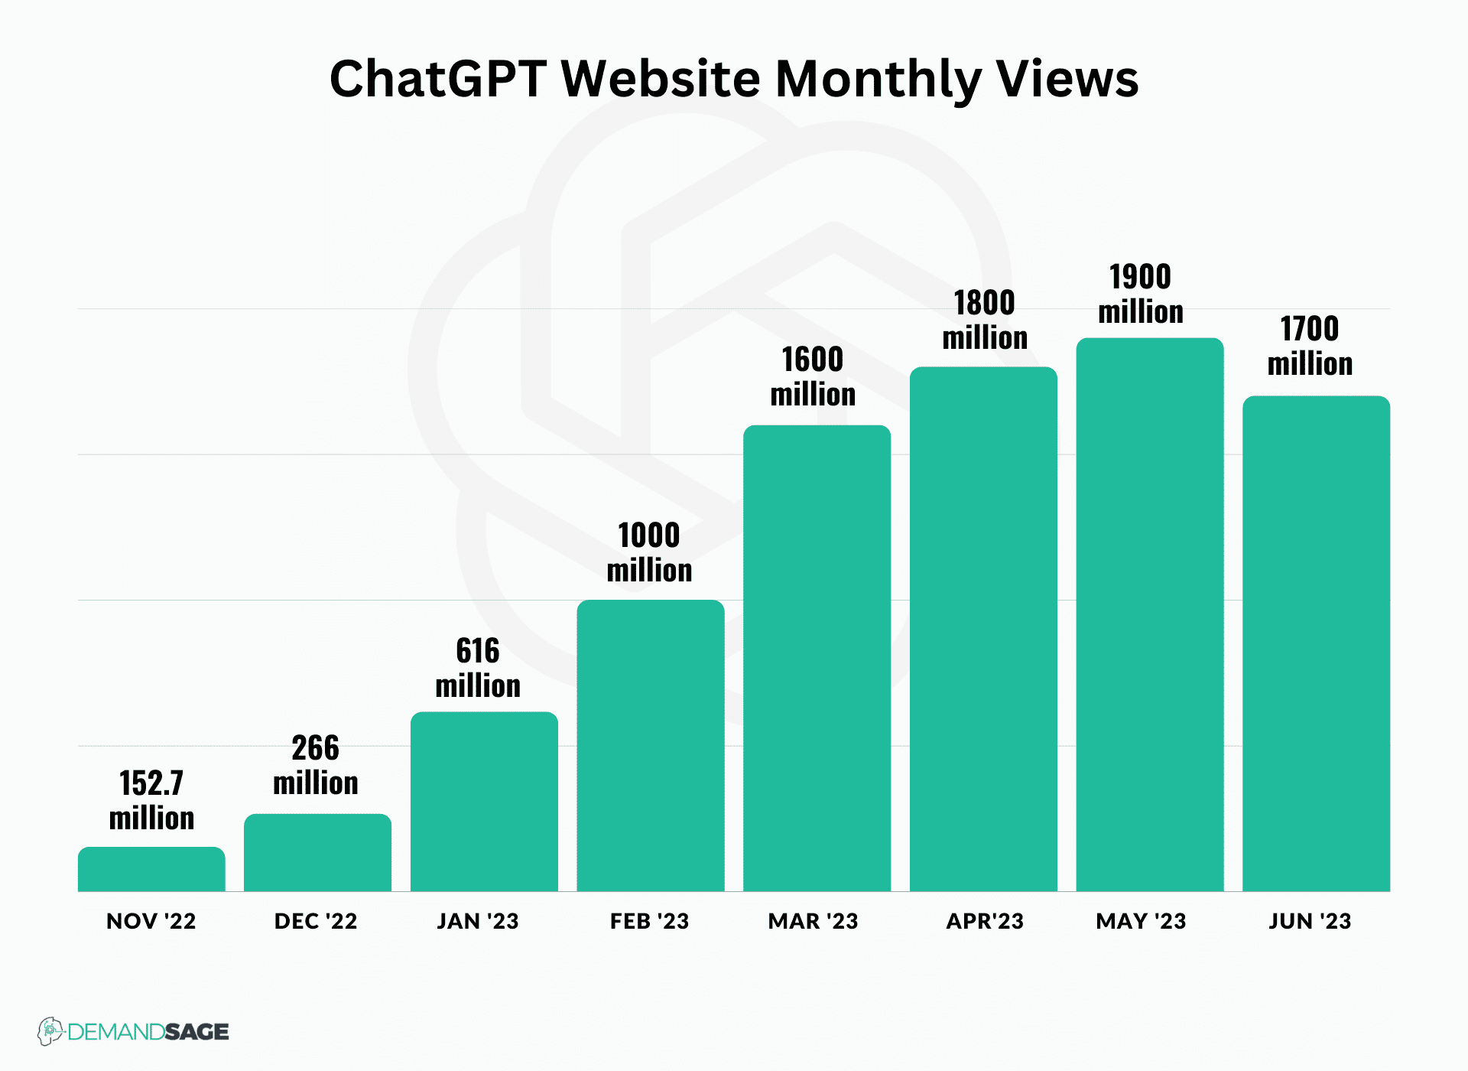
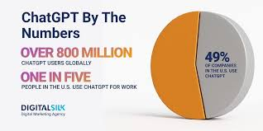
Identify and evaluate market opportunities of ChatGPT

Slide 6
3. Operational Efficiency Improvement
Organizations must continuously refine processes to reduce costs, minimize waste, and improve productivity>>>?. Knowledge of operational efficiency includes workflow redesign, automation, and performance measurement. It helps companies deliver products or services faster, maintain quality, and allocate resources effectively, especially under competitive or resource-constrained environments.

Slide 7
4. Risk Management and Mitigation
Businesses face various risks such as financial instability (?), market volatility, regulatory changes, and operational disruptions. Understanding risk management helps organizations identify vulnerabilities, evaluate potential impacts, and design mitigation strategies. This ensures business continuity, protects assets, and strengthens resilience against unexpected challenges.

Slide 8
5. Customer Value Proposition
A strong value proposition clarifies why customers should choose a product or service. Knowledge of customer expectations, preferences, and pain points helps businesses refine offerings and differentiate from competitors. It supports customer loyalty, drives sales growth, and ensures long-term market relevance.

Slide 9
Why customers should choose good product or service? Give 4 core activities

Slide 10
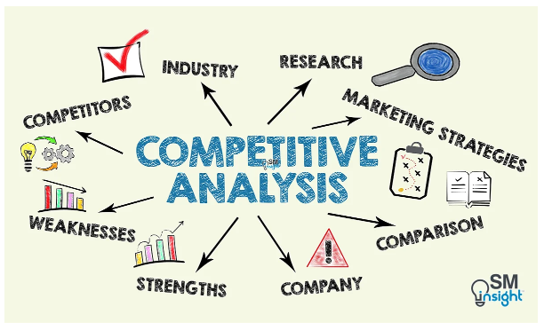
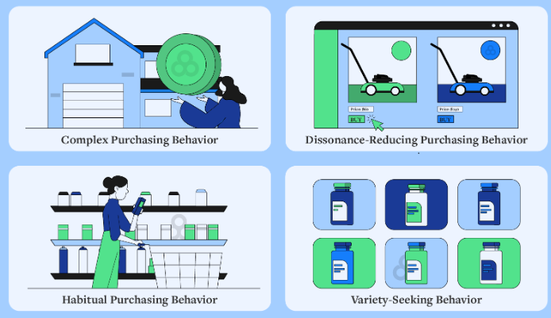
6. Competitive Landscape Assessment
Analyzing competitors (?) allows businesses to understand strategic positions, strengths, weaknesses, and market behavior. This knowledge guides decision-making related to pricing, marketing, innovation, and positioning. It enables organizations to anticipate competitor moves and adapt strategies to maintain or enhance market share.

Slide 11
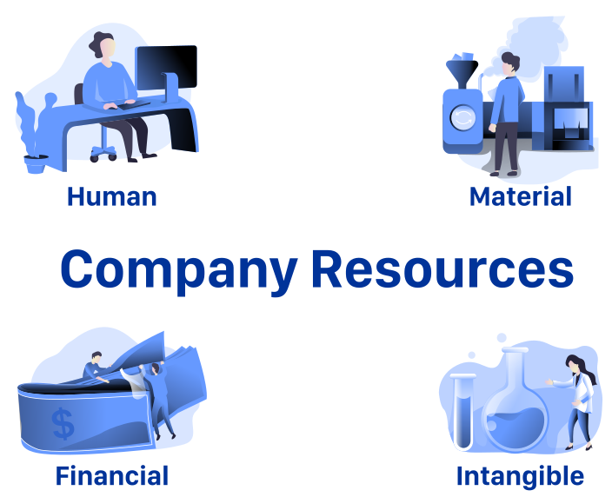
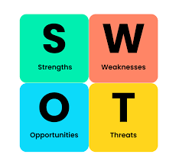
7. Organizational Resource Allocation
Effective allocation of financial, human, and technological resources ensures that strategic priorities receive adequate support. Understanding resource planning helps businesses maximize return on investment and avoid overextension. It also enables management to adjust quickly to changing market conditions and internal demands.
strategic priorities

Slide 12
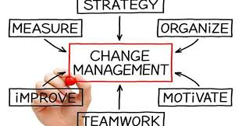
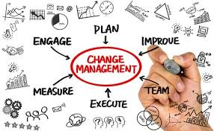
8. Change Management Readiness
Organizations often face challenges when implementing new technology, policies, or processes. Knowledge of change management helps leaders prepare employees, reduce resistance, and ensure smooth transitions. It contributes to organizational agility, employee satisfaction, and long-term success of transformation initiatives.

Slide 13
Organizations often face challenges when implementing new technology>>> Explain it with 3 issues

Slide 14
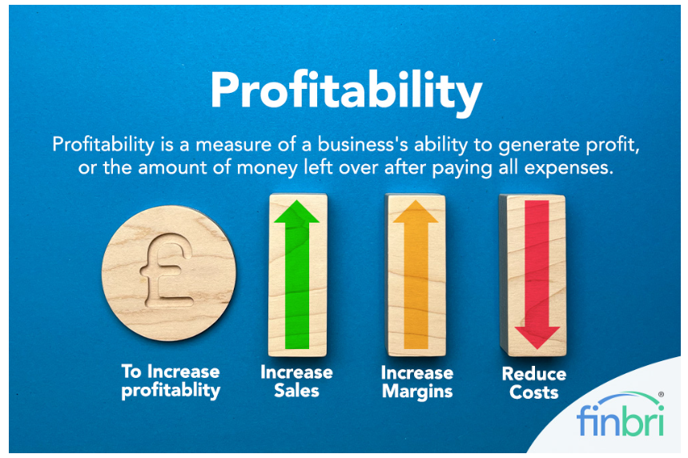
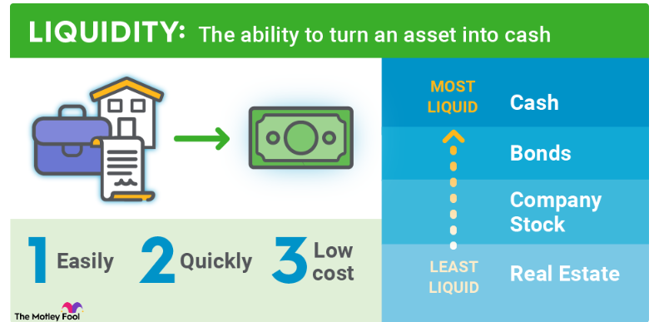
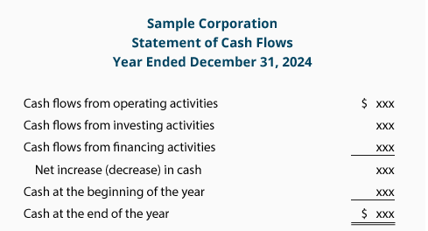
9. Financial Performance Evaluation
Understanding financial indicators such as profitability, liquidity, and cash flow helps assess business stability and growth potential. This knowledge supports decision-making on investments, cost management, and strategic planning. Accurate evaluation ensures businesses remain competitive and capable of responding to economic changes.

Slide 15
10. Innovation and Digital Transformation
Innovation and digital adoption are critical for modern business survival. Knowledge in this area includes understanding new technologies, process automation, and data-driven decision-making. It helps organizations improve customer experience, reduce operational costs, and stay ahead of competitors in rapidly evolving markets.

Slide 16
Explain Innovation and Digital Transformation of Chiang Mai University

