Slide 1
Chapter 4 Empathy and user-centricity
Assoc. Prof. Dr. Thacha Lawanna

Slide 2
Objective of the Study:
To develop a deep understanding of empathy as a strategic foundation for user-centric design and innovation, enabling learners to analyze user needs, emotions, and behaviors systematically and apply empathy-driven approaches to improve products, services, and digital solutions.

Slide 3
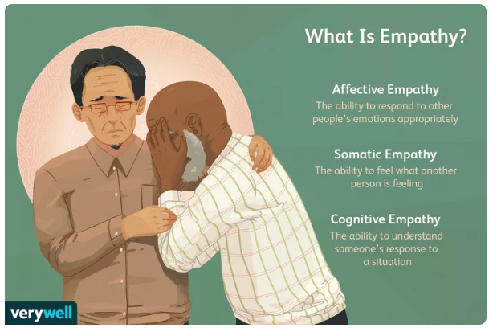
1: Concept of Empathy
Empathy refers to the ability to understand and share the feelings, needs, and perspectives of users. In innovation and design, empathy enables creators to move beyond assumptions and see problems from the user’s viewpoint, forming the foundation for meaningful, relevant, and human-centered solutions.
Empathy is the first process of Design Thinking

Slide 4
Empathize Aj. Thacha (ask questions about what topic>> healthy)
1. How?
2. What they say?
3. Knees
4. For knees
5. I use balm & herb, pill
6. You offer me leg supports >>> (process 3)
7. What>>>
Ask and listen (deeper than understanding, you can fell it)

Slide 5
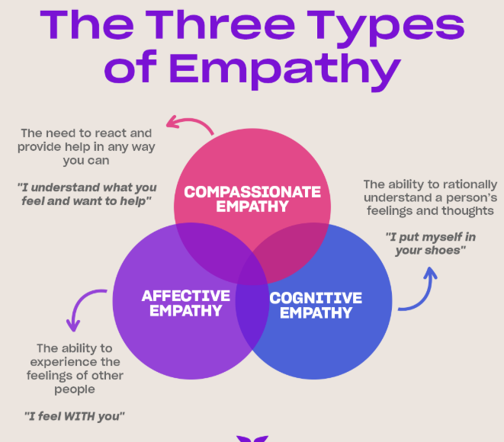
2: Cognitive vs. Emotional Empathy
Cognitive empathy focuses on understanding users’ thoughts, motivations, and decision processes, while emotional empathy involves recognizing users’ feelings and emotional responses. Both are essential in user-centric design, as effective solutions must address not only functional needs but also emotional experiences.

Slide 6
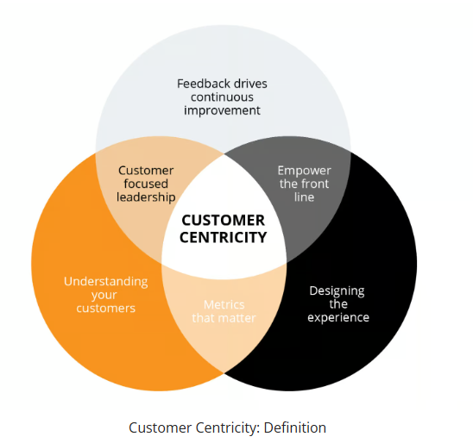
3. User-Centricity Defined
User-centricity is an approach that places users at the center of decision-making, design, and evaluation. It emphasizes designing systems, services, and products based on real user needs, behaviors, and feedback rather than organizational assumptions or technological convenience.

Slide 7
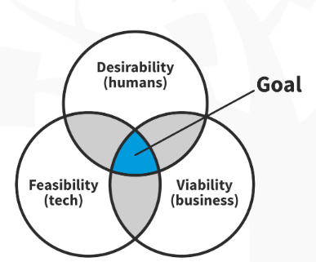
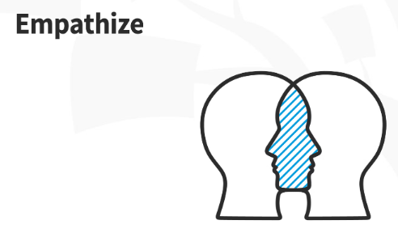
4: Importance of Empathy in Innovation
Empathy drives innovation by revealing unmet needs and hidden pain points. When organizations empathize with users, they can identify opportunities for improvement, reduce design failures, and create solutions that are more likely to be adopted, trusted, and valued by users.

Slide 8
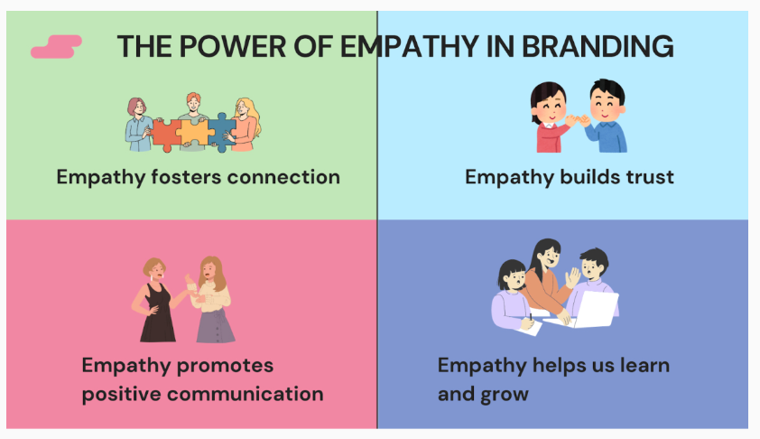
5: Empathy in Digital Products
In digital systems, empathy ensures usability, accessibility, and positive user experience. Understanding users’ limitations, contexts, and expectations helps designers reduce cognitive load, improve interaction flow, and create intuitive interfaces that support diverse user groups effectively.

Slide 9
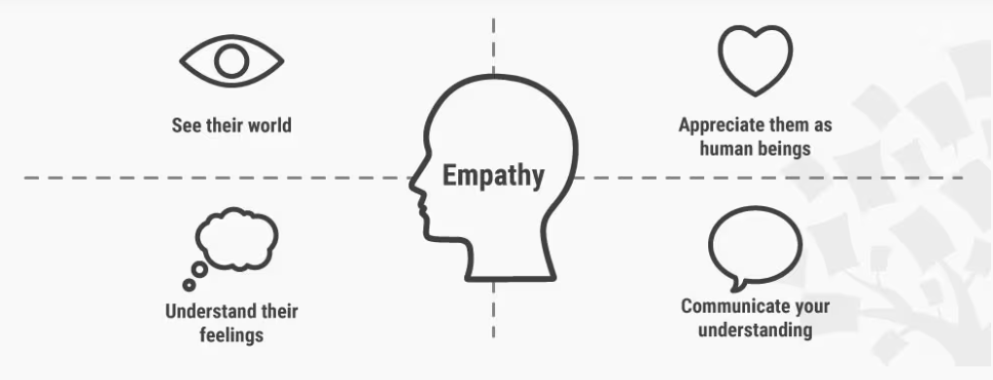
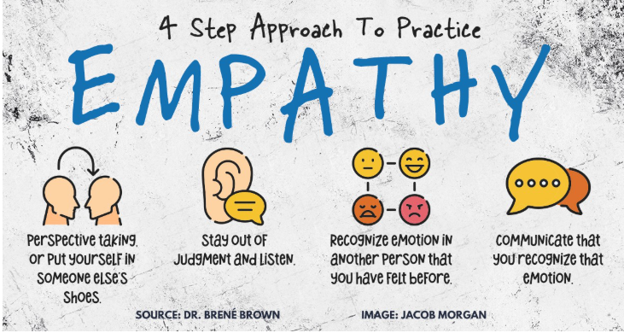
6: Methods for Building Empathy
Common empathy-building methods include user interviews, observations, surveys, personas, and journey mapping. These techniques help collect qualitative insights about user behavior and emotions, allowing designers and researchers to ground decisions in real-world user experiences.

Slide 10
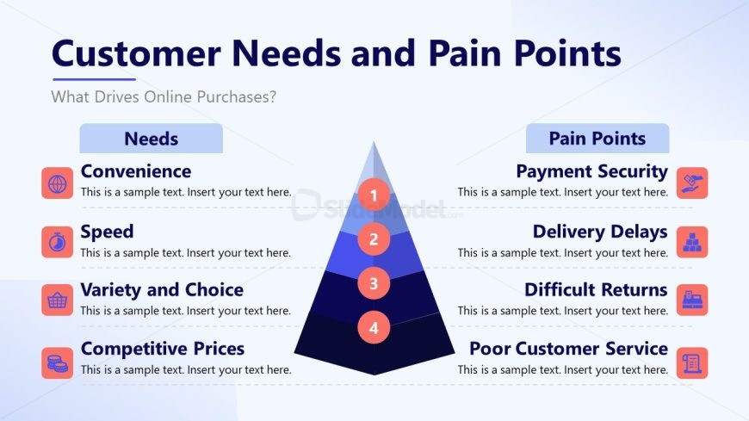
7: User Pain Points and Needs
Identifying pain points involves recognizing obstacles, frustrations, and inefficiencies users face. Empathy enables deeper analysis of why these issues occur and how they affect users emotionally, helping designers prioritize solutions that truly improve user satisfaction and engagement.

Slide 11
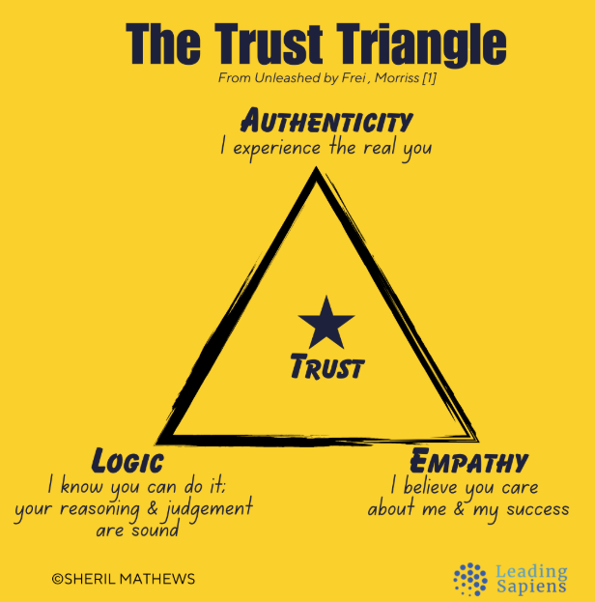
8: Empathy and Trust
Empathy strengthens trust between users and systems. When users feel understood and supported, they are more likely to engage, share feedback, and continue usage. Trust is especially critical in digital platforms involving personal data, financial transactions, or long-term user interaction.

Slide 12
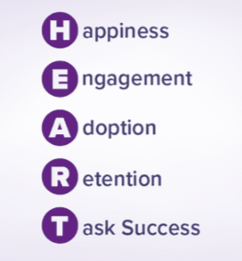
9: Measuring User-Centric Success
User-centric success can be measured through user satisfaction, usability scores, retention rates, and qualitative feedback. Empathy-driven evaluation focuses not only on performance metrics but also on users’ perceived value, comfort, and emotional responses during interaction.

Slide 13
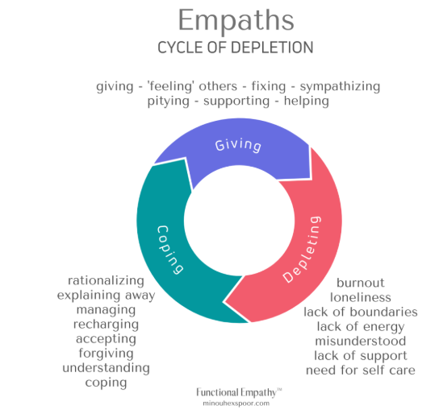
10: Empathy as a Continuous Process
Empathy is not a one-time activity but an ongoing process. User needs evolve over time, requiring continuous observation, feedback, and adaptation. Sustaining user-centricity ensures long-term relevance, innovation, and alignment between systems and the people they serve.

Slide 14
Question:
How does empathy contribute to user-centric design, and why is it essential for creating effective and sustainable digital solutions?

Slide 15
Activity:
1st Design steps for “Empathy” process + it’s template
2nd Show type of users + set of questions + Examples of report (in Template) from 1st + Summary report (info graphic)

