Slide 1
Chapter 5 Defining problem statements
Assoc. Prof. Dr. Thacha Lawanna

Slide 2
Objective of the Study:
To clearly identify, analyze, and articulate the core research problem by examining existing gaps, limitations, and inconsistencies in current knowledge, thereby establishing a precise and actionable problem statement that will guide the direction, scope, and methodology of the research.

Slide 3
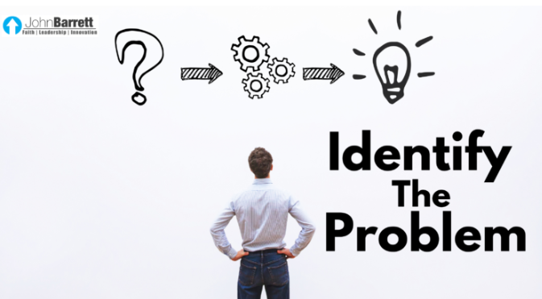
1. Problem Identification
Identifying a problem requires assessing gaps, inconsistencies, or unresolved issues within existing literature or practice. This process ensures the researcher understands what is missing, why it matters, and how it impacts the field. Clear identification leads to a focused research direction and avoids vague or overly broad investigations.

Slide 4
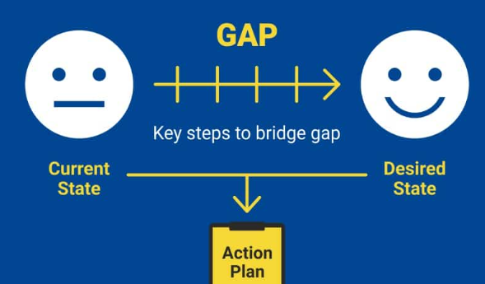
2. Research Gap Analysis
Gap analysis involves reviewing previous studies to pinpoint areas where knowledge is incomplete, outdated, or contradictory. By mapping what has been studied and what remains unexplored, researchers justify the importance of their work and demonstrate how their study contributes to advancing academic understanding or practical applications.

Slide 5
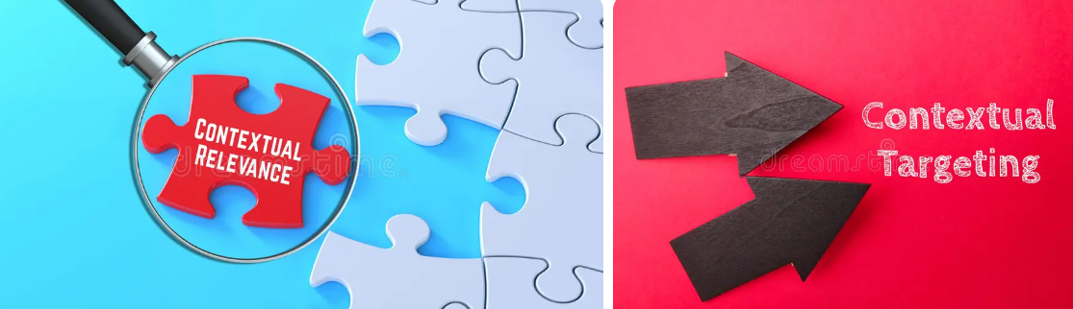
3. Contextual Background
Providing background information helps situate the research problem within its real-world or theoretical context. This includes historical developments, current trends, and influencing factors. A well-defined context enhances clarity, supports relevance, and ensures readers understand why the issue is worth investigating and how it emerged.

Slide 6
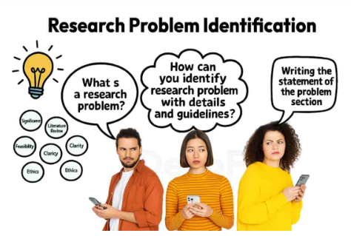
4. Significance of the Problem
Explaining the significance highlights the value and impact of solving the problem. It addresses how the issue affects individuals, organizations, or society. A strong significance statement convinces readers that the research is important, timely, and capable of producing meaningful benefits or addressing critical challenges in the field.

Slide 7
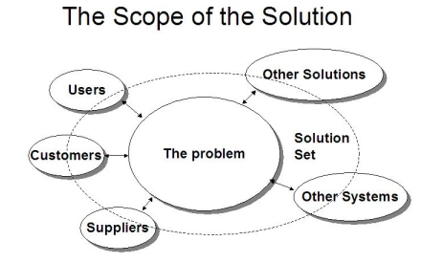
5. Scope of the Problem
The scope defines the boundaries and limitations of the research problem. It clarifies what will be included or excluded, helping to keep the investigation manageable and focused. Establishing scope prevents unnecessary complexity and ensures that the research remains realistic, achievable, and aligned with available resources and time.

Slide 8
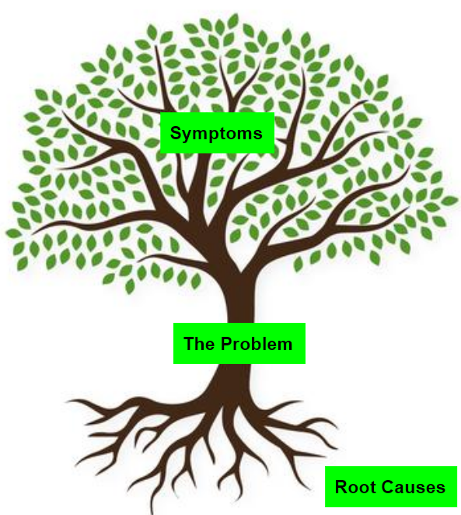
6. Problem Symptoms vs. Root Causes
Distinguishing between symptoms and root causes enhances the accuracy of the problem statement. Symptoms are visible issues, while root causes are underlying factors driving them. Effective problem definition requires identifying true causes rather than addressing surface-level indicators, ensuring that the research leads to meaningful and lasting solutions.

Slide 9

7. Stakeholder Needs and Perspectives
Understanding stakeholder perspectives ensures that the problem statement aligns with real needs. Stakeholders may include users, policymakers, organizations, or researchers. Their viewpoints provide valuable insights into the problem’s impact, urgency, and relevance. Incorporating stakeholder input strengthens research credibility and increases the likelihood of practical, accepted outcomes.

Slide 10

8. Human–Technology Interaction
Understanding how users naturally interact with technology helps designers create intuitive systems. This includes analyzing user habits, decision-making patterns, and cognitive loads. Empathy aids in reducing complexity, enabling users to achieve goals more efficiently and comfortably in digital environments.

Slide 11
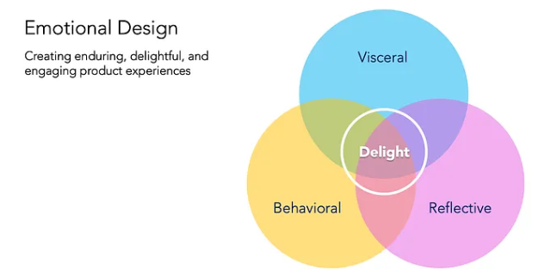
9. Emotional Design in Digital Products
Emotional design focuses on how aesthetics, interactions, and feedback influence user feelings. Designs that evoke positive emotions increase trust, satisfaction, and long-term engagement. Applying empathy ensures digital products respond gracefully to mistakes and celebrate achievements, creating strong emotional connections.
(Experience)

Slide 12
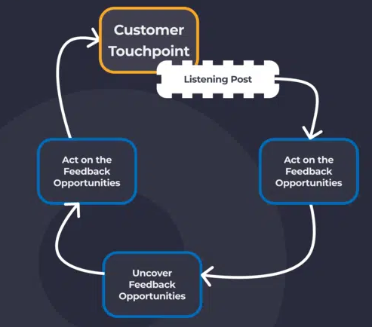
10. Continuous User Feedback Integration
Empathy requires ongoing dialogue with users. Continuous feedback loops allow designers to understand evolving user needs and adapt solutions proactively. By integrating real-time user insights into product updates, organizations stay aligned with user expectations and maintain relevance in rapidly changing digital landscapes.

Slide 13
Activity:
No.1 Use the results from process 1 to design form of problem statement.
Using results from Process 1, the problem statement should clearly translate observed gaps, patterns, or inefficiencies into a concise researchable issue. It must specify the context, affected stakeholders, and measurable consequences, ensuring the problem is evidence-based, focused, and aligned with the study’s objectives.

Slide 14
Activity:
No. 2 Prioritize set of problems by effective method with efficient concept.
Problem prioritization should apply systematic methods such as impact–feasibility analysis or weighted scoring models. Problems with high impact, strong alignment to strategic goals, and low resource consumption are ranked first. This ensures efficient use of time and resources while maximizing practical and theoretical value.

Slide 15
Question:
Why is clearly defining the problem statement critical to successful problem-solving and innovation, and what risks arise when the problem is poorly defined? Give 1 Example

