Slide 1
Chapter 6 Ideation and Brainstorming
Assoc. Prof. Dr. Thacha Lawanna

Slide 2
Processes of Design Thinking: process 1: Empathize>>>Talk&Ask process 2: Define>>> Find what are problems process 3: Ideation>> Find what are solutions process 4: Prototype>>> Show your idea in paper/ppt/platform: draw diagram!
Process 5: Test

Slide 3
Objective of the Study:
To examine and evaluate structured ideation and brainstorming techniques that enhance creative problem-solving, enable the generation of diverse innovative ideas, and support effective decision-making in digital innovation contexts.

Slide 4
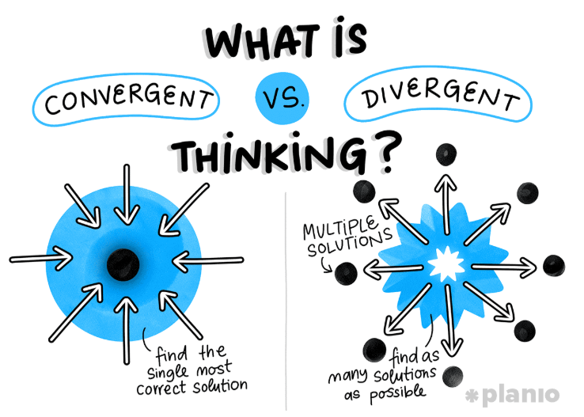
1. Divergent Thinking in Innovation
Divergent thinking expands the range of possible solutions by encouraging participants to explore unconventional, creative, and wide-ranging ideas. It supports open-ended exploration without early judgment, allowing individuals and teams to push beyond traditional boundaries. This mindset is essential for generating fresh concepts before moving into evaluation or refinement stages.

Slide 5
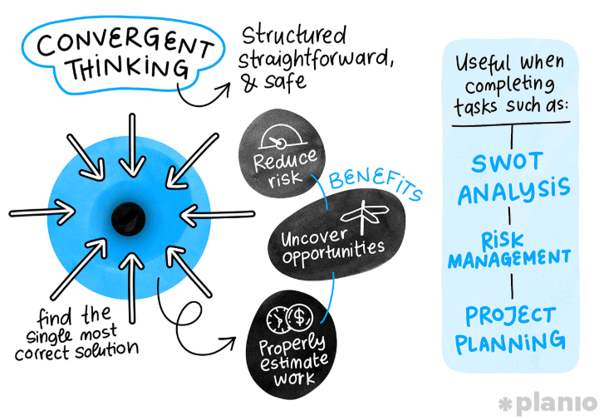
2. Convergent Thinking for Idea Selection
Convergent thinking narrows broad ideas into focused, practical solutions. After brainstorming, this stage helps evaluate ideas based on criteria such as feasibility, value, and alignment with goals. It ensures that creativity is balanced with structured decision-making, enabling teams to choose the most effective concepts for development and implementation.

Slide 6
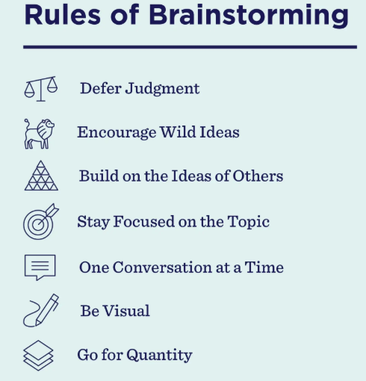
3. Brainstorming Rules and Group Dynamics
Effective brainstorming relies on clear guidelines: withholding criticism, welcoming unusual ideas, building on others’ suggestions, and aiming for quantity. Supportive group dynamics—trust, openness, and equal participation—encourage idea sharing. Following these principles maximizes creativity while reducing fear of judgment or dominance by stronger voices.
Empathize Aj. Thacha>> hiking
Define Aj. Thacha>> problem: knee /puke
Ideation>> brainstorming (find solution)

Slide 7
Process 3:Ideation>> brainstorming (find solutions)
Numbers of solution
30-100 solutions
vote
Few numbers of solutions
First group >>1 solution
List of solutions
Second group >> 3 solutions
Answer?

Slide 8
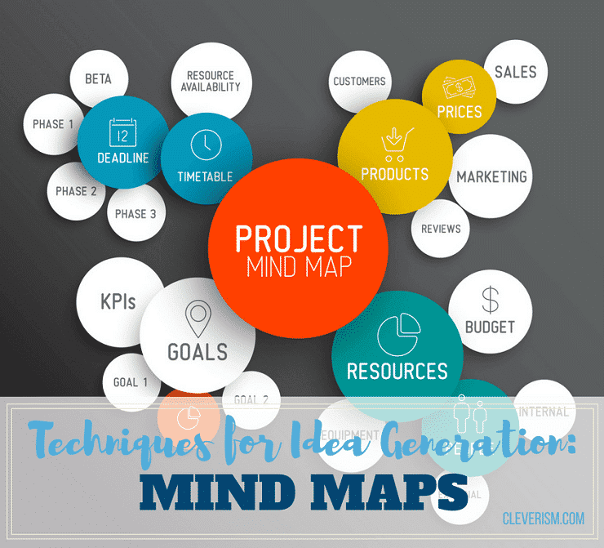
4. Mind Mapping for Idea Expansion
Mind mapping visually organizes ideas around a central theme. It helps teams identify connections, patterns, and sub-topics that may not emerge through linear thinking. This technique stimulates creativity by presenting concepts in a flexible structure, allowing participants to explore multiple angles and expand ideas into more detailed insights.

Slide 9
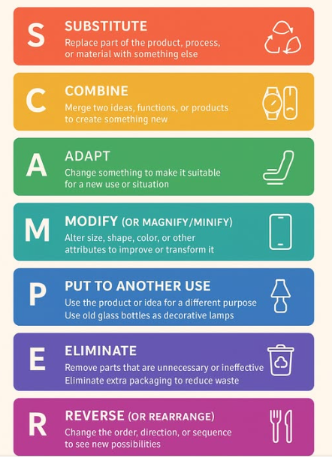
5. SCAMPER Technique for Creative Adjustment
SCAMPER (Substitute, Combine, Adapt, Modify, Put to another use, Eliminate, Reverse) is a structured method for shifting existing ideas into new variations. It encourages systematic creativity by questioning each element of a product or problem. This guided approach helps teams reimagine existing solutions and discover fresh opportunities for innovation.

Slide 10
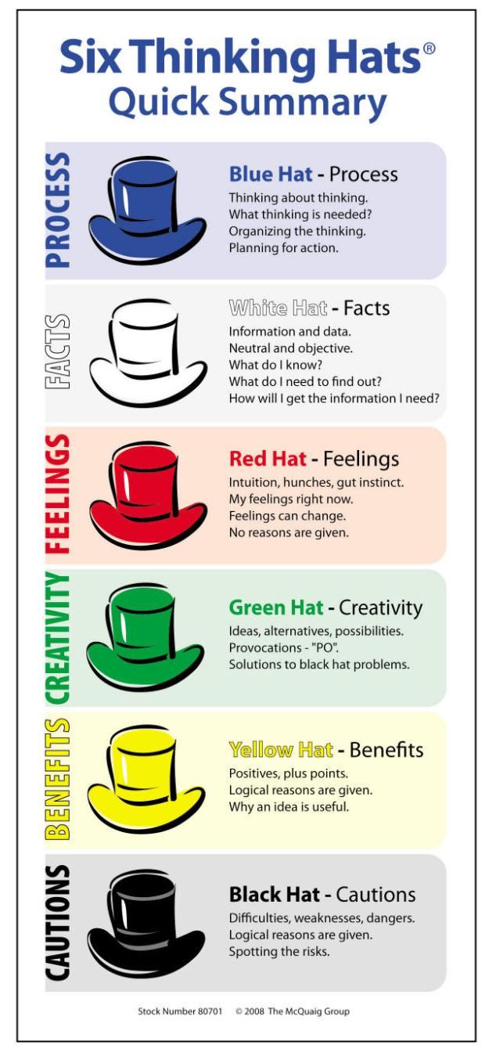
6. Six Thinking Hats for Structured Ideation
The Six Thinking Hats model organizes thinking into six perspectives—facts, emotions, caution, optimism, creativity, and control. By intentionally switching hats, teams explore issues holistically and avoid bias. This method enhances innovation by ensuring balanced viewpoints, structured dialogue, and deeper insights during collaborative ideation sessions.

Slide 11
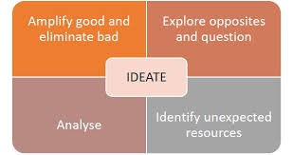
7. Design Thinking Ideation Stage
Design Thinking’s ideation phase focuses on generating human-centered solutions through empathy, creativity, and collaboration. Techniques such as rapid ideation, sketching, and brainstorming help generate diverse ideas. This approach encourages experimentation and prioritizes user needs, leading to meaningful, practical innovations that address real-world challenges.

Slide 12

8. Role-Storming for Perspective Shifting
Role-storming involves adopting fictional or real characters’ viewpoints to generate ideas. By stepping into another’s identity—such as a customer, expert, or competitor—participants break out of habitual thinking patterns. This technique encourages unconventional perspectives and fosters creativity by expanding how problems and opportunities are perceived.

Slide 13
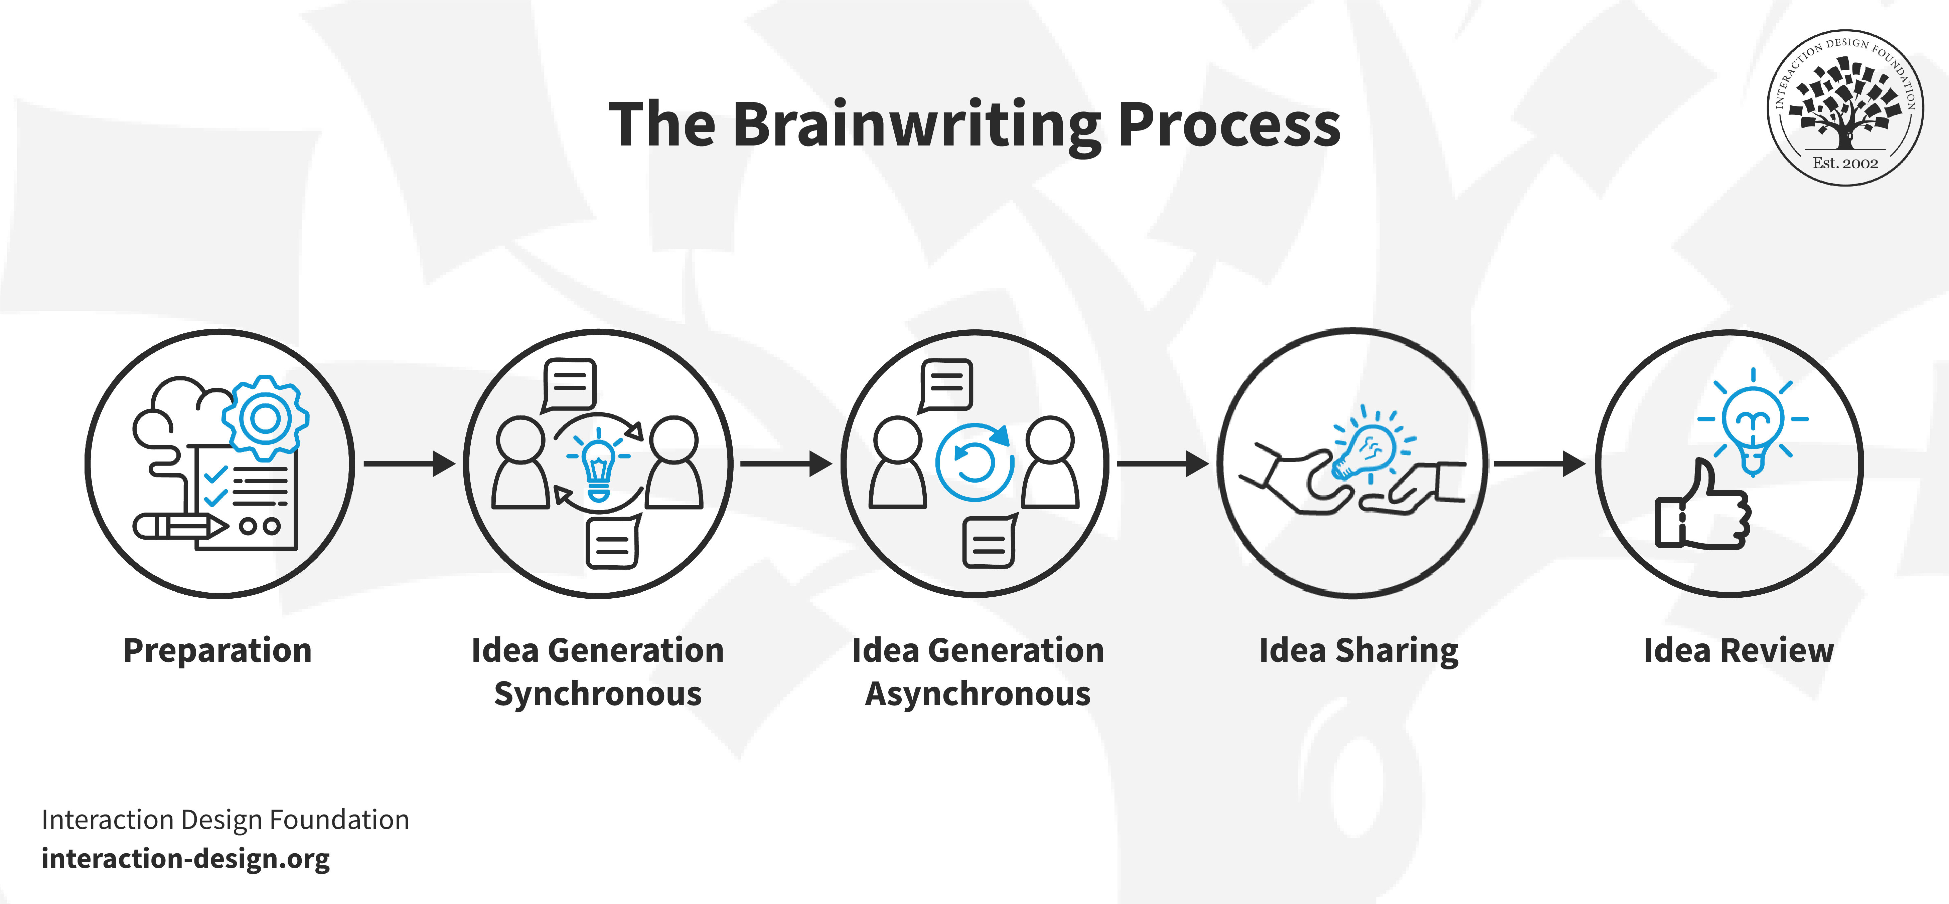
9. Brainwriting for Quiet Idea Generation
Brainwriting allows participants to write ideas individually before sharing them. It reduces pressure from group conversations and prevents dominant voices from overshadowing others. This technique promotes equal contribution, encourages deeper reflection, and often leads to a richer variety of ideas compared to traditional verbal brainstorming.

Slide 14
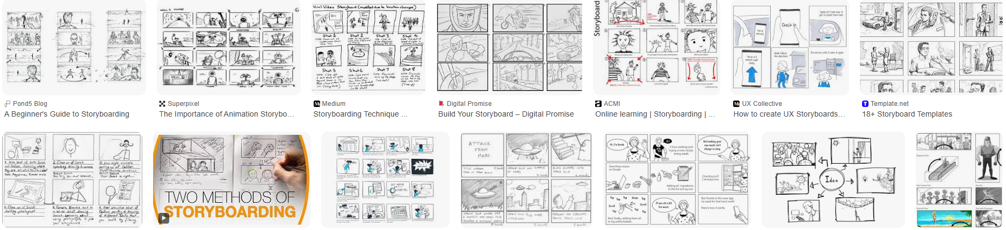
10. Storyboarding to Visualize Ideas
Storyboarding uses sequential images or sketches to illustrate an idea’s flow, user experience, or process. It transforms abstract concepts into visual narratives, helping teams understand interactions, identify gaps, and refine solutions. This technique strengthens communication and supports more concrete, actionable innovation planning.

Slide 15
Question:
How do ideation and brainstorming techniques support the generation of innovative solutions, and why is encouraging diverse perspectives important during this stage?

