Slide 1
Chapter 7 Prototyping for design thinking in digital transformation
Assoc. Prof. Dr. Thacha Lawanna

Slide 2
Objective of the Study:
To investigate how rapid prototyping techniques enhance solution validation, stakeholder engagement, and iterative improvement within digital transformation initiatives.

Slide 3
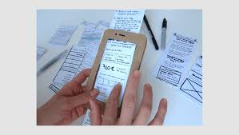

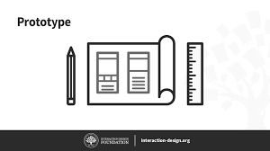
1. Role of Prototyping in Design Thinking
Prototyping transforms abstract ideas into tangible representations that teams can evaluate early in the design process. It helps reduce uncertainty, reveal user needs, and validate assumptions before costly development begins. Prototypes support rapid learning, encourage experimentation, and ensure solutions align closely with user expectations during digital transformation initiatives.

Slide 4
2. Low-Fidelity vs. High-Fidelity Prototypes
Low-fidelity prototypes such as sketches or paper mockups allow teams to explore ideas quickly and cheaply. High-fidelity prototypes replicate real interfaces and functions for deeper testing. Knowing when to use each type helps organizations balance speed and accuracy, accelerating decision-making in digital transformation projects.
https://www.youtube.com/watch?v=yafaGNFu8Eg
https://www.youtube.com/watch?v=rfjHV0sas50

Slide 5

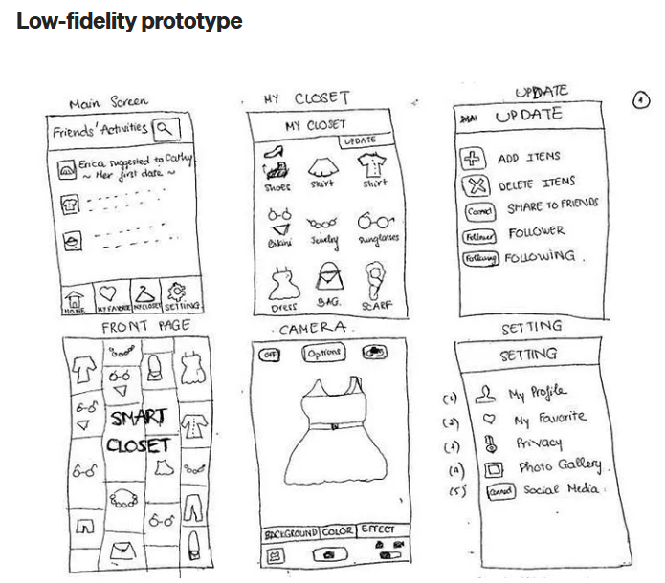

Slide 6
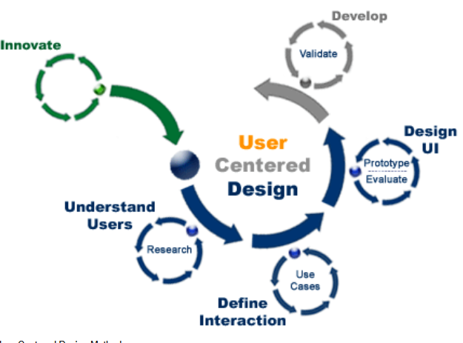
3. User-Centered Prototyping
User-centered prototyping focuses on creating early models based on actual user behaviors, expectations, and feedback. Through direct testing sessions, designers observe pain points and refine concepts iteratively. This approach ensures that digital solutions remain relevant, accessible, and meaningful for target audiences in transformation efforts.

Slide 7
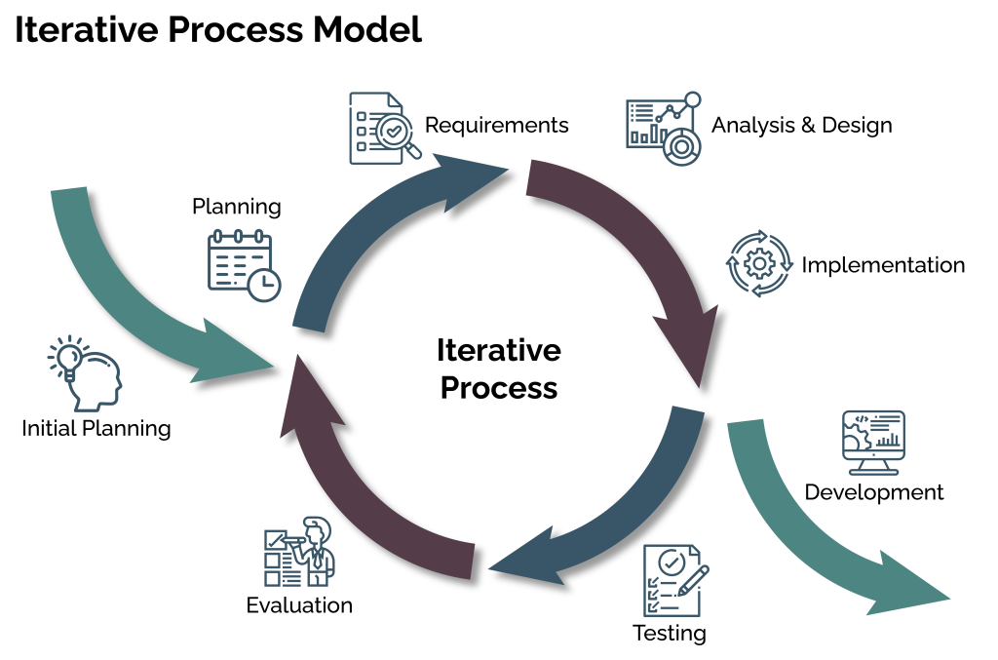
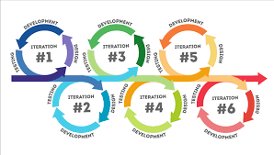
4. Iterative Experimentation
Prototyping supports continuous improvement through iterative cycles of build–test–learn. Each iteration provides insights into what works and what needs revision. This process reduces risk, improves solution quality, and ensures alignment between business goals and user needs throughout digital transformation.

Slide 8
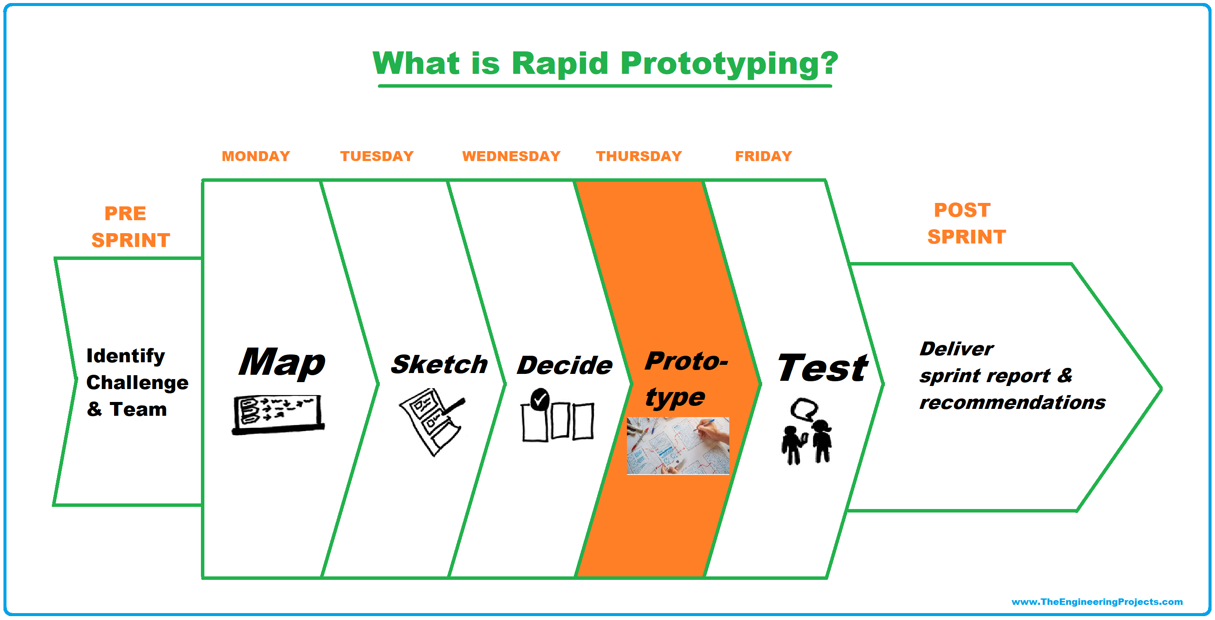
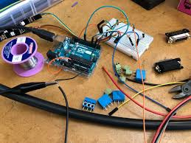
5. Rapid Prototyping Tools
Digital tools such as Figma, Adobe XD, and ProtoPie speed up prototyping by enabling teams to create interactive interfaces quickly. These platforms facilitate collaboration, real-time updates, and user testing, making them essential in modern digital transformation projects that require speed and agility.

Slide 9
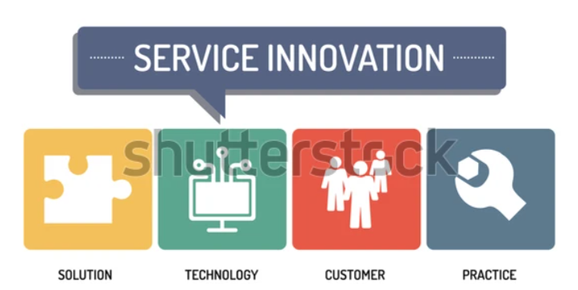
6. Prototyping for Service Innovation
Prototyping is not limited to products or interfaces; it also applies to digital services. Service blueprints, customer journey simulations, and role-playing enable organizations to visualize service delivery. This helps refine workflows, identify bottlenecks, and create improved service experiences during digital transformation.

Slide 10
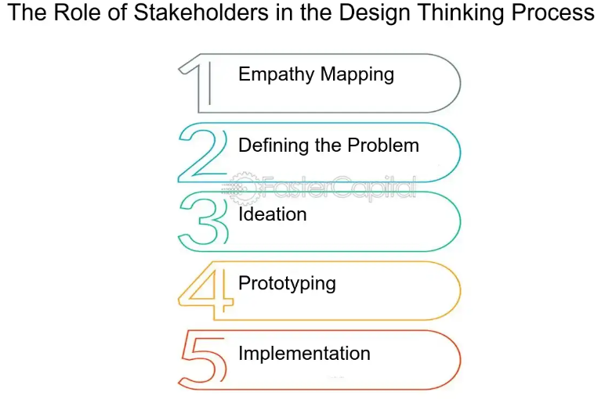
7. Stakeholder Engagement Through Prototypes
Prototypes act as communication tools that help stakeholders understand proposed solutions clearly. They reduce ambiguity, facilitate collaboration, and support informed decision-making. Engaging stakeholders early through prototypes increases alignment, reduces resistance, and accelerates transformation adoption across the organization.

Slide 11
8. Testing Assumptions and Hypotheses
Prototypes allow teams to test key assumptions about user behavior, technical feasibility, and business value. By validating hypotheses early, digital transformation initiatives avoid costly failures. This evidence-based approach ensures solutions are grounded in real insights rather than assumptions.

Slide 12
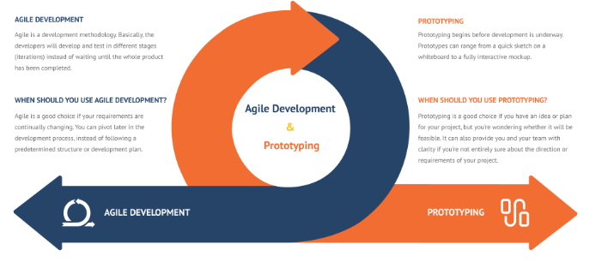
9. Prototyping in Agile Development
In agile environments, prototypes support short development cycles and continuous delivery. They help align developers, designers, and product owners before coding begins. Prototyping ensures agile teams iterate efficiently, improve sprint outcomes, and maintain user focus throughout digital transformation.

Slide 13
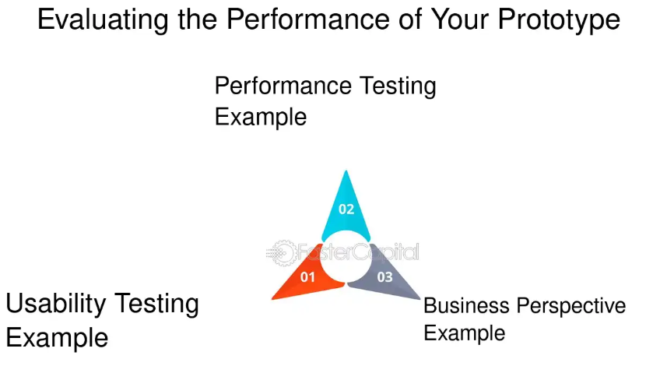
10. Measuring Prototype Effectiveness
Effective prototyping requires evaluation metrics such as usability, clarity, task success, and user satisfaction. Measuring prototype performance helps identify weaknesses early and supports prioritization of improvements. This ensures that final digital solutions deliver value and meet the strategic goals of transformation.

Slide 14
From ideation (brainstorm) process>>> you answer/solution/product
In prototyping process>>> show how to use that product
+ how to make money with that product
Mid-Term Exams 20%
4 questions (Essay)
About Empathize
About Define problems
About Ideation
About Prototyping

Slide 15
Question:
How does prototyping in design thinking support digital transformation, and why is rapid iteration important for reducing risk and improving solution quality?

