Slide 1
Chapter 8 User testing and feedback
Assoc. Prof. Dr. Thacha Lawanna

Slide 2
Objective of the Study:
To evaluate the usability, effectiveness, and user satisfaction of the developed system by collecting structured feedback from representative users and analyzing their interaction behaviors to identify areas for improvement.

Slide 3
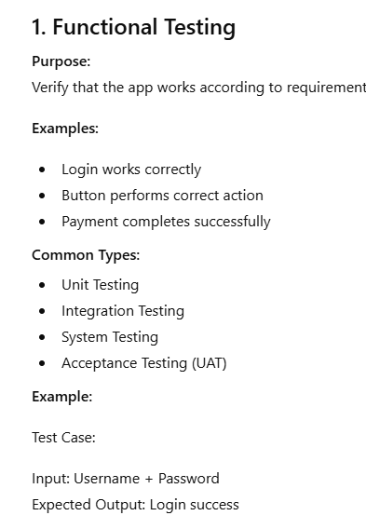
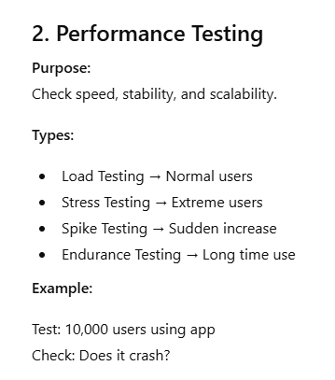
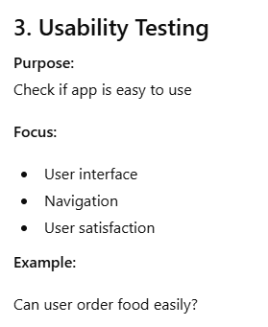

Slide 4
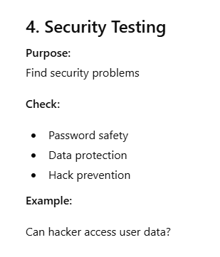
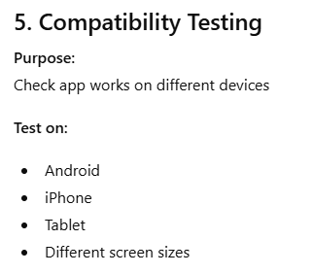
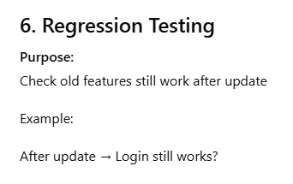

Slide 5
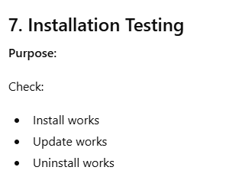
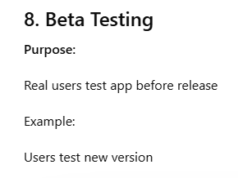

Slide 6
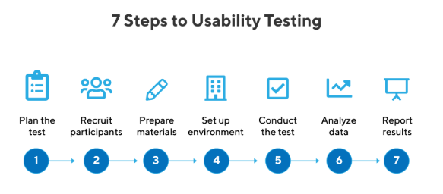
1. Usability Testing
Usability testing evaluates how easily users can interact with a system. Participants perform real tasks while observers identify usability problems such as confusing navigation, unclear instructions, or inefficient workflows. The results help improve system design, enhance user experience, and ensure the product meets user expectations before final deployment.

Slide 7
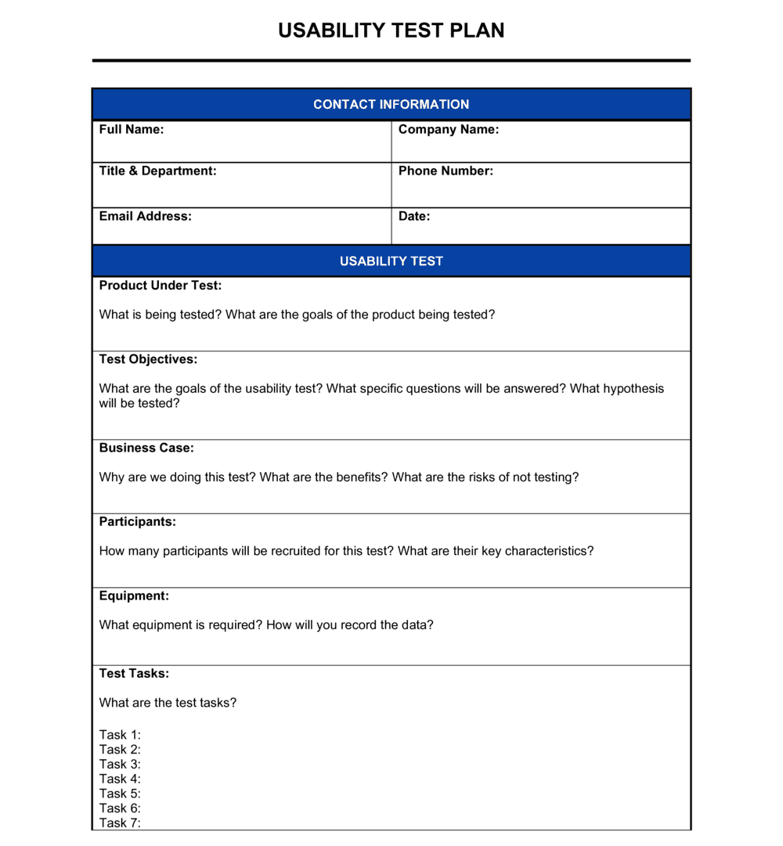
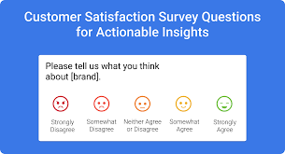
Design usability test form for TikTok or Douyin

Slide 8
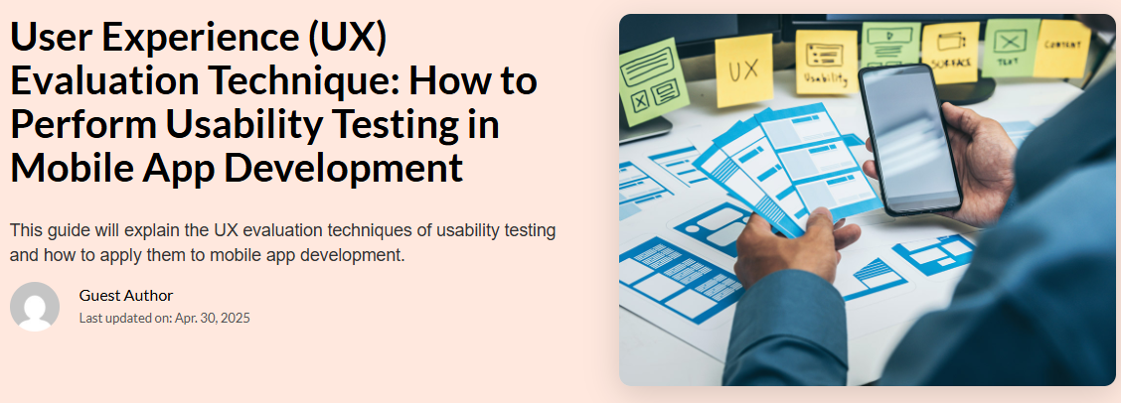
2. User Experience (UX) Evaluation
UX evaluation examines how users feel when interacting with a system. It measures satisfaction, comfort, perceived usefulness, and emotional response. Methods include observation, interviews, and surveys. Understanding UX helps designers refine interfaces, reduce frustration, and create intuitive, enjoyable digital experiences that increase acceptance and long-term engagement.

Slide 9
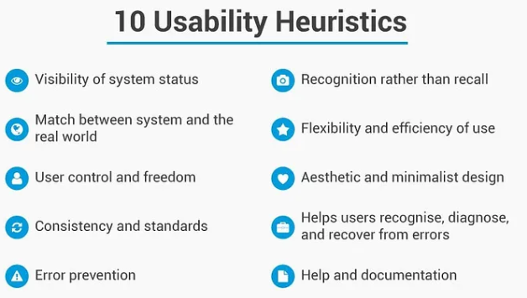
3. Heuristic Evaluation
Heuristic evaluation involves experts reviewing a system using established usability principles, such as Nielsen’s heuristics. It identifies issues related to consistency, visibility, error prevention, and user control. This method is fast, cost-effective, and highlights design flaws early, enabling teams to correct problems before conducting broader user testing.

Slide 10
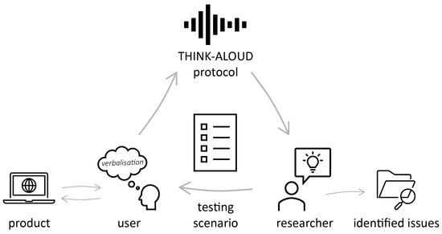
4. Think-Aloud Protocol
The think-aloud method asks users to verbalize their thoughts while performing tasks. Their comments reveal confusion, decision points, and expectations. This technique offers insight into cognitive processes and helps researchers understand user reasoning, enabling targeted improvements to interface structure, navigation flow, and overall system clarity.

Slide 11
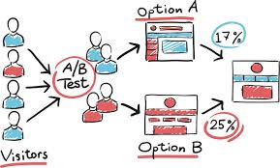
5. A/B Testing
A/B testing compares two design versions to determine which performs better. Users are randomly assigned to version A or B, and their behaviors are measured quantitatively. This approach helps identify subtle design differences that improve user engagement, task completion, and conversion rates, leading to evidence-based design decisions.

Slide 12
6. User Satisfaction Surveys
Surveys measure users’ perceived satisfaction with system features, usability, and overall experience. They use structured questions such as Likert scales to quantify feedback. Survey data provides actionable insights, highlights strengths and weaknesses, and helps teams prioritize improvements based on real user opinions rather than assumptions.

Slide 13
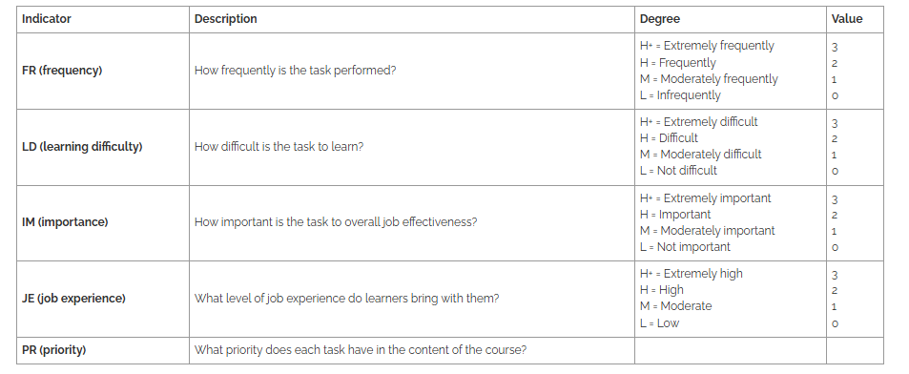
7. Task Performance Analysis
Task performance metrics—such as completion time, error rates, and success rates—reveal how efficiently users interact with a system. Analyzing these metrics shows which functions are easy or difficult. This data guides design refinements, improves workflow efficiency, and ensures that the system effectively supports user goals.

Slide 14
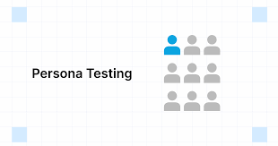
8. Persona-Based Testing
Persona-based testing uses fictional user profiles representing target audiences. Testers evaluate how well the system supports each persona’s goals, skills, and challenges. This method ensures inclusiveness, helps identify overlooked user needs, and improves system accessibility and functionality across diverse user groups.

Slide 15
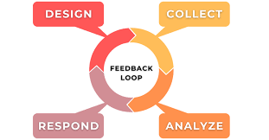
9. Feedback Loop Integration
Feedback loops involve collecting user comments continuously throughout the development cycle. Repeated testing and refinement ensure that improvements align with real user needs. Integrating feedback loops supports iterative design, reduces long-term development costs, and strengthens the final product’s relevance and usability.

Slide 16

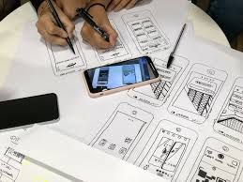
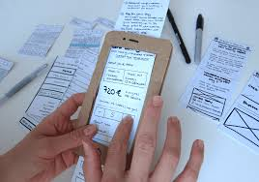
10. Prototype Testing
Prototype testing involves evaluating early versions of the system, from low-fidelity wireframes to high-fidelity clickable models. Users interact with prototypes to reveal early usability issues. This process enables fast corrections, improves concept validation, and ensures that the final product is built on validated design ideas.

Slide 17
Question:
Why is user testing and feedback essential in the design process, and how does it help improve usability, functionality, and user satisfaction in digital solutions?

